Slide 1
Daytime DIMM Observation at Dome Fuji
Hirofumi Okita
Ph.D student of Tohoku University
52nd Japan Antarctic Research Expedition, Observer
29 June 2011, SCAR AAA meeting

Slide 2
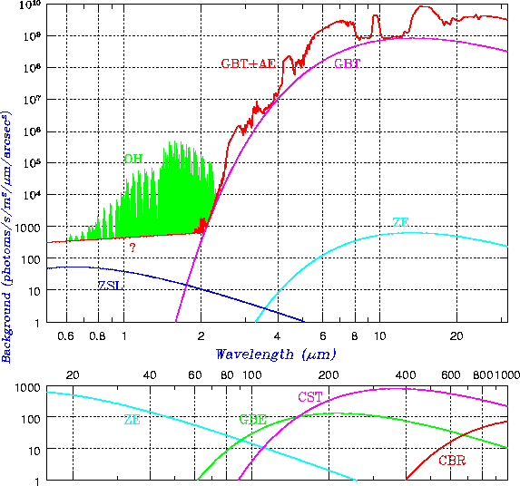
Introduction: Why Antarctica?
airglow emission
We are interested in Infra-red astronomy. However, it is difficult to observe infra-red rays from the ground.
airglow emission
thermal emissions from the atmosphere and from a telescope
strong absorption lines of water vapor exist
thermal emissions
Visible
Infra-red
There are minimum sky background and water absorption at the coldest and the driest (highest) site on the Earth.
Sky background emission
Cox 1999
transparency
Antarctic plateau
wave length
Water absorption
Cox 1999

Slide 3
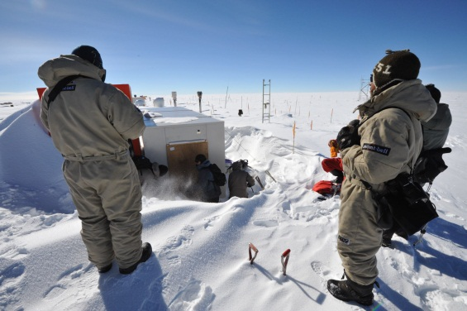
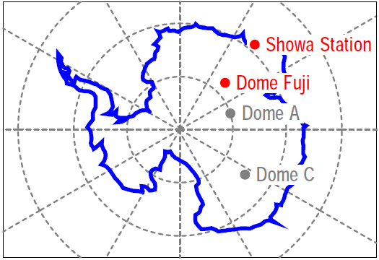
Introduction: Dome Fuji
Dome Fuji is one of the peaks of the Antarctic plateau and
located at 77º19’ 01’’S 39º42’12’’ E, which is 1,000km inland from Showa Station.
The altitude is 3,810m and it is the second highest next to Dome A (4,093m).
The annual average temperature at the station is -54.4ºC, and the lowest temperature ever recorded was -79.7ºC
Dome Fuji is one of the best site for
Infra-red Astronomy.
Excellent seeing may be exist above the surface boundary layer (~15m?).
(Saunders et al.2009, Swain&Gallee 2006)
Get higher resolution
the location of Dome Fuji
We want to know Dome Fuji’s potential for Astronomy.

Slide 4
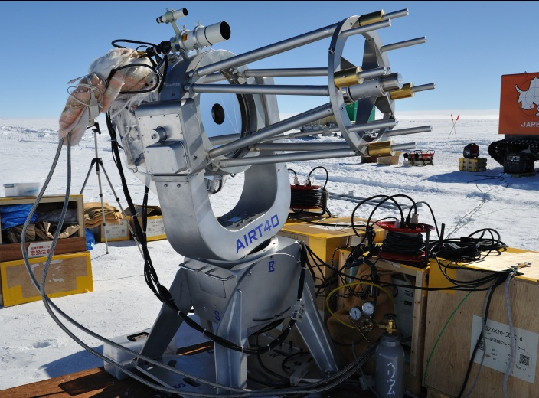
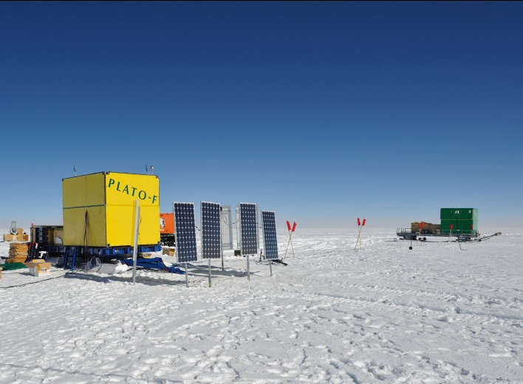
52nd Japan Antarctica Research Expediton
12 Jan 2011 – 29 Jan 2011
Summer Observation
・PWV (infra-red fiber spectrograph)
・Cloud covering (all-sky camera)
・daytime infra-red Sky background (AIRT40 + TONIC2)
・daytime DIMM (AIRT40 + interlace video camera)
Winter- over Observation
・Twin CAM
・16m weather tower
(Pt thermometers & ultra-sonic anemometer)
・Snodar
・HR-CAM2
・PLATO-F

Slide 5
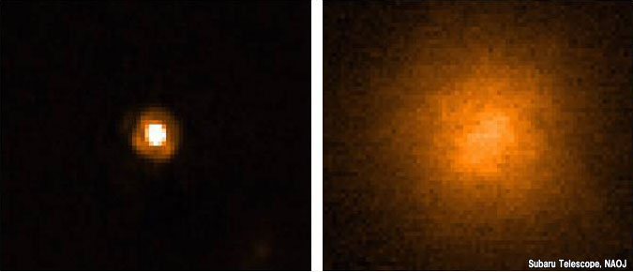
Seeing
Seeing is a parameter that describes how blurry a star image will be. It is caused by atmospheric turbulence and is the apparent angular diameter of a point source measured in arcsecond.
http://subarutelescope.org
Site name | seeing
Okayama (Japan’s best site) | 1.2”
Mauna-Kea | 0.6”
Dome C | 0.3”
Dome Fuji | ?
→ It is important to choice the site because the spatial resolution is decided by seeing.

Slide 6
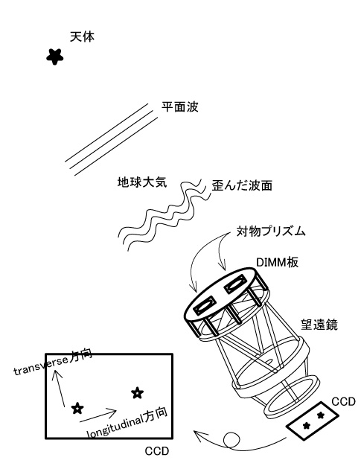
DIMM -outline-
The DIMM (Differential Image Motion Monitor) which is now broadly used for site testing over the world is a technique to measure seeing using a small telescope.
Atmosphere above the telescope disturb the wave front of the star right.
DIMM get 2 images of the same star on the detector(s) which throw different pass in the atmosphere.
(we used wedge prisms on the front of the apertures)
For Kolmogorov turbulence theory, the deviation of the relative position of these images correlate to the seeing.
(Tatarski 1997, Dierickx 1988)
Notes:
長時間露出すればシーイングは得られる、が小型望遠鏡では追尾精度や震動の問題で難しい
DIMM
大気を通過した経路の違う2つの星の相対運動でシーイングを測定

Slide 7
DIMM -theory-
longitudinal
transverse
The Deviation of the images were measured on the longitudinal direction and the transverse direction, we can get 2 values of the seeing simultaneously.
σ²: deviation of the relative
position of stars
λ: wavelength
r₀: Fried parameter
D: Aperture Diameter
d: separation two aperture
θ: seeing
Note: This “l” and “t” directions are defined not images position, but 2-apartures position!
Notes:
長時間露出すればシーイングは得られる、が小型望遠鏡では追尾精度や震動の問題で難しい
DIMM
大気を通過した経路の違う2つの星の相対運動でシーイングを測定

Slide 8
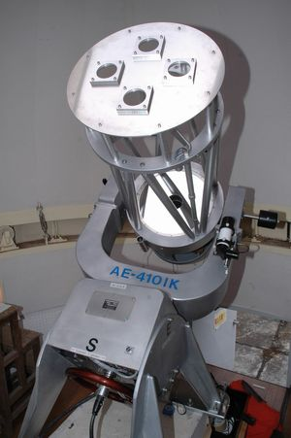
Tohoku DIMM -overview-
Tohoku DIMM is “2 pair 2-aperture DIMM”
These 2 DIMMs intersect at right angle, so “l” seeing of the vertical set equal to “t” seeing of the horizontal set.
vertical pair
horizontal pair
We get 4 seeing value simultaneously,
θvl
θvt
θhl
θht
The atmosphere as in the Kolmogorov theory, these 4 seeing values are the same, or θvl = θht and θvt = θhl in the strong wind.
We compare these 4 seeing for accuracy of the observation.
Notes:
今回開発したDIMMは東大TAO計画のDIMMとほとんど同じ
ソフトウェアはすでに東大で開発済み→短期間で観測可能に
最大の特徴は開口が2つではなく4つ
それぞれ対角線2つの開口を用いてシーイングを測定
上空の風の影響を考慮する為
右の写真は屋上の小さいドームに納めてある40cm南極望遠鏡にDIMM板を取り付けた状態

Slide 9
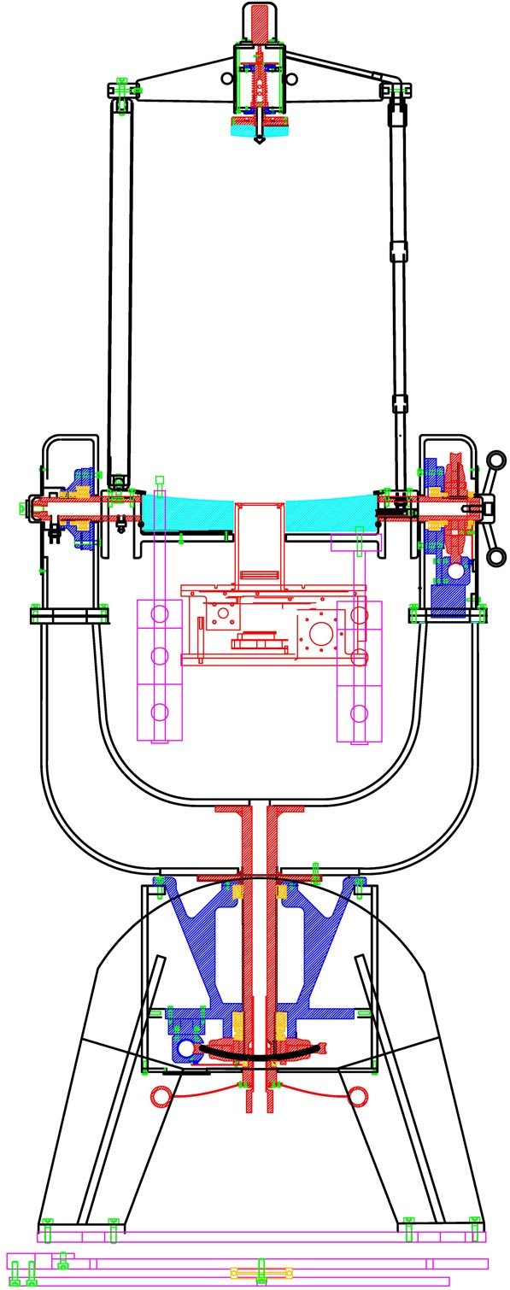
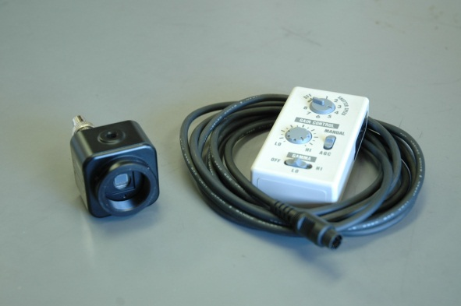
Tohoku DIMM -hardware-
AIRT40
Aperture | 400mm
Focal length | 4,800mm
DIMM
Separation of diagonal apertures d | 250[mm]
Aperture diameter D | 74mm[mm]
Apex angle of Wedge prism | 30[arcsec]
Okita et al. 2010
Detector
WAT-100N (Watec Co., Ltd.)
Min. 0.001 lx, and
Exp. time/gain/gamma
Manually changeable
Expose time: 1/1000s
Notes:
今回開発したDIMMは東大TAO計画のDIMMとほとんど同じ
ソフトウェアはすでに東大で開発済み→短期間で観測可能に
最大の特徴は開口が2つではなく4つ
それぞれ対角線2つの開口を用いてシーイングを測定
上空の風の影響を考慮する為
右の写真は屋上の小さいドームに納めてある40cm南極望遠鏡にDIMM板を取り付けた状態

Slide 10
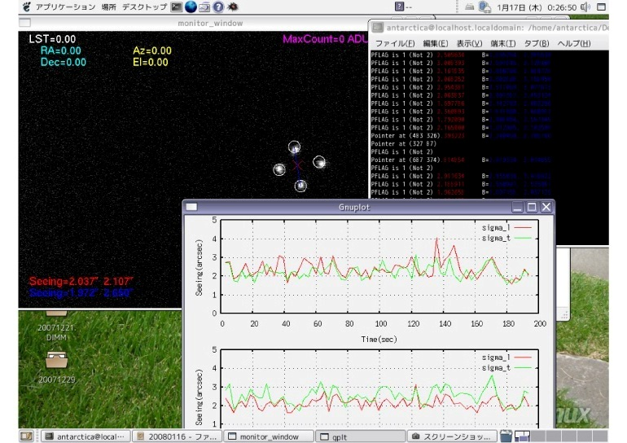
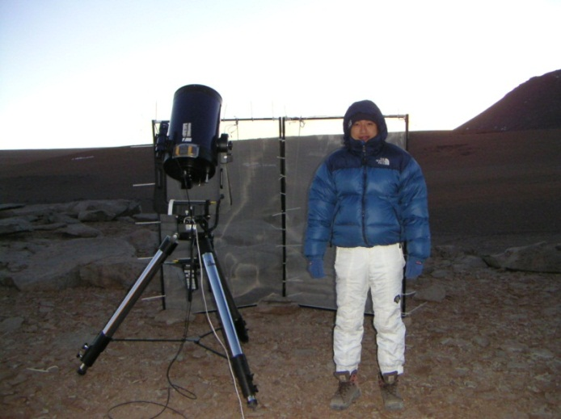
Tohoku DIMM -software-
DIMM Observation Software was Developed by Dr. Motohara (University of Tokyo).
UT-DIMM with Dr.Motohara @Atakama
Motohara’s Software
Motohara’s Software uses 30 frames to calculate the variance of the images, and converts the seeing value per 3 second (it depends on CPU power).
WAT-100N is a interlace video camera and it takes 30 shots per a second.
Its exposure time is manually controllable, and we set 1/1000sec.
Notes:
今回開発したDIMMは東大TAO計画のDIMMとほとんど同じ
ソフトウェアはすでに東大で開発済み→短期間で観測可能に
最大の特徴は開口が2つではなく4つ
それぞれ対角線2つの開口を用いてシーイングを測定
上空の風の影響を考慮する為
右の写真は屋上の小さいドームに納めてある40cm南極望遠鏡にDIMM板を取り付けた状態

Slide 11
Tohoku DIMM -pipeline-
Motohara’s software we can get “temporary” seeing. This seeing don’t consider the zenith angle of the star. We made some software for zenith angle correction and other correction.
Raw data (image files)
↓
Motohara’s Software
↓
convert from “JST” to “UTC”, “MJD”
↓
zenith angle correction
↓
get 4 seeing value (θvl, θvt, θhl, θht)
↓
check the value, and calculate the statistical information
→
→
PRE correction
↓
↓
↓
get final data(histogram, mean, median, expected value, and standard deviation)
Notes:
今回開発したDIMMは東大TAO計画のDIMMとほとんど同じ
ソフトウェアはすでに東大で開発済み→短期間で観測可能に
最大の特徴は開口が2つではなく4つ
それぞれ対角線2つの開口を用いてシーイングを測定
上空の風の影響を考慮する為
右の写真は屋上の小さいドームに納めてある40cm南極望遠鏡にDIMM板を取り付けた状態

Slide 12
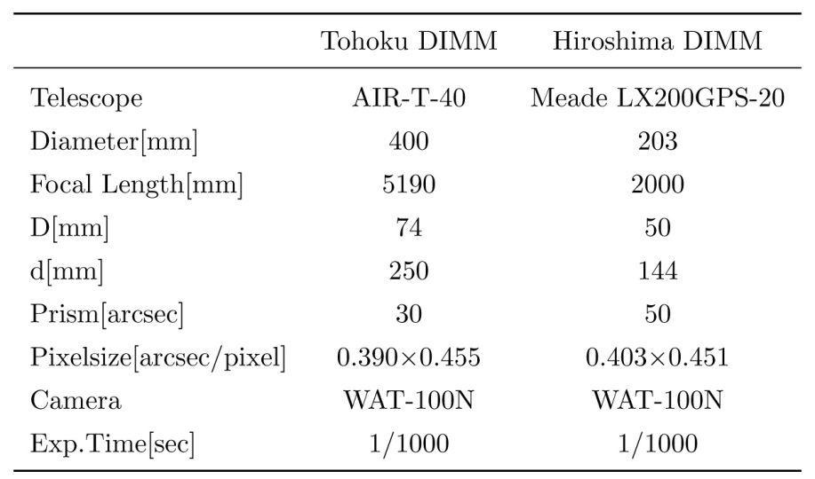
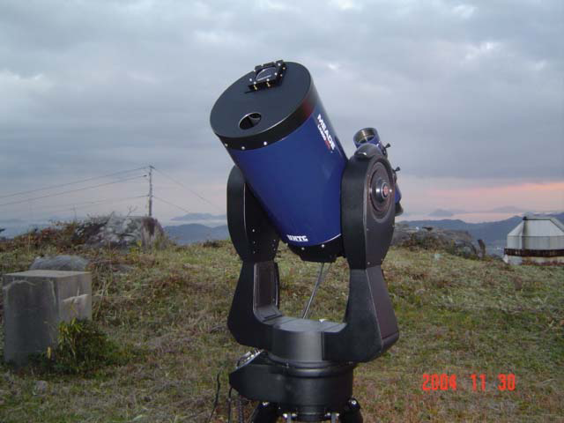
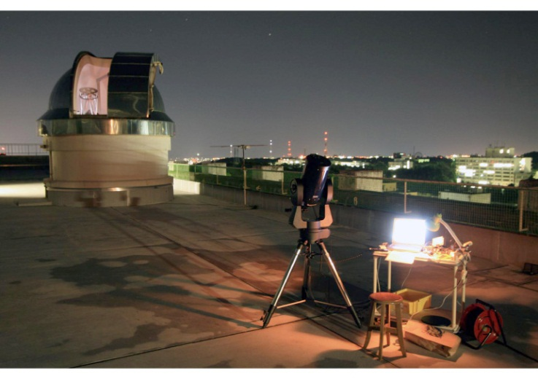
Accuracy of Tohoku DIMM
To check the seeing value is reasonable or not, we compare Tohoku DIMM with Hiroshima Univ. DIMM.
Hiroshima Univ. DIMM
13 Jul 2008, 4hours
3 Oct 2008, 4hours
9 Oct 2008, 7hours
13 Oct 2008, 6hours
→ Good agreement
(left)Tohoku-DIMM inside the astronomical dome, (right) Hiroshima Univ. DIMM
Notes:
まず観測装置のピクセルサイズを求める観測を行った
次に実際のDIMM観測
天頂付近のふたご座の星で観測、10分間
動画
参考までに土星
この観測で得られたシーイングは、およそ2秒
仙台としてはまあまあ良いほう？
これが今回の観測結果

Slide 13
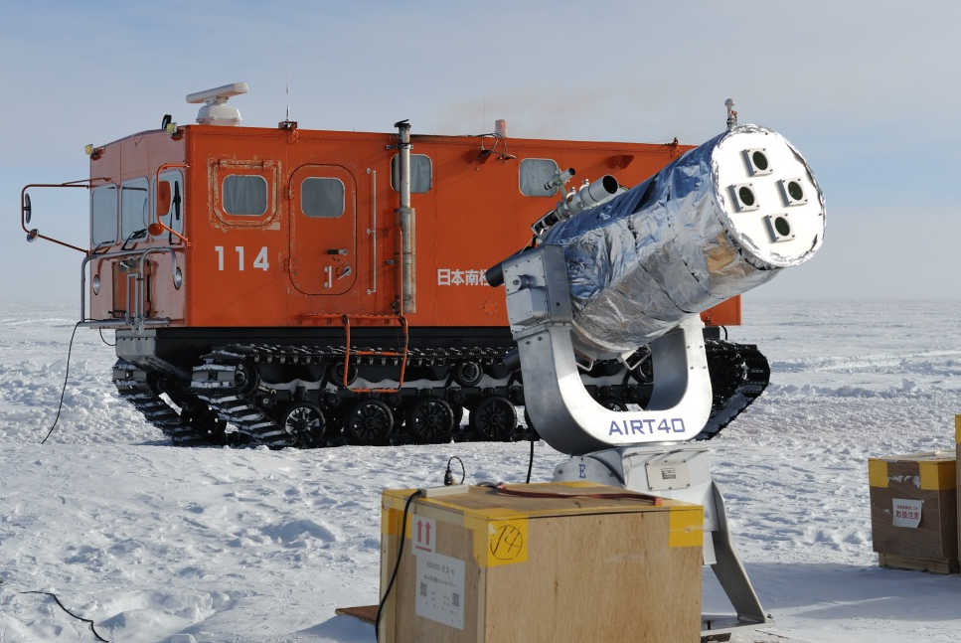
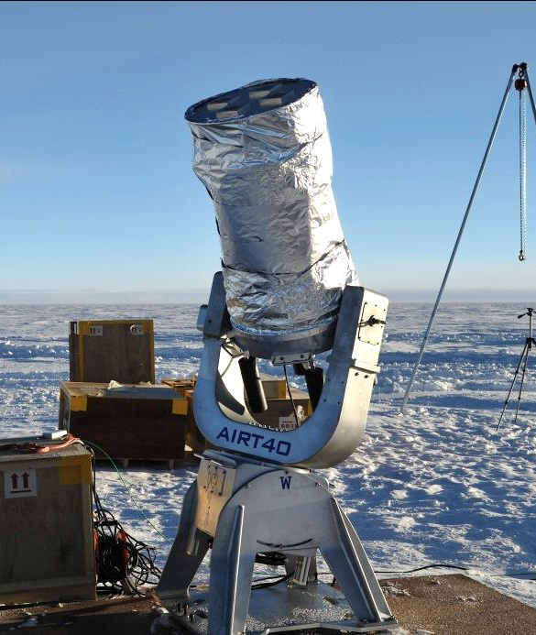
Observation
We carried out DIMM observation from 25 Jan 2011 to 28 Jan 2011(LST).
We used Canopus.(α Car, -0.72mag, δ-52º)
~2m
Telescope was set up at snow surface, the hight of aperture ~ 2m
First we can’t get the star images because of the strong scattering light by the sun. Thus we covered AIRT40 with cooking-foil. Because the cooking-foil is very thin (10μm) and made by aluminum, we thought this cover was hard to warm and it was minimum to make a local turbulence inside the telescope.
Notes:
まず観測装置のピクセルサイズを求める観測を行った
次に実際のDIMM観測
天頂付近のふたご座の星で観測、10分間
動画
参考までに土星
この観測で得られたシーイングは、およそ2秒
仙台としてはまあまあ良いほう？
これが今回の観測結果

Slide 14
Data reduction (1)
First, we converted from JST to MJD, and corrected zenith angle.
After, we checked these four data. (θvl , θvt, θhl, θht)
But,,,
Vertical pair
Red: θvl
Green: θvt
Horizontal pair
Red: θhl
Green: θht
Obviously θhl is different from θht at all time! (and in fact, there are θvl ≠ θht and θvt ≠ θhl)
We thought this cause was not the wind effect but the instrumental problem.
Notes:
まず観測装置のピクセルサイズを求める観測を行った
次に実際のDIMM観測
天頂付近のふたご座の星で観測、10分間
動画
参考までに土星
この観測で得られたシーイングは、およそ2秒
仙台としてはまあまあ良いほう？
これが今回の観測結果

Slide 15
Data reduction (2)
Our DIMM use wedge prisms to divide star light on the detector. These prisms are required to set correctly for Motohara’s Software.
Longitudinal direction is originally defined the line connect 2-apartures and its orthogonal line as a transverse direction. However Motohara’s software defines the line which is connect 2 star images as a longitudinal. If the prisms are not set correctly, “l” and “t” seeing are not accurate.
transverse
We can correct this error using rotation matrix.
We say this error “Prism Rotation Error (PRE)”.
aperture plane
longitudinal
detector plane
φ
longitudinal
If there is no prism, telescope makes only one image. The prism bents the light and make two images on the detector.
Notes:
まず観測装置のピクセルサイズを求める観測を行った
次に実際のDIMM観測
天頂付近のふたご座の星で観測、10分間
動画
参考までに土星
この観測で得られたシーイングは、およそ2秒
仙台としてはまあまあ良いほう？
これが今回の観測結果

Slide 16
Data reduction (3)
Best fit of PRE = 0.12 radian
These are the histogram of the θht and θhl.
Before PRE correction, there are not same distribution. After this correction, θht and θhl are almost the same.
After PRE correction, we define the seeing value
and accuracy of this seeing,
Typical
→ good agreement
Notes:
まず観測装置のピクセルサイズを求める観測を行った
次に実際のDIMM観測
天頂付近のふたご座の星で観測、10分間
動画
参考までに土星
この観測で得られたシーイングは、およそ2秒
仙台としてはまあまあ良いほう？
これが今回の観測結果

Slide 17
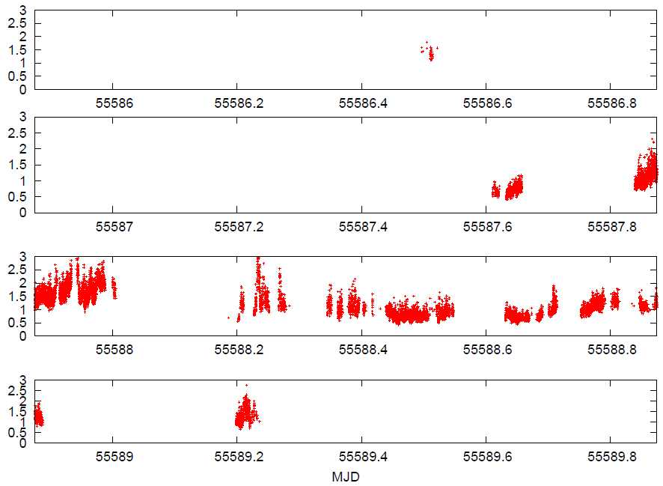
Result (1)
LST (UTC+3)
0 6 12 18 24
Jan 25th
Jan 26th
Jan 27th
Jan 28th
Notes:
まず観測装置のピクセルサイズを求める観測を行った
次に実際のDIMM観測
天頂付近のふたご座の星で観測、10分間
動画
参考までに土星
この観測で得られたシーイングは、およそ2秒
仙台としてはまあまあ良いほう？
これが今回の観測結果

Slide 18
Result (2)
Δbin = 0.01”
ほんとはフィッティング曲線無しで)
Notes:
まず観測装置のピクセルサイズを求める観測を行った
次に実際のDIMM観測
天頂付近のふたご座の星で観測、10分間
動画
参考までに土星
この観測で得られたシーイングは、およそ2秒
仙台としてはまあまあ良いほう？
これが今回の観測結果

Slide 19
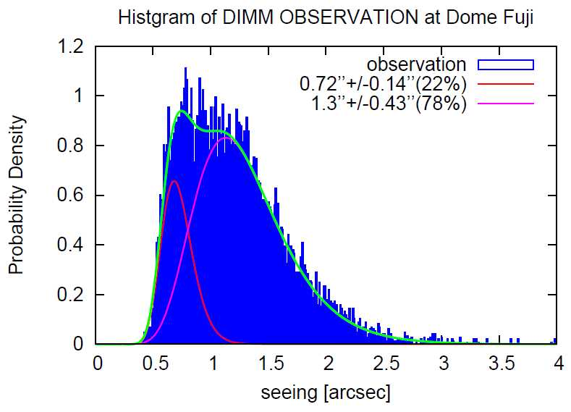
Two log-normal fitting
We fit sum of multiple log-normal distributions,
Aristidi et al. 2010 says that Dome C seeing is matched three log-normal, but the Best fit of our data is two log-normal.
a₁=0.22
μ₁=-0.34
σ₁=0.19
a₂=0.78
μ₂=0.22
σ₂=0.32
0.72” +/- 0.14” (22%)
1.3” +/- 0.43” (78%)
Notes:
まず観測装置のピクセルサイズを求める観測を行った
次に実際のDIMM観測
天頂付近のふたご座の星で観測、10分間
動画
参考までに土星
この観測で得られたシーイングは、およそ2秒
仙台としてはまあまあ良いほう？
これが今回の観測結果

Slide 20
Discussion
0.72” +/- 0.14” (22%)
1.3” +/- 0.43” (78%)
Good seeing appears at afternoon, and Bad one appears at night. These are the same trend to Aristidi et al. 2005, 2006, 2010 (Dome C) which say the minimum at 17 o’clock and the strong temperature gradient makes strong turbulent at night.
The value 0.72” is reasonable since this DIMM observation carried out at only 2m height above snow surface.
No data: bad weather condition or instrumental accident

Slide 21
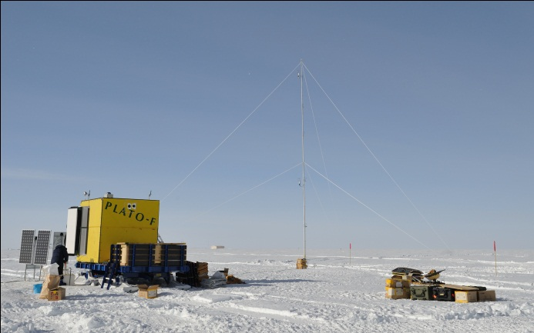
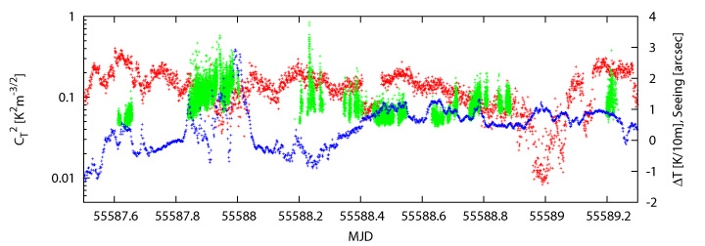
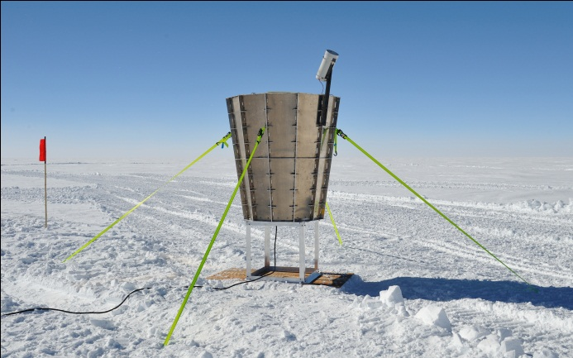
Future work
Seeing, C_{T}², and temperature gradient
Green: seeing
Red: C_{T}²
Blue: Temperature gradient
We are now starting to compare DIMM with 16m weather tower (6 Pt thermometers & 2 ultra-sonic anemometers) and Snodar. The weather tower give us the information about the temperature gradient, C_{T}², wind speed, and wind direction. Snodar gets C_{T}² of the distribution and the thickness of the boundary layer .

Slide 22
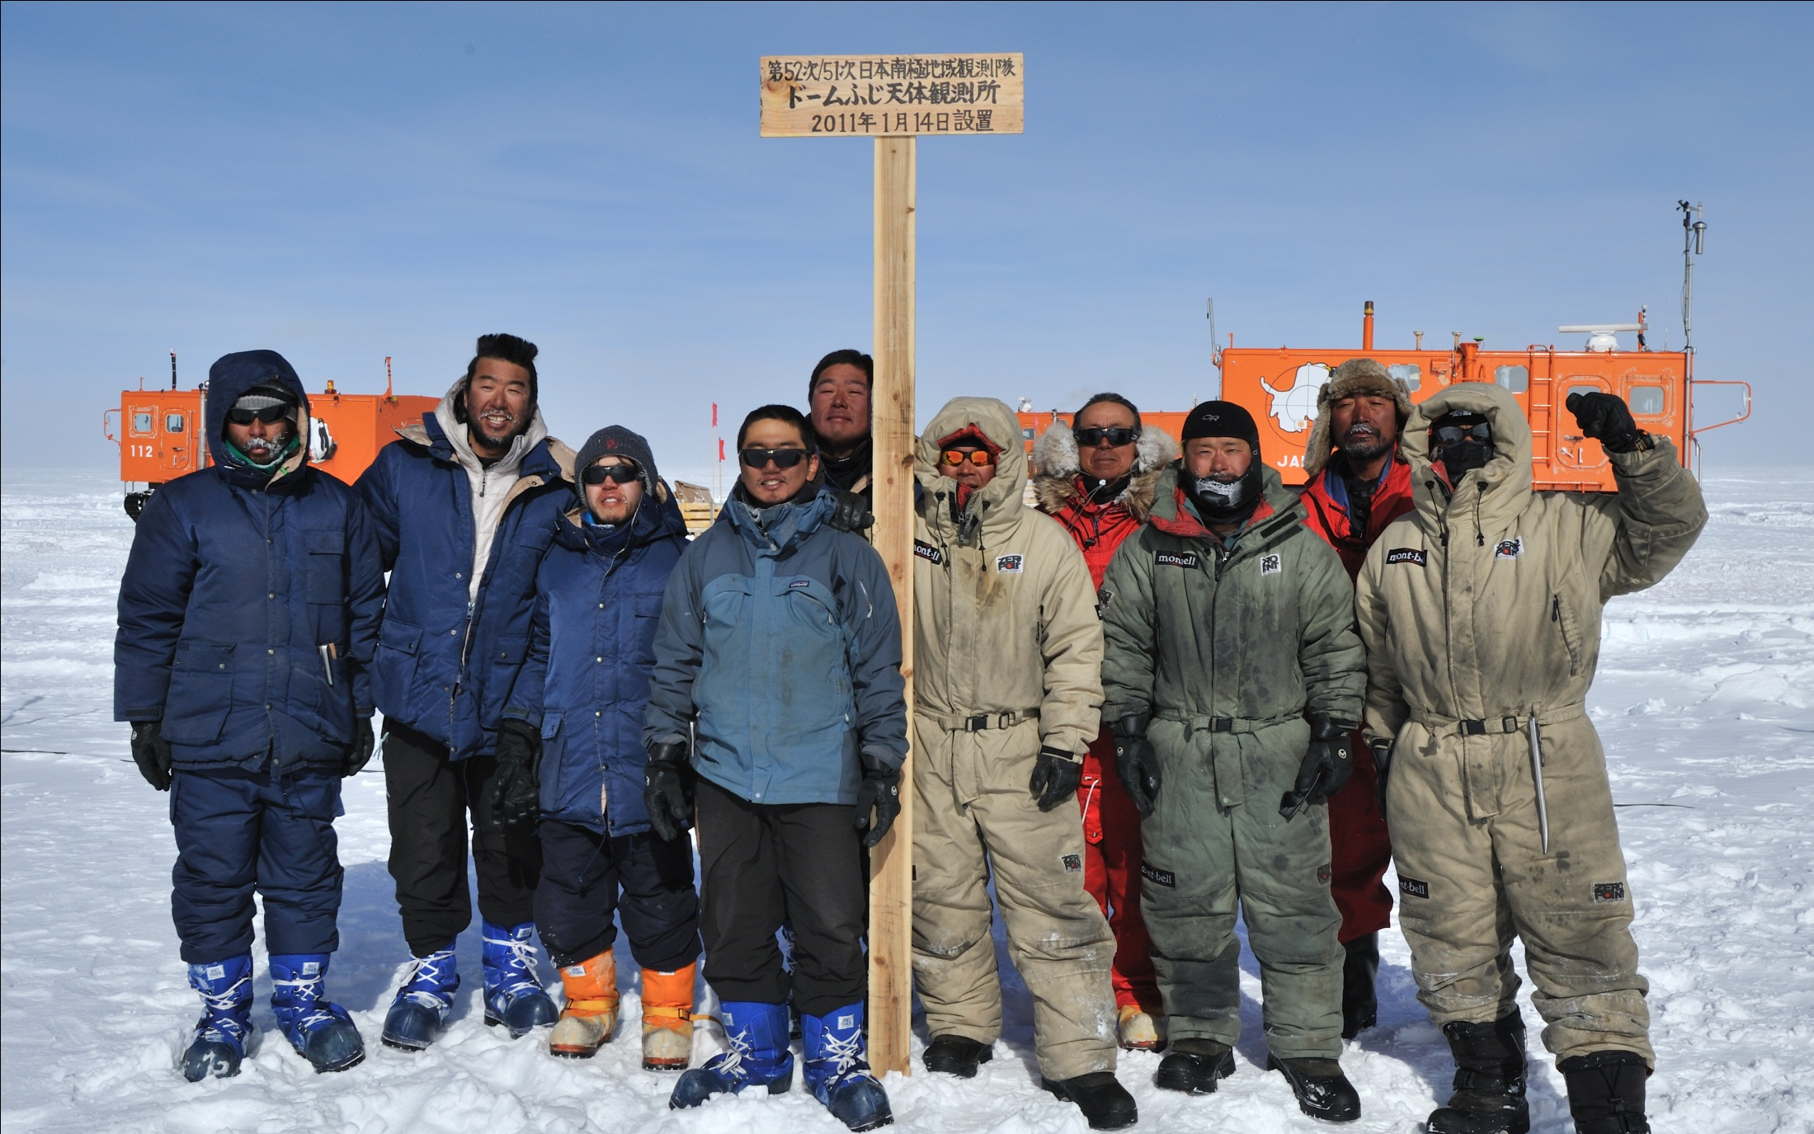
Acknowledgements
JARE 51/52 Dome Fuji Traverse Team
Thanks for All 51st/52ndJapanese Antarctic Research Expedition members.

