Slide 1
Excellent seeing at Dome Fuji
Second workshop of the SCAR AAA
July 24-26,2013, Siena, Italy
“Site” Session
12:30-12:45, July 24, 2013
Okita et al. A&A, 554, L5 (2013)
and
some unpublished results
Hirofumi OKITA
Astronomical Institute, Tohoku University
Ph. D student

Slide 2
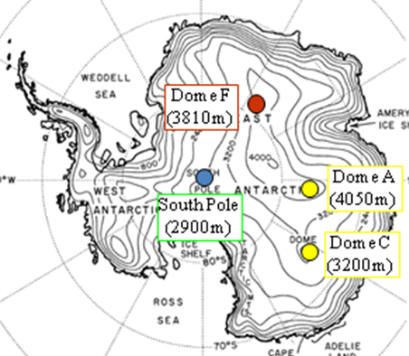
Abstract
1. Abstract
We found,
Height of surface boundary layer is 15.3 m
Free atmosphere seeing is 0.2’’
Solar heating makes convection, which affects the seeing
at Dome Fuji on the Antarctic Plateau.
Murata et al. 2009

Slide 3
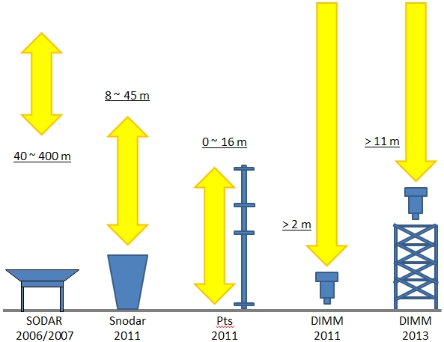
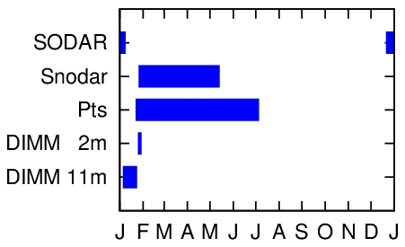
Observations
2. Observations and Results
Observations were carried out during 2006 – 2013.
↑ Measurement range for the instruments.
Polar Night
Polar Day

Slide 4
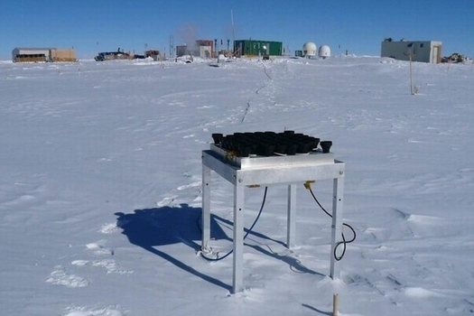
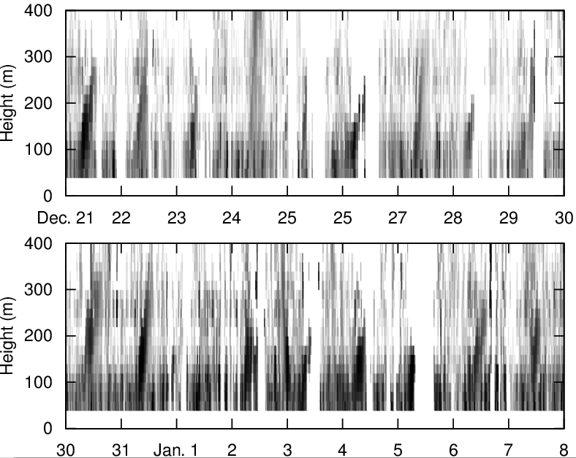
2006-2007 SODAR
2. Observations and Results
(Sonic Detection And Ringing)
From 2006 December 21 to 2007 January 7
Observations in “Polar day season”
Turbulence profiling between 40 and 400 m with Δh = 20 m
Photo by H. Motoyama
→ Diurnal variation is clearly seen.

Slide 5
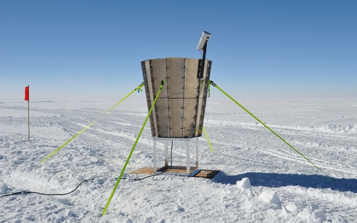
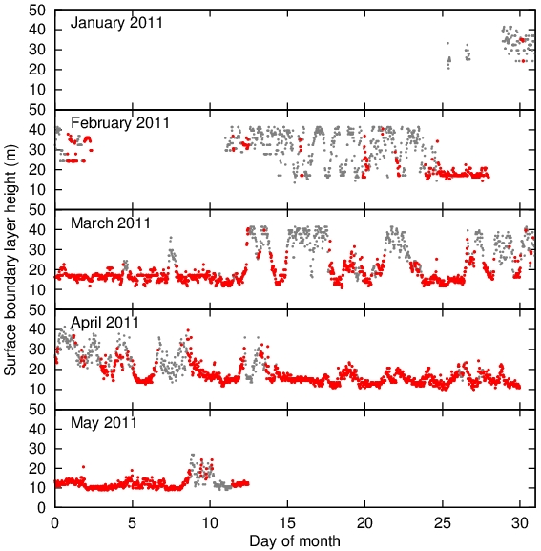
2011 Snodar
2. Observations and Results
- From 2011 January 25 to May 13
- Turbulence profiling between 8 and 45 m with Δh = 0.9 m
We used the definition of Bonner et al. (2009) for the height of the surface boundary layer.
Polar day
Polar night
Note: This results are not considered with the weather condition!

Slide 6
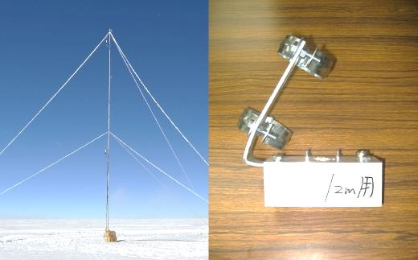
2011 PTs
2. Observations and Results
From 2011 January 21 to July 4
0.3, 9.5, 12, and 15.8 m above snow surface
Measuring each two minute
Polar day
Sometimes the temperature of 0.3 m above the snow surface became cold.
→Inversion layer
Polar night
red cross – 0.3 m
blue square – 9.5 m
green circle – 12 m
black triangle – 15.8 m
Polar night

Slide 7
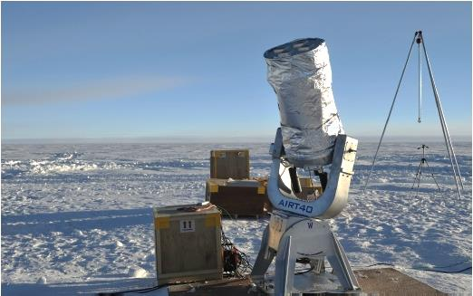
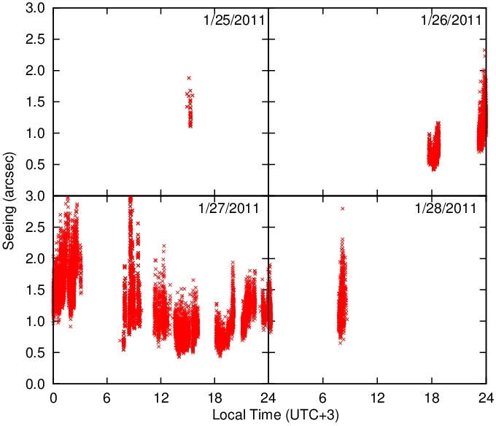
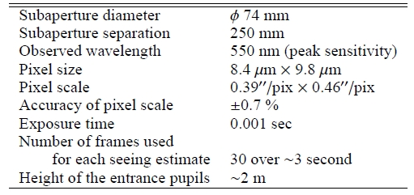
2011 Tohoku DIMM
2. Observations and Results
From 2011 January 25 to 28
Observations in “Polar day season”
Observations 2 m above the snow surface

Slide 8
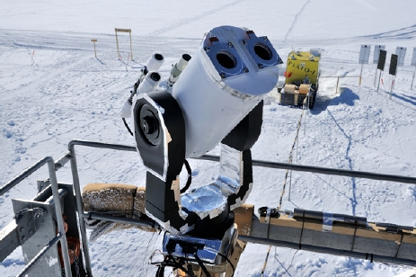
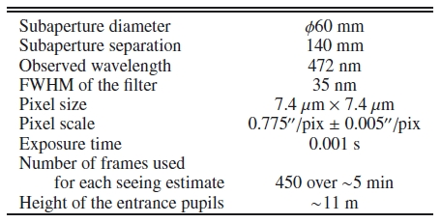
2013 DF-DIMM
2. Observations and Results
From 2013 January 4 to July 23
Observation in “Polar day season”
Observations 11 m above the snow surface
Excellent seeing, below 0.2′′ and continuing for several hours, was observed near local midnight.
Local minimum of ∼ 0.3′′ near 18 h local time is also observed.

Slide 9
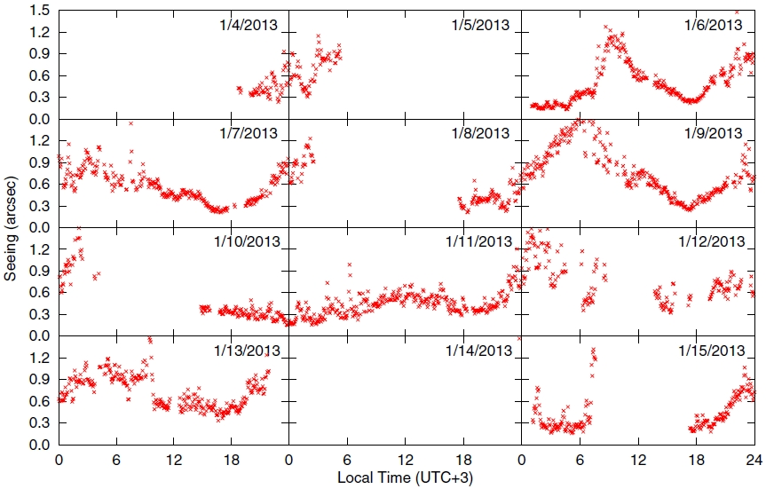
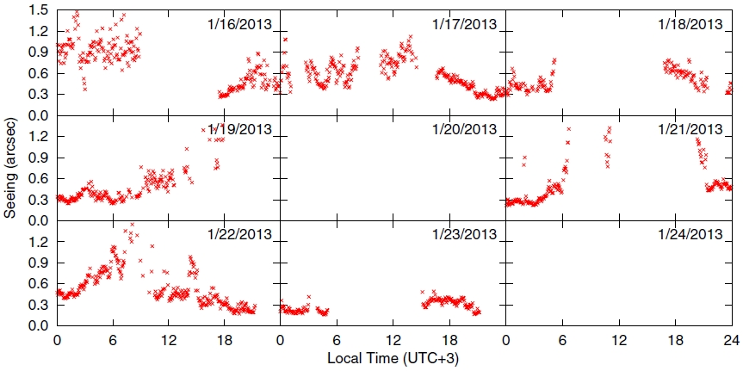
2013 DF-DIMM
2. Observations and Results
- From 2011 January 21 to July 4
- 0.3, 9.5, 12, and 15.8 m above the snow surface temperature
- Measuring each two minute

Slide 10
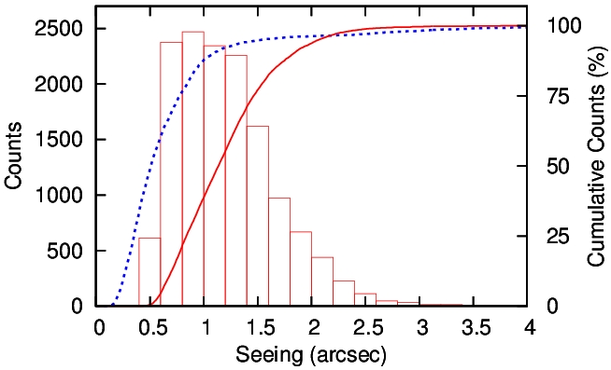
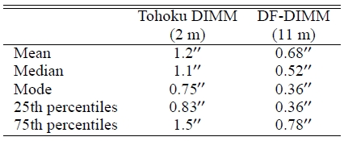
Tohoku DIMM & DF-DIMM
2. Observations and Results
Seeing values are considered to become large due to the turbulent layer near snow surface, i.e., surface boundary layer.

Slide 11
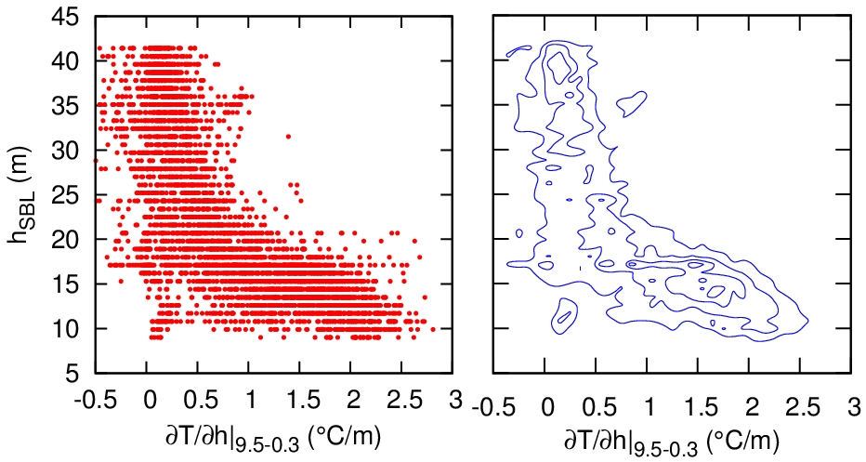
3. Discussions
3.1 Surface Boundary Layer
We should discuss the surface boundary layer height only in the fine weather condition that the astronomical observations can be performed.
In the find weather, the atmosphere near the snow surface becomes cold by the radiative cooling and make a positive temperature gradient.
Thus we define the “fine weather” as the temperature gradient become 0.5 C/m or larger.
0.3-9.5 -- red cross
9.5-15.8 -- blue square

Slide 12
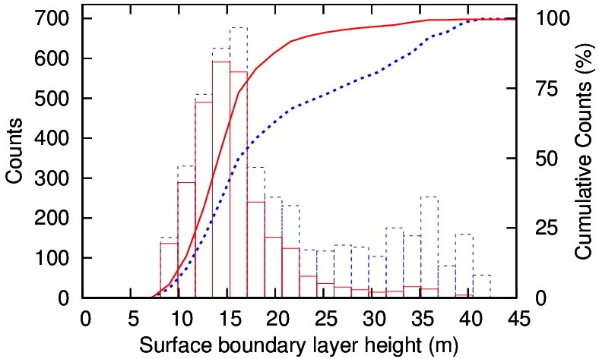
3. Discussions
3.1 Surface Boundary Layer
Fine weather --- Red solid
All weather --- blue dot
Only in the fine weather condition, the surface boundary layer height at Dome Fuji is 15.3 m.

Slide 13
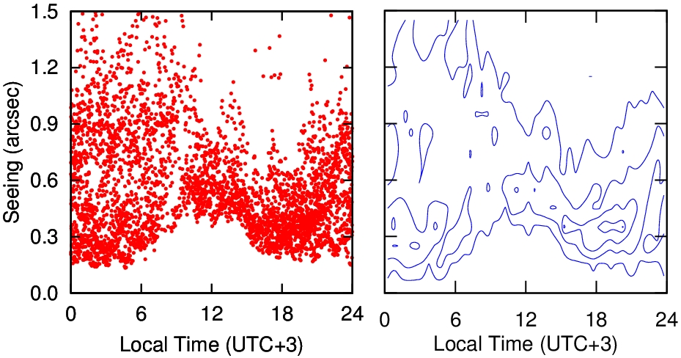
3. Discussions
3.2 Free Atmosphere
We plot all seeing value with the same hour.
The lower limit of the seeing would be obtained when the telescope was higher than the surface boundary layer.
Thus the lower limit of 0-6h, 16-24h means that the free atmosphere seeing is about 0.2’’.

Slide 14
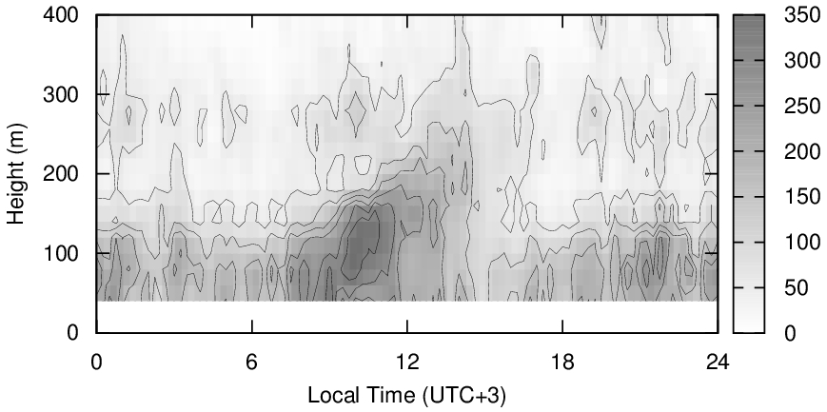
3. Discussions
3.3 Atmospheric Convection
Convection
by the solar heating
The lower limit of 6-16h is about 0.5’’.
This means that the solar heating in the polar day makes the atmospheric convection up to 300 m above the snow surface.
In the polar night, the convection will not occur.

Slide 15
Conclusion
4. Conclusion
At Dome Fuji on the Antarctic plateau,
Height of surface boundary layer is 15.3 m in the fine weather condition.
Free atmosphere seeing is 0.2’’.
Solar heating at daytime in the polar day season makes convection and affects the seeing.

Slide 17
Backup

Slide 18
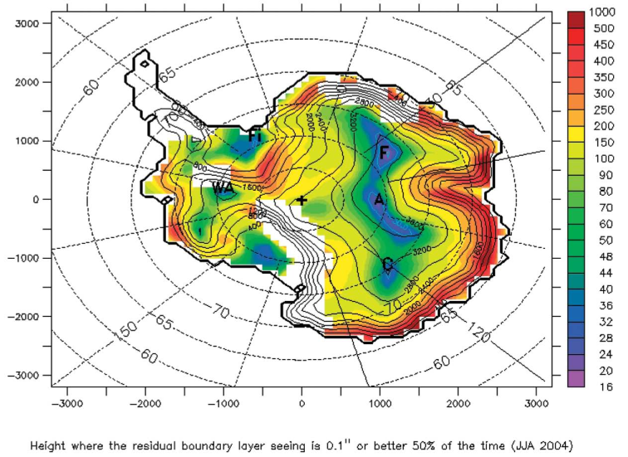
1.4 Simulations’ results
1. Introduction
Dome Fuji
Dome Fuji
Saunders et al. (2009)
Simulation of the free atmosphere seeing
Swain & Gallee (2006)
Simulation of the height of the surface boundary layer
The free atmosphere seeing could be 0.21”.
The height of the surface boundary layer would be 18 m.
→ We planed to observed them at Dome Fuji.

Slide 19
3. Discussions
3.4 Turbulence Strength
Tohoku DIMM (2 m) 1.1”
DF-DIMM (11 m) 0.52”
Surface Boundary Layer
e_{SBL}~0.89”
Atmospheric Convection
e_{AC}~0.32”
Free Atmosphere
e_{FA}~0.2”

