Slide 1
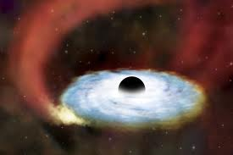
BH perturbation in parity violating gravitational theories
1107.3705 (to appear in PRD)
Hayato Motohashi & Teruaki Suyama
(Research Center for the Early Universe, The University of Tokyo)

Slide 2
Alternative theories of gravity
In the weak gravitational field regime, GR is fully consistent with observations and experiments so far.
In the near future, we will be able to test GR in the strong gravity regime, such as the vicinity of BH.
It is interesting to consider alternative theories of gravity and see what kinds of phenomena are expected.
By studying alternative theories of gravity, we learn a lot about gravity.

Slide 3
Gravity with parity violation
It is interesting to explore a possibility that parity is violated in gravity sector due to the Chern-Simon term C defined by,
Totally anti-symmetric tensor
I assume that the Lagrangian for gravity is a general function of Ricci scalar and the CS term,
If f(R,C) does not depend on C, then we have the standard f(R) gravity.

Slide 4
Gravity with parity violation
for FLRW universe (and scalar type perturbations on top of it) and spherically symmetric spacetime.
Cosmological and solar system constraints achieved so far constrain the CS gravity only very loosely.
We need to consider more complicated spacetime to search for the parity violation.
We therefore study linear perturbation of spherically symmetric and static spacetime.

Slide 5
Gravity with parity violation
Other models
Non-Dynamical CS gravity (R.Jackiw&S.Pi, 2003)
BH perturbation study was done by N.Yunes&C.Sopuerta in 2007.
Linear perturbation analysis by using field equations.
Dynamical CS gravity (T.Smith et al, 2007)
BH perturbation study was done by C.Molina et al in 2010.
Linear perturbation analysis by using field equations.
These two theories do not overlap with f(R,C) theories we consider.

Slide 6
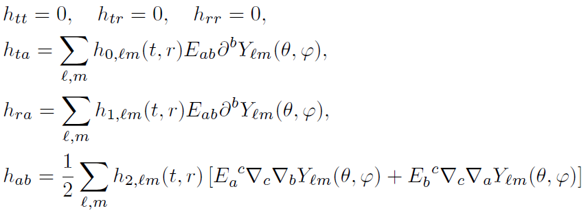
BH perturbation
Background spacetime
Metric perturbation (Regee-Wheeler decomposition, 1959)
Odd-type perturbations

Slide 7
BH perturbation
Background spacetime
Metric perturbation (Regee-Wheeler decomposition, 1959)
Odd-type perturbations
set to zero

Slide 8
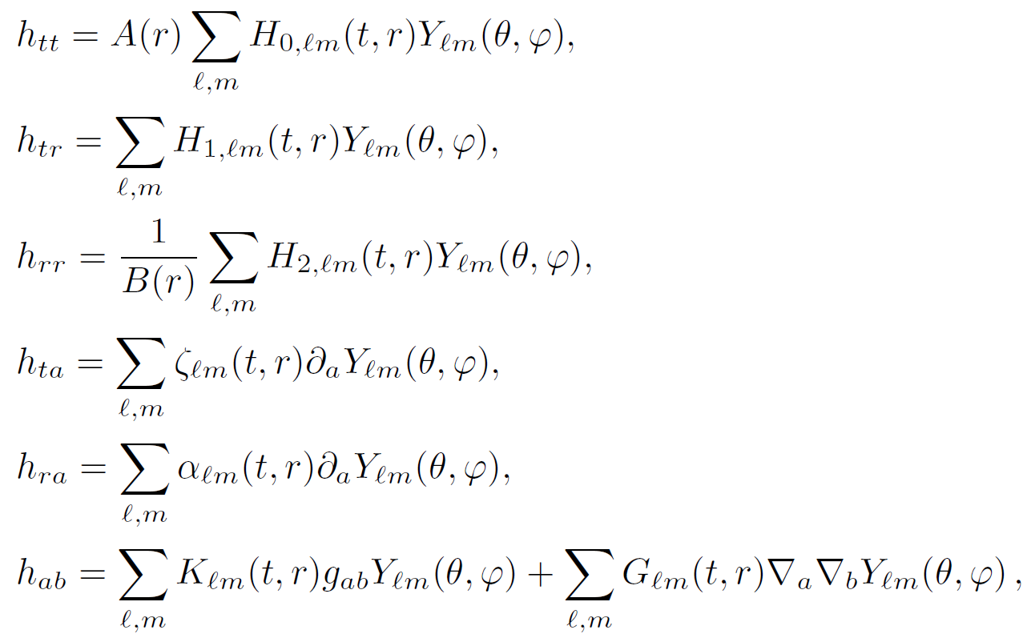
BH perturbation
Even-type perturbations

Slide 9
BH perturbation
Even-type perturbations
set to zero
set to zero
set to zero

Slide 10
BH perturbation
Equivalent to f(R,C)
Substituting metric perturbations into the above action and expanding it to second order in perturbation, eliminating auxiliary fields and integration by parts, we end up with the following Lagrangian density

Slide 11
BH perturbation
Equivalent to f(R,C)
Substituting metric perturbations into the above action and expanding it to second order in perturbation, eliminating auxiliary fields and integration by parts, we end up with the following Lagrangian density
Even and odd modes are coupled. (In f(R), they decouple.)

Slide 12
BH perturbation
Equivalent to f(R,C)
Substituting metric perturbations into the above action and expanding it to second order in perturbation, eliminating auxiliary fields and integration by parts, we end up with the following Lagrangian density
Even and odd modes are coupled. (In f(R), they decouple.)
Due to this term, Hamiltonian is not bounded from below. (Ostrogradskii’s theorem)
General f(R,C) theories have a ghost.

Slide 13
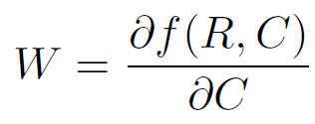
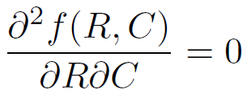
BH perturbation
In which case, can we avoid ghost?
On the background spacetime, we have
Either or R=const. is the condition for the absence of the ghost.
For example,
Theories that have Schwarzschild spacetime as a solution.

Slide 14
BH perturbation
For the special case, the Lagrangian reduces to
1 propagating field from the odd-type perturbations,
2 propagating fields from the even-type perturbations.
Ghost is absent (as long as F>0) and all the modes propagate at the speed of light.
Still, odd and even modes are coupled.

Slide 15
Conclusion
Ghost is present in the general f(R,C) theories for perturbations on spherically symmetric and static background.
We gave necessary and sufficient conditions to avoid such ghost.
For such theories, all the modes propagate at the speed of light.
We are now doing similar analysis for non-dynamical and dynamical CS theories.

Slide 16
Thank you!!

