Slide 1
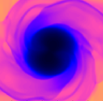
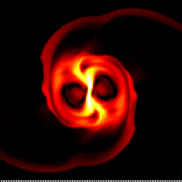
Effects of Hyperon in Binary Neutron Star Mergers
Phys. Rev. Lett. (2011) 107, 051102
Phys. Rev. Lett. (2011) submitted
Yukawa Institute for Theoretical Physics
Yuichiro Sekiguchi (HPCI Collaboration)
with K. Kiuchi, K. Kyutoku, & M. Shibata
JGRG21@ Tohoku University, September 26-27, 2011

Slide 2
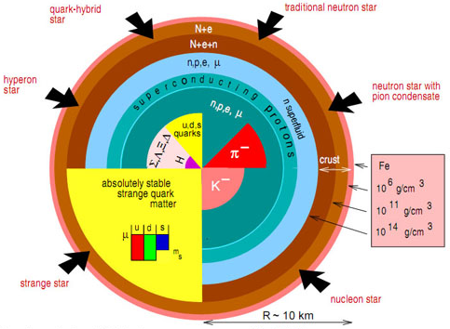
Properties of Dense Matter
Still poorly understood
There may be exotic phases at high densities (Pauli principle)
  Meson cond., Quarks, Hyperons, …
How to constrain equation of state (EOS) of neutron star (NS) matter
Popular methods
  Mass-Radius relation
  Maximum mass of NS
    Strong impact by PSR J1614-2230
Existence of exotic phases remains unconstrained
Mmax = 1.97 Msun
Lattimer & Prakash 2007

Slide 3
Numerical Studies Exploring Exotic Phases
Stellar Core Collapse
  Quarks (Nakazato+ 2008,2010; Sagert+ 2009; Fischer+ 2011)
  Hyperons (Sumiyoshi+ 2009)
Binary Neutron Star (BNS) Merger
  Not yet studied in detail
  Parametric Study (Hotokezaka+ 2011), Bauswein+ 2011
This Study
  The first full GR simulations for BNS merger with finite temperature EOS with Λ hyperons
    Λ hyperons are believed to appear first because they are lightest and feel an attractive potential (e.g. Ishizuka+ 2008)
    Σ hyperons feel a repulsive potential and will not appear at lower densities (Noumi+ 2002)
Key Question:
  Is it possible to tell the existence of Λ hyperons by observations of Neutrino and Gravitational-Wave (GW) signals ?

Slide 4
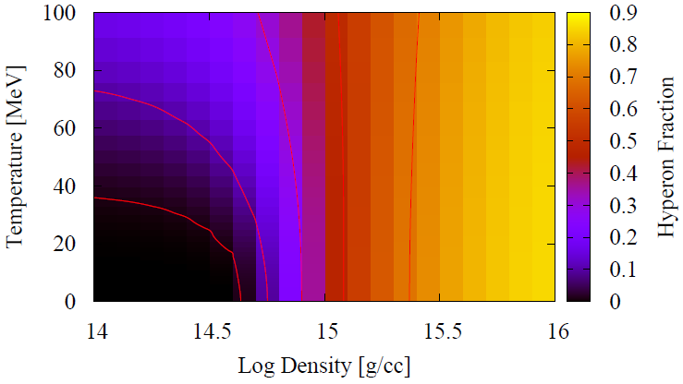
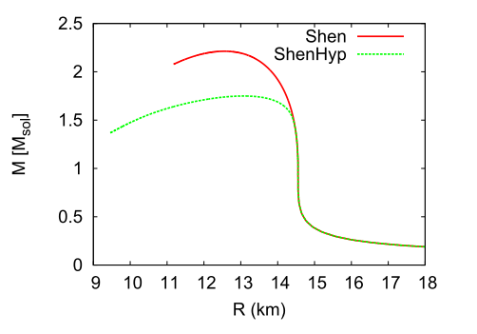
Equations of State (EOS)
H-EOS: EOS with Λ hyperons (Shen+ 2011: ShenHyp)
S-EOS: ‘normal’ nucleonic matter EOS (Shen+ 1998)
  Both based on the relativistic mean field theory
At T = 0, Λ hyperons appear at ρ ~ a few ρnuc, and XΛ increases as density and temperature increase
Due to the appearance of Λ hyperons, the maximum mass of the cold spherical NS is decreased

Slide 5
Basic Equations & Initial Condition
Einstein’s equations: Shibata-Nakamura (BSSN) formalism
  4th order finite difference in space, 4th order Runge-Kutta time evolution
  Gauge conditions : 1+log slicing, dynamical shift
GR Hydrodynamics with GR Leakage Scheme (Sekiguchi 2010)
  EOM of Neutrinos
  Lepton Conservations
  Weak Interactions
    e± captures, pair annihilation, plasmon decay, Bremsstrahlung
  A detailed neutrino opacities
  BH excision technique
  High-resolution-shock-capturing scheme
Initial condition
  Equal mass BNS with individual mass of 1.35, 1.5, 1.6 Msolar

Slide 6
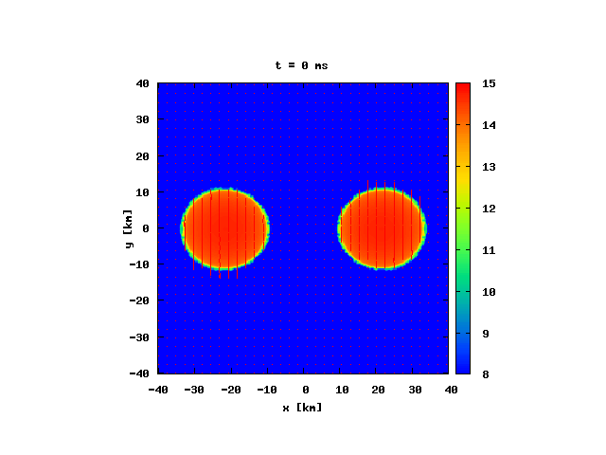
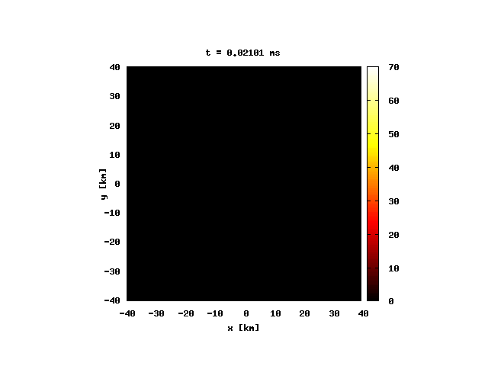
Merger Dynamics: Hyperon EOS Case
Hyper massive NS (HMNS) first forms and eventually collapses to BH
  As HMSN shrinks, density and temperature increase and consequently more hyperons appear, making EOS more softer
After the BH formation, a massive accretion disk (~0.08 Msolar) is formed ⇒ short GRB ?
Density [ log10 g/cc]
Temperature [ MeV ]

Slide 7
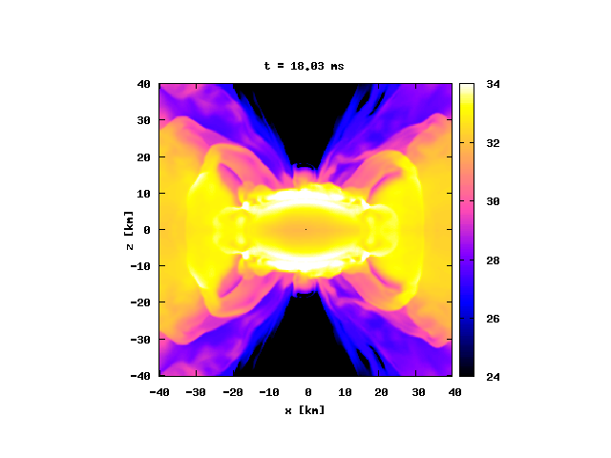
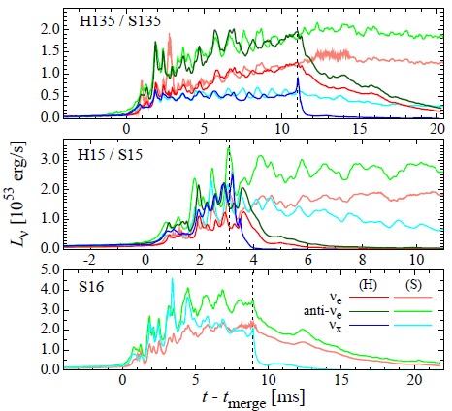
Neutrino Luminosities
There is no difference except for the duration until the BH formation
  Effects of hyperons are significant in the central region where neutrino diffusion time is very long, and swallowed into BH
Difficult to tell the existence of hyperons using the neutrino signals alone
Neutrino emissivity [log erg/s/cc ]

Slide 8
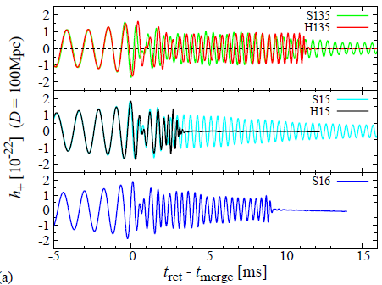
Gravitational Waveforms
For the same mass models, GWs from inspiral phase agree well
GWs damp steeply at BH formation
Characteristic GW frequency for the hyperon model increases with time (although GWs for H135 and S16 look similar) ⇒ see the GW spectra
Nucleonic / Hyperonic
Nucleonic / Hyperonic
Nucleonic

Slide 9
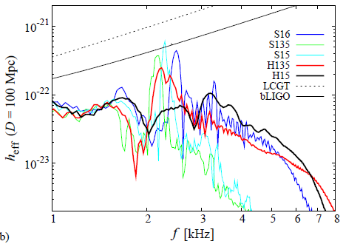
Gravitational-Wave Spectra
Nucleonic models show prominent peak associated with GWs from HMNS
In Hyperonic models, the peak is weakened and broadened
  Reflecting the short lifetime of HMNS and the frequency shift
Nucleonic EOS
Hyperonic

Slide 10
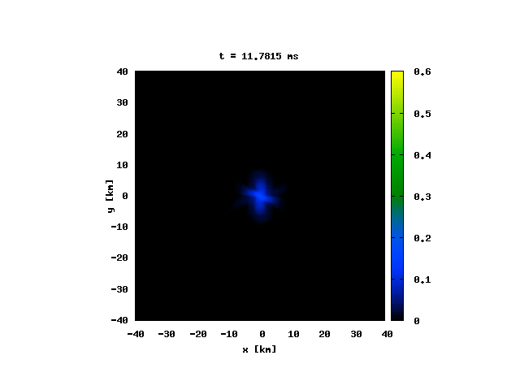
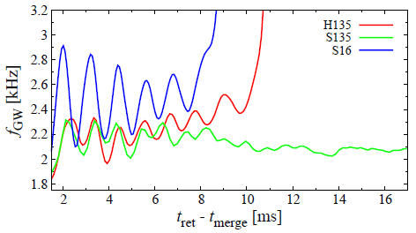
Frequency Shift due to Hyperon
Dynamics of HMNS formed after the merger
  Nucleonic：HMNS shrinks by angular momentum loss due to GW emission
  in a long timescale
  Hyperonic：GW emission ⇒ HMNS shrinks ⇒ More Hyperons appear ⇒
  EOS becomes softer ⇒ HMNS shrinks more ⇒ ….
  As a result, the characteristic frequency of GW increases with time
    Providing potential way to tell existence of hyperons (exotic particles)
Hyperon Fraction
Hyperonic

Slide 11
Summary
We performed the first numerical-relativity simulations of BNS merger incorporating a finite temperature EOS with hyperons
Existence of hyperons are imprinted in GWs
  The characteristic GW frequency increases in time
  which stems from Nucleonic-to-Hyperonic Transition
  Providing potential way to tell existence of hyperons by GW obs.
It is difficult to constrain EOS by neutrino signals only
  Effects of hyperons are significant in the central high density region which is swallowed into BH

Slide 12
Prospects
Gravitational Waves from Hadron-Quark Transition
  Second order phase transition
    ⇒ Frequency shift (as in hyperon case)
  First order transition
    ⇒ Double peaked GW spectrum is expected:
    One associated with NS and the other with Quark star
Second order
First order
Hadron
Quark
Hadron
Quark

Slide 14
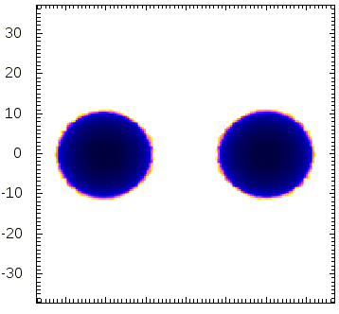
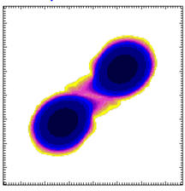
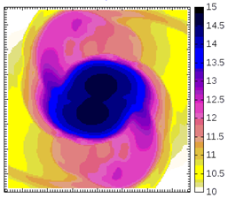
Gravitational Waves from Neutron Star Merger
Tidal deformation
Inspiral phase
Merger and oscillation
Chirp Signals
Information of orbits,
neutron star mass etc.
Finite-Size effects
Information of
radius (EOS)
Maximum mass, oscillation
Information of dense part
of EOS
km
Log density [g/cm³]
Density contour
Amplitude
Typical Waveform
Time

Slide 15
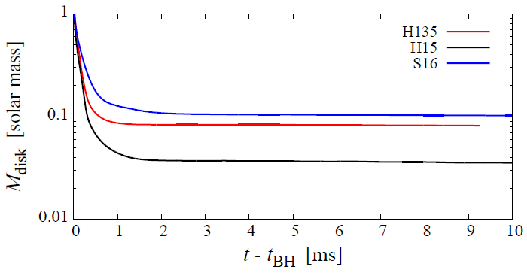
Disk Mass
Disk mass is smaller for the hyperonic EOS models
  Shorter time for angular momentum transport
  HMNS formed after the merger is more compact

Slide 16
Final Fate after the Merger
Maximum NS mass：
    Recent observational lower bound : 1.97 Msolar (Demorest et al. 2010)
The maximum mass can be increased by 30 ― 70 % compared to the cold maximum mass

Slide 17

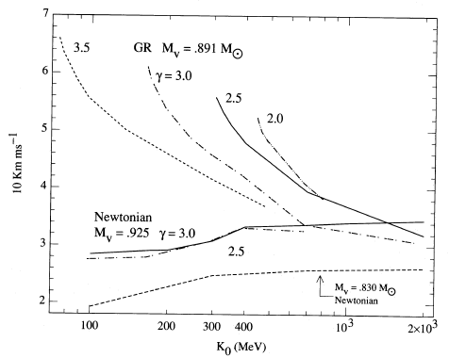
Remark: Importance of GR
Van Riper (1988) ApJ 326, 235
Shock velocity @ 300 km (1000km/s)
Incompressibility K(sym) (MeV)

Slide 18
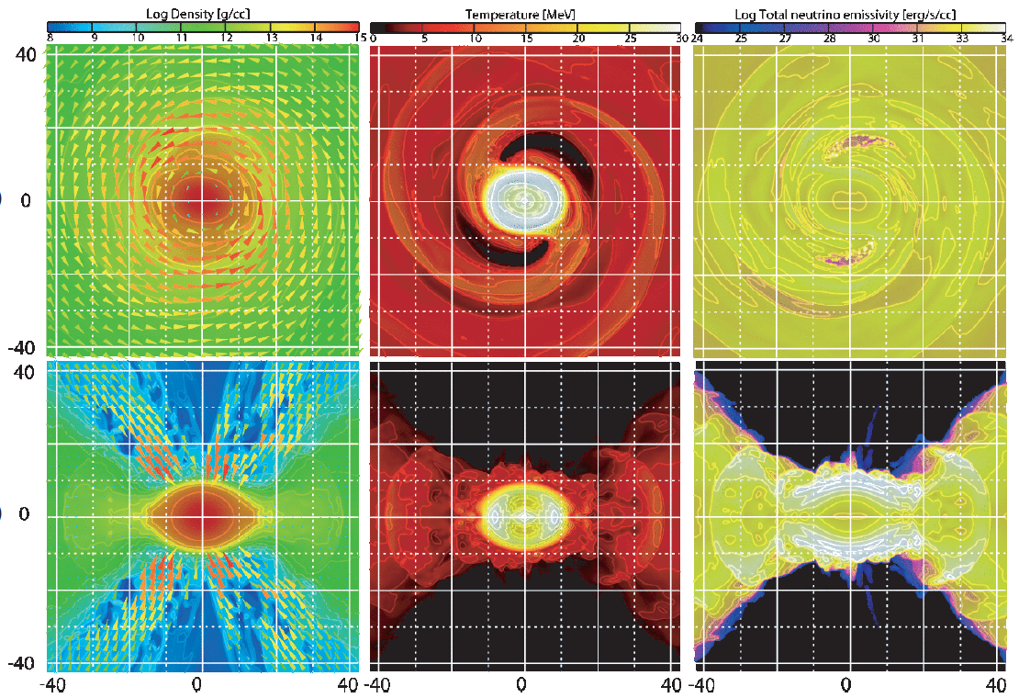
x-y
density
temperature
ν emissivity
x-z

