Slide 1
Weak lensing of CMB from cosmic (super-)strings
9/28/2011 JGRG21 @ Tohoku U
Daisuke Yamauchi
ICRR, U Tokyo
with A. Taruya (U Tokyo, RESCEU), T. Namikawa (U Tokyo),
K. Takahashi (Kumamoto U), Y. Sendouda (Hirosaki U), C.M. Yoo (YITP)

Slide 2
Introduction

Slide 3
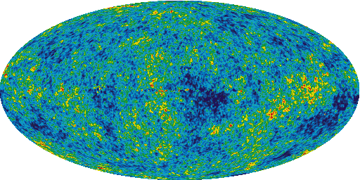
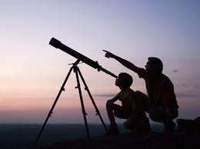
CMB lensing
If no foreground sources, light ray goes straight along unperturbed path.
If LSS exists, light ray will be bent!
Large scale structure
Lensing effect on the CMB can be treated as a mapping of the intrinsic temperature/polarization fields.

Slide 4
Scalar lensing potential
Scalar perturbations such as foreground density perturbations produce only the gradient mode of the deflection:
: scalar lensing potential
Lens object
Lensing strength
Geometry of the universe
×
Matter potential
=

Slide 5
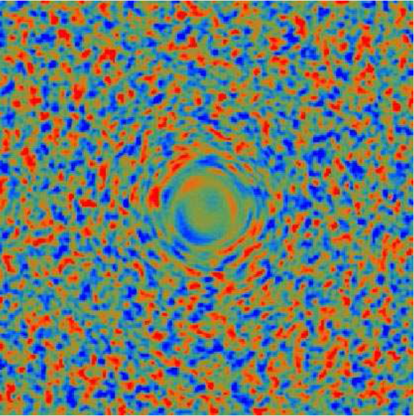
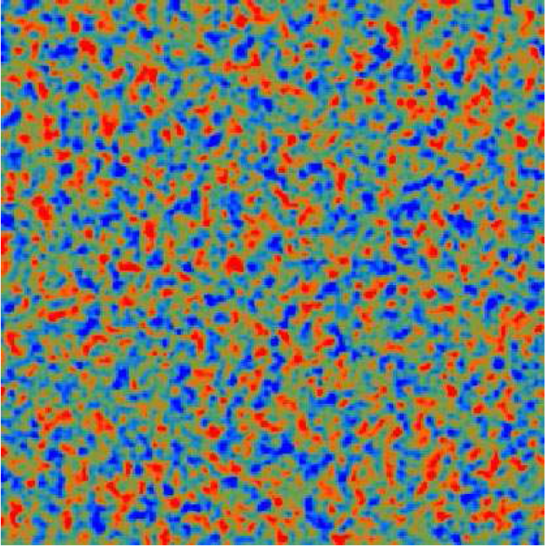
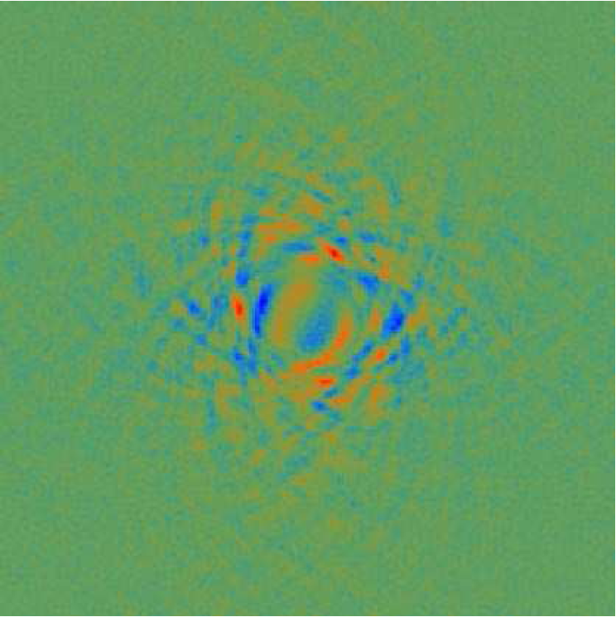
Lensing induces CMB B-mode
[Hu+Okamoto (2002)]
Lensed E-mode
Only E-mode (unlensed)
Foreground matter distribution
+
=
Nonzero lensed B-mode !!!
Foreground density perturbations contribute to B-mode through the partial conversion of E-mode to B-mode !

Slide 6
CMB lensing from a string network
Key: Cosmic strings can produce not only scalar, but also vector and tensor perturbations !

Slide 7
Gradient and curl part of deflection
subdominant, but may be helpful for very high energy physics !
``Curl mode’’ can be induced by vector and/or tensor perturbations:
Scalar/Vector/Tensor perturbations
Scalar/Vector/Tensor perturbations
Lens object
We should investigate cosmic strings as the possible source of the B-mode though weak lensing.
The curl mode is a new smoking gun of cosmic strings.

Slide 8
Cosmic (super-)strings
It is natural to expect that conventional cosmic strings have formed during phase transitions in the early universe.
Various new types of cosmic strings, so-called cosmic superstrings, may be formed at the end of the stringy inflation (KKLMMT).
Intercommutation process provides a mechanism for a string network to lose its energy and approach to an attractor sol.
→ P is strongly related to the string number density !
Remnants of unified theory
Intercommuting probability P (clue to detect superstrings !)
Conventional cosmic strings : P=1
Cosmic superstrings : P~10⁻³ <<1

Slide 9
CMB Lensing from strings

Slide 10
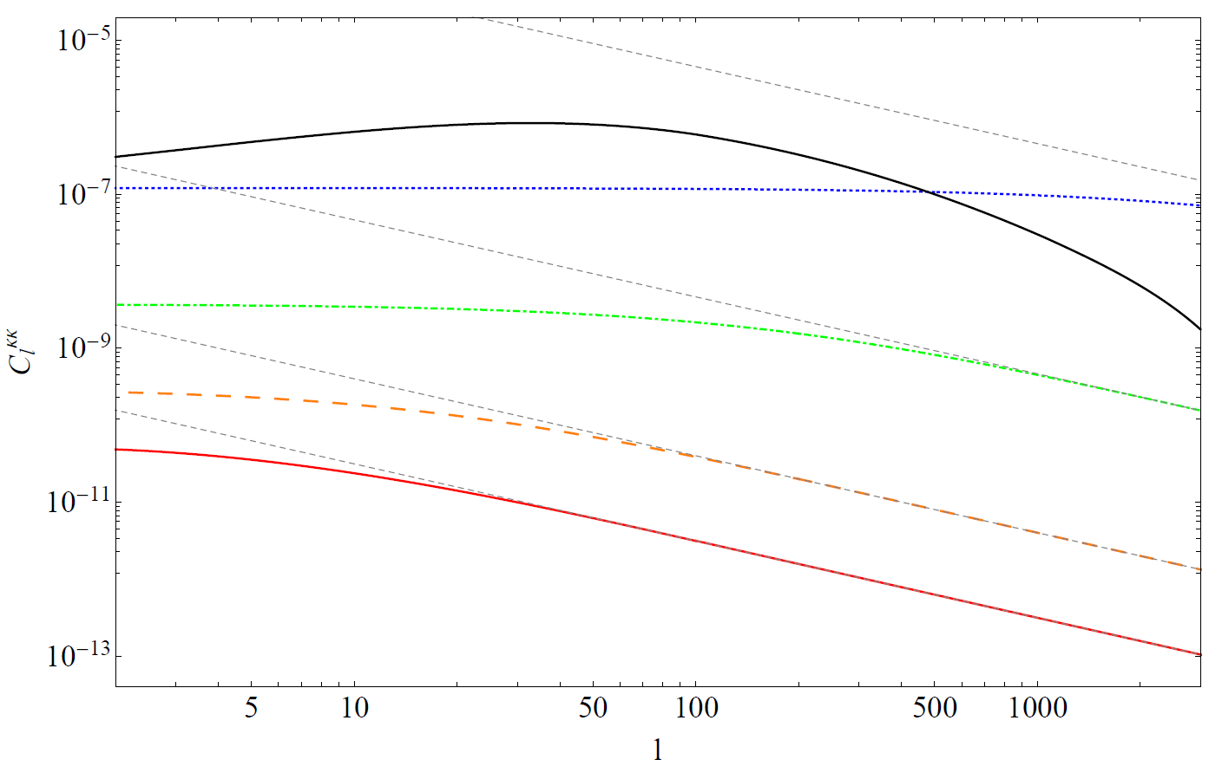
Scalar lensing potential from cosmic (super-)strings
[DY, Takahashi, Sendouda, Yoo, in prep.]
The spectra decay more slowly compared with primordial scalar lensing.
Primordial scalar perturbations
strings (P=10⁻⁶)
strings (P=10⁻³)
Power spectrum for gradient mode
Cosmic superstrings
The amplitudes become large for smaller P since the number density of the strings becomes large.
strings (P=10⁻¹)
strings (P=1)
Conventional strings
multipole

Slide 11
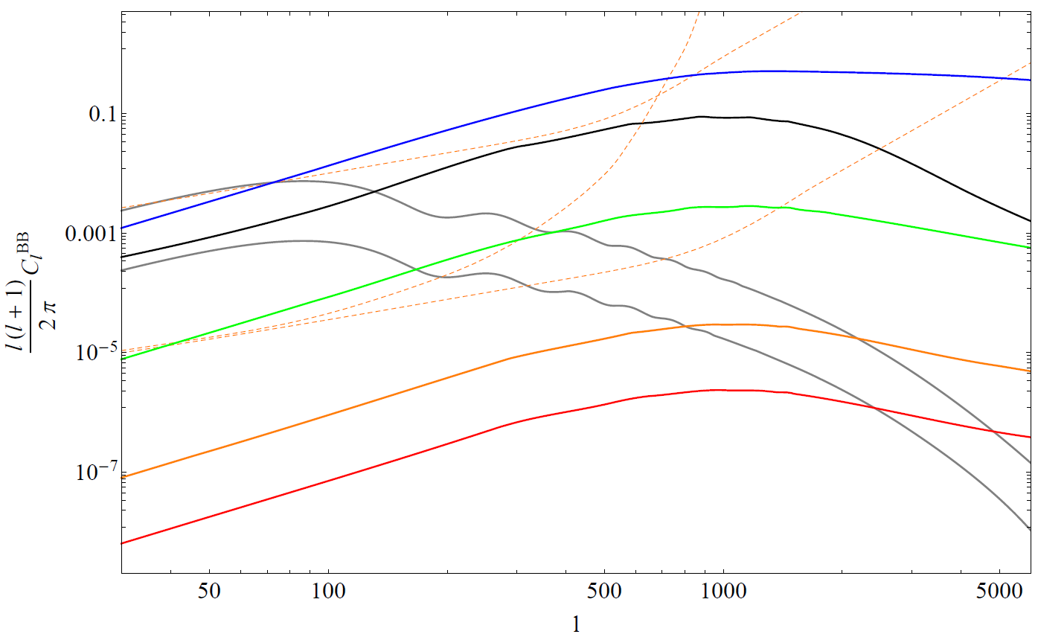
B-mode from scalar lensing by CS
[DY, Takahashi, Sendouda, Yoo, in prep.]
In the small scale limit:
the lensed BB spectra decay more slowly compared with primordial scalar lensing.
PLANCK sensitivity
strings (P=10⁻⁶)
EPIC-2m
LiteBIRD
Primordial scalar perturbations
Cosmic superstrings
Power spectrum for B-mode
strings (P=10⁻³)
inflationary BB (r=0.1)
strings (P=10⁻¹)
Conventional strings
(r=0.01)
strings (P=1)
The amplitudes become large for smaller P because the string number density becomes large.
multipole

Slide 12
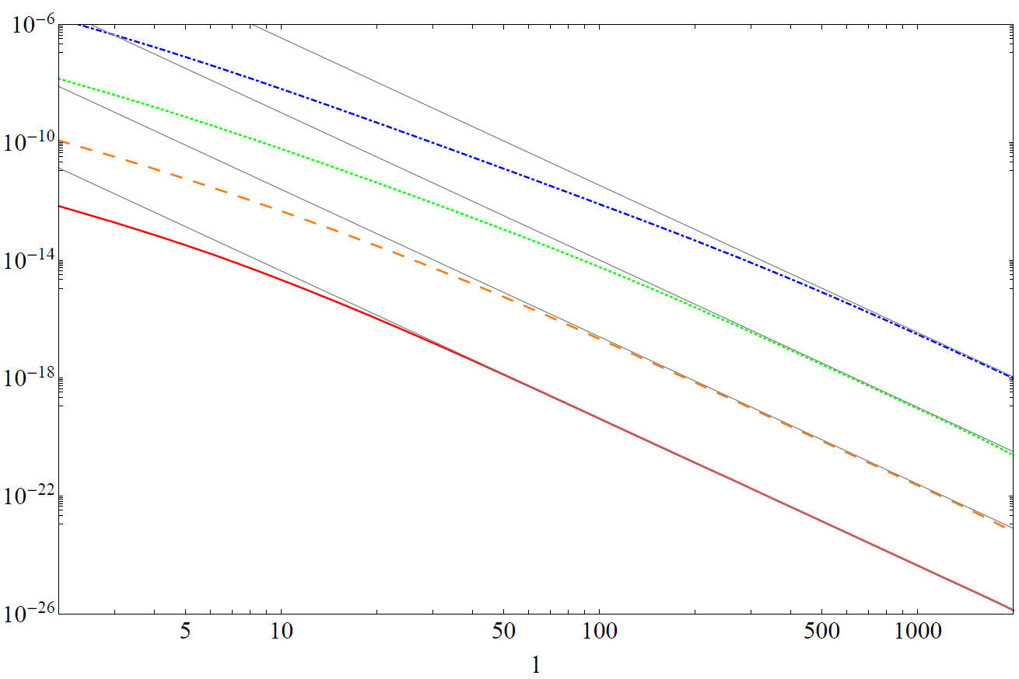
Pseudo-scalar lensing potential from vector perturbations by CS
[Namikawa, DY, Taruya, in prep.]
∝ l ⁻⁵
Vector perturbations
strings (P=10⁻³)
Power spectrum for curl mode
strings (P=10⁻²)
Vector perturbations from a string network actually produce the pseudo-scalar lensing potential !
strings (P=10⁻¹)
Cosmic superstrings
strings (P=1)
Conventional strings
multipole

Slide 13
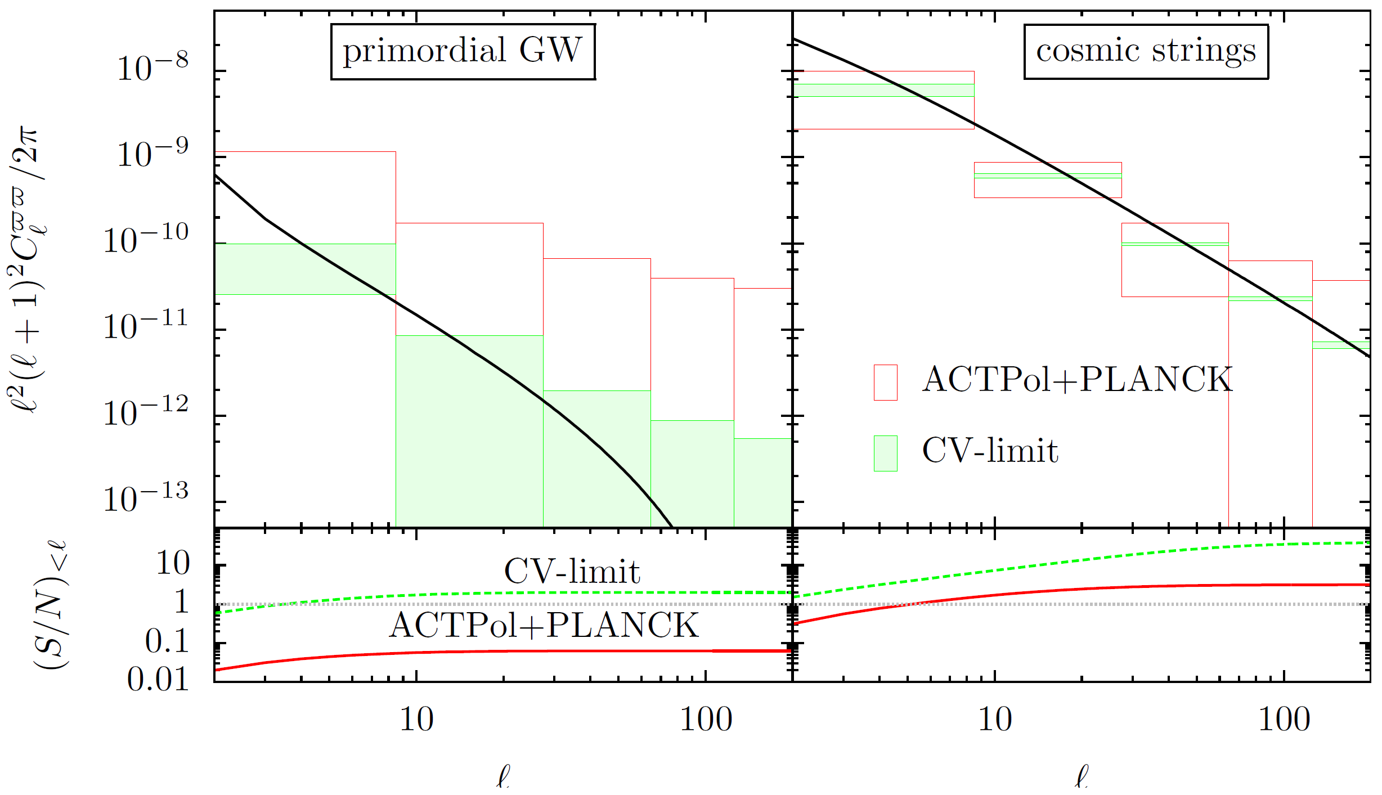
Detectability for pseudo-scalar lensing potential
[Namikawa, DY, Taruya, in prep.]
Power spectrum for curl mode
The signals have no counterpart from density perturbations.
The observations of the pseudo-scalar lensing potential would provide a candidate of cosmic superstrings !
S/N>1 even for PLANCK/ACTPol !!!

Slide 14
Summary
Topological defects can produce not only scalar-, but also vector-/tensor-perturbations, which lead to the unusual deflection:
In small scale limit, the BB spectrum decays more slowly compared with the primordial matter perturbations.
The pseudo-scalar lensing potential can be induced by a string network and it would provide a new smoking gun of cosmic superstrings!
Scalar/Vector/Tensor perturbations
Scalar/Vector/Tensor perturbations

Slide 15
Thank you !

