Slide 1
Hawking temperature for near-equilibrium black holes
The 21st workshop on General Relativity and Gravitation in Japan
Shunichiro Kinoshita (Kyoto University)
with Norihiro Tanahashi (UC Davis)

Slide 2
Introduction
The fact that black holes possess thermodynamic properties has been intriguing in gravity
Hawking temperature, Black hole entropy
The AdS/CFT has opened up new insights about these properties
Stationary black holes correspond to thermal equilibrium state of dual field theories at finite-temperature
It is interesting to explore generalization for non-stationary spacetime

Slide 3
What is problem?
In stationary cases Hawking temperature is given by surface gravity of (Killing) horizon. How about dynamical cases?
No Killing horizon. Which horizon?
If we defined temperatures by using some quantities associated with event horizon, how can we observe it at asymptotic region? It is puzzling from causality.
Our approach: we try to define temperature from spectrum of Hawking radiation
For gravitational collapse, Barcelo et al. (2011) have considered.
We will focus our attention on eternal BHs because we are interested in near-equilibrium systems

Slide 4
Conventional derivation of the Hawking radiation
We introduce two null coordinates
u: asymptotic time (natural time for asymptotic observers)
U: Kruskal time (an affine parameter on the past horizon)
Bogoliubov transfomation between two sets of modes
Thermal spectrum

Slide 5
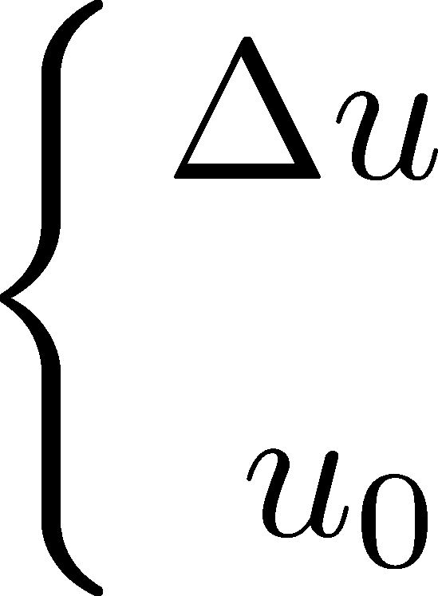
Extension to time-dependent spacetime
We use wave packets which are localized in both of time and frequency domains
: a window function which goes rapidly to zero outside
: a duration of observation
: a time of observation
We expect to be able to define temperature, if the background spacetime would evolve sufficiently slowly within the above time interval

Slide 6
Saddle-point approximation
Bogoliubov coefficients for wave packets
This integral can be evaluated as
Geometric optics
Saddle point:
We have defined

Slide 7
Adiabatic expansion
To clarify what slowly evolving is, we will define adiabatic expansion
Expanding U(u) with respect to ε

Slide 8
Adiabatic expansion
Also, we will expand the saddle point and solve the saddle point equation order by order
To guarantee that the purturbative expansion is valid, we should require each of correction term to be sufficiently smaller than its leading term
Sufficient condition

Slide 9
Surface gravity for past horizon
Geometrical meaning of κ(u)
In-going null vectors with respect to u and U
Geodesic equation
“surface gravity” for past horizon

Slide 10
Application to AdS-Vaidya
A toy model of thermalization for CFT fluid
Mass injection into BH
AdS boundary
Mass function:
: time-scale of injection

Slide 11
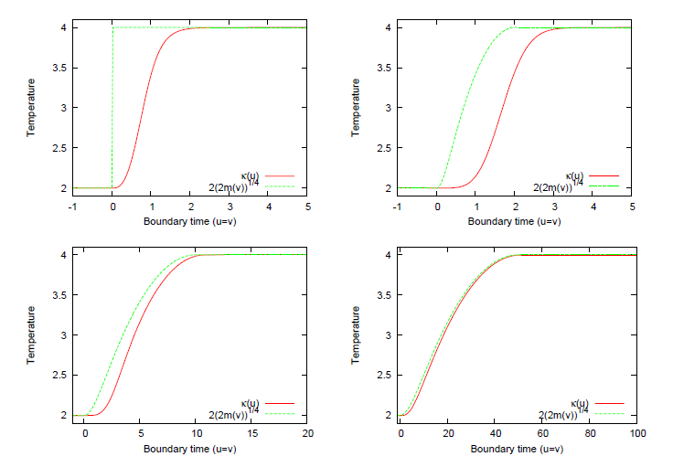
Results
Even if the mass injection is so rapid, the temperature will gradually change.
The delay time is determined by typical thermal scale 1/T.
Red lines: temperature determined by κ(u)
Green lines: “temperature” determined by m(v) in a similar way to static BHs

Slide 12
Summary
We have discussed Hawking temperature for non-stationary spactimes
Hawking temperature is determined by surface gravity for the past horizon
We have applied it to AdS-Vaidya as a toy model of thermalization process in AdS/CFT
Even if the spacetime rapidly changes, the temperature will gradually evolve and its time-scale is bounded by typical thermal time-scale

