Slide 1
Multi-field
Open Inflation ＆ Instanton
YITP, Kyoto University
Kazuyuki Sugimura
(Collaborator : D. Yamauchi and M. Sasaki)

Slide 2
Contents
Introductions
Multi-field Open Inflation
  Scenario and model
  Formulation of multi-field tunneling
  Multi-field instanton
  Evolution after tunneling
Conclusions and Discussions

Slide 3
Introductions

Slide 4
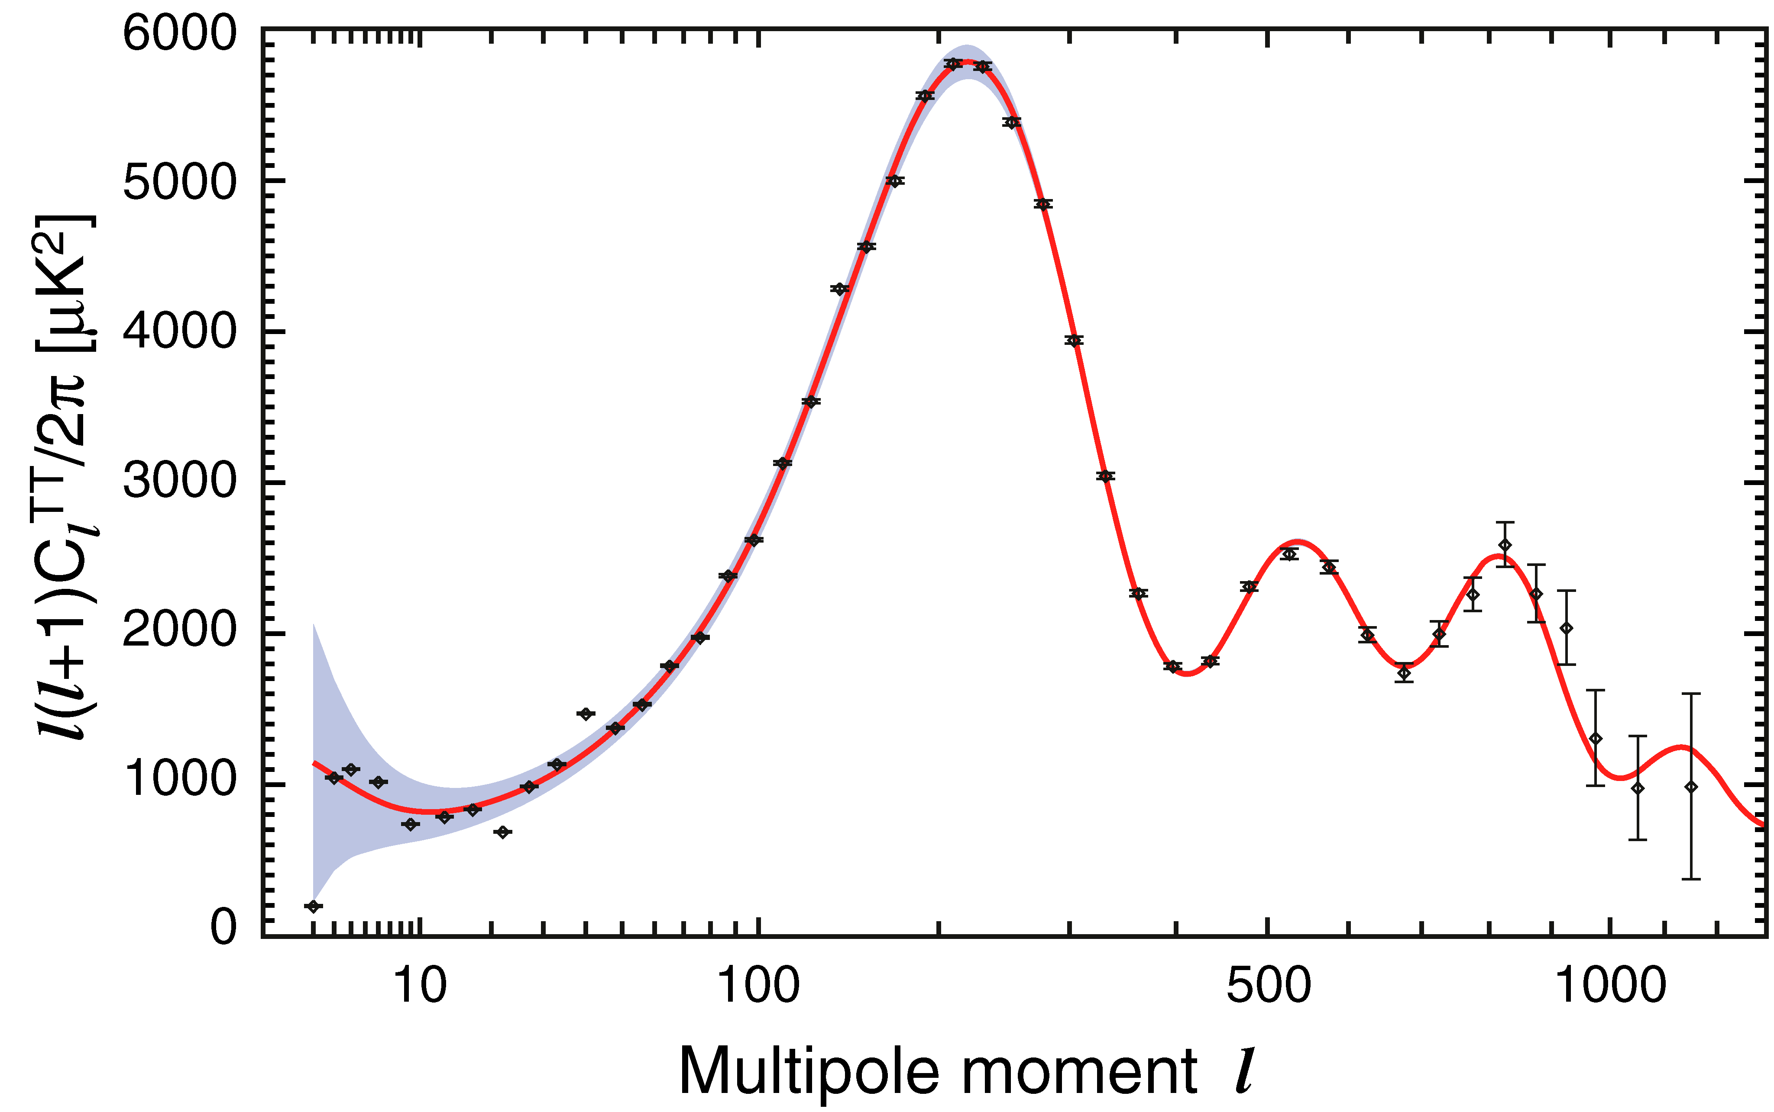
Inflation and beyond
http://lambda.gsfc.nasa.gov
Inflation solves
Horizon problem
Flatness problem
Monopole problem
also predicts power spectrum
very good agreement!!
But
How is it implemented in particle physics?
How does it start?
？

Slide 5
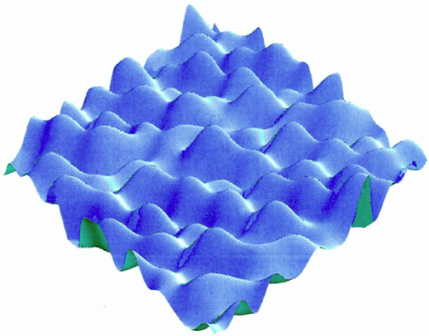
String landscape
(Susskind, 2003)
In String theory
High dimensionality
Integration out of high energy physics
many physical degrees of freedom
Non-trivial structure of vacuum
implementation of inflation seems possible
scalar field
flat potential
http://journalofcosmology.com

Slide 6
String landscape
(Susskind, 2003)
In String theory
High dimensionality
Integration out of high energy physics
many physical degrees of freedom
Non-trivial structure of vacuum
implementation of inflation seems possible
scalar field
flat potential
String theory also implies
multi-field
quantum tunneling
Multi-field open inflation
http://journalofcosmology.com

Slide 7
Multi-field open inflation
Quantum tunneling before slow-roll (in multi-field system)
(Multi-field) Open inflation
Ω_{k}〜-0.01 is most favorable(?) (Freivogel, et al., 2006)
good point of
multi-field system
possibility of curvature detection
Open inflation in multi-field system
may solve a problem in single-field case
Only an artificial potential model is known (Linde 1998)
We will study multi-field open inflation!!

Slide 8
Multi-field open inflation

Slide 9
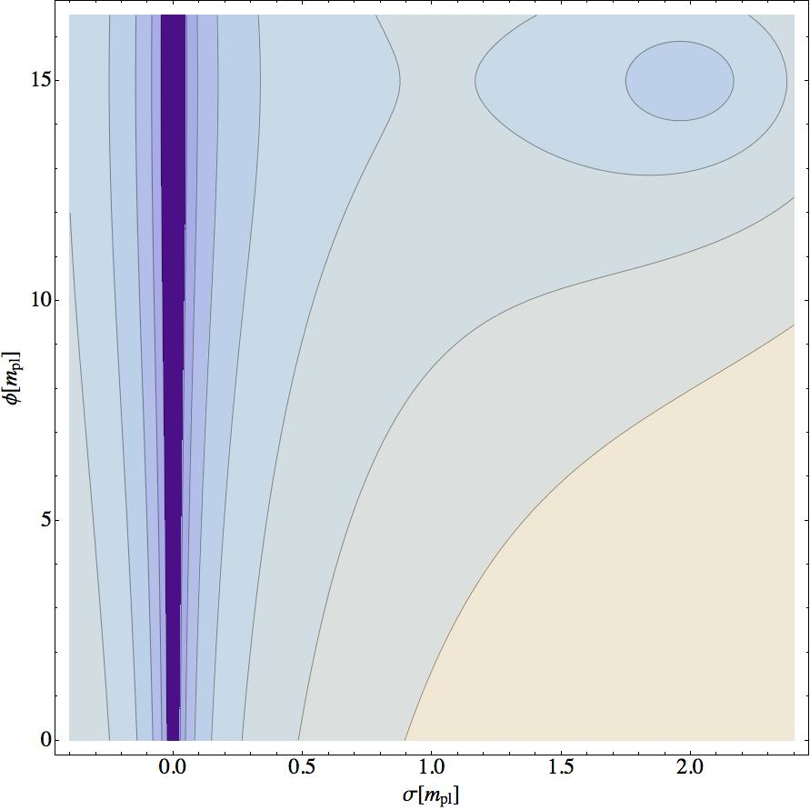
Multi-field model with a simple potential
tunneling field σ
inflaton φ
φ
Contour of V(σ,φ)
σ

Slide 10
Multi-field model with a simple potential
tunneling field σ
inflaton φ
false vacuum inflation
φ
quantum tunneling
rolling to false vacuum
Scenario
slow-roll inflation
rolling to false vacuum
false vacuum inflation
quantum tunneling
slow-roll inflation
reheating
Contour of V(σ,φ)
reheating
σ

Slide 11
Formulation of multi-field tunneling with gravity
Multi-field extension of Coleman-De Luccia instanton
(Coleman and De Luccia, 1980)
instanton
O(4)-symmetric non-trivial
Euclidean classical path
Euclidean metric
image of instanton
for single-field system
inside of nucleated bubble is open Friedmann universe
initial state is given by instanton value at t=0
1. construct a multi-field instanton
We will
2. evolve the universe inside bubble

Slide 12
Multi-field instanton
tunneling
multi-field instanton with gravity is
explicitly constructed for the first time
inflaton φ moves during tunneling
but a little for this parameter choice
instanton value at t=0 gives
the initial state of bubble
evolution after tunneling

Slide 13
Evolution of inflaton φ after tunneling
slow-roll inflation
reheating

Slide 14
Evolution of tunneling field σ after tunneling
slow-roll inflation

Slide 15
Evolution after tunneling
slow-roll inflation
energy decomposition
curvature dominant
slow-roll inflation
reheating

Slide 16
Evolution after tunneling
tunneling field σ is massive
slow-roll inflation
damped oscillation
energy decomposition
curvature dominant
slow-roll inflation
reheating

Slide 17
Evolution after tunneling
tunneling field σ is massive
slow-roll inflation
damped oscillation
curvature dillution
potential of inflatonφ gets dominant
energy decomposition
curvature dominant
slow-roll inflation
reheating

Slide 18
Evolution after tunneling
tunneling field σ is massive
slow-roll inflation
damped oscillation
curvature dillution
potential of inflatonφ gets dominant
energy decomposition
inflation lasts for 60 e-foldings
curvature dominant
slow-roll inflation
reheating

Slide 19
Evolution after tunneling
tunneling field σ is massive
slow-roll inflation
damped oscillation
curvature dillution
potential of inflatonφ gets dominant
energy decomposition
inflation lasts for 60 e-foldings
first explicit open inflation
model with simple potential!!
curvature dominant
slow-roll inflation
reheating

Slide 20
Conclusions and Discussions

Slide 21
Conclusions
We studied about Multi-field open inflation, which is motivated by string landscape
The Coleman De Luccia instanton method was extended to the multi-field case
Multi-field instanton with gravity and the evolution inside the bubble were explicitly calculated
Our multi-field open inflation model is the first explicit open inflation model with a simple potential

Slide 22
Discussions and Future works
Method to calculate a quantum fluctuation in open inflation seems possible to be applied to our model
Interaction between heavy oscillating tunneling field and inflaton may produce some interesting features in power spectrum
Quantum tunneling changes the state of the universe from Bunch-Davies vacuum, and this may produce a characteristic non-gaussianity
If we are very lucky, we may find an evidence of our model, or string landscape, from observations
(Garriga, Montes, Sasaki, Tanaka (1998))
(now we are working!)

Slide 23
Appendix

Slide 24
Interaction effect on decay rate

Slide 25
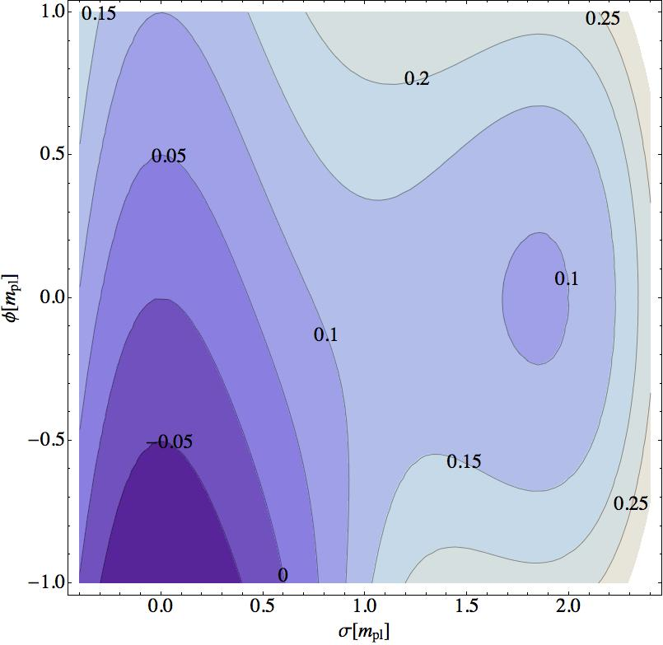
naive question about multi-field dynamics
Q. Do multi-field dynamics make
decay rate larger, or smaller?
decay rate
multi-field instanton
(Coleman and De Luccia, 1980)
instanton when neglecting
dynamical freedom of φ
without multi-field dynamics
staying at false vacuum
with multi-field dynamics
single field instanton for
Contour of V(σ,φ)
B-B₀ comes from the multi-field dynamics effect

Slide 26
Multi-field dynamics effect on decay rate
decay rate
difference of B due to multi-field dynamics
B
multi-field dynamics
more significant
decay rate
A. The multi-field dynamics make decay rate larger!!

Slide 27
Decomposition of energy density in the universe after tunneling
Hubble parameter
inflaton φ
tunneling field σ
curvature

Slide 28
m_{φ} dependence of the system
m_{φ} changes not only the strength of interaction
but also the non-interaction part
different m_{φ}
different
large m_{φ}
large V₀(σ_{F})
small
in the case of the very large m_{φ,} there
may exist only a Hawking-Moss instanton
(barrier is effectively small)

