Slide 1
Beyond delta-N formalism
Atsushi Naruko
Yukawa Institute Theoretical Physics, Kyoto
In collaboration with
Yuichi Takamizu (Waseda) and Misao Sasaki (YITP)

Slide 2
The contents of my talk
1. Introduction and Motivation
2. Gradient expansion and delta-N formalism
3. Beyond delta-N formalism

Slide 3
Introduction
Inflation is one of the most promising candidates
as the generation mechanism of primordial fluctuations.
We have hundreds or thousands of inflation models.
→ we have to discriminate those models
Non-Gaussianity in CMB will have the key of this puzzle.
In order to calculate the NG correctly,
we have to go to the second order perturbation theory,
but …

Slide 4
Evolution of fluctuation
Gradient
expansion
Perturbation
theory
Concentrating on the evolution of fluctuations on large scales,
we don’t necessarily have to solve complicated pertur. Eq.

Slide 5
Gradient expansion approach
In GE, equations are expanded in powers of spatial gradients.
→ Although it is only applicable to superhorizon evolution,
full nonlinear effects are taken into account.
At the lowest order in GE (neglect all spatial gradients),
=
lowest order Eq.
Background Eq.
Just by solving background equations,
we can calculate curvature perturbations and NG in them.
(difference of e-fold)
: delta-N formalism
Don’t we have to care about spatial gradient terms ?

Slide 6
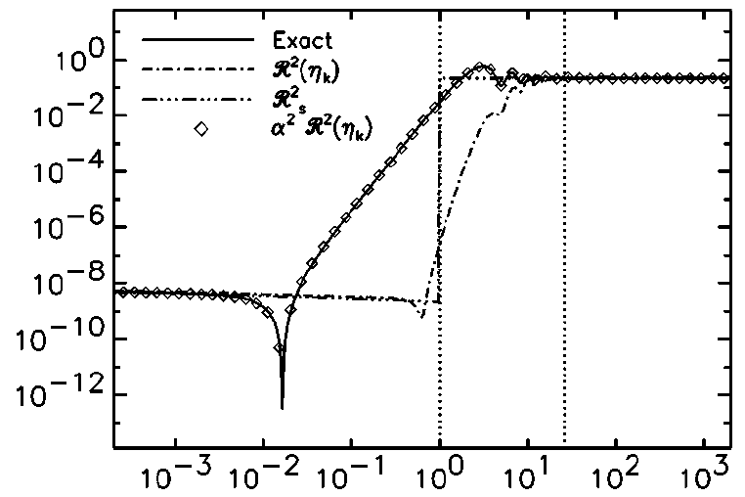
Slow-roll violation
If slow-roll violation occured, we cannot neglect gradient terms.
Power spectrum
of curvature pert.
Slow-roll violation
wave number
Leach, et al (PRD, 2001)
Since slow-roll violation may naturally occur in multi-field
inflation models, we have to take into account gradient terms
more seriously in multi-field case.

Slide 7
Goal
Our goal is to give the general formalism for solving
the higher order terms in (spatial) gradient expansion,
which can be applied to the case of multi-field.

Slide 8
Gradient expansion approach and delta-N formalism

Slide 9
Gradient expansion approach
On superhorizon scales, gradient expansion will be valid.
→ We expand Equations in powers of spatial gradients : ε
We express the metric in ADM form
We decompose spatial metric g_{ij} and extrinsic curvature K_{ij} into
a(t) : fiducial “B.G.”
Ψ 〜 R : curvature perturbation
traceless

Slide 10
Lowest-order in gradient expansion
After expanding Einstein equations, lowest-order equations are
lowest-order eq.
background eq.
→ The structure of lowest-order eq is same as that of B.G. eq
with identifications, and !
lowest-order sol.
changing t by τ
background sol.

Slide 11
delta-N formalism
We define the non-linear e-folding number and delta-N.
Choose slicing such that initial : flat ＆ final : uniform energy
E_{final}
Ψ
E
E const.
flat
flat
E_{initial}
flat
delta-N gives the final curvature perturbation

Slide 12
Beyond delta-N formalism

Slide 13
Gradient expansion approach
delta-N
Beyond
delta-N
Gradient
expansion
Perturbation
theory

Slide 14
towards “Beyond delta-N”
At the next order in gradient expansion,
we need to evaluate spatial gradient terms.
Since those gradient terms are given by the spatial derivative
of lowest-order solutions, we can easily integrate them…
Once spatial gradient appeared in equation,
we cannot use “τ” as time coordinate which depends on x^{i}
because integrable condition is not satisfied.
→ we cannot freely choose time coordinate (gauge) !!

Slide 15
Beyond delta-N
We usually use e-folding number (not t) as time coordinate.
→ We choose uniform N gauge and use N as time coordinate.
Form the gauge transformation δN : uniform N → uniform E,
we can evaluate the curvature perturbation .
lowest order
E const.
next order
flat

Slide 16
Summary
We gave the formalism, “Beyond delta-N formalism”,
to calculate spatial gradient terms in gradient expansion.
If you have background solutions, you can calculate
the correction of “delta-N formalism” with this formalism
just by calculating the “delta-N”.

Slide 18
Linear perturbation theory

Slide 19
FLRW universe
For simplicity, we focus on single scalar field inflation.
Background spacetime : flat FLRW universe
Friedmann equation :

Slide 20
Linear perturbation
We define the scalar-type perturbation of metric as
(0, 0) :
(0, i) :
trace :
traceless :

Slide 21
Linear perturbation : J = 0
We take the comoving gauge = uniform scalar field gauge.
Combining four equations, we can derive the master equation.
On super horizon scales, R_{c} become constant.
and

Slide 22
Einstein equations in J = 0
Original Einstein equations in J = 0 gauge are
(0, 0) :
(0, i) :
trace :
traceless :

Slide 23
Linear perturbation : J = 0
In original Einstein equations,
where does the decaying mode come from ?
(0, i) :
→ Lapse determines the evolution of R_c
(0, 0) :
→ Lapse 〜 shear
traceless :
→ Shear will decay as a⁻² neglecting the RHS.
The origin of decaying mode is shear.
The effects of spatial gradient appear through shear.

Slide 24
R_{c} = a δφ_{flat}
We can quantize the perturbation with
u is the perturbation of scalar field on R = 0 slice.
→ quantization is done on flat (R = 0) slice.
→ perturbations at horizon crossing
which give the initial conditions for ▽ expansion
are given by fluctuations on flat slice.

Slide 25
Curvature perturbation ?
We parameterised the spatial metric as
traceless
linearlise
In the linear perturbation, we parametrised the spatial metric as
R : curvature perturbation
Strictly speaking, Ψ is not the curvature perturbation.
→ On SH scales, E become constant and we can set E = 0.
→ Ψ can be regarded as curvature perturbation
at lowest-order in ▽ expansion.

Slide 26
Shear and curvature perturbation
Once we take into account spatial gradient terms,
shear (σ_{g} or A_{ij}) will be sourced by them and evolve.
→ we have to solve the evolution of E.
At the next order in gradient expansion,
Ψ is given by “delta-N” like calculation.
In addition, we need to evaluate E.

Slide 27
delta-N formalism 1
We define the non-linear e-folding number
Curvature perturbation is given by the difference of “N”
flat
N
flat
x^{i} = const.

Slide 28
delta-N formalism 2
Choose slicing such that initial : flat ＆ final : uniform energy
Ψ
φ
E const.
E const.
flat
E const.
flat
flat
delta-N gives the final curvature perturbation

Slide 29
Beyond delta-N
We usually use e-folding number (not t) as time coordinate.
→ We choose uniform N slicing and use N as time coordinate.
Combining equations, you will get the following equation for φ.

Slide 30
Beyond delta-N 2
We compute “delta N” from the solution of scalar field.
φ
com.
=
com.
flat

Slide 31
Beyond delta-N 3
We extend the formalism to multi-field case.
As a final slice, we choose uniform E or uniform K slice
since we cannot take “comoving slice”.
We can compute “delta N” form the solution of E, K.
@ lowest order

Slide 33
Question
How can we calculate
the correction of delta-N formalism ?

Slide 34
Answer
To calculate the cor. of delta-N,
all you have to do is calculate “delta-N”.

