Slide 1
次世代赤外線天文衛星 SPICA 搭載用 遠赤外線観測装置 SAFARI
Toyoaki Suzuki (JAXA)
P. Khosropanah, M. Ridder, R.A. Hijmering, J.R. Gao, H. Akamatsu, L. Gottardi, J. van der Kuur
and B.D. Jackson (SRON)
Notes:
Good afternoon every one. I’m glad to talk with you about our new results on the development of ultra-low noise TES bolometer arrays.

Slide 2
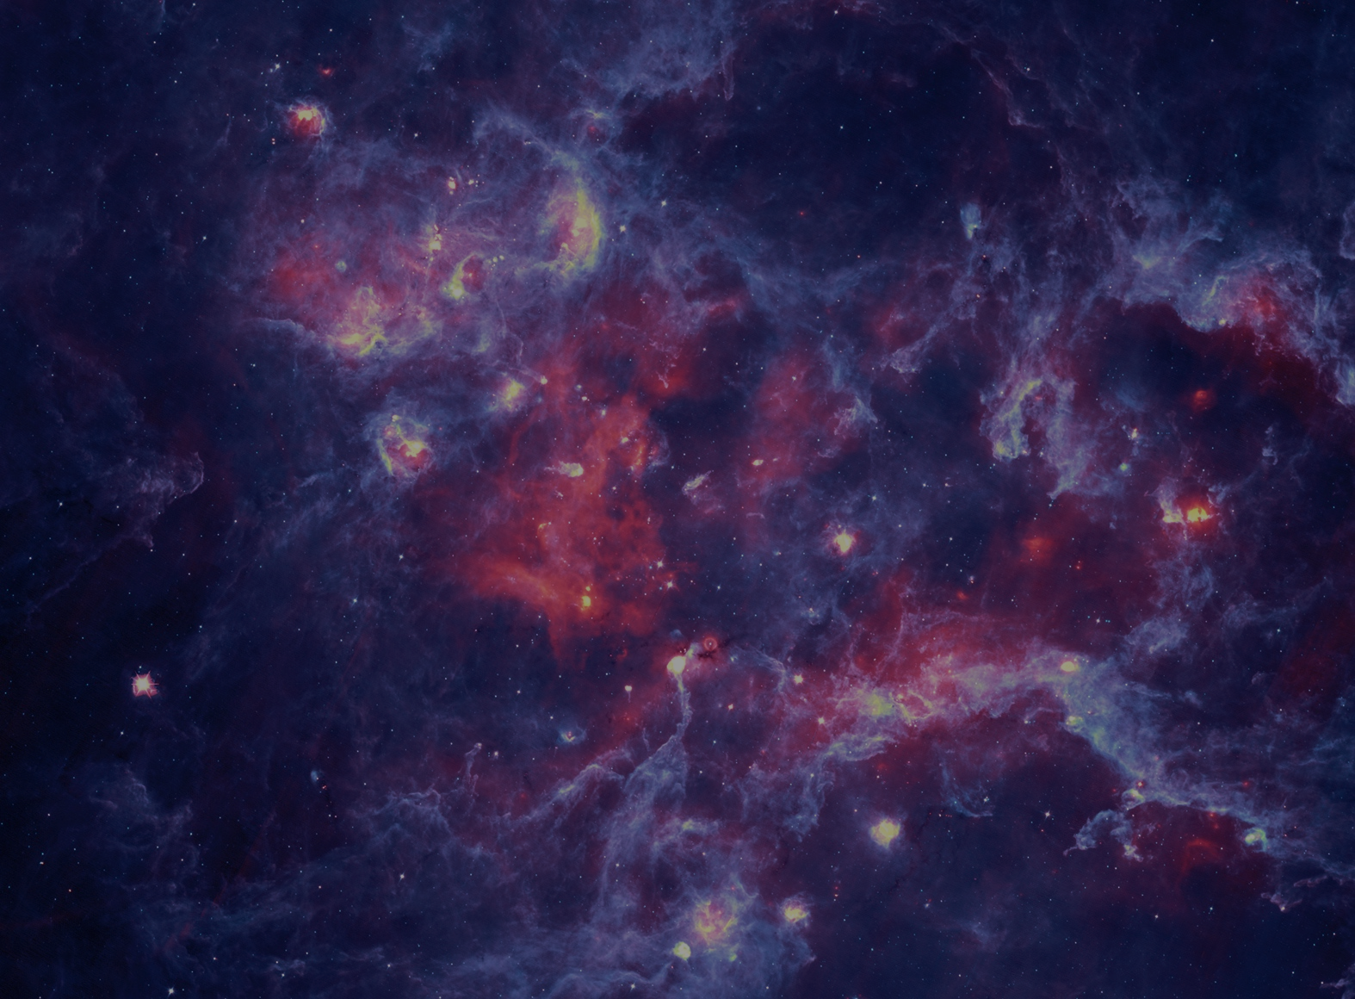
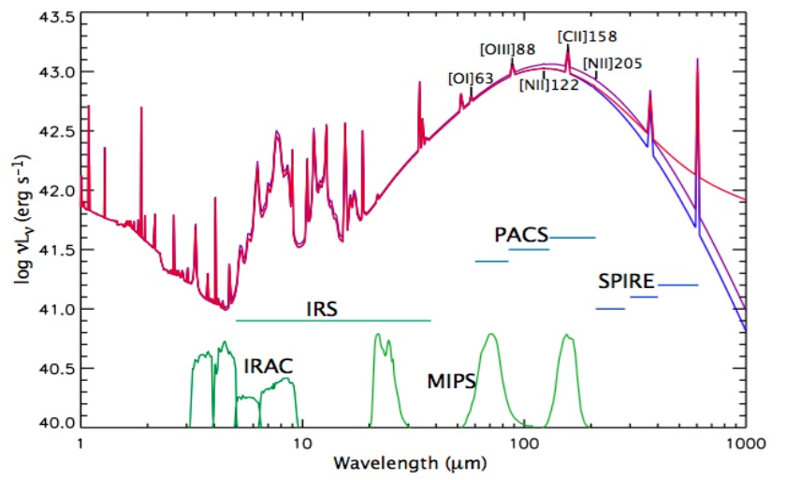
SPICA: space mission for mid-& far-IR astronomy
Telescope: 2.5 m & <8 K
-Natural background limited Infrared (IR) observations
→ Need ultra-sensitive IR detectors
34–210 μm
IR instruments
-SMI (12-37 µm)
-SAFARI (34-210 µm)
M-band
L-band
-Three-band
grating spectrometers
S-band
© Cambridge Univ.
with TES bolometer arrays
Toyoaki Suzuki: IR-detector workshop Dec.9, 2015
Notes:
SPICA is a space mission for mid and far infrared astronomy. It has a large and cold telescope. This enable us to make natural background limited observations by combination with ultra-sensitive infrared detectors. SAFARI is the far-infrared instrument onboard SPICA and has three-band grating spectrometers with TES bolometer arrays. The electrical NEP of SAFARI/TESs is required to be 2x10^-19 W/rtHz.
1.5Million km from the Earth, 1) to avoid emission from earth and sun as much as possible, 2) to cool telescope radiatively to deep space.

Slide 3
Noise Equivalent Power (NEP) required by SPICA/SAFARI
Minimum detectable input power to have S/N=1 with T_{int}=0.5 sec
Higher sensitivity = Lower NEP
ISO-Herschel era
~10⁻¹⁶ -10⁻¹⁷ W/√Hz
SPICA/SAFARI
2x10⁻¹⁹ W/√Hz
100-1000 times!!
Toyoaki Suzuki: IR-detector workshop Dec.9, 2015

Slide 4
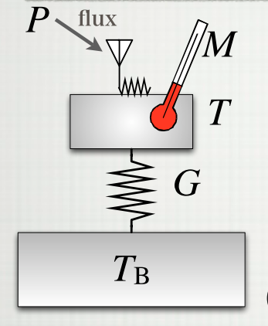
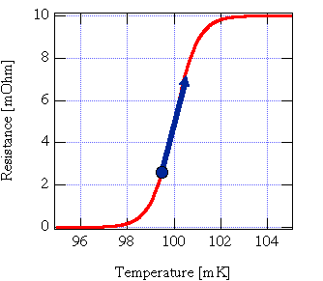
Transition Edge Sensors (TESs)
ΔP → ΔT → ΔR
TES
I
T_{c}
C
Superconducting
state
Normal
state
Resistance
Temperature
Toyoaki Suzuki: IR-detector workshop Dec.9, 2015
Notes:
A transition edge sensor is a thermometer being made of a superconducting film. The TES and a photon absorber are thermally isolated from a thermal bath. Incoming power heats the absorber. The TES measures the change in temperature by operating it in the transition between super conducting and normal states.
The TES intrinsic noise is the phonon noise due to thermal fluctuations in the thermal link. So, the NEP is proportional to square root of thermal conductance. To achieve ultra-low noise, it is essential to reduce thermal conductance.

Slide 5
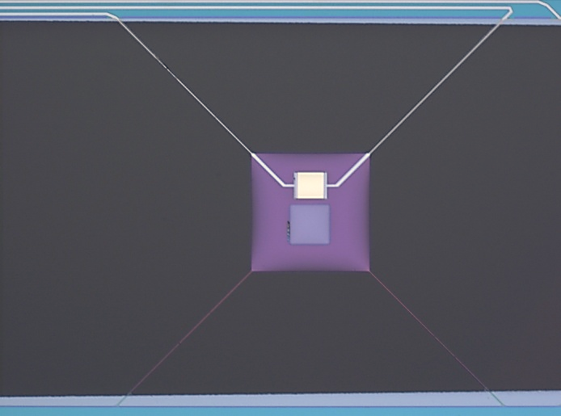
Typical TES pixel for SAFARI/S-band
TES (Ti/Au)
TES
I
Island (SiN)
C
Vaccum
Leg (SiN)
Absorber (Ta)
Thermal bath
Intrinsic noise = phonon noise
→Noise Equivalent Power (NEP_{ph})∝ √G
Toyoaki Suzuki: IR-detector workshop Dec.9, 2015
Notes:
A transition edge sensor is a thermometer being made of a superconducting film. The TES and a photon absorber are thermally isolated from a thermal bath. Incoming power heats the absorber. The TES measures the change in temperature by operating it in the transition between super conducting and normal states.
The TES intrinsic noise is the phonon noise due to thermal fluctuations in the thermal link. So, the NEP is proportional to square root of thermal conductance. To achieve ultra-low noise, it is essential to reduce thermal conductance.

Slide 6
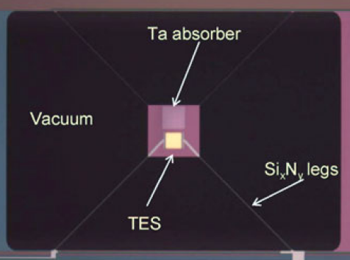
Long-standing questions (1)
SRON-TESs fabricated by KOH wet-etching
SiN legs
-Width (W ) = 1 µm
-Thickness (T ) = 0.5 µm
-Length (L ) = 400 µm
G_{meas} = 330 fW/K
NEP_{meas} = 4.2x10⁻¹⁹ W/√Hz (best)
Khosropanah, Hijmering+ 2012
→ Deep Reactive Ion Etching (DRIE)
Q1. Can we achieve lower G and thus NEP values
by making narrower and thinner SiN legs??
Toyoaki Suzuki: IR-detector workshop Dec.9, 2015
Notes:
So far, we fabricated TESs by a wet-etching route. This pixel recorded our best NEP under a required pixel pitch, although the measured NEP did not meet the SAFARI requirement. To meet the requirement, further reduction of thermal conductance is essential by making narrower and thinner SiN legs. However, the wet-etching route is technically difficult to realize such SiN legs. On the other hand, a Deep Reactive Ion Etching route can. Then, the question is ‘Can we achieve lower G and thus NEP values by making narrower and thinner SiN legs by DRIE?’
Tco = 100mK at w=1.5um

Slide 7
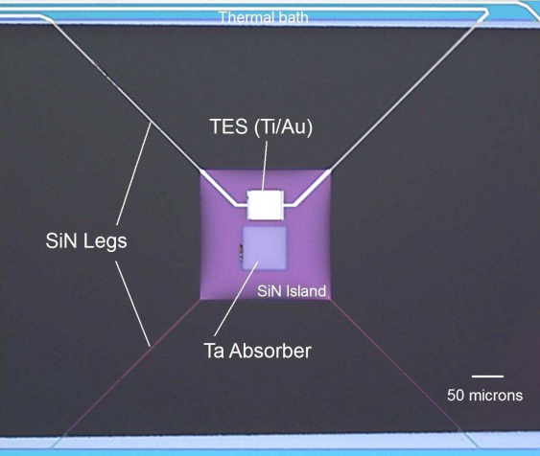
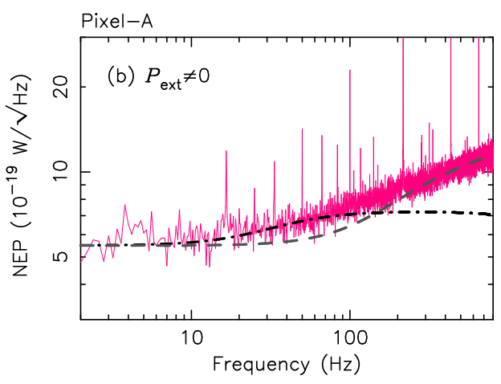
Long-standing questions (2)
Suzuki+2014
NEP_{meas}/NEP_{ph}~2-3 (typ.)
Multi-body models
with P_{ext}
Khosropanah, Hijmering+ 09,10,11,12
Excess noises
1) Extra-phonon noise (f >~10Hz)
C_{tes}~C_{island} & C_{legs}
NEP_{ph}
C_{TES}
TES
2) Photon noise
G₀
C_{island}
Island
G₁
Q2. Can we reduce the extra-phonon noise
by making lighter SiN island and SiN legs??
Thermal bath
Q3. How dark is our setup??
Toyoaki Suzuki: IR-detector workshop Dec.9, 2015
Notes:
As an another issue, our measured NEPs were typically the factor of 2 to 3 higher than the phonon NEP. Detailed studies on the excess noise indicate two major origins. The first one is the internal thermal fluctuation noise due to considerable heat capacities of SiN legs and a SiN island compared to the heat capacity of a TES. The second origin is the photon noise due to stray light. Here, there are two questions. Q2… and Q3… . To answer these three questions,,,

Slide 8
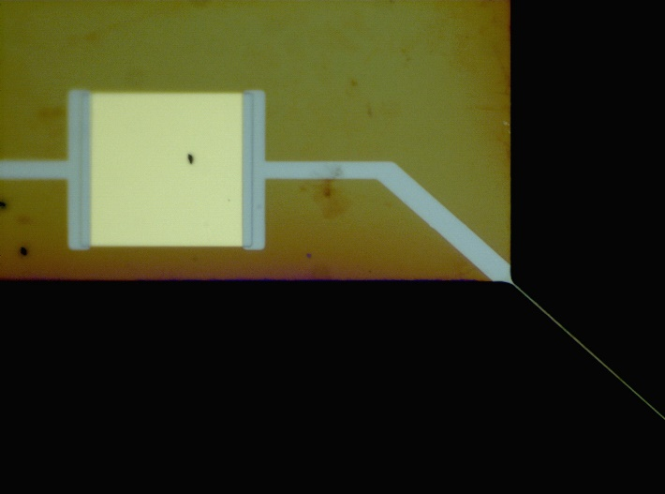
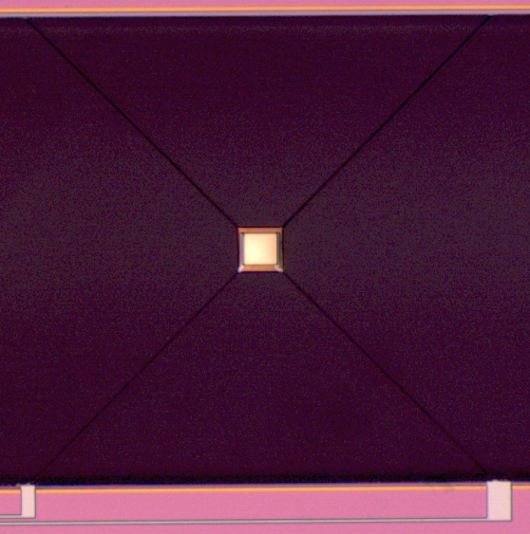
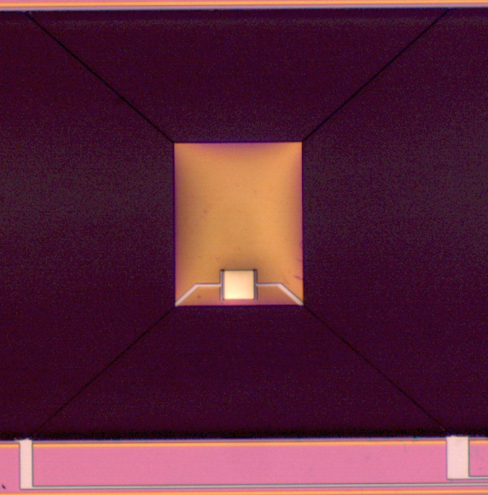
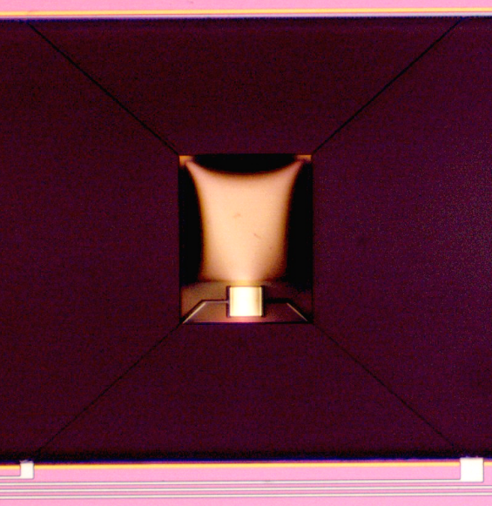
New TESs fabricated by DRIE
Deep Reactive Ion Etching (DRIE) process success
Narrow SiN legs ~0.5-0.7 µm
Thin SiN legs and island ~0.2 µm
TES(TiAu)
50 µm
Fabricated by Marcel Ridder (SRON)
Small island
without absorber
Large island
without absorber
Large island
with absorber
200 µm
200 µm
200 µm
Notes:
We fabricated three types of TESs with a dry-etching technique. One is a TES with a small island and without an absorber. Second one is the same but a larger island. Third one is a TES with a large island and with an absorber. These TESs have very narrow and thin SiN legs. The detailed fabrication process will be presented by Marcel in the poster session, today.
Ti/Au = 16/65nm

Slide 9
×
Do not blow a puff of air, please!!

Slide 10
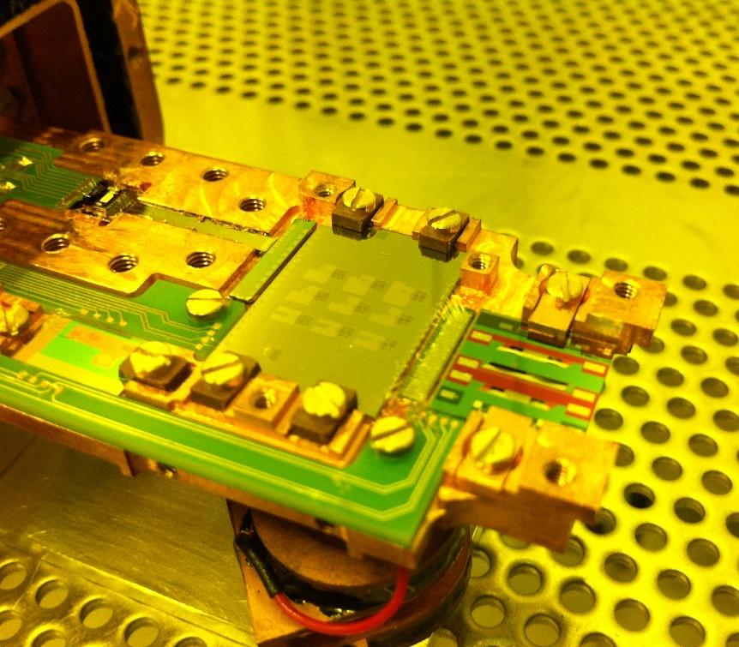
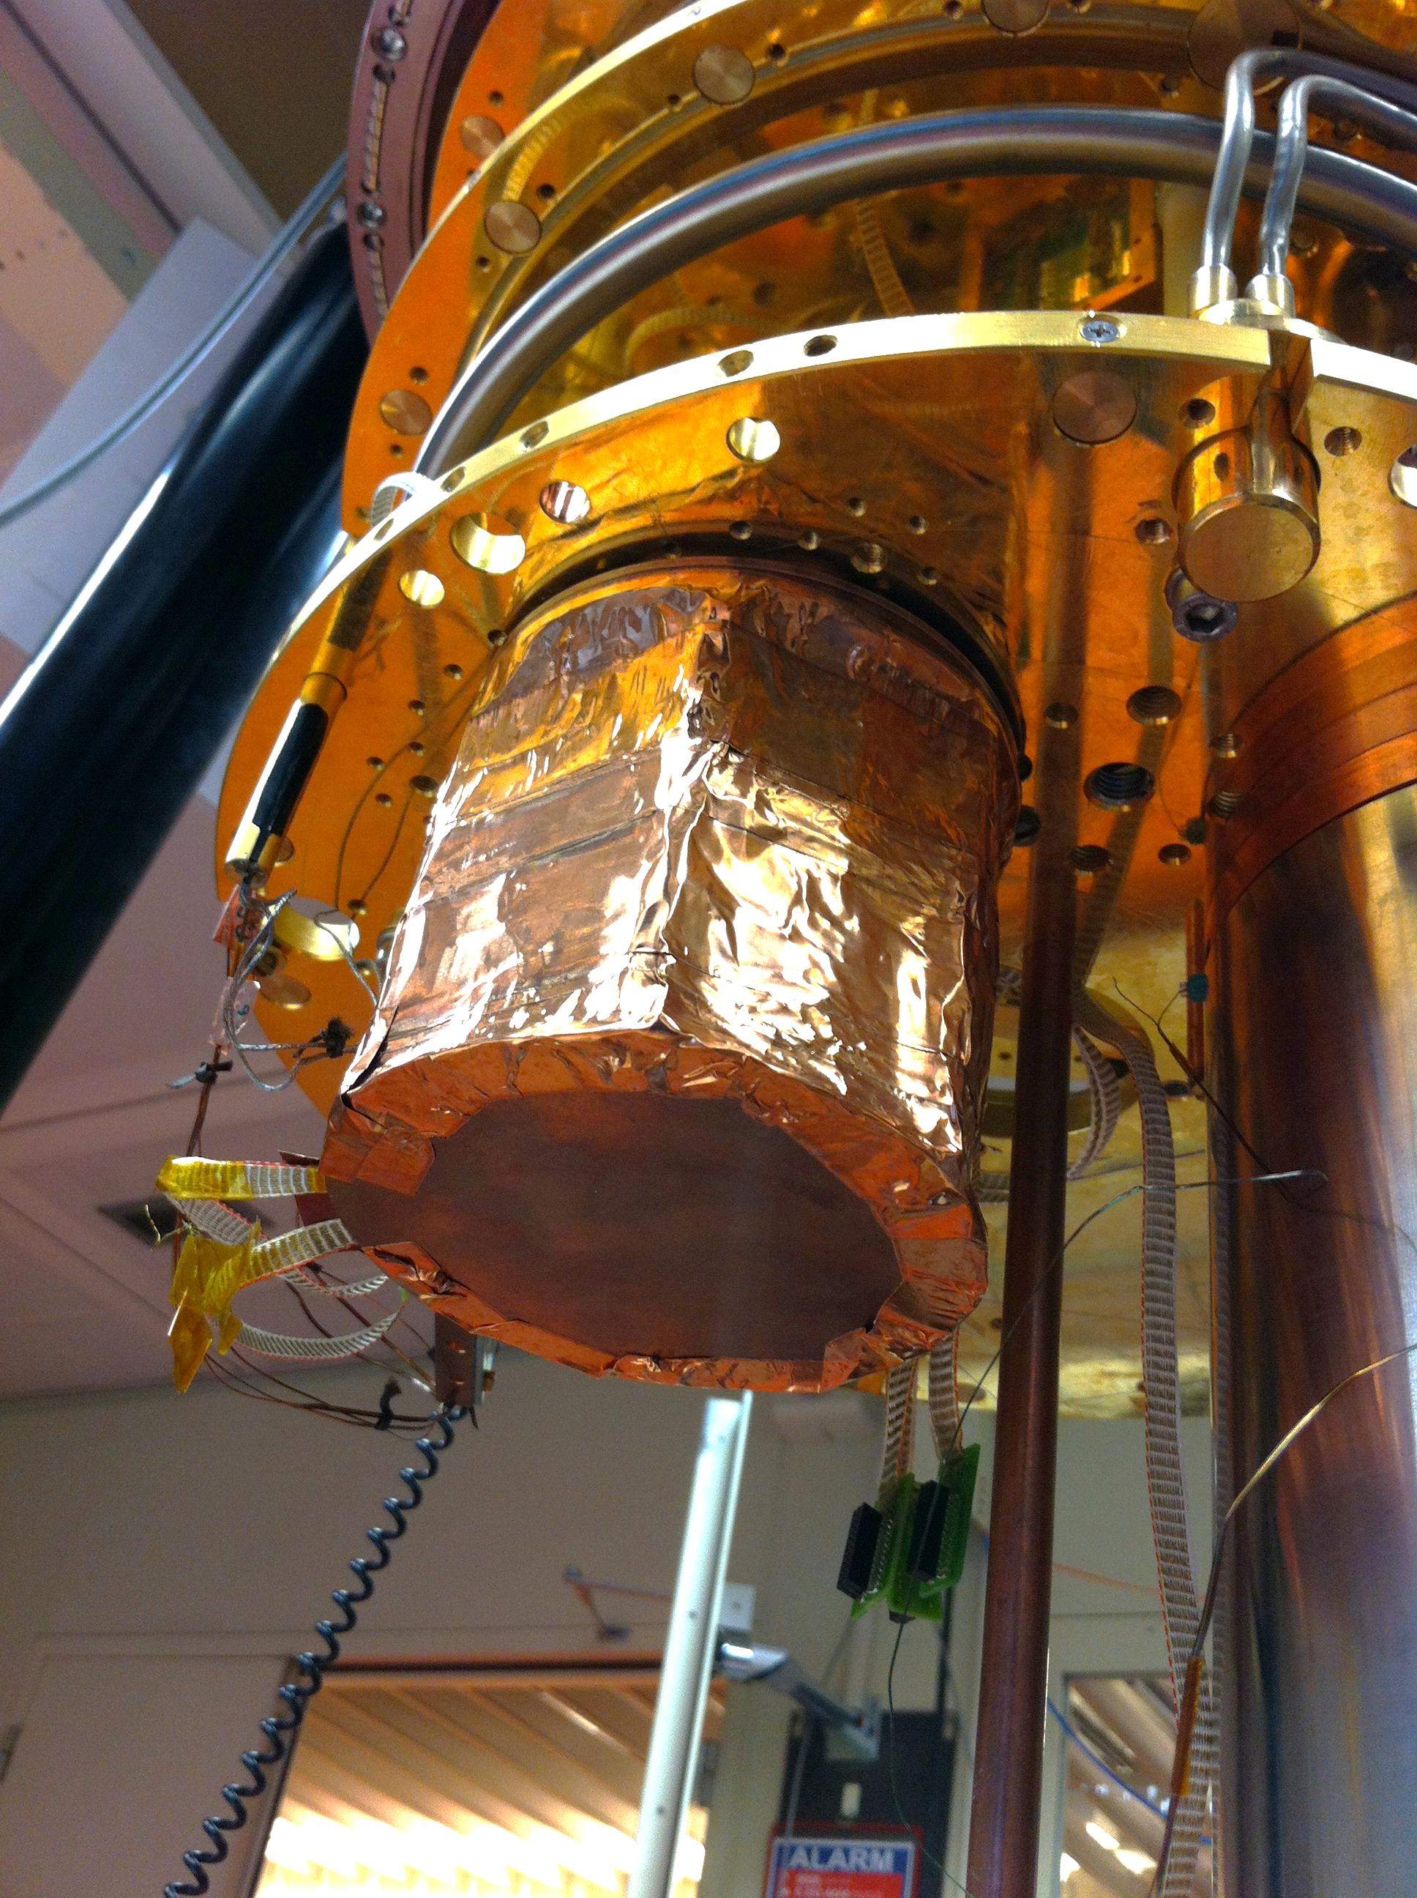
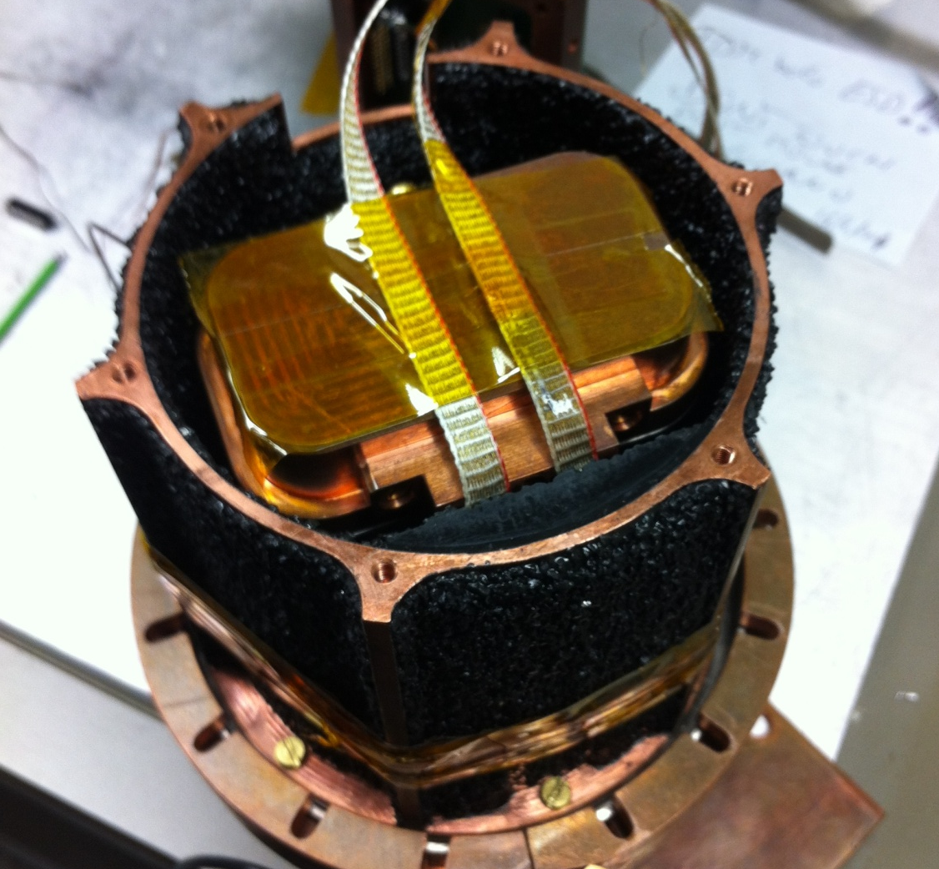
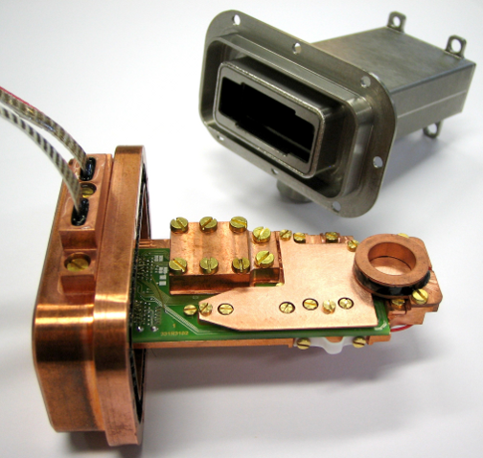
AC measurement setup
SQUIDs
LC resonators
TES array chip
FDM assembly
Stray-light absorber
FDM bracket+Nb tube
Toyoaki Suzuki: IR-detector workshop Dec.9, 2015
Notes:
This TES chip was mounted here together with an LC resonator chip and SQUIDs. Then, a Helmholtz coil was mounted to cancel a residual magnetic field (typ ~200-300 mG due to no cryo-perm shield). The bracket was closed by a Nb tube for magnetic shielding and was put inside a stray-light absorber. The unit was finally mounted onto a 30mK-cold plate.

Slide 11
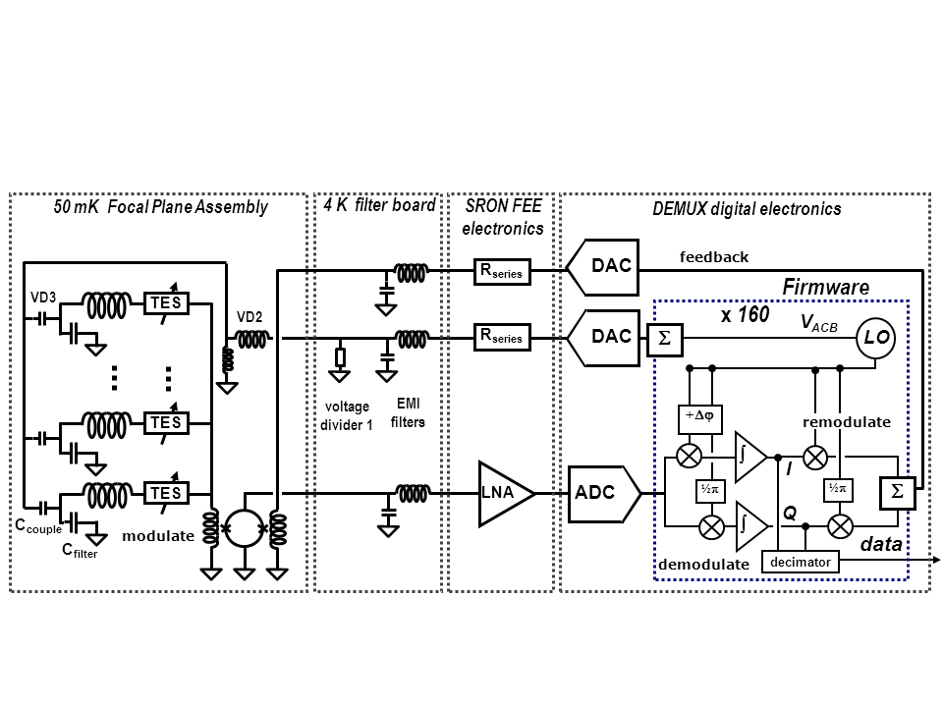
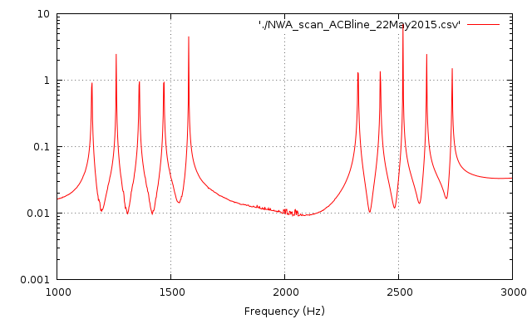
FDM readout
Cold part
Warm part
10pix-FDM system
1-3 MHz resonators
df=100 kHz
1 MHz
3 MHz
Toyoaki Suzuki: IR-detector workshop Dec.9, 2015
Notes:
The readout circuit for the TESs makes use of FDM as shown in this schematic figure. Detailed explanations on FDM will be explained by Richard in tomorrow. Here, I only mention that our resonator has resonance frequencies from 1 to 3 MHz with the 100 kHz separation.
AC bias signals are generated in high-speed digital electronics.
LC filters 1) to separate the AC bias comb over the individual single-bias-frequency pixels
2) to enable low impedance voltage bias of each TES at the certain frequency
3) to suppress the out-of-band Jhonson noise from the pixel in each readout chain
1-3 MHz lower-f side : capacitor size of the LC filter (compactness)
higher-f side: power consumption of the digital electronics (power budget)
& cable pole 3 MHz (signal bandwidth)

Slide 12
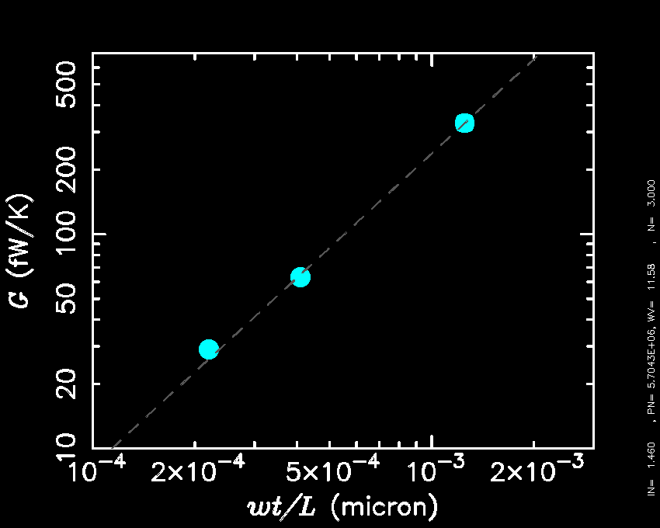
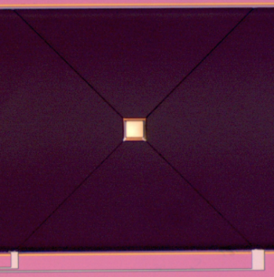
Measured thermal conductance
G (fw/K)
Khosropanah, Hijmering+ 2012
WT/L (µm)
Toyoaki Suzuki: IR-detector workshop Dec.9, 2015
Notes:
By using this measurement system, we characterized three types of TESs. This plot shows measured thermal conductance against the geometry of the SiN legs for the three TESs as indicated by the yellow symbol. Clearly, thermal conductance of new TESs is reduced by making thinner and narrower SiN legs.

Slide 13
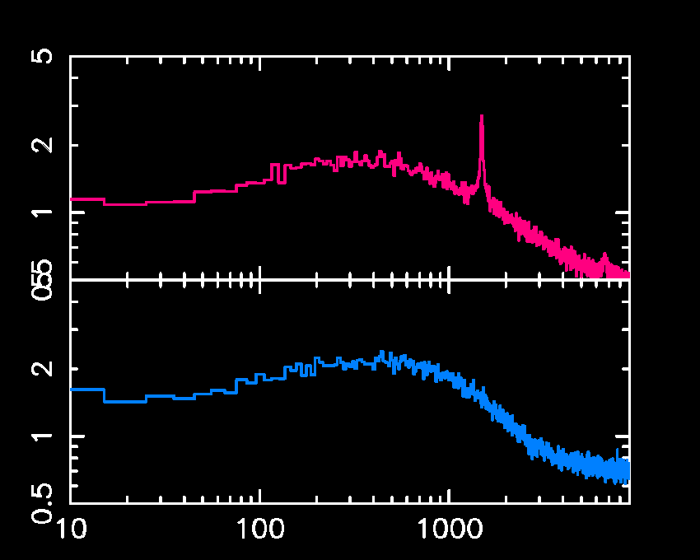
Measured NEPs
Tc=94 mK,
P =1 fW @50mK
G=30 fW/K
1.1x10⁻¹⁹ W/√Hz
SAFARI req.
Small island
Tc=93 mK,
P = 2.0 fW @50mK
G=60 fW/K
NEP_{dark} (x10⁻¹⁹ W/√Hz)
1.5x10⁻¹⁹ W/√Hz
SAFARI req.
Large island
Meet the SAFARI requirement
Frequency (Hz)
Toyoaki Suzuki: IR-detector workshop Dec.9, 2015
Notes:
Thanks to this achievement, we measured ultra-low NEPs. The upper and lower panels show measured NEP spectra for TESs without an absorber but the different island size. Their NEPs show below 2x10-19 W/rt(Hz) with the response speed of sub-msec. The results meets the SAFARI requirement!!

Slide 14
Measured NEPs
Tc=94 mK,
P =1 fW @50mK
G=30 fW/K
1.1x10⁻¹⁹ W/√Hz
Small island
NEP_{ph}
Tc=93 mK,
P = 2.0 fW @50mK
G=60 fW/K
NEP_{dark} (x10⁻¹⁹ W/√Hz)
1.5x10⁻¹⁹ W/√Hz
Large island
NEP_{ph}
Achieved phonon noise level (f<~100Hz)
Frequency (Hz)
Toyoaki Suzuki: IR-detector workshop Dec.9, 2015
Notes:
Furthermore, the measured NEPs achieve the phonon noise NEP at frequencies below 100 Hz.

Slide 15
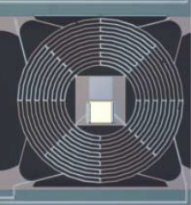
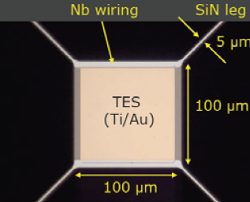
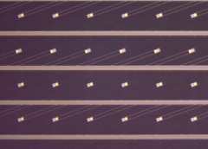
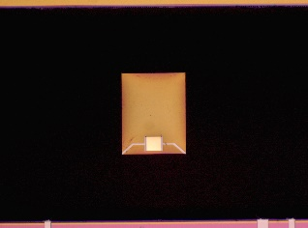
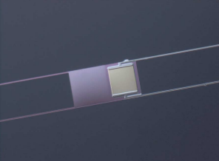
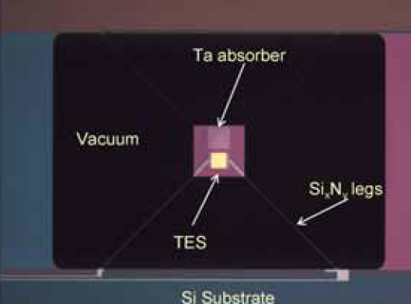
NEP-evolution track of SRON TESs
Dark NEP(x10⁻¹⁹ W/√Hz)
This work!!
Toyoaki Suzuki: IR-detector workshop Dec.9, 2015

Slide 16
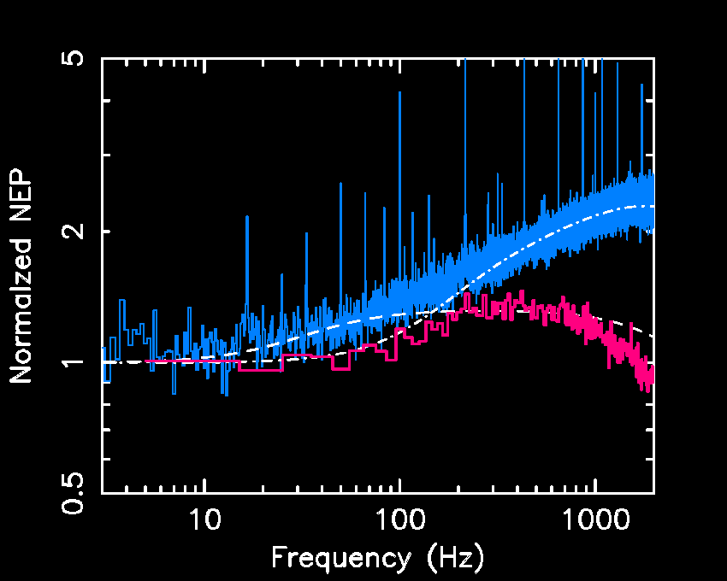
Excess noise
Legs: x3 mass
Island: x14 mass
Normalized NEP
Reduced excess noise
Frequency (Hz)
Toyoaki Suzuki: IR-detector workshop Dec.9, 2015
Notes:
Also, for the comparison with the TES with heavier legs and island, the TES with lighter SiN legs and membrane has lower excess noise as expected. The DRIE process gives advantages not only to realize ultra-low NEPs but also to reduce the excess noise.

Slide 17
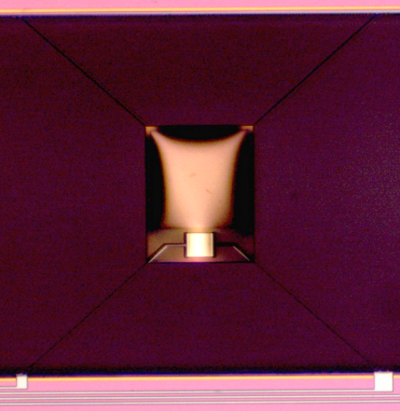
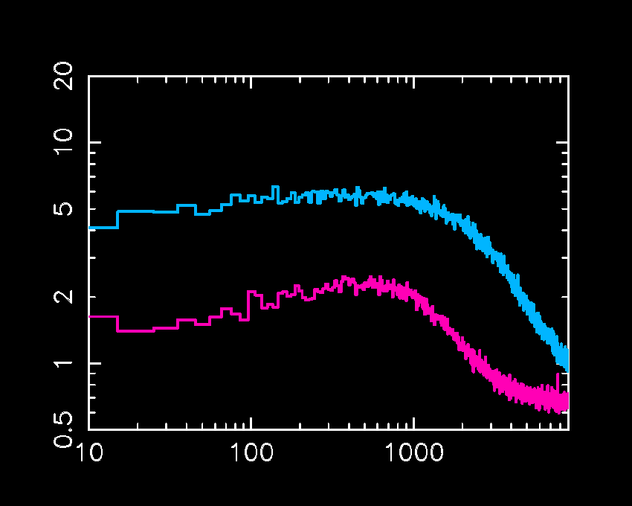
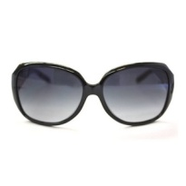
Darkness of current setup
Tc=87 mK,
G=58 fW/K
Psat=1.9fW@50mK
Similar TES properties,
but with and without absorbers
With absorber
NEP_{photon}~5x10⁻¹⁹ W/√Hz
Tc=93 mK,
G=63 fW/K
Psat=2.0fW@50mK
NEP_{dark} (x10⁻¹⁹ W/√Hz)
No absorber
Need a stray-light free setup
Frequency (Hz)
Toyoaki Suzuki: IR-detector workshop Dec.9, 2015
Notes:
Finally, we measured the photon noise to evaluate darkness of our setup. This figure shows NEP spectra of TESs with similar properties but with and without an absorber. Now we know that the TES without an absorber achieves the phonon noise at low frequencies. The measured NEP at low frequencies is not affected by the photon noise. On the other hand, the TES with an absorber can see photons. So the difference between the two lines gives the photon noise of 5x10-19 W/rt(Hz), which is much higher than the TES intrinsic noise level. So, we need to improve our setup to be a stray-light free.

Slide 18
Summary
Ultra-low G TESs were fabricated by DRIE
Without an absorber
We measured an electrical NEP as low as 1.1x10⁻¹⁹ W/√Hz,
which achieved the phonon noise limit, and also a reasonable response speed (<1 msec).
With an absorber
We confirmed a higher NEP (~5x10⁻¹⁹) due to stray light.
Toyoaki Suzuki: IR-detector workshop Dec.9, 2015

