Slide 1

Antarctic Infra-Red Telescope with a 40cm primary mirror (AIRT40), Development and Improvement
Hirofumi Okitaª, Takashi Ichikawaª, Tomohiro Yoshikawa^{b}, Ramsey Guy Lundockª
and Kentaro Kuritaª
ªAstronomical Institute, Tohoku University, Aramaki Aoba Sendai 980-8578, Japan
^{b}Koyama Astronomical Observatory, Kyoto Sangyo University, Motoyama, Kamigamo,
Kita-ku, Kyoto 603-8555, Japan

Slide 2
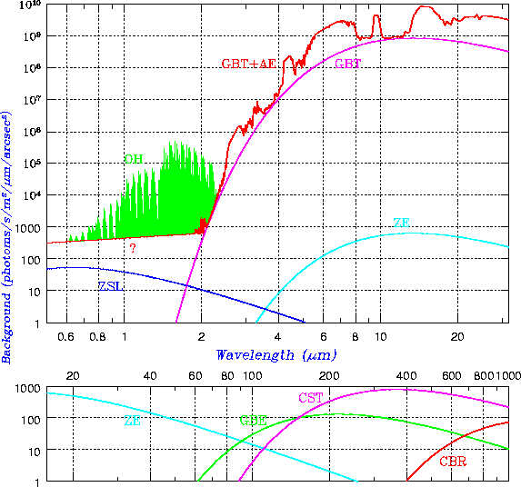
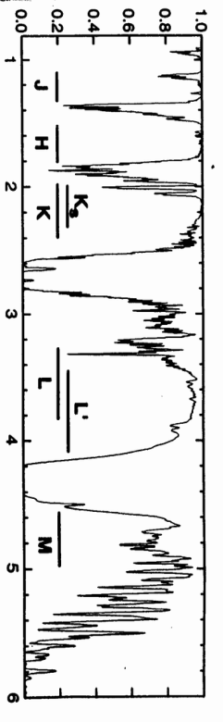
Introduction
airglow emission
thermal emissions
Infra-red observation is important for researching distant galaxies, extrasolar planets, and star forming regions. However, it is difficult to observe infra-red rays from the ground.
  airglow emission
  thermal emissions from the atmosphere and from a telescope
  strong absorption lines of water vapor exist
Visible
Infra-red
Cox 1999
There are minimum sky background and water absorption at the coldest and the driest (highest) site on the Earth.
Sky background emission
transparency
Antarctic plateau
wave length
Cox 1999
Water absorption
South Pole
Dome C
Dome A
To enjoy these advantages, Japanese groups are also planning to construct 2m-class infra-red telescopes at Dome Fuji.
Now starting Site testing,
Astronomical observation

Slide 3
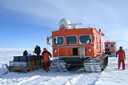
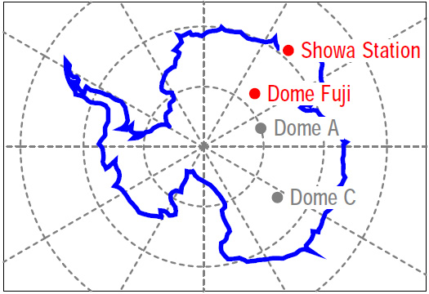
Dome Fuji
Dome Fuji is one of the peaks of the Antarctic plateau and located at 77º19’ 01’’S 39º42’12’’ E, which is 1,000km inland from Showa Station.
The altitude is 3,810m and it is the second highest next to Dome A (4,093m).
The annual average temperature at the station is -54.4ºC, and the lowest temperature ever recorded was -79.7ºC
Snowmobile SM100,
We need 3-weeks to go to Dome Fuji
Copyright NIPR
Astronomical Site-Testing History
2006-2007 SODAR + Radiomater
2009-2010 Radiomater + Infra-red spectrograph
2010-2011 AIRT40
In the coming decade, the National Institute of Polar Research of Japan (NIPR) plans to construct a permanent station at Dome Fuji for ice-core research and for “astronomy.”
the location of Dome Fuji

Slide 4
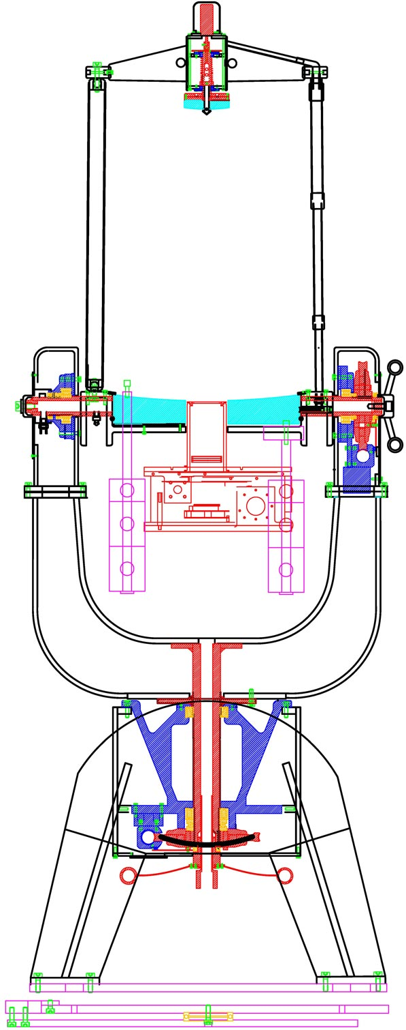
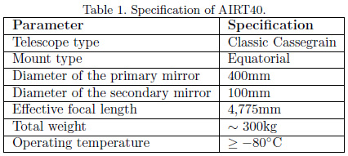
AIRT40
The Antarctic Infra-Red Telescope with a 40cm primary mirror (AIRT40) will be the first optical/infra-red telescope to be set up in Dome Fuji.
Some problems were found from the test observations in Sendai, Japan. We solved these problems with improvements to the original units and by developing additional parts.
Infra-Red Telescope
  →truss
  →small secondary mirror
  →no buffle
Using Solvay Solexis FOMBLIN ZLHT grease
The same material for Bush and Shaft
  →Work even in -80ºC
Light weight (<300kg)
Handles
  →for easy transportation
Polar Alignment Stage
Balance Adjuster
  →for easy operation
for minimum thermal emission

Slide 5
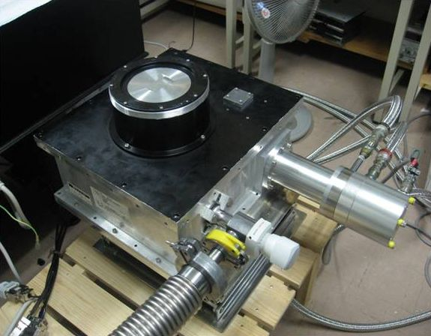
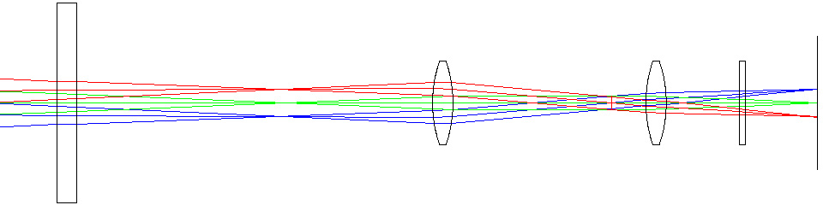
AIRT40
TONIC2 (The TOhoku university Near Infra-red Camera II) is a near infra-red camera for AIRT40 using Reytheon VIRGO-2k astronomical array.
Two optical modes can be selected for TONIC2;
Mode A: narrow field of view (φ5’) camera with cold Lyot stop
Mode-B: φ30 arcminute wide field of view direct camera
pixel scale = 0.8’’
diffraction limit = 1.4’’ @2.3μm
TONIC2
We have planned observations that use Mode-A TONIC2 with J, H, K-band, and a few narrow band filters during the austral summer of 2010-2011.
cold Lyot stop
window
filter
collimator
camera
Optical layout of Mode-A TONIC2
simple optical system brings more higher efficiency
Copyright Raytheon
VIRGO-2k detector

Slide 6
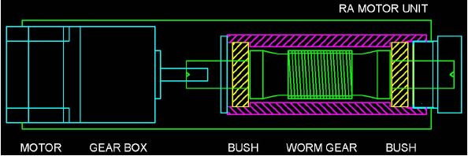
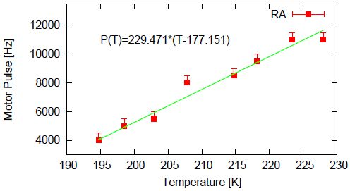
Cold Test
AIRT40 was too big to put it in the freezer as a whole, we disassembled it and tested four of the vital components individually: the RA motor unit, dec motor unit, focus unit, and RA shaft unit. If the units work individually even at -80ºC, AIRT40 should work as a whole in low temperature.
RA & Dec Motor Unit
5-phase stepping motors
Solvay Solexis FOMBLIN ZLHT grease
The worm gear which is made of steel is supported with two bushes, which are made of gunmetal (90% Cu and 10% Sn).
Because the space between the worm gear shaft and the bushes decreases and the grease becomes thicker in low temperatures, the motor cannot rotate at high speed.
We treated the grease as a Newtonian fluid,
The major cause of motor rotation failure is the decrease of the space between the shaft and the bushes.

Slide 7
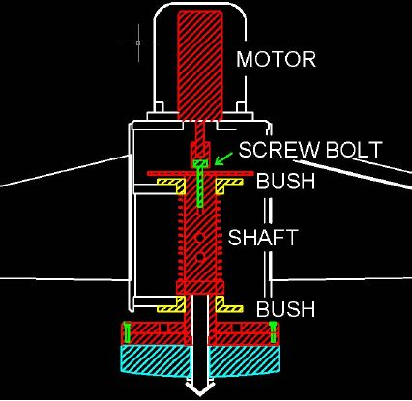
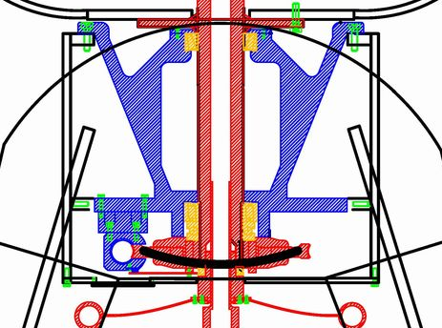
Cold Test
Focus Unit
5-phase stepping motors
Solvay Solexis FOMBLIN ZLHT grease
The secondary mirror was fixed to the shaft and supported by two bushes. This shaft and bushes are made from the same steel.
We tested the Focus Unit in the freezer and verified that it could move even at -80ºC. The space between the shaft and the bushes hardly changes if these are made of the same material.
Worm Drive Unit
The worm drive units are made of various materials
RA/dec worms ← brass
shaft and bearings ← steel
bearing holders ← aluminum
The backlash (the space between the worm screw and
the worm wheel) changes depending on the temperature.
backlash

Slide 8
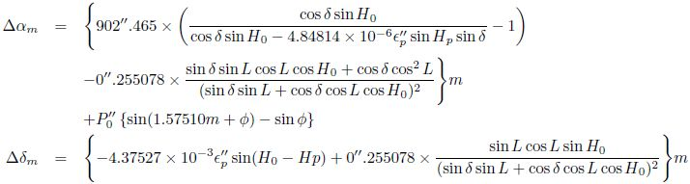
Tracking Error Analysis
Due to the set up error, the atmospheric refraction and a periodic error, it is not possible to track by driving only the RA axis.
We track an object whose position is (H, δ) for m minutes, this object moves (Δα_{m}, Δδ_{m}) in the telescope FOV.
RA
set up error
atmospheric refraction
periodic error
Dec
set up error
atmospheric refraction
H₀ hour angle of the set up error
ε_{p} separation angle of the set up error
L latitude of the observatory
P₀ periodic motion amplitude
φ periodic motion phase

Slide 9
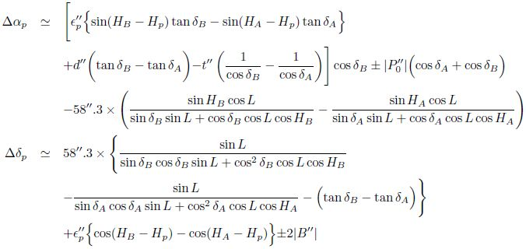
Pointing Error Analysis
AIRT40 has three axes (RA, dec, and opt axis). These three axes should be orthogonal, although telescope as built is not quite orthogonal.
AIRT40 is aligned using the object A (H_{A}, δ_{A}) and then points to the object B (H_{B}, δ_{B}), the pointing errors of the RA and dec axis (Δα_{p}, Δδ_{p})are given below,
orthogonal error
RA
set up error
periodic error
Dec
atmospheric refraction
atmospheric refraction
set up error
backlash

Slide 10
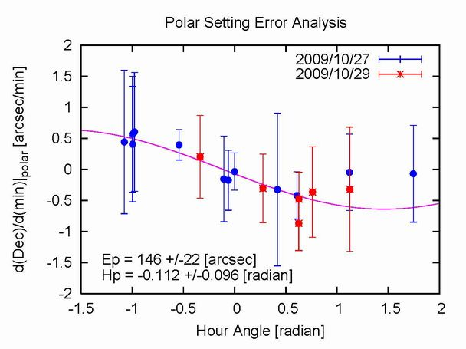
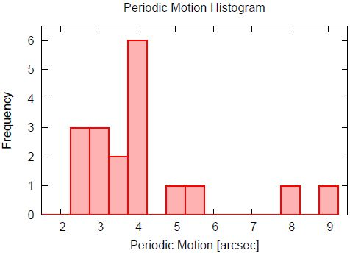
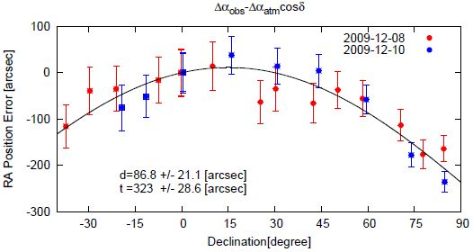
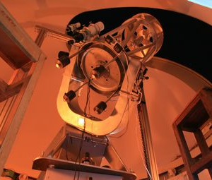
Test Observation
We had test observations at Sendai, Japan.
set up error
periodic error
orthogonal error
Polar Alignment Stage
Periodic motion 4.3 +/- 1.8 [arcsecond]
RA – Dec axes 87 +/- 21 [arcsecond]
Dec – Opt axes 320 +/- 29 [arcsecond]
This accuracy is not generally good, although it is enough for the 2010-2011 summer campaign at Dome Fuji.
Short exposure time
Manually pointing
Observed at Tohoku Univ.

Slide 11
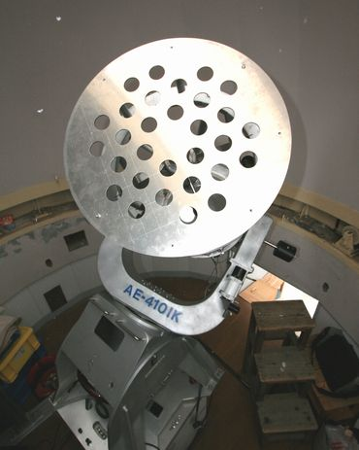
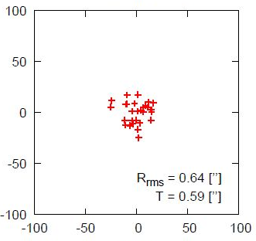
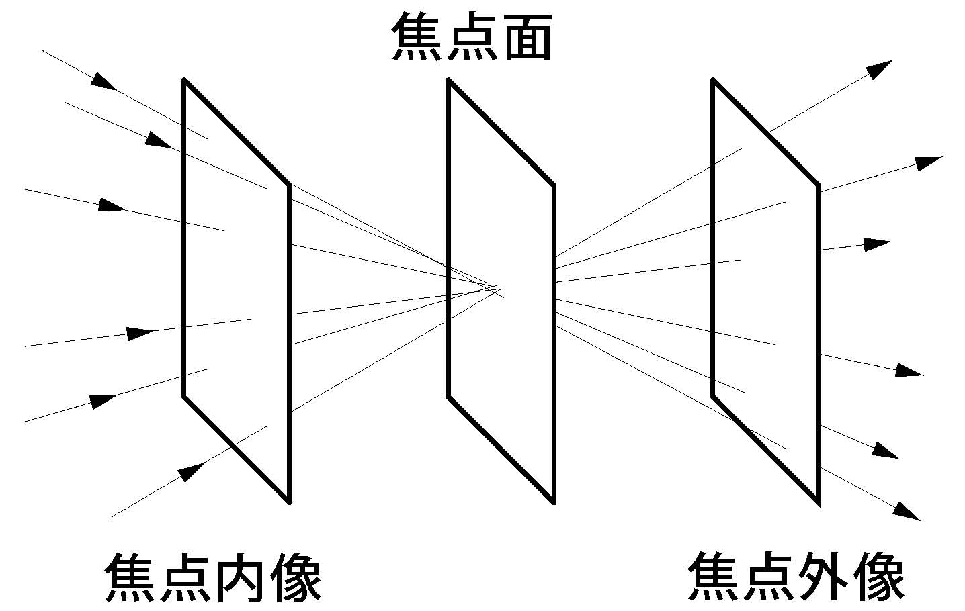


Optical Analysis
We carried out the Hartmann test to check the potential of AIRT40’s optics and the accuracy of the optical alignment.
If the optical system of AIRT40 is perfect, starlight passes these small holes and converges at the focal plane. Although the aberrations, tolerances and/or miss alignments cause the light to diverge.
Focal plane
Hartmann plate on AIRT40
forwards
backwards
Hartmann constant 0.59 [arcsecond]
We take forwards and backwards images
diffraction limit = 1.4’’ @2.3μm
AIRT40 has enough accuracy for infra-red observation.

Slide 12
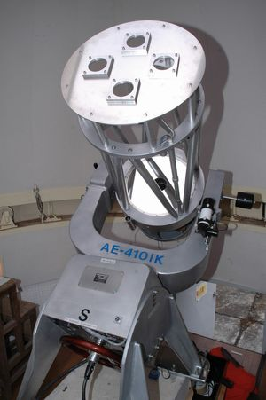
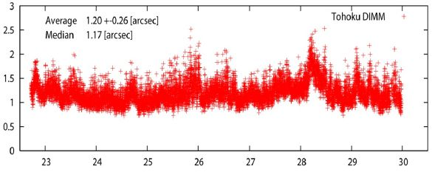
Observation plan
We will perform site-testing and astronomical observation at Dome Fuji during the austral summer of 2010-2011. This is the first observation to use an optical/infra-red telescope at Dome Fuji.
Only 2 weeks observation
Day-time observation (No sunset)
Seeing measurement
Seeing is a parameter that describes how blurry a star image will be.
The DIMM (Differential Image Motion Monitor) which is now broadly used for site testing over the world is a technique to measure seeing using a small telescope.
We plan to measure the seeing using Canopus.
( -0.72mag, δ-52º)
arcsecond
Tohoku DIMM on AIRT40
Local time
Test observation at Sendai, Japan

Slide 13
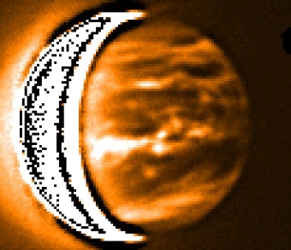
Observation plan
Daytime Infra-red Sky Background
The Sky background is one of the important parameters to decide the limiting magnitude. We expect that the strength of the scattering is much lower because there is no air pollution in the Antarctic plateau.
Continuous Observation of Venus
We plan to perform the continuous observations of Venus. It is possible to observe Venus continuously because like the sun, Venus doesn’t set during summer in Antarctica.
Copyright Jeremy Bailey
Venus @2.3μm
We plan to observe Venus continuously for a week at infra-red wavelengths and examine the cloud structure by following the movement of the cloud of Venus.

Slide 14
Conclusion
Dome Fuji, on the Antarctic plateau, is expected the best site for infra-red astronomy on Earth. To enjoy these advantages, we are planning to construct 2m-class infra-red telescopes at Dome Fuji. For this purpose we developed the Antarctic Infra-Red Telescope with a 40cm primary mirror (AIRT40), which will be the first optical/infra-red telescope setting up at Dome Fuji.
Work well even at -80ºC
Easy operation
Pointing, Tracking, and optical accuracy
AIRT40 is suited to observe at Dome Fuji.
We plan to observe the seeing, infra-red sky background, and Venus using AIRT40 during the 2010-2011 austral summer campaign.

Slide 15
Thank you.
Acknowledgements
This work has been supported by a Grant-in-Aid for Scientific Research (21244012) of the Ministry of Education, Culture, Sports, Science, and Technology in Japan, and be supported by a grant from the Hayakawa Satio Fund awarded by the Astronomical Society of Japan.

