Slide 1
Dome Fuji Seeing – the Summer Results and the Future Winter-over Observations
1/10
Hirofumi Okita, Naruhisa Takato, Takashi Ichikawa, Colin Bonner, Michel Ashley, John Storey, 51st and 52nd JARE Dome Fuji team
IAU Symposium 288 “Astrophysics from Antarctica”
Beijing, China, August 20-24, 2012
IAU General Assembly XXVIII

Slide 2
Seeing of the Antarctic Plateau
2/10
The seeing is a parameter that describes how blurry a star image will be. It is caused by the atmospheric turbulence. A good seeing brings the high spatial resolution and get deeper detection limit, therefore it is important to curried out an astronomical observation at a good seeing site.
The Antarctic plateau is expected to be the best seeing site on Earth. At the peaks of the Antarctic plateau, we can reach an excellent seeing only tens meters above the surface boundary layer, which has the strongest turbulent in the atmosphere.
Site name | elevation | Free atmosphere seeing | Height of the surface boundary Layer
South Pole | 2,835m | 0.37” | 270m
Dome A | 4,093m | ? | 13.9m
Dome C | 3,250m | 0.36” | 30m
Dome Fuji | 3,810m | ? | ?
Table.1 Seeing values and the height of the surface boundary layer at the Antarctic plateau.
The Differential Image Motion Monitor (DIMM) is now broadly used for seeing measurement. We use the DIMM for seeing measurement at Dome Fuji.

Slide 3
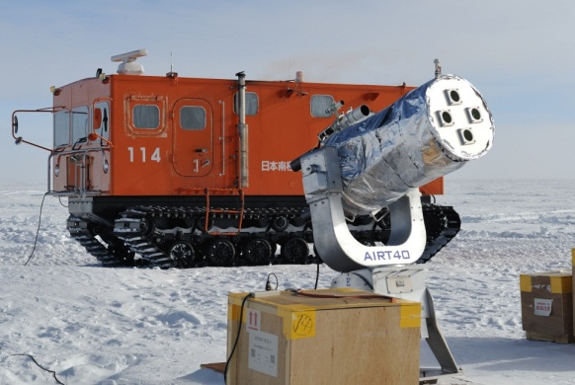
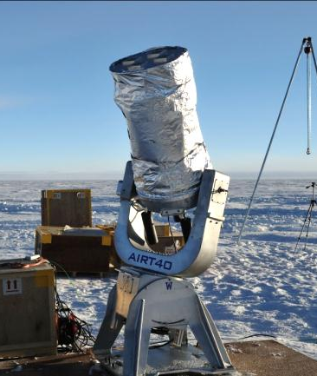
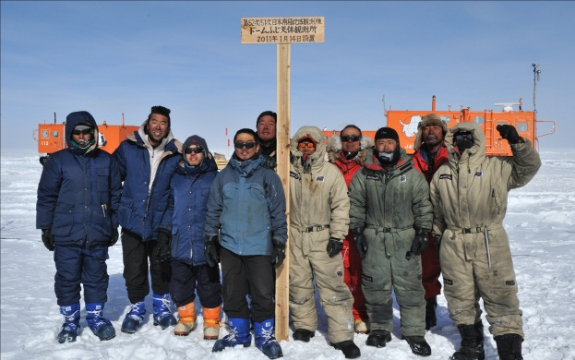
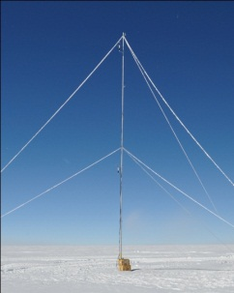
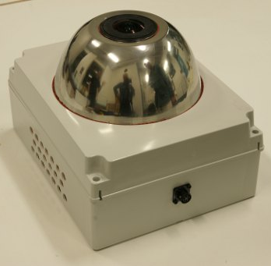
JARE52 and Tohoku-DIMM
3/10
We planed to measure the seeing at Dome Fuji. We developed the Tohoku-DIMM put on the Antarctic Infra-red Telescope with a 40cm primary mirror (AIRT40). We participated the 52nd Japanese Antarctic Research Expedition (JARE52) and operated the seeing measurements at Dome Fuji during 2010-2011 austral summer.
We also set up the 16m weather mast, SNODAR, HR-CAM, Twin-CAM, and PLATO-F for winter-over operation in this campaign.
about 2m
Fig.1 and 2 Tohoku-DIMM put on the AIRT40. The entrance pupils were about 2m above snow surface.
Fig.3 JARE51st and JARE52nd Dome Fuji team members
Fig.4 the 16m weather mast, SNODAR, HR-CAM, Twin-CAM, and PLATO-F. We set up them at Dome Fuji in this campaign.
(c) Naruhisa TAKATO
(c) UNSW

Slide 4
Results (1)
4/10
We carried out the seeing observation from January 25 to January 28, 2011.
The mean was 1.2” and the median was 1.1”, and the 25th and 75th percentiles were 0.83”, and 1.5” in our results. We note that our observation were carried out at the surface level. Thus these seeing values would be influenced by the surface boundary layer.
Table.2 statistics of our seeing measurements
Fig.5 DIMM seeing with the wavelength =0.55μm. All measurements were curried out during daytime (the Sun didn’t set). We chose the exposure times as 1/1,000 second, and the height of the entrance pupils of our DIMM were about 2m above snow surface.

Slide 5
Results (2)
5/10
We calculated the time dependence of the seeing. We found that the seeing values change continuously and have a minimum around 0.7” at about 6 p.m.
We compared the seeing with some weather parameters obtained by the 16m mast. We also found that the seeing has good correlations with the temperatures and with the wind shear. These results support that the seeing will be degraded by the turbulence near the surface boundary layer.
0.5
Wind shear (m/s)
Fig.6 (i) the seeing values versus Dome Fuji local time. (iii) temperatures with some offsets. (blue is at 0.3m with -6◦C offset, magenta is at 6.5m & -3◦C, cyan is at 9,5m without offset, yellow is at 12m & +3◦C, and black is at 15.8m & +6◦C. (iv) wind speeds at the height of 6.1m (red) and 14.4m (green).
Fig.7 (left) The scattergram between the seeing and the temperatures. (right) The scattergram between the seeing and the wind shear.

Slide 6
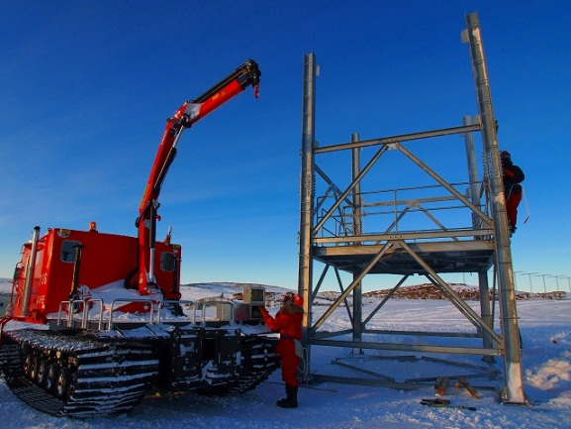
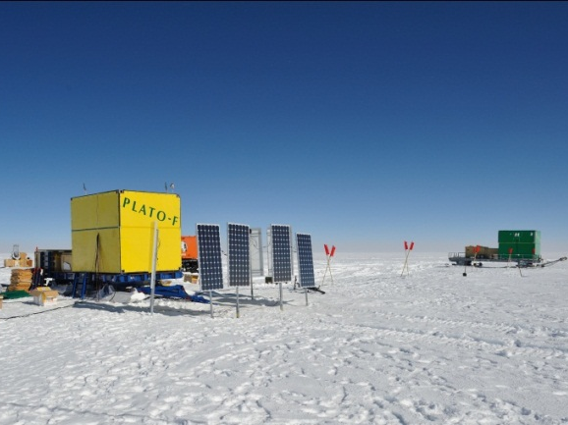
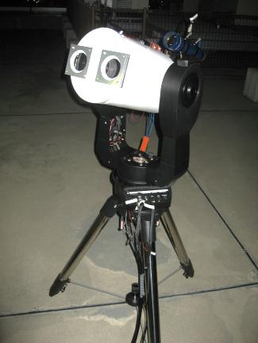
Future seeing measurements
6/10
We want to know the seeing above surface boundary layer in winter time. We plan to observe the seeing on the 8m telescope stage, which we are going to construct this year. In winter there are no crews in Dome Fuji station, we have to operate any instruments automatically. PLATO-F is the only one answer for this unmanned operation. PLATO-F supplies max.2KW electric powers and the Iridium internet communications.
We make a new DIMM for unmanned winter-over operation. We call this new telescope “Dome Fuji DIMM (DF-DIMM)”.
8m
Fig.8 8m telescope stage and a snow vehicle. This picture shows a test construction at Syowa station. Photo by Hideaki HORIKAWA.
Fig.9 PLATO-F at Dome Fuji Statio in 2010. PLATO-F supplies max. 2kW electric powers and the Iridium internet communication.
Fig.10 Dome Fuji DIMM (DF-DIMM) for unmanned winter-over operation at Dome Fuji.

Slide 7
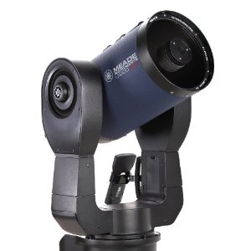
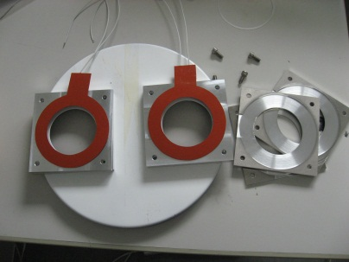
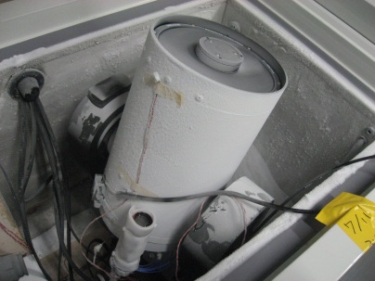
DF-DIMM Hardware
7/10
We use Meade LX200AFC-8” telescope and SBIG ST-i CCD camera for DF-DIMM. These commercial models are relatively low prices and have high reliability. We have to modified them for in the low temperature operation. We replaced grease, bearings, and cables, and we added heaters inside them. After the modification we checked them in a -80ºC freezer.
Fig.11 Meade
LX200ACF-8”
Fig.12 SBIG ST-i
・2W heaters protect the frosting of the optical windows.
・Motors and the electric circuits are heated for -80ºC operation.
・LX200 and ST-i were tested in -80ºC environment in a freezer.
The Telescope, the CCDs, and the control PCs need 30W. It needs additional 30W for heaters in -80ºC operation.
Fig.13 (top) optical windows with 2W heaters, (middle) motor and circuit with heaters and polyurethane form, (bottom) LX200 in a freezer

Slide 8
DF-DIMM Software
8/10
Two Linux (Ubuntu 11.04) PCs control LX200 and ST-i(s). We made control software using C language, awk and bash script. The pointing, focusing, and seeing measurements are curried out automatically by this software.
Pointing Automatically
We use Canopus for seeing measurements. This seeing measurement will be repeated. The ST-i CCD camera takes 30 frames for each measurements. We use cfitsio for pre-reductions of their images. After the pre-reduction we use Sextractor for detecting the star positions. The results of the seeing measurement will be transported via PLATO-F Iridium communication.
Focusing Automatically
take 30 frames
pre-reduction
detect the star positions
by using Sextractor
calculate the average, variance, and covariance of the relative star positons
Fig.14 overview of the software

Slide 9
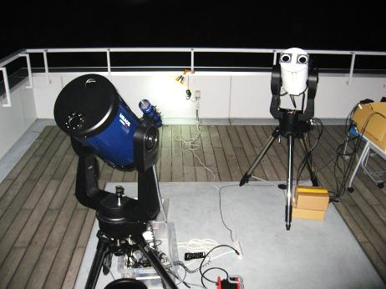
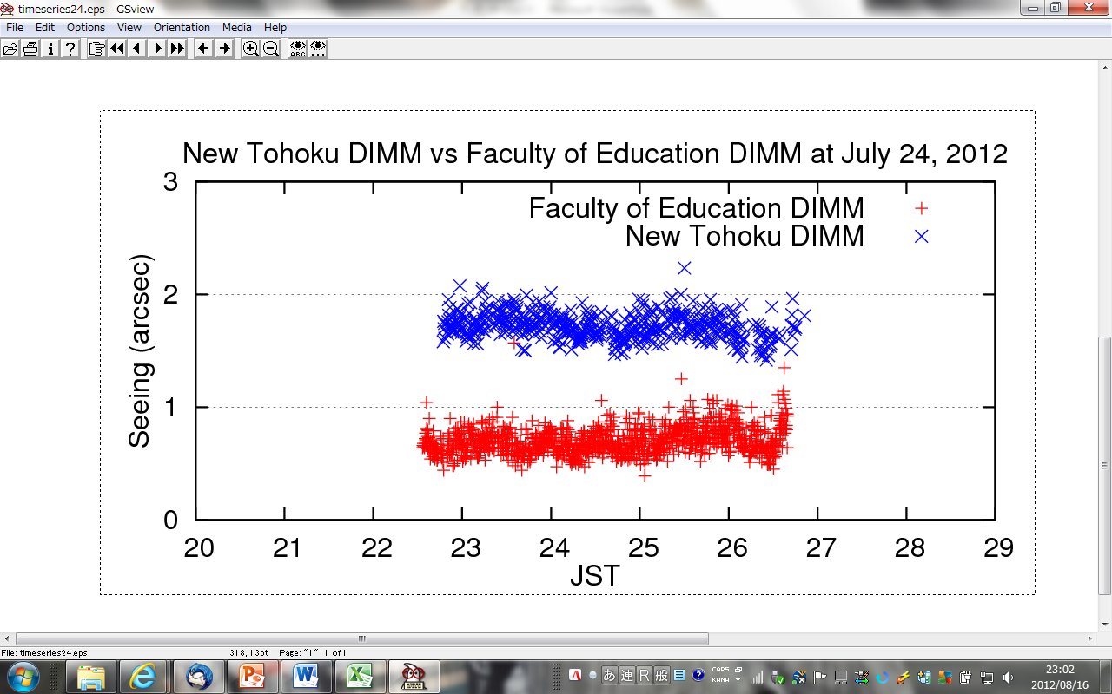
Comparison with the Hiroshima-DIMM
9/10
In order to check the accuracy of DF-DIMM, we compared the seeing values with the Hiroshima-DIMM. By this comparison the seeing obtained by DF-DIMM were good agreement with the Hiroshima’s one. We thought that DF-DIMM seeing values were accurate.
Fig.15 Hiroshima-DIMM (left, dark blue one) and DF-DIMM (right, white one)
DF-DIMM vs Hiroshim-DIMM at July 24, 2012
FIg.16 Time series seeing values. Red: Hiroshima- DIMM Blue: New Tohoku DIMM (with offset +1”)
Fig.17 (left) The histgram of two DIMMs. Red line means Hiroshima-DIMM and blue one means DF-DIMM.
(right) Correlation map of DF-DIMM and Hiroshima-DIMM. The correlation coefficient is 0.63.
Hiroshima-DIMM
DF-DIMM

Slide 10
Conclusion
10/10
It is important to find a good seeing site for astronomy.
The Antarctic plateau is expected to be the best seeing site on Earth.
We operated the seeing measurements at Dome Fuji during 2010-2011 austral summer.
We found that the seeing at Dome Fuji change continuously and have a minimum around 0.7” at about 6 p.m.
We also found that the seeing has good correlations with the temperatures and with the wind shear.
We want to know the seeing above surface boundary layer in winter time.
We plan to set up DF-DIMM at Dome Fuji this austral summer, and we plan to start the annual seeing measurement at 8m stage using PLATO-F powers and communications.

