Slide 1
Excellent daytime seeing at Dome Fuji on the Antarctic Plateau
Medium-Size Telescope Science Workshop
East Asian Core Observatories Association (EACOA)
June 21-25,2013, Kunming, China
Site Session
9:45-10:05, June 23, 2013
Based on Okita et al., A&A, 554, L5 (2013)
and some unpublished results
Hirofumi OKITA
Astronomical Institute, Tohoku University
Ph. D student
54th Japanese Antarctic Research Expedition, Summer party (2012-2013)
52nd Japanese Antarctic Research Expedition, Observer (2010-2011)
Coauthors: Takashi Ichikawa, Michael C. B. Ashley, Takato Naruhisa, and Hideaki Motoyama

Slide 2
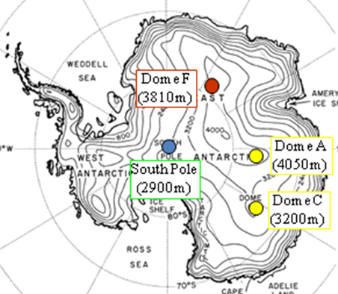
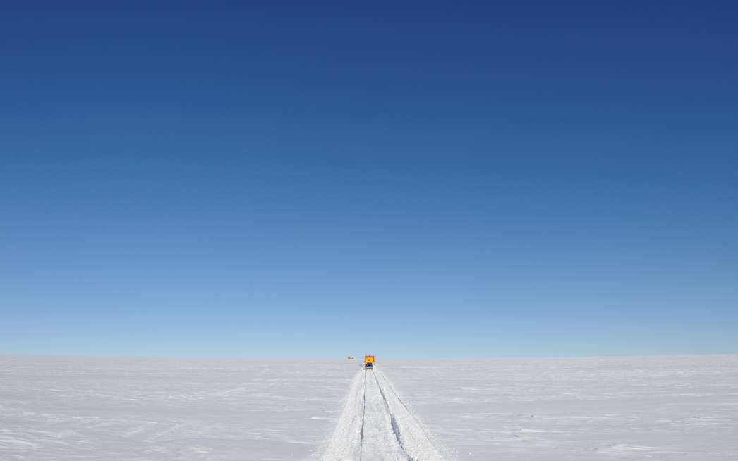
1.1 Aim of this study
1. Introduction
The aim of this study is to investigate the astronomical seeing in the free atmosphere above and to determine the height of the surface boundary layer at Dome Fuji on the Antarctic plateau.
Murata et al. 2009

Slide 3
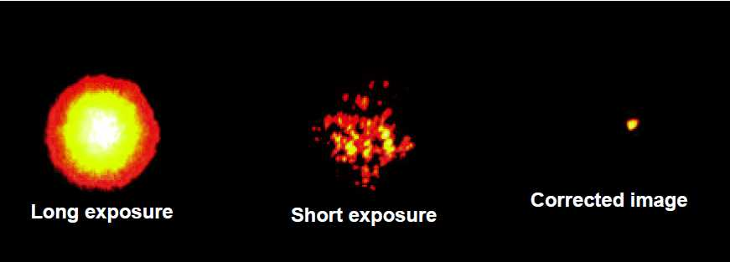
1.2 Turbulence in the Atmosphere
1. Introduction
Object
Atmosphere
(Turbulence layer)
Telescope
Bright Star (Arcturus) Observed with Lick Observatory's 1-m Telescope. (Copyright: Claire Max,
http://cfao.ucolick.org/EO/resources/History_AO_Max.pdf)

Slide 4
1. Introduction
1.3 Atmosphere structure
No jet-stream
on the Antarctic plateau
Height
Free Atmosphere
~10km
Troposphere
FA seeing
< 0.3”
200 ~
10 m
Surface Boundary Layer
SBL seeing
> 1”
Astronomical seeing on the Antarctic plateau is generally considered as the superposition of the contributions from two layers; the surface boundary layer and the free atmosphere above.

Slide 5
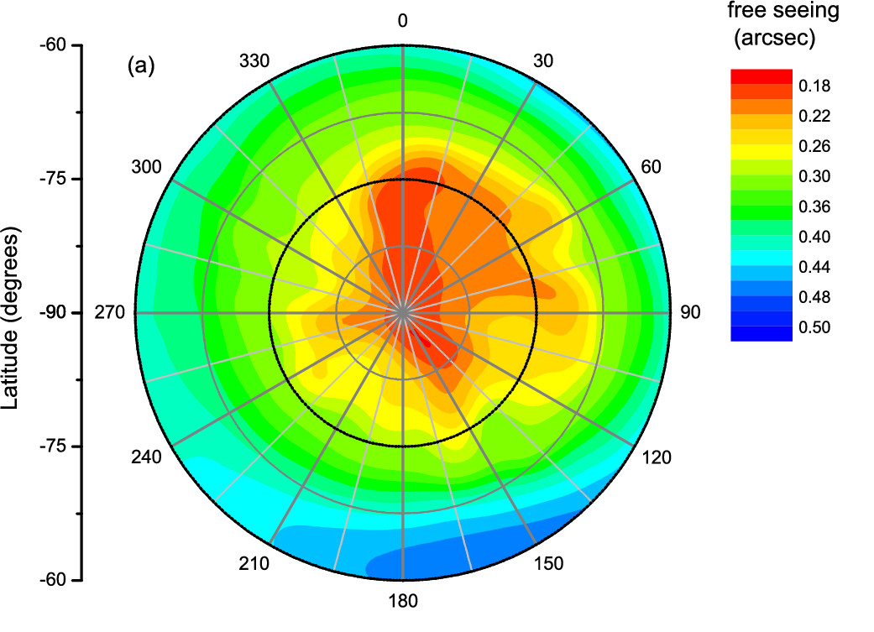
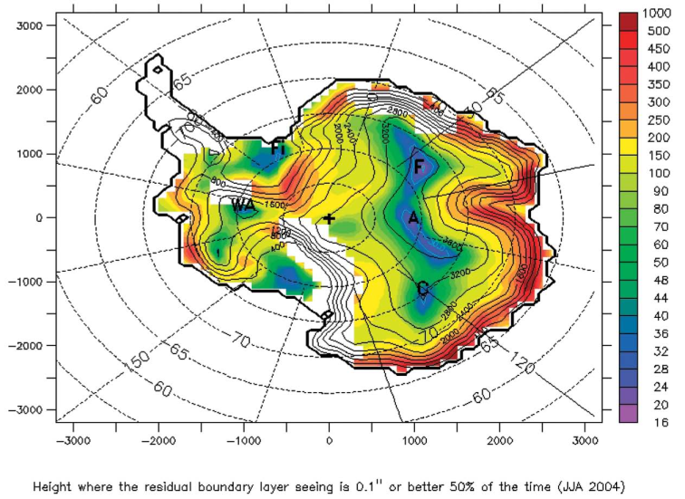
1.4 Simulations’ results
1. Introduction
Dome Fuji
Saunders et al. (2009)
Simulation of the free atmosphere seeing
Swain & Gallee (2006)
Simulation of the height of the surface boundary layer
The free atmosphere seeing could be 0.21”.
The height of the surface boundary layer would be 18 m.
→ We planed to observed them at Dome Fuji.

Slide 6
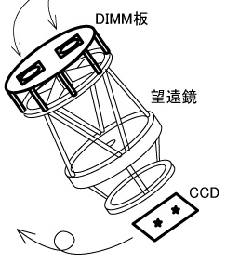
1.5a DIMM instrument
1. Introduction
Differential Image Motion Monitor
(Sarazin & Roddier 1990)
DIMM measures the variance of the incidence angles on the detector CCD.
d
Incidence angle structure function
Phase structure function
Fried parameter
seeing

Slide 7
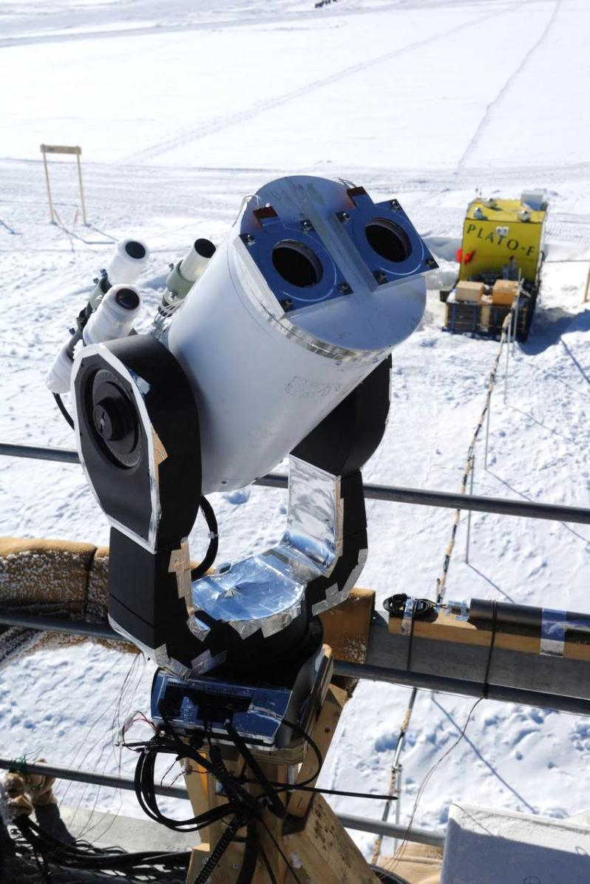
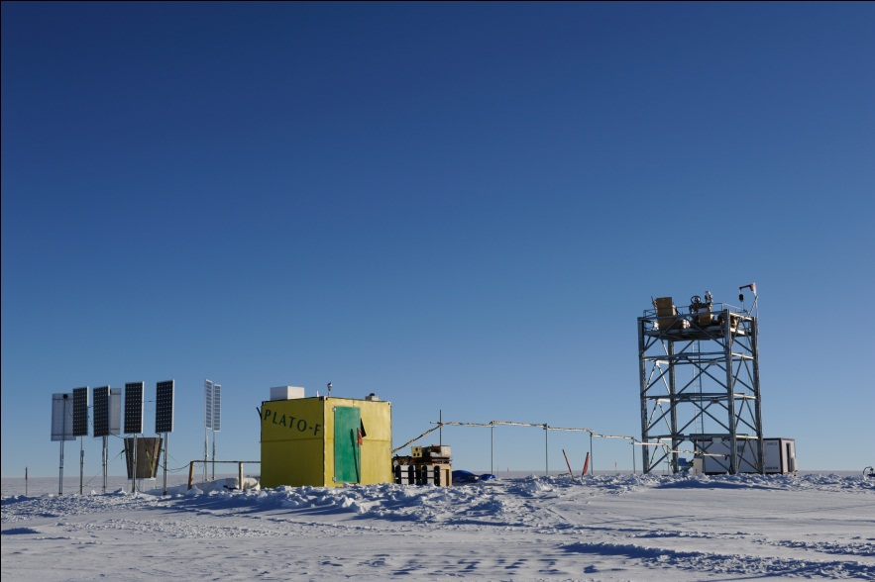
1.5b DF-DIMM
1. Introduction
Dome Fuji Differential Image Motion Monitor
We used an exclusive small full-automatic telescope on the 9 m astronomical tower in order to be as height as possible within, and sometimes above, the surface boundary layer.
Power supply,
Communication
DF-DIMM
PLATO-F
11m

Slide 8
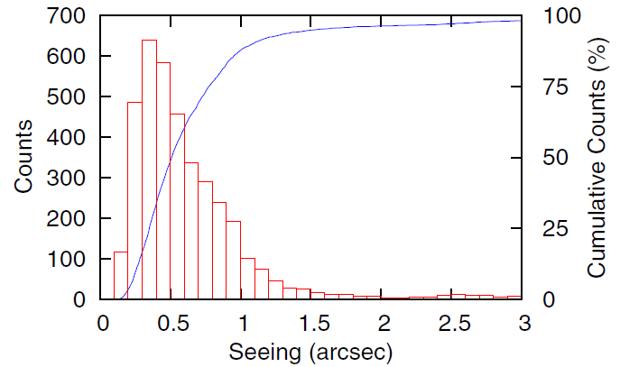
2. Results
2.1 Histogram of seeing
From January 4 to January 23, 2013
3768 seeing estimated, each one being the average of 450 images over a period of about five minutes
11 m above the snow surface
Wavelength of 472nm
Mean | 0.68”
Median | 0.52”
Mode | 0.36”
75%tile | 0.78”
25%tile | 0.36”
We expect the higher seeing measurements to be due to periods when the surface boundary layer was above the level of the top of the telescope.

Slide 9
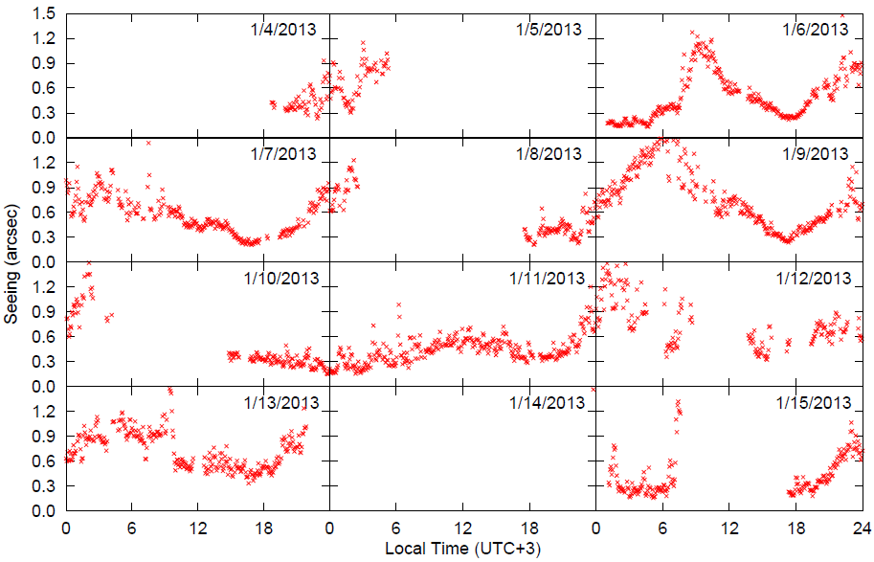
2. Results
2.2a Time series of seeing(1/2)

Slide 10
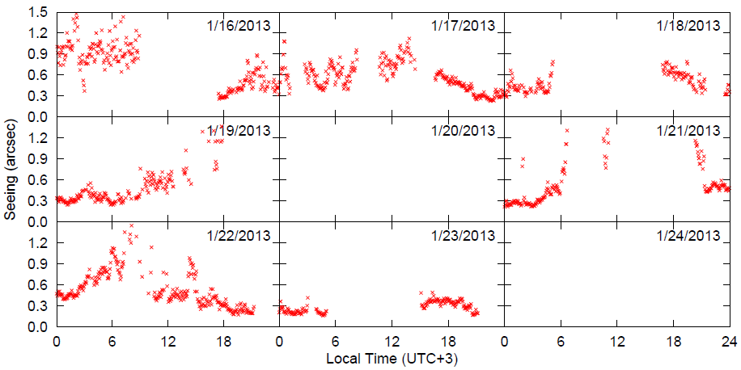
2. Results
2.2b Time series of seeing (2/2)

Slide 11
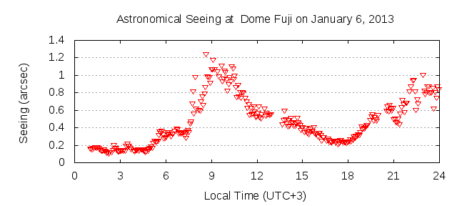
2. Results
2.3 Tendency of seeing
The seeing has a tendency to have a local minimum of ~0.3” a few hours before local midnight (around 18h).
This is clear in the data for January 6,7,9, and 16.
A period of excellent seeing, below 0.2” and continuing about 4 hours, was observed near local midnight at 2013 January 6.
Other periods of excellent seeing, less than 0.3”, were observed close to midnight on a total of six occasions (January 6, 11, 15, 19, 21, and 23)

Slide 12
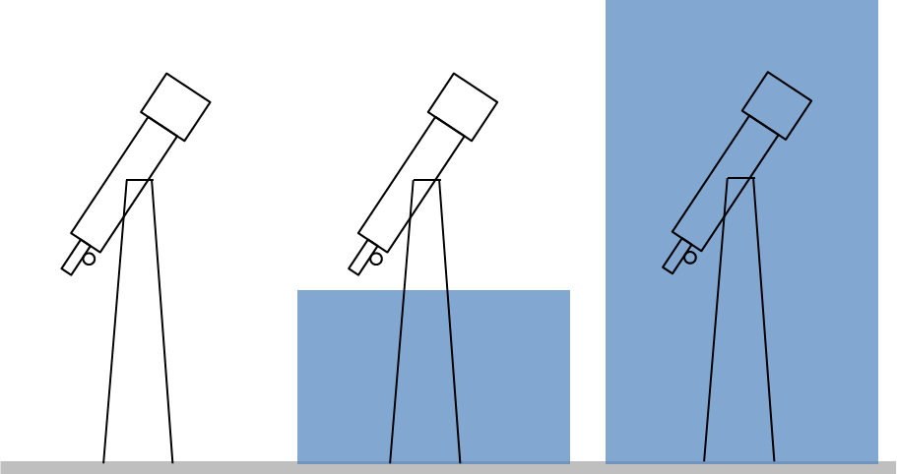
2. Results
2.4 Excellent seeing
Height
Free Atmosphere
~10km
10 ~
200 m
Surface Boundary Layer
A)
B)
C)
We can consider three cases;
the surface boundary layer is
disappeared at all.
below the level of the telescope.
higher than the level of the telescope.
When there is case A) or B), we can get free atmosphere seeing at a height.

Slide 13
2. Results
2.5 Disappearance of the SBL
Local minimum around 18h
A similar local minimum at local dusk has also been seen at Dome C.
Aristidi et al. (2005) has interpreted this as the disappearance of the surface boundary layer. Our results are consistent with this.
Case A)

Slide 14
2. Results
2.6 Above SBL
The excellent seeing at local midnight has not been reported from site testing of 8 m above the snow surface at Dome C.
At local midnight,
surface boundary layer
weak
Solar input
temperature gradient
poor seeing at surface
This is only consistent with our observations if the surface boundary layer is below the level of our telescope. We therefore conclude that our DIMM was above the surface boundary layer during these periods and was sampling the free atmosphere seeing.
Case B)

Slide 15
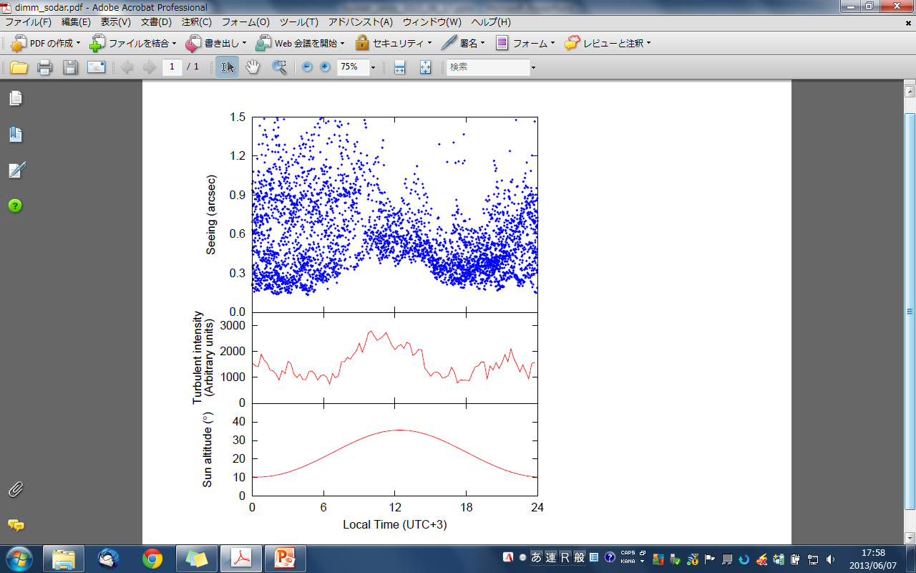
2. Results
2.7 Diurnal variation for seeing
We plotted all seeing data with the local time.
Large seeing values
→
Inside surface
boundary layer
Small seeing values
0.2”
→
Above SBL, or
No SBL
0
6
12
18
24
Local time (UTC+3)
Lower limit of seeing ~0.2” can be observed every time except around local noon.
This means that the free atmosphere seeing would be ~0.2”.

Slide 16

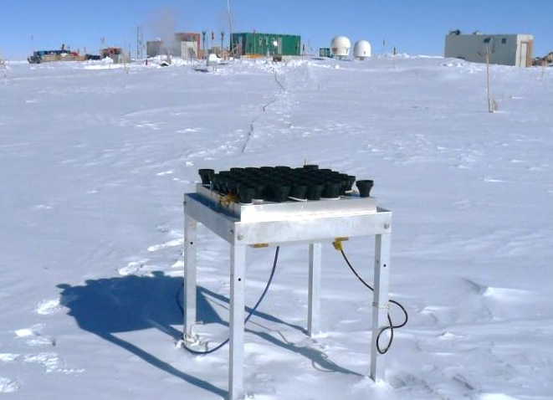
2.8 SODAR
2. Results
To consider the turbulence above, we used SODAR data during 2006 to 2007 austral summer.
V
SOnic Detection And Ranging
pppp…
∝Turbulence strength
Takato (2008)
SODAR can observe above from 40 to 400 m snow surface.
Therefore SODAR cannot measure the strength of the surface boundary layer.
Takato (2008)

Slide 17
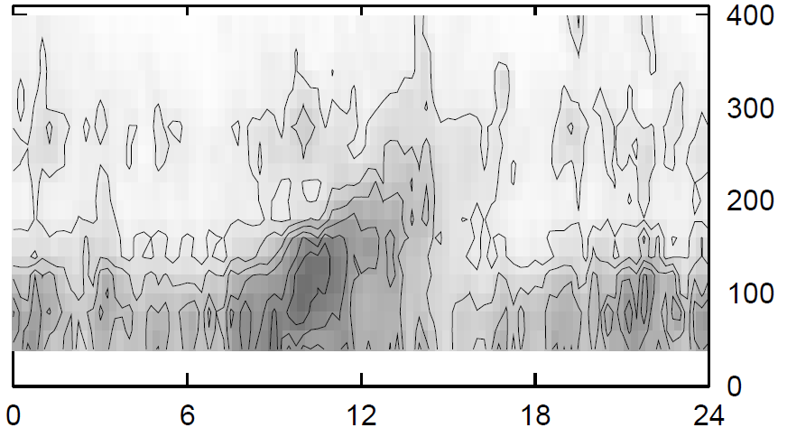
2. Results
2.9 Considering SODAR results
Convection
by the solar heating
Diurnal turbulence profile
minimum height = 40m
Integrate from 40 to 400m,
Turbulence within 40-400m would be caused by the convection by the solar heating.
Turbulence strength is almost constant except around local noon.

Slide 18
2. Results
2.10 Effect of convection
Lower limit of the seeing value correlates with the turbulence strength within 40-400m.
During 18h–6h (nighttime)
Seeing value depends on the height of the surface boundary layer and its strength. We can obtain ~0.2” seeing when SBL is lower than the telescope.
During 6h-18h (daytime)
Convection by the solar heating makes worse the seeing value around local noon.
Around 18h
Seeing value tends to be small. No SBL and/or no convection.

Slide 19
3. Conclusion
3. Conclusion
Model turbulence profile
at Dome Fuji
From our observations, we found that
the free atmosphe seeing is about 0.2 arcsecond
the height of the surface boundary layer can be as low as about 11 m.
the convection by the Sun makes worse the free atmosphere seeing at local noon
Height
Free Atmosphere
~10km
~400m
0.2”
Convec-tion
~11m
Surface Boundary Layer
0
12
24
hour

