Slide 1








Astronomical site evaluation at
Dome Fuji on the Antarctic plateau
Hirofumi OKITA
June 17, 2013
Based on Okita et al., A&A, 554, L5 (2013)
and some unpublished results

Slide 2
Contents
Introduction
Instrumentations
Data processing and error analysis
Results
Discussion and conclusion
Future work

Slide 3
Contents
Introduction
Instrumentations
Data processing and error analysis
Results
Discussion and conclusion
Future work

Slide 4
1. 1 Aim of this study
The aim of this study is to investigate the astronomical seeing in the free atmosphere above and to determine the height of the surface boundary layer at Dome Fuji on the Antarctic plateau.

Slide 5
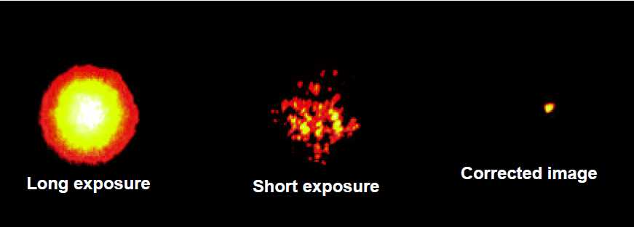
1. 2 Turbulence in the Atmosphere
Object
Atmosphere
Telescope
Bright Star (Arcturus) Observed with Lick Observatory's 1-m Telescope. (Copyright: Claire Max,
http://cfao.ucolick.org/EO/resources/History_AO_Max.pdf)

Slide 6
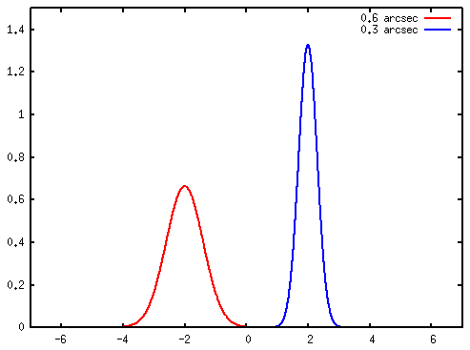
1. 3 Seeing
Seeing is a parameter that describes how blurry a star image will be. It is caused by atmospheric turbulence and is the apparent angular diameter of a point source measured in arcsecond.
Bright Star (Arcturus) Observed with Lick Observatory's 1-m Telescope. (Copyright: Claire Max,
http://cfao.ucolick.org/EO/resources/History_AO_Max.pdf)
at wavelength of 500 nm
PSF
Site | seeing
Mauna-kea (Subaru-site) | 0.69”
Cerro Paranal (VLT-site) | 0.88”
Cerro Chajnantor (TAO-site) | 0.69”
La Palma (GTC-site) | 0.69”
0.75 mag
0.3”
0.6”
Good seeing brings not only high resolution imaging, but also more deeper detection limit.
good seeing
excellent seeing
→ It is important to choice ”the site”.

Slide 7
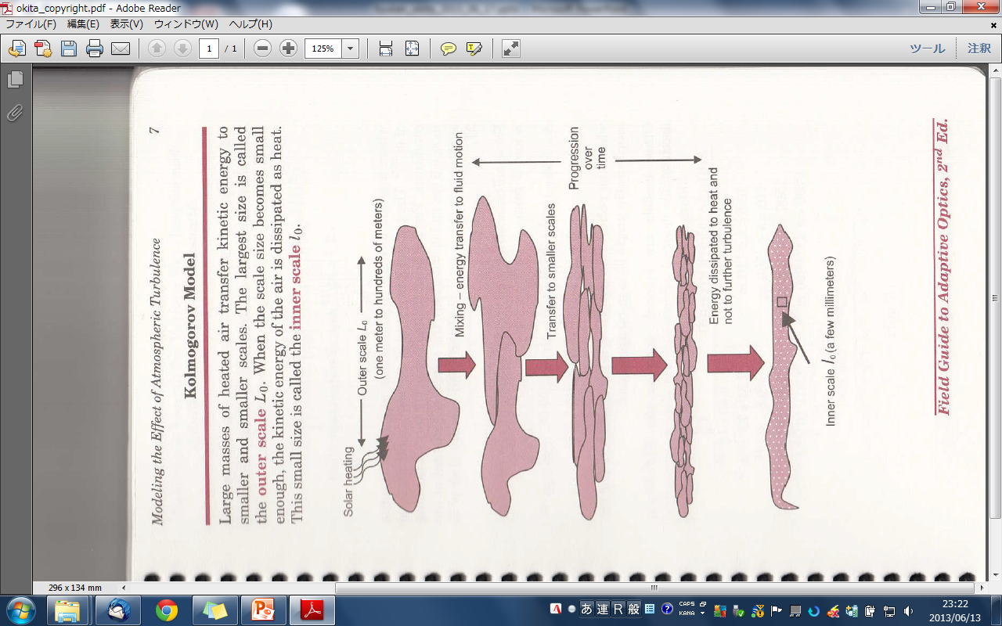




1. 4 Kolmogorov Model
In the inertial range, the Velocity fluctuations V [L T⁻¹] are governed only by the scale size l [L] and the rate of energy input and dissipation ε [L²T⁻³]. Dimensional consideration,
Kolmogorov (1941)
Structure function
Correlation function
Tyson & Frazier (2012)

Slide 8

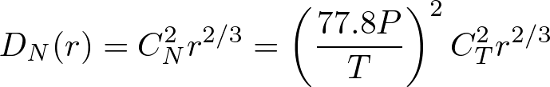
1. 5 Structure function
Velocity structure function
Tatarskii (1971)
Kolmogorov (1941)
Temperature structure function
Refractivity
P = pressure in mill bar
T = temperature, K
Refractive index structure function

Slide 9

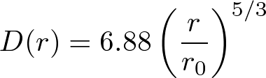
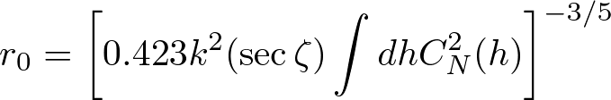


1. 6 Fried parameter & seeing
Phase structure function
k = 2π/λ
ζ = zenith angle
Fried parameter
Seeing
Fried defined the parameter r₀ , which is the diameter of a telescope which would have the same resolving power as in the atmospheric turbulence

Slide 10
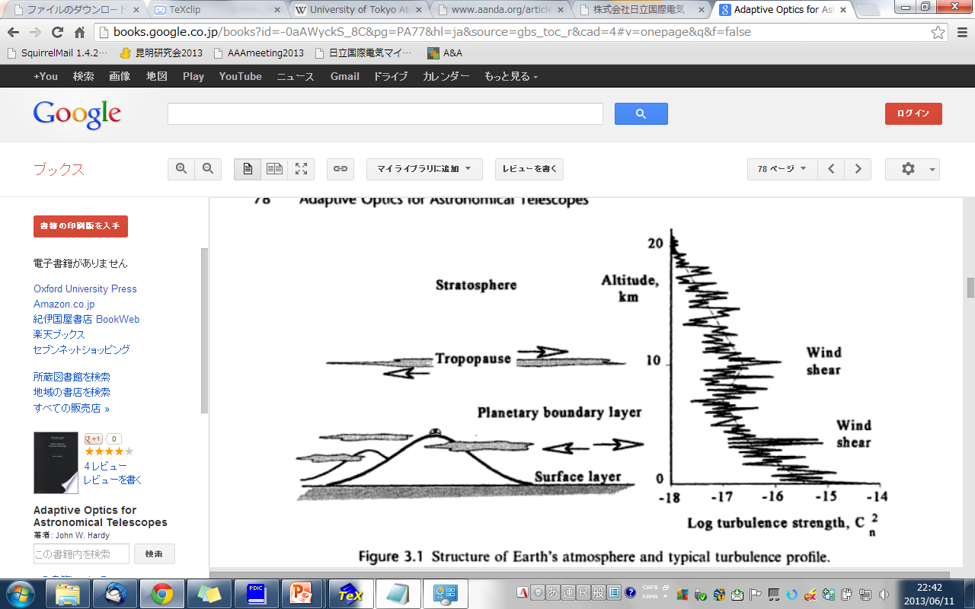
1. 7 Atmosphere structure
Wind shear
Wind shear
Solar heating
Friction
Surface Boundary Layer
Planetary boundary layer
Tropopause (Jet-stream)
“Adaptive Optics for Astronomical Telescope” (Hardy 1998)

Slide 11
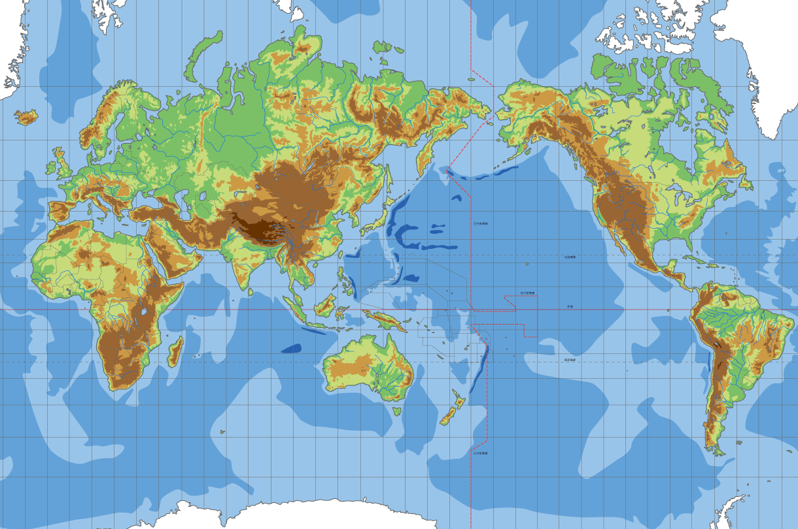
1. 8 Atmosphere structure
During the day, turbulence is usually strongest near the ground, in response to solar heating and the development of thermal currents. At nigh, especially at good observing sites, surface turbulence is low and most disturbances occur in layers at higher altitudes, especially at the tropopause, as a result of wind shear.
The best observing sites are located on mountain peaks near the ocean, which has a moderating effect on temperature variations. (“Adaptive Optics for Astronomical Telescope”, Hardy 1998)
World’s best astronomical seeing sites
La Palma
Mauna Kea
Chajnantor
Paranal
“Adaptive Optics for Astronomical Telescope” (Hardy 1998)

Slide 12
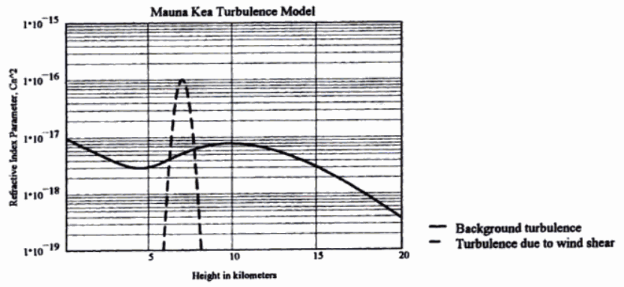
1. 9 C_{N}² distribution at Mauna Kea
Effect of the surface boundary layer is negligible because the telescope locates at the top of the mountain and the telescope is mounted on high pillar.
Refractive index parameter C_{N}²
h_{SBL} ~ a few x 10 m
Height (km)
“Adaptive Optics for Astronomical Telescope” (Hardy 1998)
- Background turbulence alone = 0.36 arcsec
- Addition of the single layer = 0.53 arcsec

Slide 13
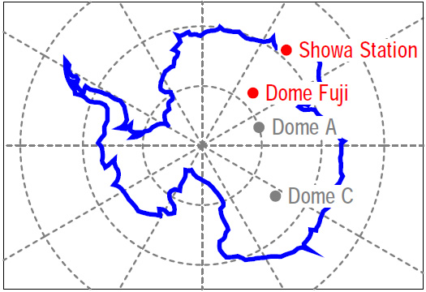
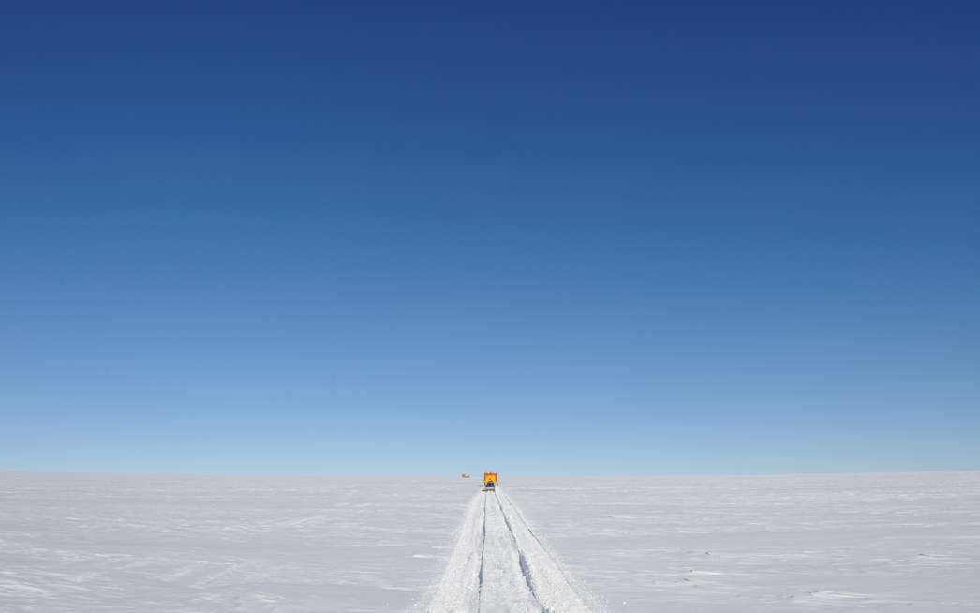
1. 10 On the Antarctic plateau
Syowa Station
Okita et al. 2010
No diurnal temperature variation in winter
weak wind-shear (polar vortex)
smooth snow surface
Dome = local maxima of the plateau
Stable atmosphere
Weak wind shear
South Pole

Slide 14
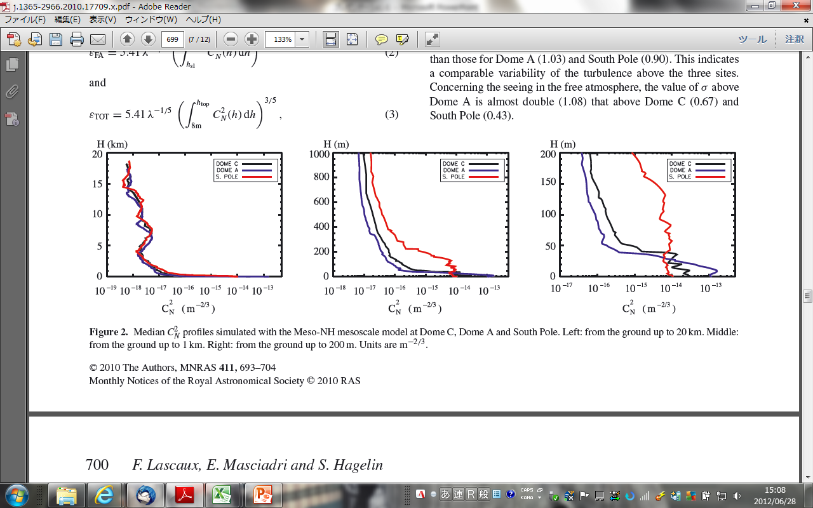
1. 11 C_{N}² distribution on Antarctica
Lascaux et al. (2011)
Lascaux et al. (2011)
- No strong turbulence at high altitude
- Strong surface boundary layer near the surface

Slide 15
1. 12 C_{N}² distribution on Antarctica
15 ~ 30m
at Dome A, C, (and F?)
Lascaux et al. (2011)

Slide 16
1. 13 Atmosphere structure at “Dome”
Height
Stratosphere
Astronomical seeing at “Dome” on the Antarctic plateau is generally considered as the super-position of the contributions from two layers; the surface boundary layer and the free atmosphere above.
Free Atmosphere
~10km
Troposphere
200 ~
10 m
Surface Boundary Layer
On the Antarctic plateau has only two component of turbulence,
Surface boundary Layer near the snow surface, and
Free atmosphere above it

Slide 17
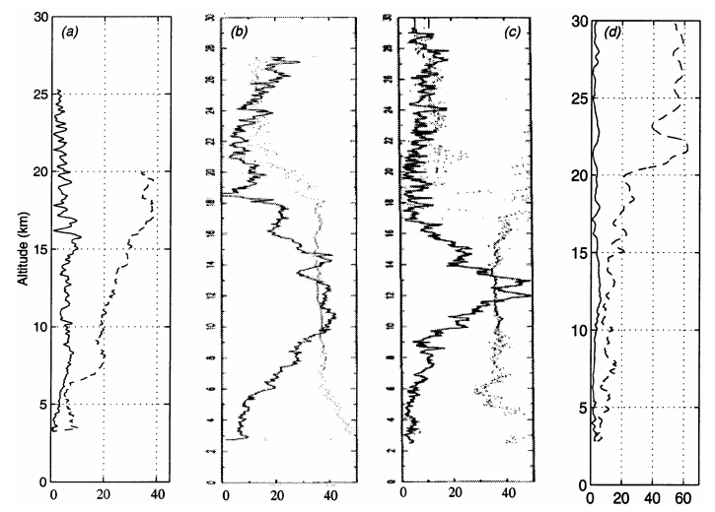
1. 14 Wind speed
Dome C
Paranal
Mauna Kea
South Pole
Jet stream
Altitude (km)
full line = summer
dashed = winter
Aristidi et al. (2005)
Wind speed (m/s)
Polar vortex
“In sub-polar regions the speed of the vortex decreases with increasing latitude.”
Aristidi et al. (2005)
Latitude of Dome C = 75 degree

Slide 18
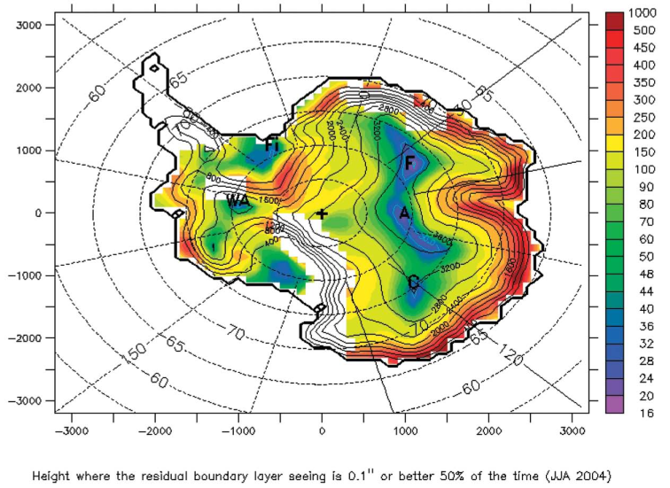
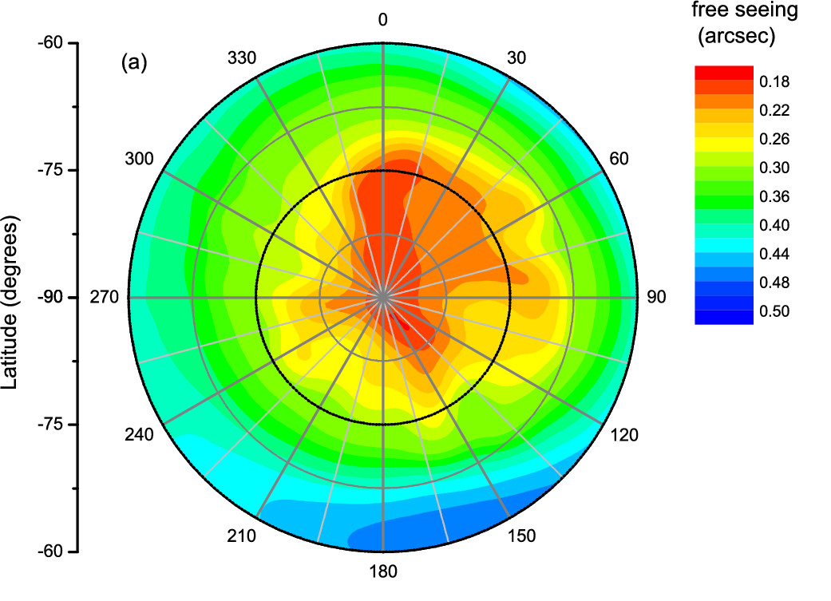
1. 15 Previous studies (Simulation)
Dome Fuji
Swain & Gallee (2006)
Simulation of the height of the surface boundary layer
Saunders et al. (2009)
Simulation of the free atmosphere seeing
Simulations suggest that the free atmosphere seeing could be 0.21” and the height of the surface boundary layer is 18 m at Dome Fuji (Saunders et al. 2009; Swain & Gallee 2006).

Slide 19
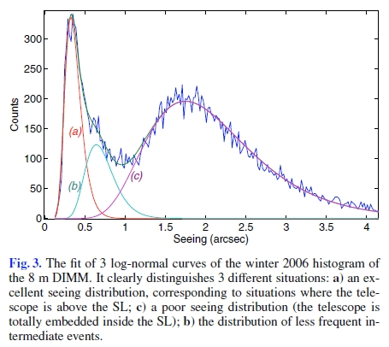
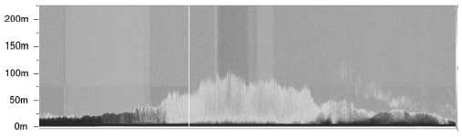
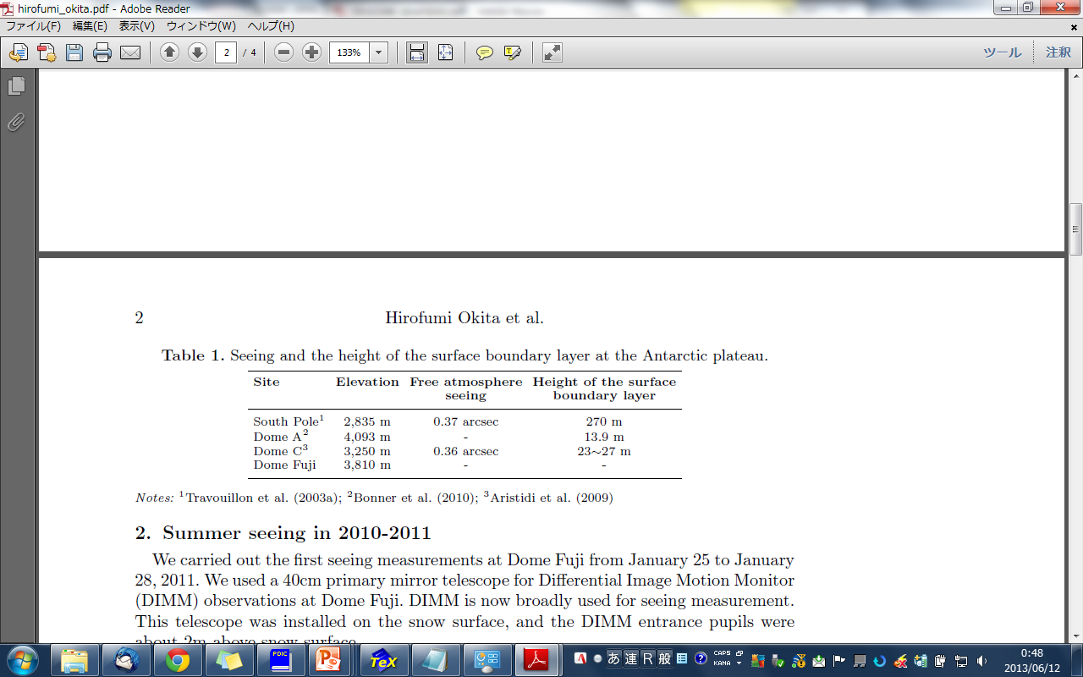
1. 16 Previous studies (site tests)
Dome C
Seeing distribution
Dome A
C_{T}² distribution
Aristidi et al. (2009)
height (m)
Bonner et al. (2009)
Seeing (arcsec)
Median height = 13.9m
(a) above surface layer
(c) Inside surface layer
(b) intermediate
Dome Fuji
not observed yet

Slide 20
1. 17 Aim of this study
The aim of this study is to investigate the astronomical seeing in the free atmosphere above and to determine the height of the surface boundary layer at Dome Fuji on the Antarctic plateau.

Slide 21
Contents
Introduction
Instrumentations
Data processing and error analysis
Results
Discussion and conclusion
Future work

Slide 22
2. 1 Measuring quantity
Refractive index structure function
Phase structure function
Fried parameter
Seeing

Slide 23
2. 2 C_{T}², D_{α}(r) → ε
DIMM
α = incidence angle
φ = phase
SODAR
Snodar
Ultrasonic anemometer
Micro-thermal sensor
Balloon-bone temperature sensor
In this presentation, we only discus the data of DIMM and SODAR.

Slide 24
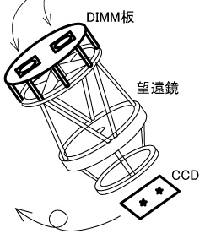
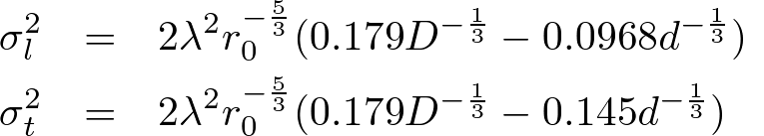
2. 3 DIMM principle
Differential Image Motion Monitor
r
DIMM measures the variance of the incidence angles on the detector CCD.
α = incidence angle
DIMM can not measure the profile of C_{N}².
DIMM only measure the integrated value of r₀ = “total seeing”

Slide 25
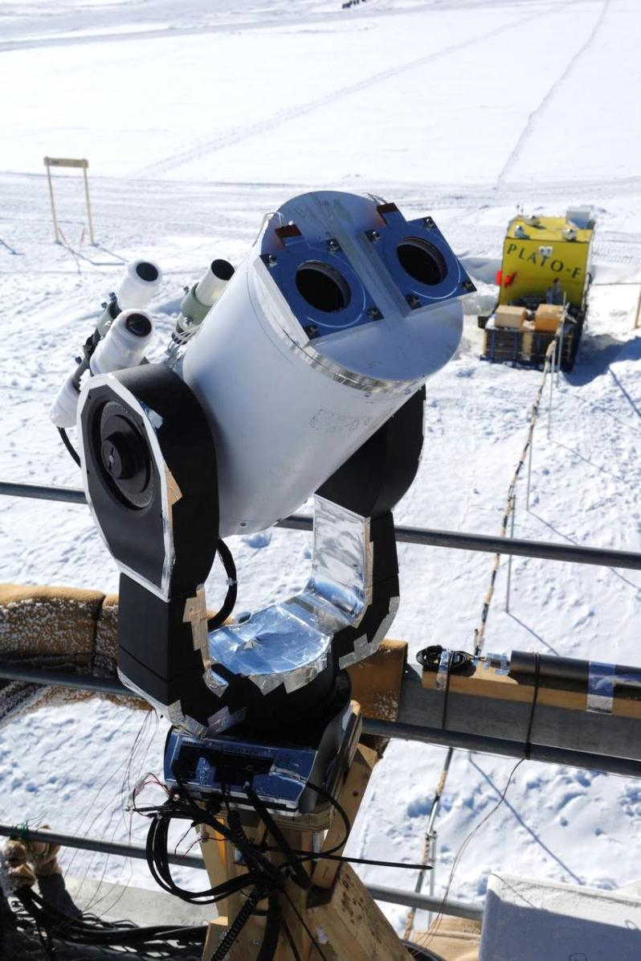
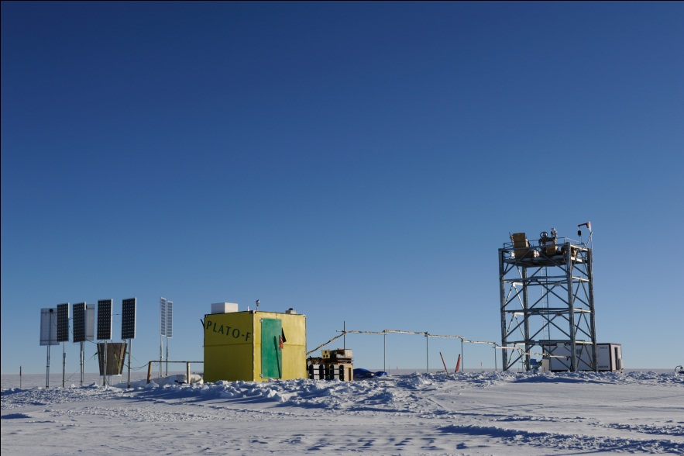
2. 4 DF-DIMM
Dome Fuji Differential Image Motion Monitor
We used an exclusive small full-automatic telescope on the 9 m astronomical tower in order to be as height as possible within, and sometimes above, the surface boundary layer.
Power supply,
Communication
DF-DIMM
PLATO-F
11m

Slide 26

2. 5 SODAR principle
SOnic Detection And Ranging
dh
Emit sound and receive the echo.
V
(1) Intensity of echo → turbulence strength (C_{T}²)
(2) Doppler shift → 3-D wind velocity (u, v, w)
pppp…
Received power Pr(h) is,
Takato (2008)
Tatarskii (1971)

Slide 27
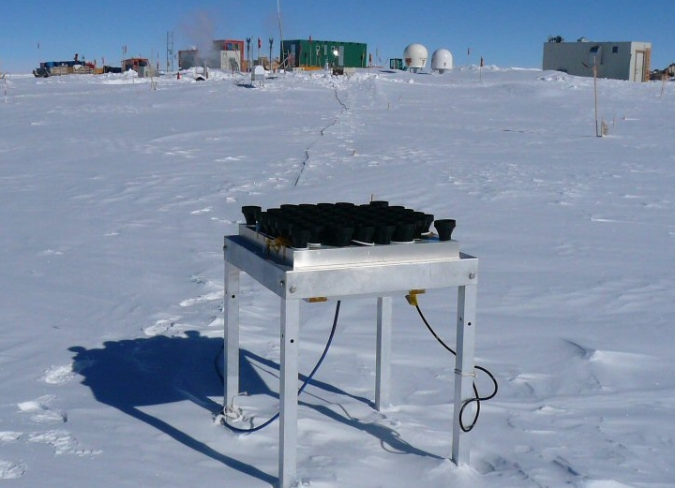
2. 6 SODAR at Dome Fuji
Takato (2008)
Unfortunately we had no calibration for η, so we couldn’t convert from Pr to C_{T}².

Slide 28
2. 7 Observable height
8 ~ 50 m
∝C_{T}²
0 ~ 16 m
C_{T}²
wind speed
temperature
pressure
In this presentation we discuss > 11 m seeing and turbulence strength from 40 to 400m.
40 ~ 400 m
∝C_{T}²
Future work
> 11m
seeing ε
> 2m
seeing ε
Snodar
2011
Weather mast
2011
DIMM
2011
DIMM
2013
SODAR
2006/2007

Slide 29
Contents
Introduction
Instrumentations
Data processing and error analysis
Results
Discussion and conclusion
Future work

Slide 30
Contents
Introduction
Instrumentations
Data processing and error analysis
Results
Discussion and conclusion
Future work

Slide 31
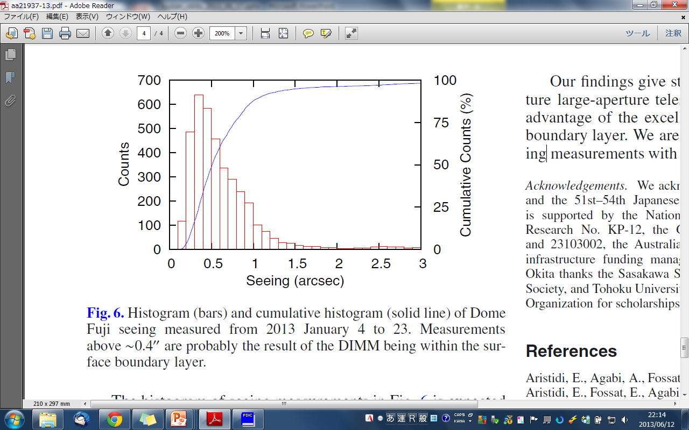
4. 1 Seeing histogram
DIMM observations 11 m above the snow surface at a wavelength of 472nm from 2013 January 1 to January 23 in 2013.
In all, 3768 seeing estimated, each one being the average of 450 images over a period of about five minutes.
Mean | 0.68”
Median | 0.52”
Mode | 0.36”
75%tile | 0.78”
25%tile | 0.36”
Note: This larger statistic values are believed to be caused by periods when the telescope was within the turbulence boundary layer.

Slide 32
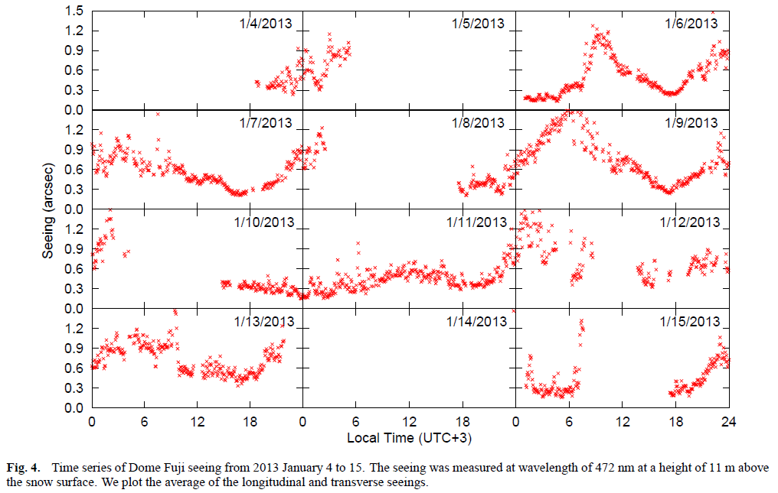
4. 2 DIMM time series (1/2)

Slide 33
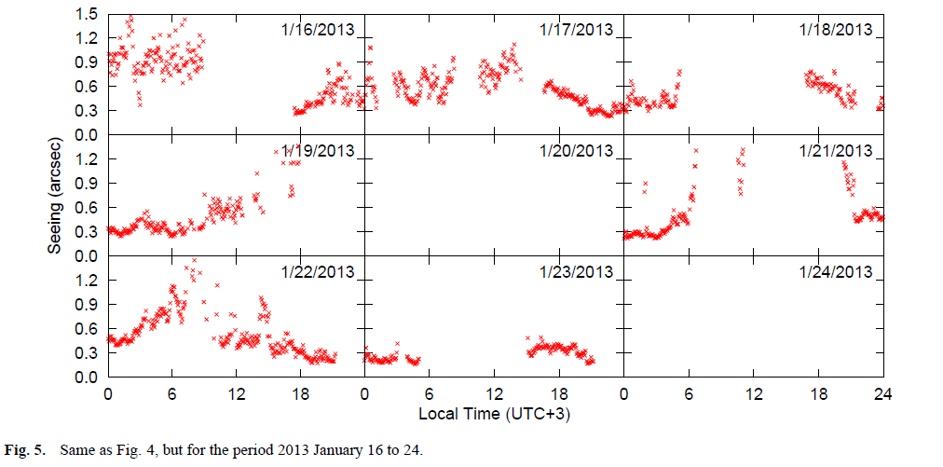
4. 3 DIMM time series (2/2)

Slide 34
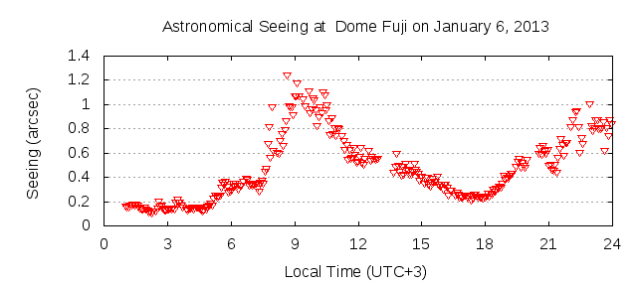
4. 4 DIMM result
A period of excellent seeing, below 0.2” and continuing about 4 hours, was observed near local midnight at 2013 January 6.
Other periods of excellent seeing, less than 0.3”, were observed close to midnight on a total of six occasions (January 6, 11, 15, 19, 21, and 23)
The seeing has a tendency to have a local minimum of ~0.3” a few hours before local midnight.
This is clear in the data for January 6,7,9, and 16.

Slide 35
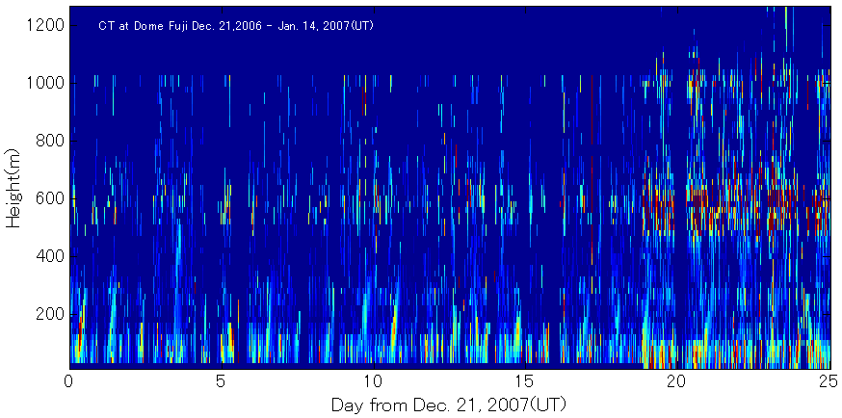
4. 5 SODAR time series
SODAR observations from 2006 December 21 to 2007 January 7.
We setup the minimum height h_{min} = 40 m and the resolution Δh = 20 m.
height (m)
Takato (2008)
Day from December 21, 2007 (UT)

Slide 36
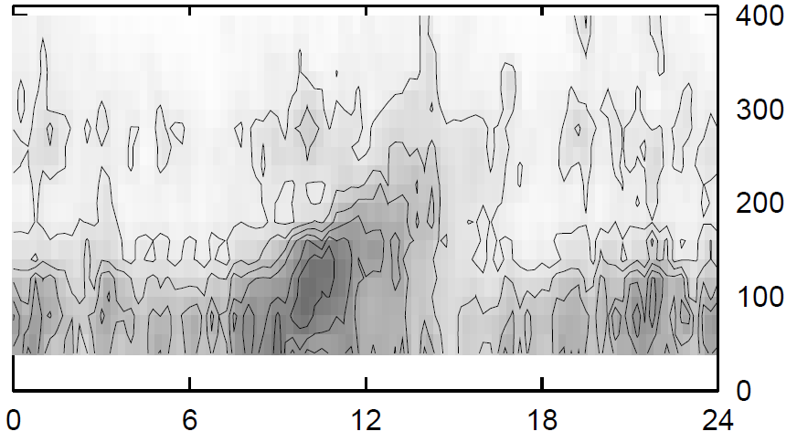
4. 6 Diurnal variation for turbulence
To investigate the diurnal variation of the turbulence, we used the dataset from 2006 December 21 to 2007 January 7 (h_{min} = 40 m and Δh = 20 m).
turbulence strength
Convection
by the solar heating
Height (m)
minimum height = 40m
Local time (UTC+3)

Slide 37
Contents
Introduction
Instrumentations
Data processing and error analysis
Results
Discussion and conclusion
Future work

Slide 38
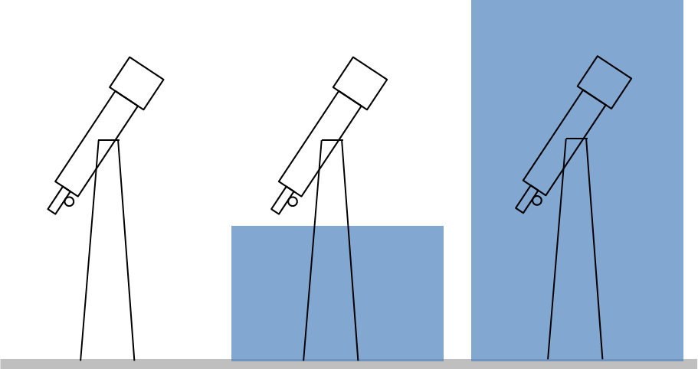
5. 1 Cause for excellent seeing
Height
Stratosphere
Free Atmosphere
~10km
Troposphere
Model of the atmosphere structure at “Dome” on the Antarctic plateau
10 ~
200 m
Surface Boundary Layer
1)
2)
3)
disappearance of the surface boundary layer
the surface boundary layer is below the level of the telescope
the surface boundary layer is higher than the level of the telescope

Slide 39
5. 2 Disappearance of the SBL
A similar local minimum before midnight has also been seen at Dome C
Aristidi et al. (2005) has interpreted this as the disappearance of the surface boundary layer.
Our results are consistent with this.

Slide 40
5. 3 Above SBL
The excellent seeing at local midnight has not been reported at Dome C.
The weak solar energy input at midnight is expected to result in an intense temperature gradient near the snow surface at this time.
This strong temperature gradient should produce a strong surface boundary layer, and hence poor seeing from the surface.
This is only consistent with our observations if the surface boundary layer is below the level of the telescope.
Our DIMM was above the surface boundary layer during these periods, and was sampling the free atmosphere seeing.

Slide 41
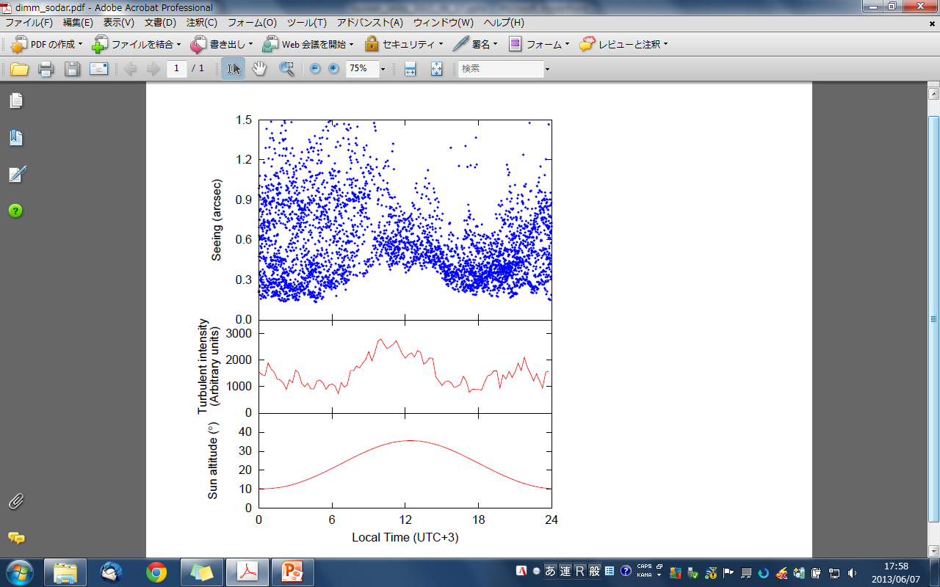
5. 4 Diurnal variation for seeing
We plot all seeing data,
Large seeing value
→ Observation inside SBL
Small seeing value
→ Observation above SBL
0.2”
0
6
12
18
24
Local time (UTC+3)
~0.2” seeing can be observed every time except around noon.
This means that the free atmosphere seeing will be ~0.2” every time around noon.

Slide 42
5. 5 Considering SODAR results
Turbulence strength
Integrate from 40 to 400m,
Turbulence of 40-400m would be caused by the Convection of the solar heating.
Turbulence is almost constant except around noon.

Slide 43
5. 6 Effect of convection
Lower limit of the seeing value correlates with the turbulence strength of 40-400m.
At 18h–6h (nighttime), the seeing value depends on the height of the surface boundary layer and its strength. When low SBL, we can obtain ~0.2” seeing.
At 6h-18h (daytime), convection by the solar heating makes worse the seeing value even in the low SBL.
Around 18h, seeing value tends to small by disappearance of SBL.

Slide 44
5. 7 Conclusions
Model turbulence profile
At Dome Fuji on the Antarctic plateau,
The free atmosphe seeing is ~0.2”.
The height of the surface boundary layer can be as low as ~11 m.
At daytime the convection by the solar heating makes worse the free atmosphere seeing.
Height
Free Atmosphere
~10km
Polar Vortex
~300m
0.2”
Convection
~10m
Surface Boundary Layer
0
12
24
hour

Slide 45
Contents
Introduction
Instrumentations
Data processing and error analysis
Results
Discussion and conclusion
Future work

Slide 46
6. 1 Aim of this study
The aim of this study is to investigate the astronomical seeing in the free atmosphere above and to determine the height of the surface boundary layer at Dome Fuji on the Antarctic plateau.

Slide 47
6. 2 Observable height
8 ~ 50 m
∝C_{T}²
0 ~ 16 m
C_{T}²
wind speed
temperature
pressure
40 ~ 400 m
∝C_{T}²
> 11m
seeing ε
> 2m
seeing ε
SODAR
2006/2007
Snodar
2011
Weather mast
2011
DIMM
2011
DIMM
2013

Slide 48
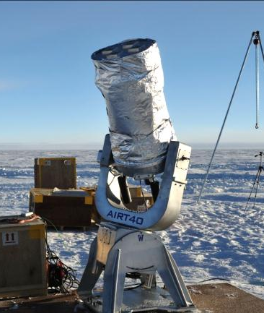
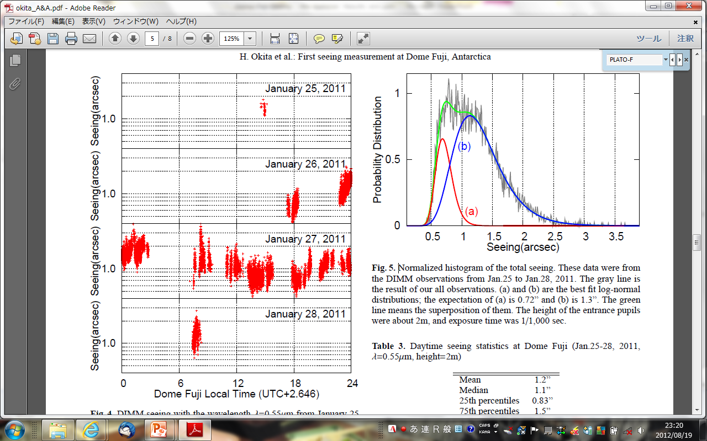
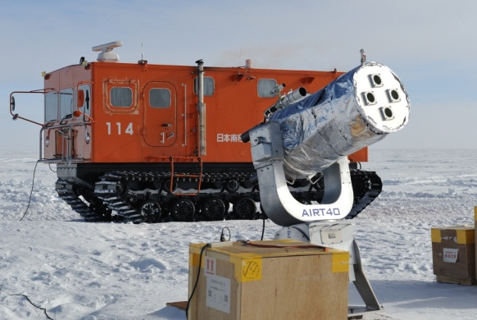
6. 3 DIMM at 2 m
Preliminary Result
about 2m

Slide 49
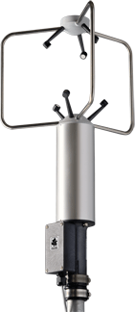
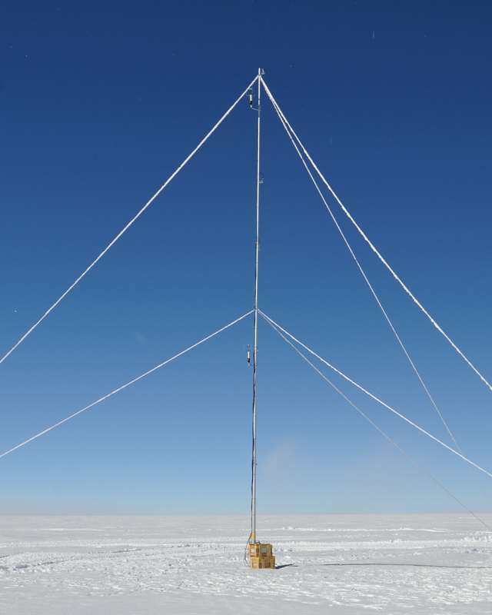
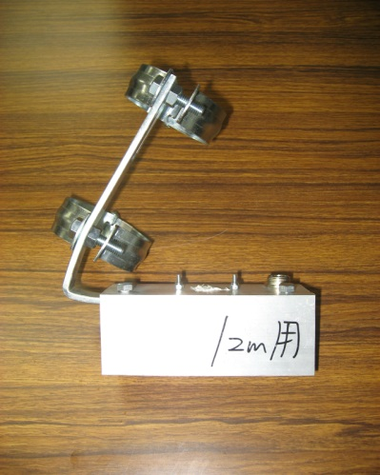
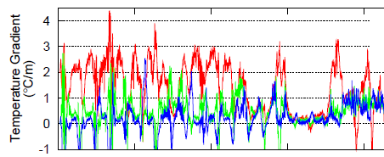
6. 4 Weather mast
Pt 15.8
Sonic 14.4
Pt 12.0
(C) Young
Company
Pt 9.5
Pt sensor
Sonic anemometer
Sonic 6.1
Temperature gradient
Preliminary Result
Barometer
Pt 0.3
0
5
10
15
20

Slide 50
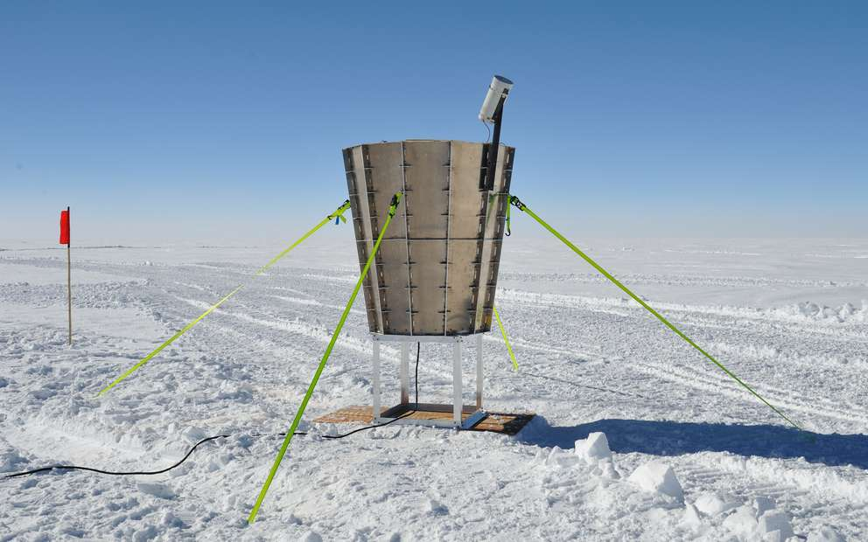
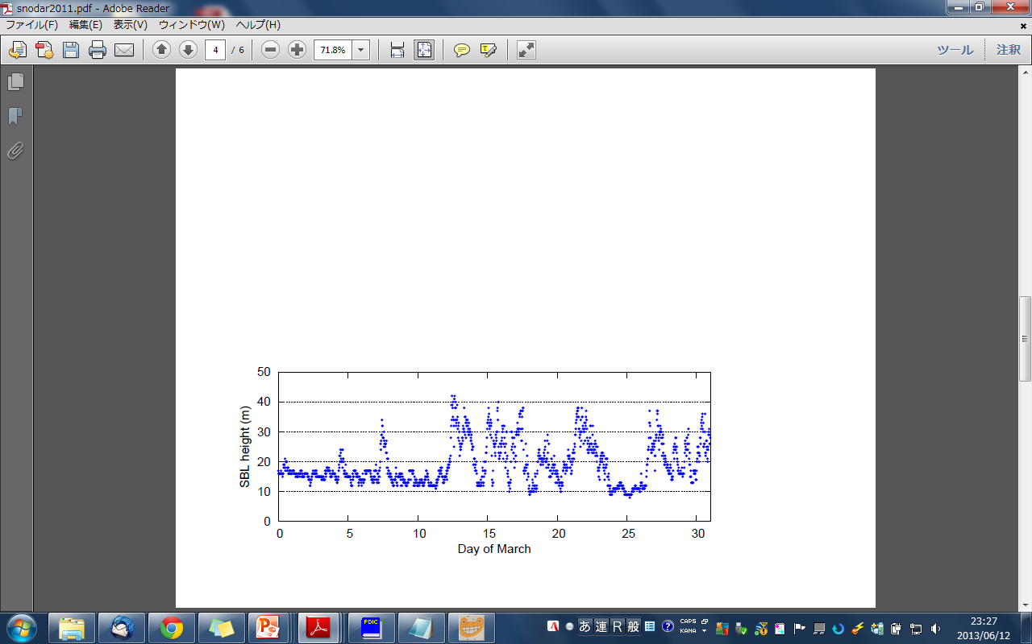
6. 5 Snodar
Surface layer NOn-Doppler Acoustic Radar
Bonner et al. (2009)
Preliminary Result

Slide 51
6. 6 Aim of this study
The aim of this study is to investigate the astronomical seeing in the free atmosphere above and to determine the height of the surface boundary layer at Dome Fuji on the Antarctic plateau.
Future Work

Slide 52
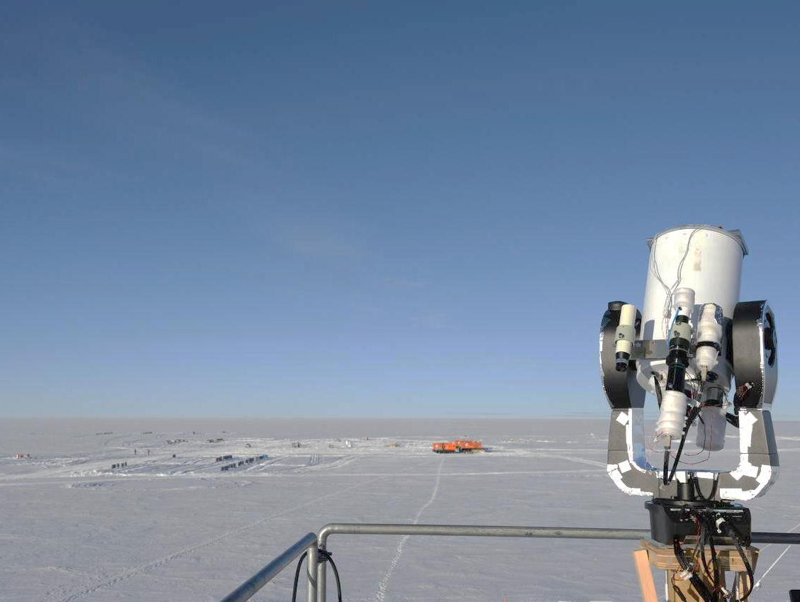
Acknowledgements
We acknowledge the National Institute of Polar Research and the 51st - 54th Japanese Antarctic Research Expeditions. This research is supported by the National Institute of Polar Research through Project Research no.KP-12, the Grants-in-Aid for Scientific Research 18340050 and 23103002, the Australian Research Council and Australian government infrastructure funding managed by Astronomy Australia Limited. Hirofumi Okita thanks the Sasakawa Scientific Research Grant from The Japan Science Society, and Tohoku University International Advanced Research and Education Organization for scholarships and research expenses.

Slide 53
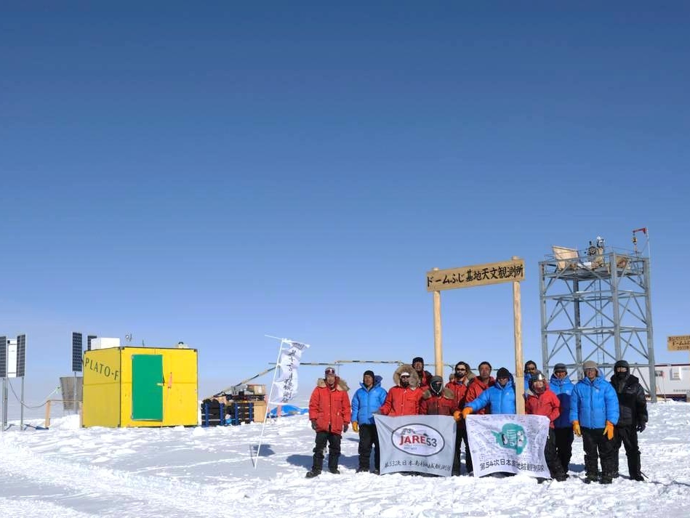
Thank you.

Slide 54
Contents
Introduction
Instrumentations
Data processing and error analysis
Results
Discussion and conclusion
Future work
Appendix

Slide 55
A. 1 Kolmogorov theory
In the inertial range, the Velocity fluctuations V [L T⁻¹] are governed only by the scale size l [L] and the rate of energy input and dissipation ε [L²T⁻³]. Dimensional consideration,
Kolmogorov (1941)
Structure function
Correlation function
Tyson & Frazier (2012)

Slide 56
A. 2 Structure function
Velocity structure function
Tatarskii (1971)
Temperature structure function
Refractivity
P = pressure in mill bar
T = temperature, K
Refractive index structure function

Slide 57



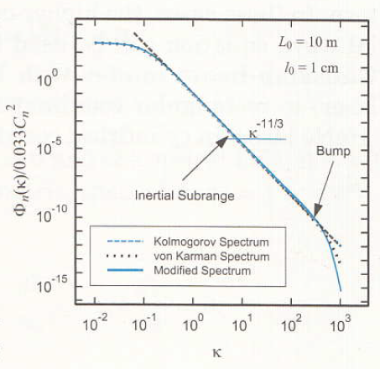
A. 3 Power spectrum
Three-dimensional power spectrum of temperature fluctuation
Tatarskii (1968)
Three-dimensional refractive index power spectrum
Andrews (2004)

Slide 58
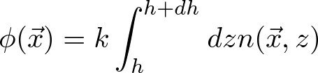







A. 4 Phase structure function
Phase shift
Phase correlation function
Phase structure function

Slide 59
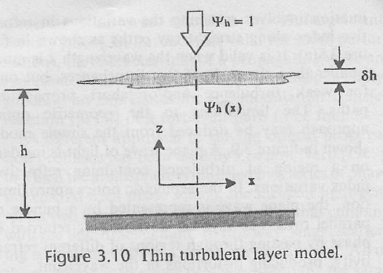
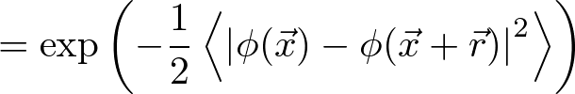
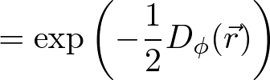
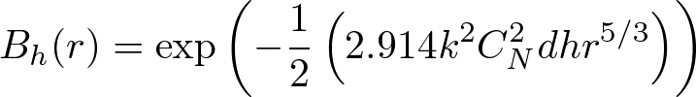
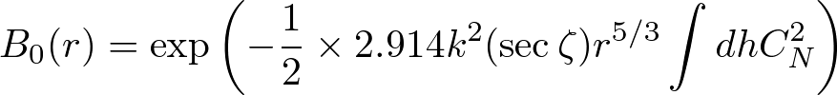
A. 5 Coherence function
Coherence function
“Adaptive Optics for Astronomical Telescope” (Hardy 1998)
Coherence function at the telescope aperture
zenith angle correction

Slide 60

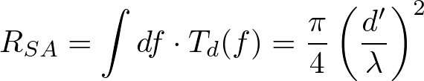


A. 6 Optical transfer function
Optical transfer function
B(f) = atmospheric transfer function
T(f) = telescope transfer function
Small aperture
Large aperture
Fried also defined the parameter r₀, which is the diameter of a telescope which would have the same resolving power as the atmospheric transfer function

Slide 61



A. 7 Fried parameter
Here, B(f) may be written
Fried parameter
Phase structure function

Slide 62

B. 1 DF-DIMM

Slide 63







B. 2 DF-DIMM hardware
Based on Okita et al. 2013, IAU Symposium, 288, 25
We use Meade LX200AFC-8” telescope and SBIG ST-i CCD camera for DF-DIMM. These commercial models are relatively low prices and have high reliability. We have to modified them for in the low temperature operation. We replaced grease, bearings, and cables, and we added heaters inside them. After the modification we checked them in a -80ºC freezer.
Meade LX200ACF-8”
Cassegrain telescope
SBIG ST-i
monochrome CCD camera
・5W heaters protect the frosting of the optical windows.
・Motors and the electric circuits are heated for -80ºC operation.
・LX200 and ST-i were tested in -80ºC environment in a freezer.
The Telescope, the CCDs, and the control PCs need 43W. It needs additional 63W for heaters in -80ºC operation.
(top) optical windows with 2W heaters, (middle) motor and circuit with heaters and polyurethane form, (bottom) LX200 in a freezer of -80C

Slide 64
B. 3 DF-DIMM software
Based on Okita et al. 2013, IAU Symposium, 288, 25
Two Linux (Ubuntu 11.04) PCs control LX200 and ST-i(s). We made control software using C language, awk and bash script. The pointing, focusing, and seeing measurements are curried out automatically by this software.
Pointing Automatically
We used Canopus for seeing measurements. This seeing measurement procedure was repeated. The ST-i CCD camera, which were controled by Nightview, takes 450 frames for each measurements. We use cfitsio for pre-reductions of their images. After the pre-reduction Sextractor is used for detecting the star positions. The results of the seeing measurement is transported via PLATO-F Iridium communication.
Focusing Automatically
take 450 frames
pre-reduction
detect the star positions
by using Sextractor
calculate the average, variance, and covariance of the relative star positions
air-mass correction

Slide 66
11m
disappearance of the surface boundary layer
the surface boundary layer is below the level of the telescope
the surface boundary layer is higher than the level of the telescope

Slide 67

Seeing Results (2/4)

Slide 68

Seeing Results (3/4)

