Slide 1

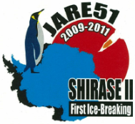






The Current status for Dome Fuji astronomy
Based on the seminar at UNSW, Sydney (March 14, 2013)
Excellent daytime seeing at Dome Fuji on the Antarctic plateau
Based on Okita+ 2013 (in preparation)
Hirofumi OKITA
Misa-seminar
May 16, 2013

Slide 2
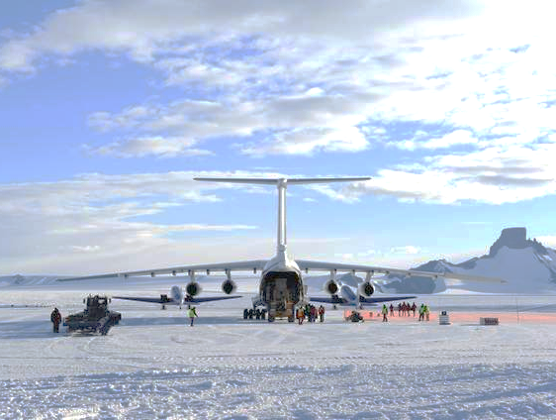
JARE 54th Activities
We planed to carried out six subjects at Dome Fuji in 2012-2013 summer.
Repairing, Modifying, Refueling of PLATO-F
Construct an Astronomical Platform
Infra-red sky scattering measurements
Seeing measurements
Maintenance for JARE 52nd Instruments
Set up all-sky aurora cameras

Slide 3
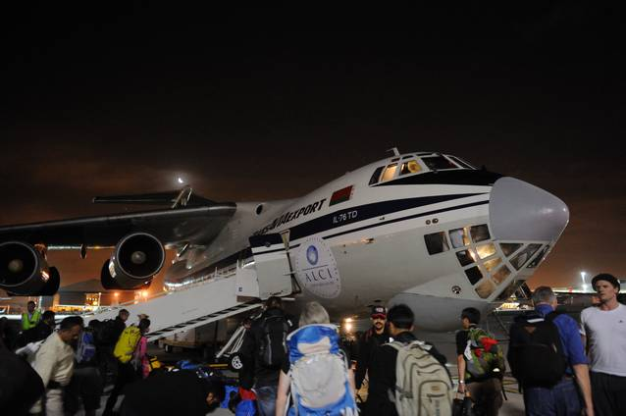
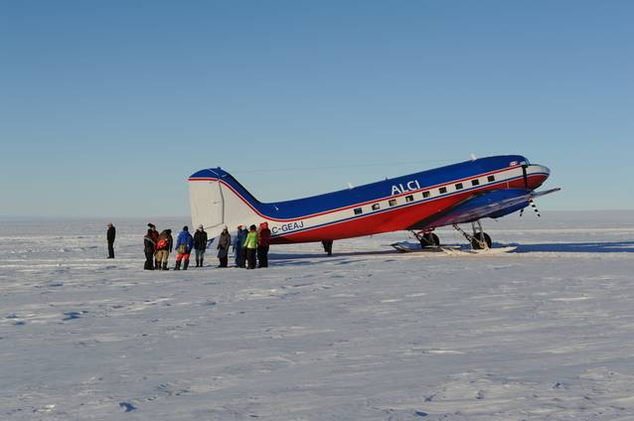
0. Time table
Nov. 10 Tokyo
Nov. 12 Cape Town
Nov. 19 Troll/Novo station
Nov. 20 S17 runway
Nov. 27 Mizuho station
Dec. 8 Mid point
Dec. 15-Jan.23 Dome Fuji
Jan. 27 Mid point
Jan. 31 Mizuho station
Feb. 7 S17 runway/Novo station
Feb. 8 Cape Town
Feb.14 Tokyo
96 days
79 days
stay 39 days

Slide 4
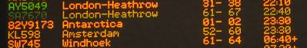

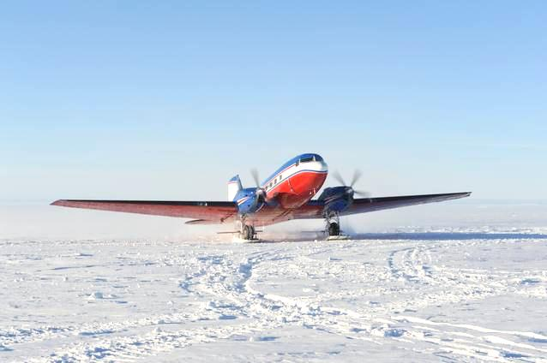
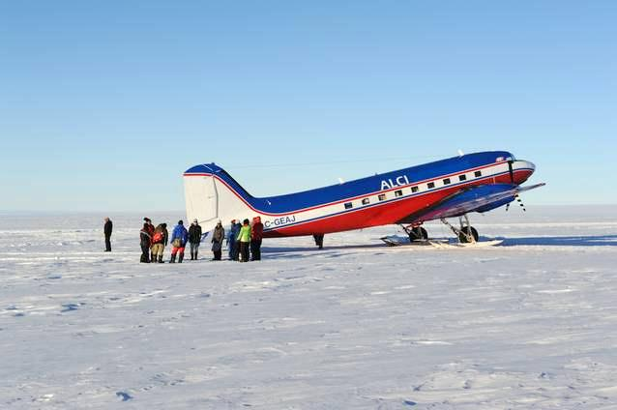
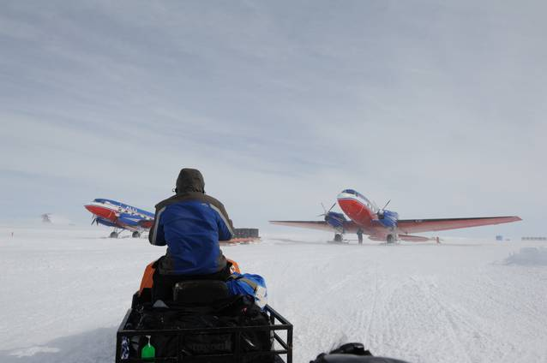
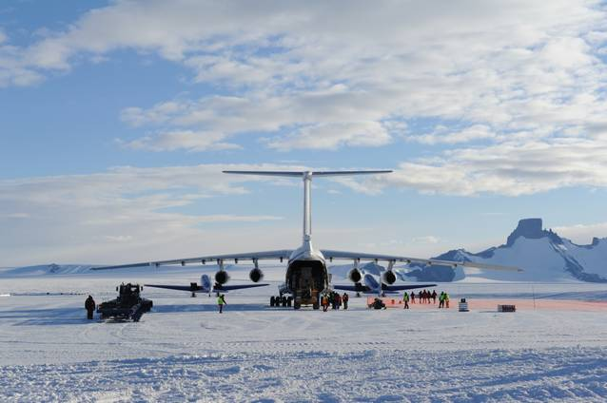
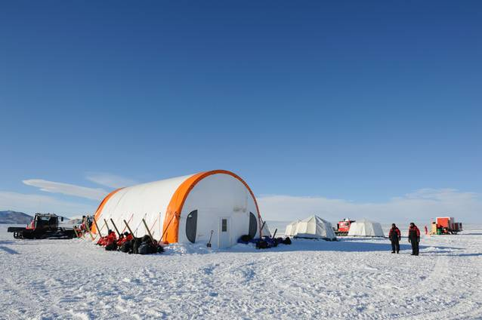
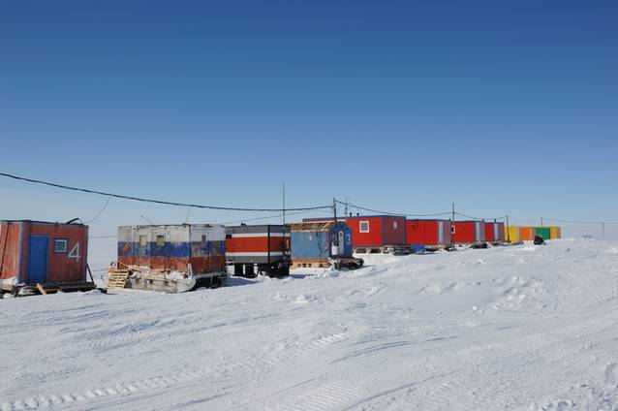
0. To Antarctica
Cape Town
Int’l Airport
Novo runway (Russia)
S17 runway
Troll runway (Norway)

Slide 5
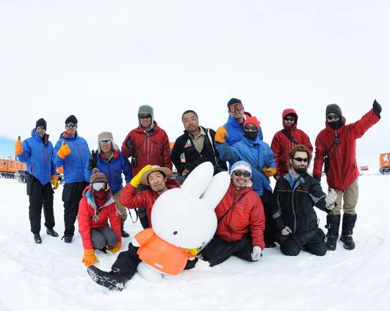
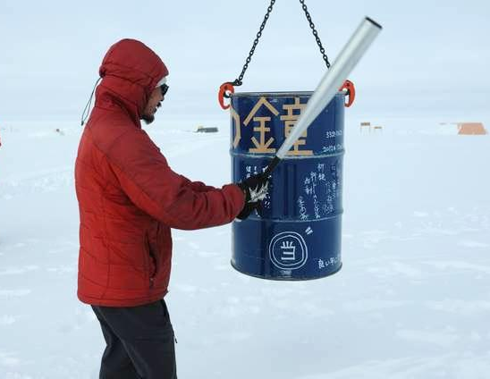
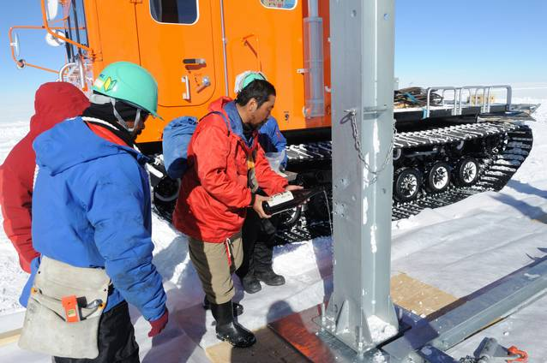
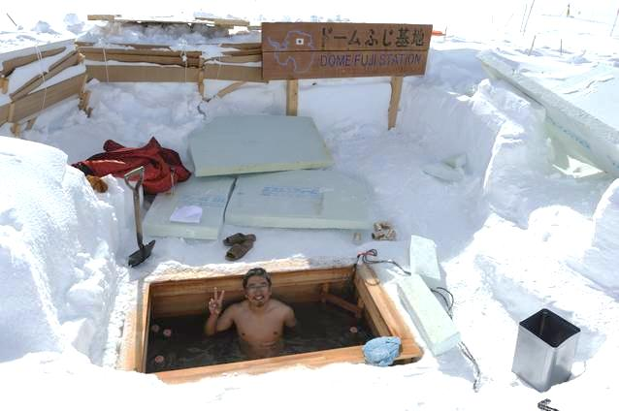
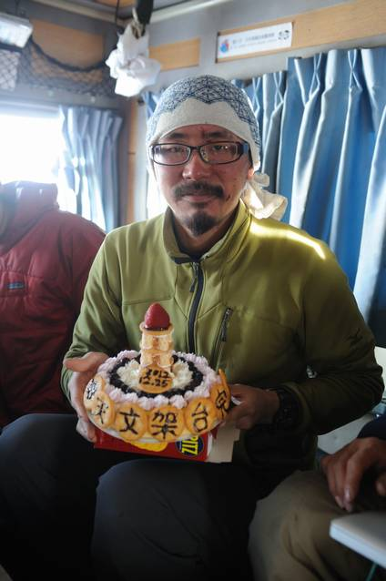
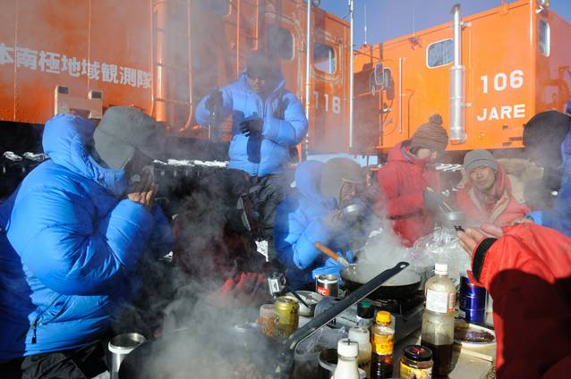
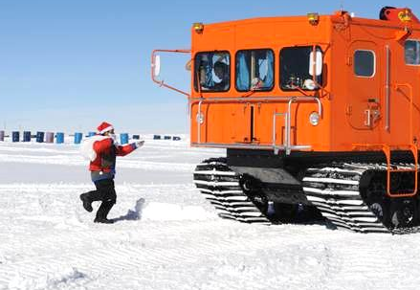
Enjoy Antarctica
take a lot of group photos
new year’s bell
hot spring (bath)
pray for gods
party cake
outside dinner
Santa Claus coming!

Slide 6
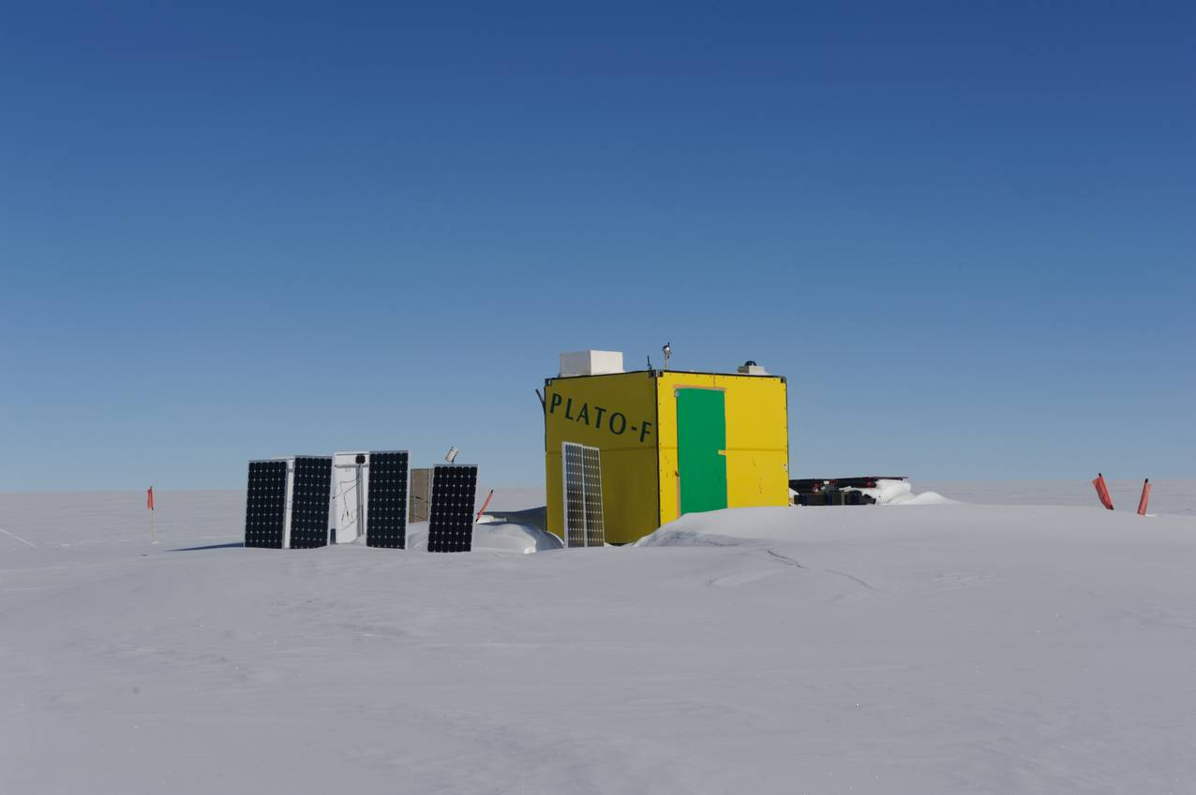
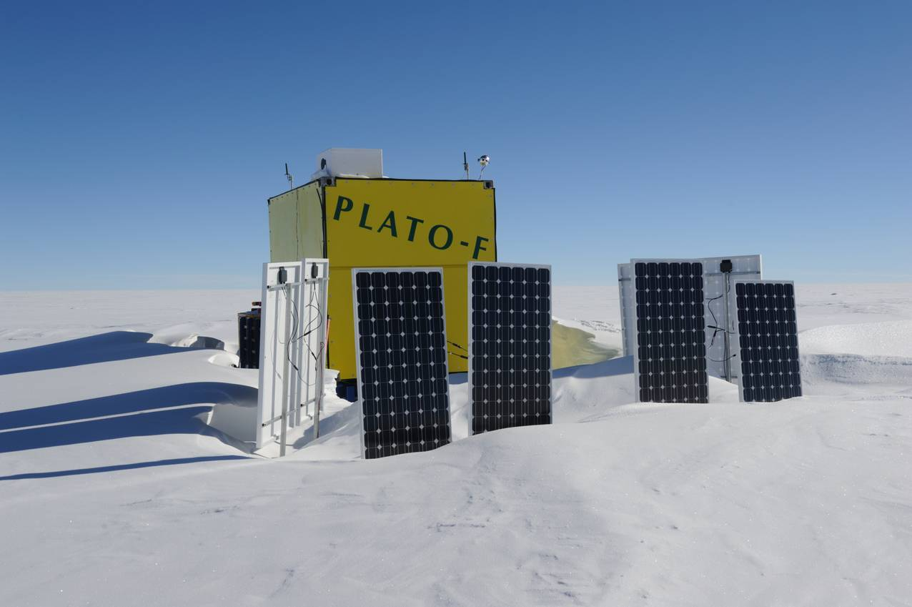
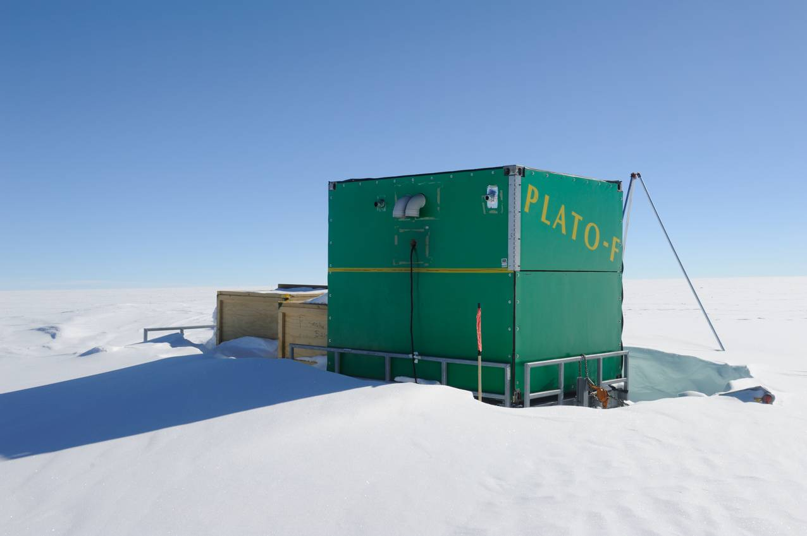
1. Repairing, Modifying, Refueling of PLATO-F
December 15
(Arrival at Dome Fuji)
Check outside
→ snow accumulation (~1m)
→ snow drift at leeward (South West)

Slide 7
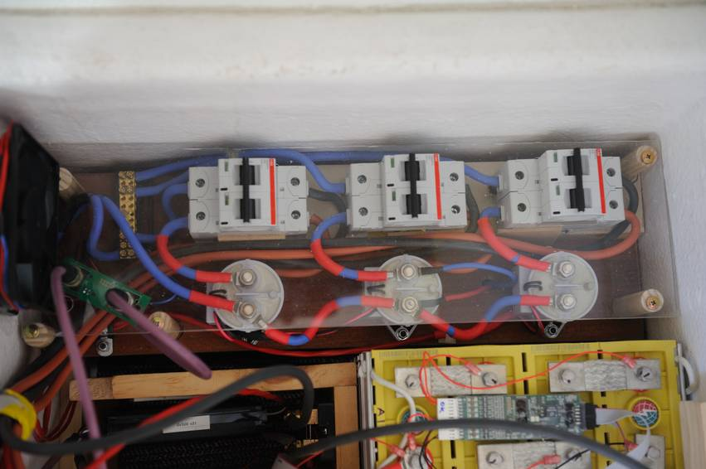
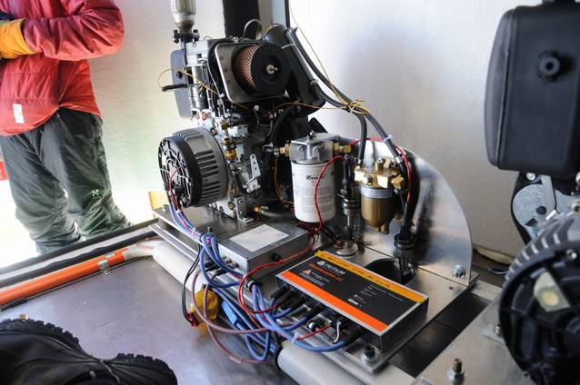
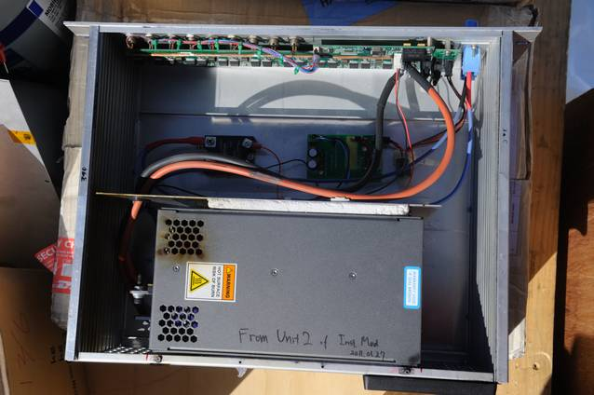
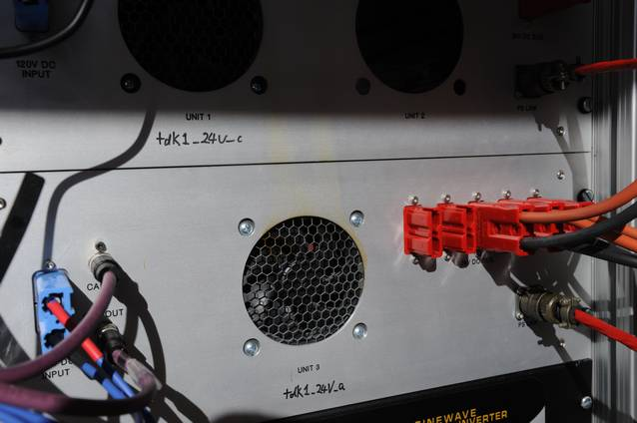
1. Repairing, Modifying, Refueling of PLATO-F
December 16
Check inside
→ no snow blow inside
→ some oil leak
→ “OFF” position of the electric breaker
→ marks of smoke at DC/DC converters
(both instrument and engine module)

Slide 8
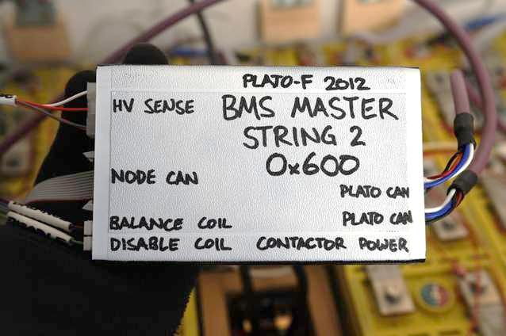
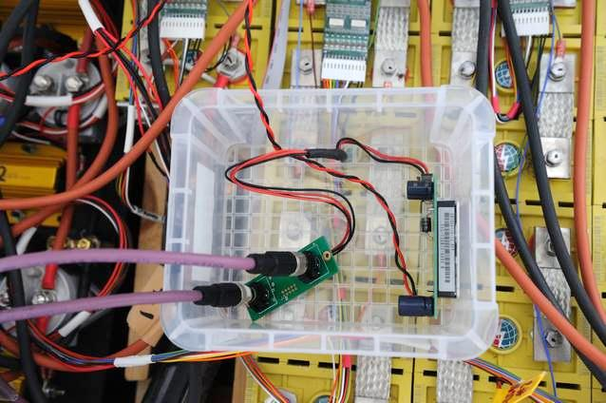
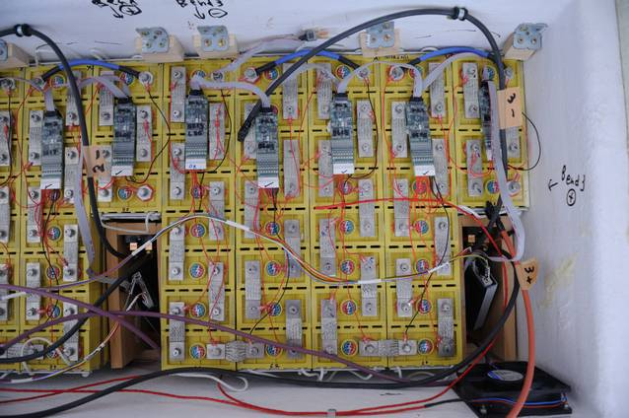
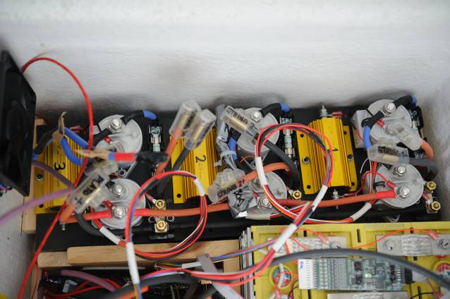
1. Repairing, Modifying, Refueling of PLATO-F
December 17-29
replace the battery harnesses
replace the battery nodes
replace the BMS3s
One of three new BMS3s did not work.
→ added a DC power supply for CAN-bus of BMS3
→ used old BMS3 with software update
We needed about 10 days to fix.

Slide 9
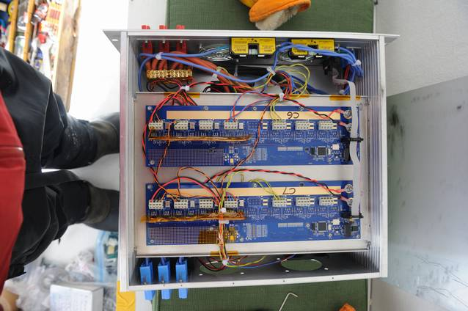
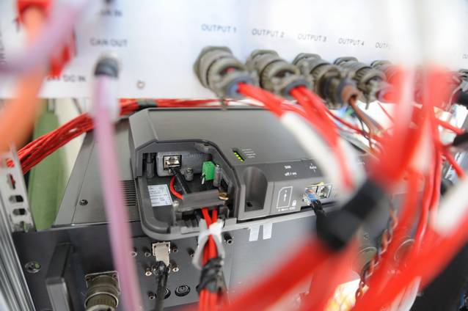
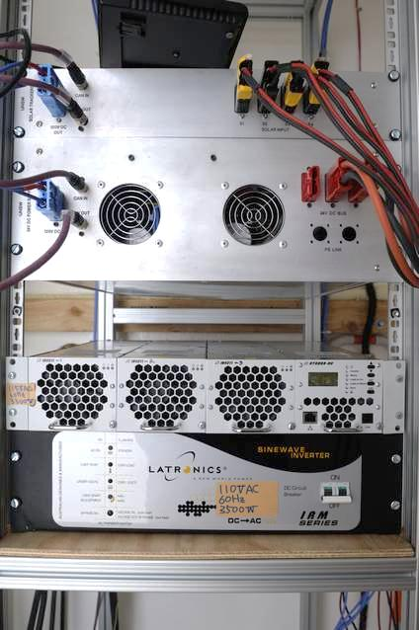
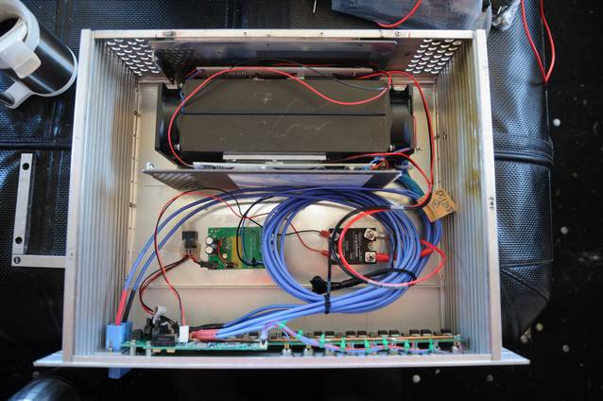
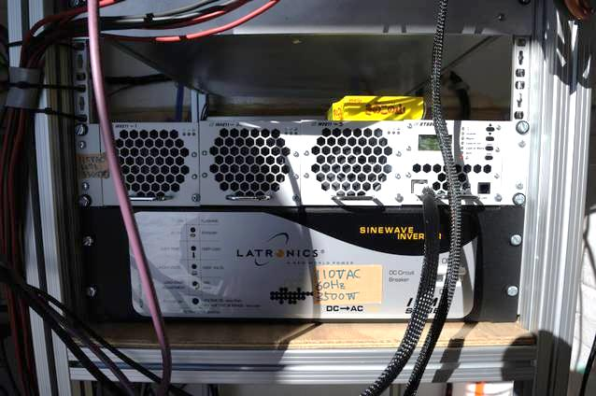
1. Repairing, Modifying, Refueling of PLATO-F
December 19-22
replaced DC/DC converters
→ establish Iridium Open Port
replaced DC/AC converters
Instrument Module
Engine Module

Slide 10
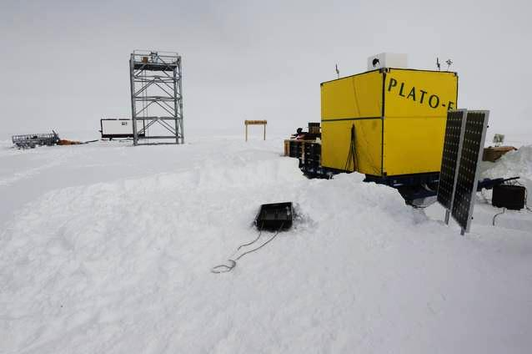
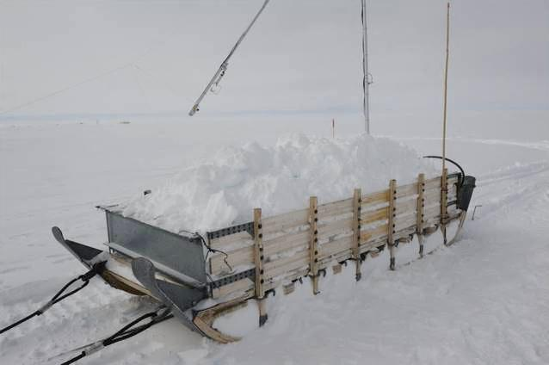
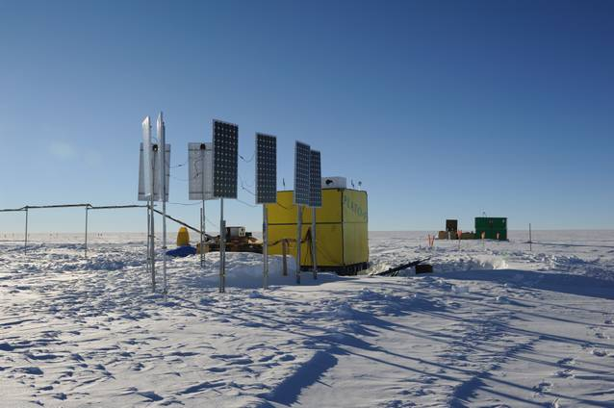
1. Repairing, Modifying, Refueling of PLATO-F
December 26
replace solar panels
really heavy work!
Do not put cables on snow!

Slide 11
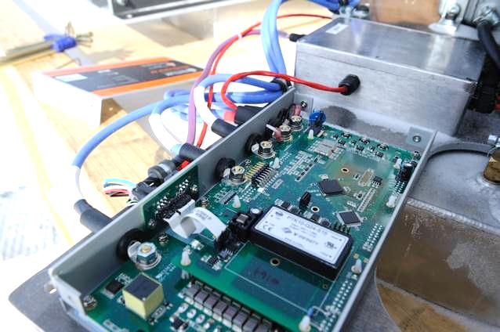
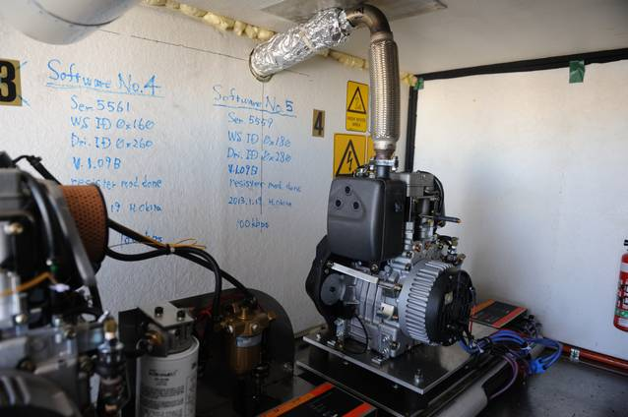
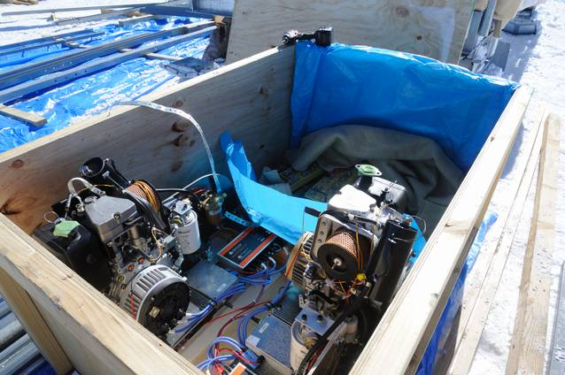
1. Repairing, Modifying, Refueling of PLATO-F
December 27 – January 20
check engines
update WS22 (software & hardware)
replace two engines
Fault to update the firmware on a WS22
→ try again and again, but it did not work
→ new firmware-update procedure made success
→ We needed about 3 week to fix

Slide 12
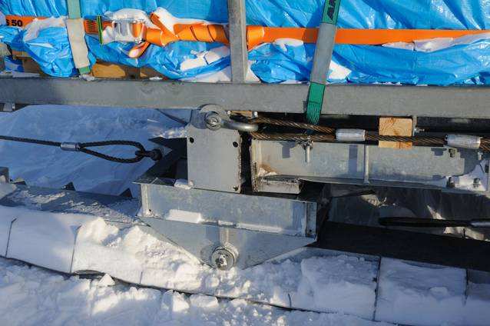
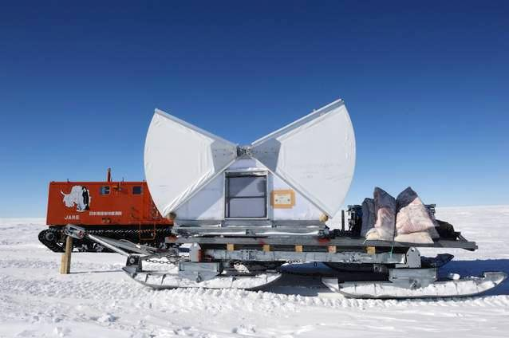
2. Construct an Astronomical Platform
We planed to build an astronomical platform at Dome Fuji to avoid the effect the surface boundary layer as much as possible.
Clamshell-roof type enclosure protects from diamond- dust, wind, and blizzard.
Astronomical Platform (stage height ~ 9m)
Clamshell-roof type enclosure
However, …
The sledge were broken! We gave up to transport the enclosure.
@ NMD30

Slide 13
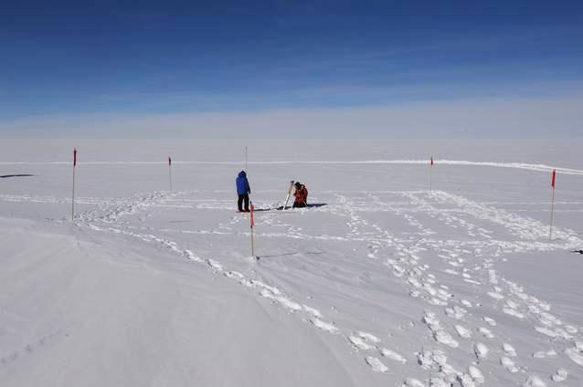
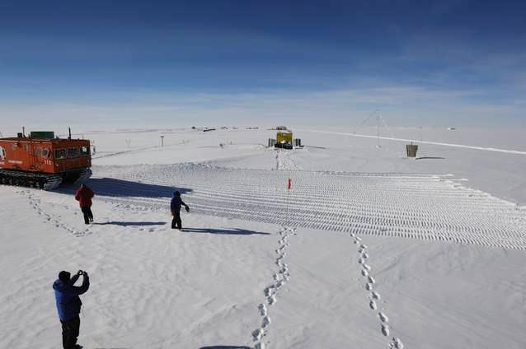
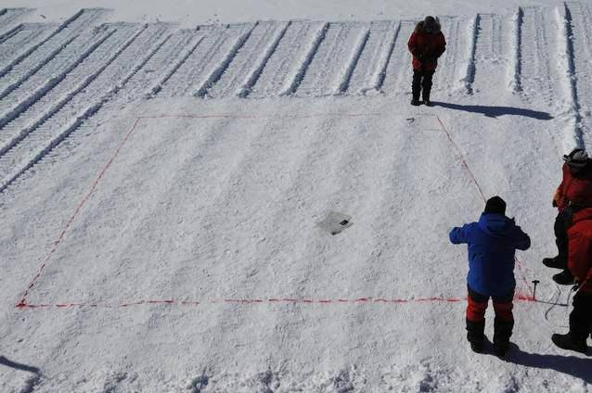
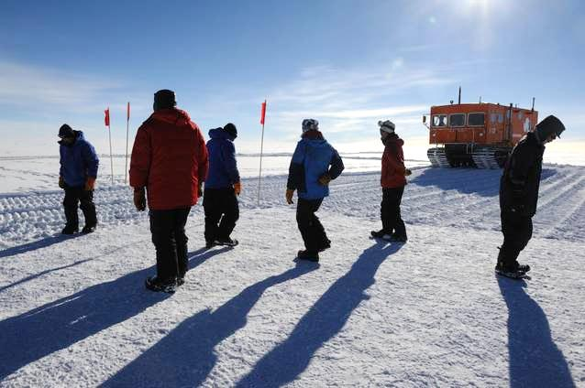
2. Construct an Astronomical Platform
December 16 – 29
made solid snow foundation

Slide 14
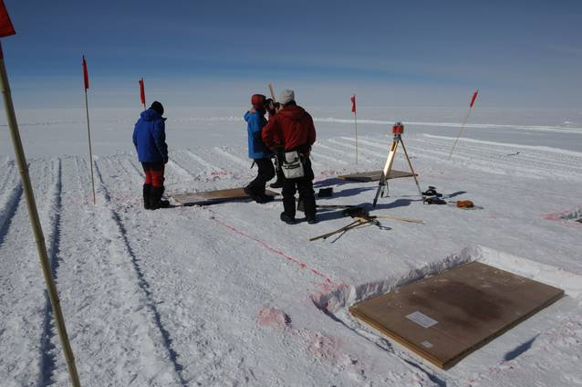
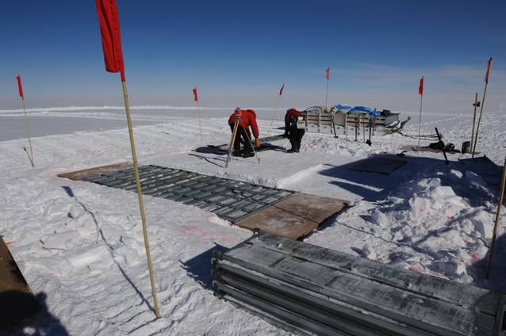
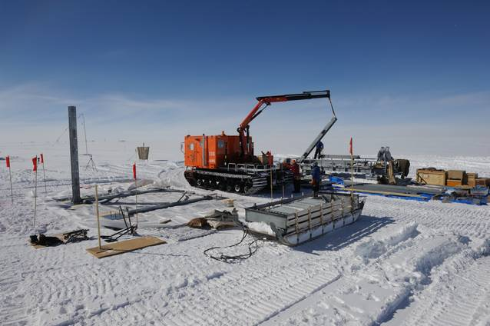
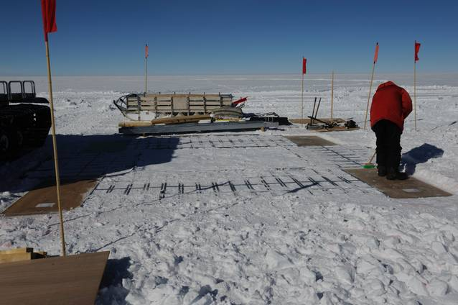
2. Construct an Astronomical Platform
December 16 – 29
reveling and making the base

Slide 15




2. Construct an Astronomical Platform
December 16 – 29
construct steel beams

Slide 16




2. Construct an Astronomical Platform
December 16 – 29
constructing steer beans, wind protection wall, and electric cabling
9m
cabling
wind protection wall

Slide 17

3. Infra-red sky scattering measurements
We really did our best, however it failed.
December 26 - January 21
Compressor, and Vacuum-pump did not work.
We added some heaters, try and try everything for repairing the Infrared camera, but we could not fix it.
We lost ~ 4 weeks...
Winter-over infra-red observations were canceled.

Slide 18

4. Seeing measurements
an “exclusive” small telescope
on the 9m astronomical stage
full-automatic
→ DF-DIMM
Dome Fuji Differential Image Motion Monitor
set up on December 27
pixel scale calibration on January 1
observations from January 4 to January 23

Slide 19


5. Maintenance for JARE 52nd Instruments
We lost almost all time to fix the trouble of BMS3s, WS22s, and infrared camera. We had no time to maintenance the old instruments.
SNODAR
→ re-set up on December 30
→ no software/hardware maintenance
HR-CAM
→ no software/hardware maintenance,
but it worked well
Egg of Vision
→ no software/hardware maintenance

Slide 20



5. Maintenance for JARE 52nd Instruments
16m weather mast
--- Established by JARE52 in 2010 austral summer
Removed on January 18
Data collection

Slide 21




5. Maintenance for JARE 52nd Instruments
TwinCAM --- for transit observation
PI: Takato-san (Subaru)
remove ITO window
adjust the focuses

Slide 22

6. Set up all-sky aurora cameras
Miyaoka-san’s all sky camera
Two camera housings
server PC in IM
set up on January 17-22
Aurora cameras work well even in the cold (-70C) temperature!

Slide 23



6. Set up all-sky aurora cameras
2013/04/07 01:00:00
Unit #2
2013/05/15 00:25:00
Unit #1

Slide 24
Excellent daytime seeing at Dome Fuji on the Antarctic plateau
Okita et al. 2013
in preparation
We acknowledge the National Institute of Polar Research and the 51st - 54th Japanese Antarctic Research Expeditions. This research is supported by the National Institute of Polar Research through Project Research no.KP-12, the Grants-in-Aid for Scientific Research 18340050 and 23103002, the Australian Research Council and Australian government infrastructure funding managed by Astronomy Australia Limited. Hirofumi Okita thanks the Sasakawa Scientific Research Grant from The Japan Science Society, and Tohoku University International Advanced Research and Education Organization for scholarships and research expenses.

Slide 25


DF-DIMM
Dome Fuji Differential Image Motion Monitor
We used an exclusive small full-automatic telescope on the 9 m astronomical tower in order to be as height as possible within, and sometimes above, the surface boundary layer.
DF-DIMM
PLATO-F
11m

Slide 26

Seeing Results (1/4)
We carried out DIMM observations 11 m above the snow surface at a wavelength of 472nm from 2013 January 1 to January 23 in 2013.
In all, we obtained 3768 seeing estimates, each one being the average of 450 images over a period of about five minutes.
Mean | 0.67”
Median | 0.52”
Mode | 0.36”
75%tile | 0.78”
25%tile | 0.36”
Note: This larger statistic values are believed to be caused by periods when the telescope was within the turbulence boundary layer.

Slide 27

Seeing Results (2/4)

Slide 28

Seeing Results (3/4)

Slide 29

Seeing Results (4/4)
A period of excellent seeing, below 0.2” and continuing about 4 hours, was observed near local midnight at 2013 January 6.
Other periods of excellent seeing, less than 0.3”, were observed close to midnight on a total of six occasions (January 6, 11, 15, 19, 21, and 23)
The seeing has a tendency to have a local minimum of ~0.3” a few hours before local midnight.
This is clear in the data for January 6,7,9, and 16.

Slide 30

Discussion (1/3)
Height
Stratosphere
~10km
Jet Stream
Free Atmosphere
Astronomical seeing in Antarctica is generally considered as the super-position of the contributions from two layers; the surface boundary layer and the free atmosphere above. (No jet stream on the Antarctic plateau!)
Troposphere
10m ~
1km
Surface Boundary Layer
Simulations suggest that the free atmosphere seeing could be 0.21” and the height of the surface boundary layer is 18 m at Dome Fuji (Saunders et al. 2009; Swain & Gallee 2006).
1)
2)
3)
disappearance of the surface boundary layer
the surface boundary layer is below the level of the telescope
the surface boundary layer is higher than the level of the telescope

Slide 31
Discussion (2/3)
A similar local minimum before midnight has also been seen at Dome C, and has been interpreted by Aristidi et al. (2005) as due to the disappearance of the surface boundary layer.
Our results are consistent with this.

Slide 32
Discussion (3/3)
It is interesting to note that the excellent seeing we have observed at local midnight has not been reported from site testing at Dome C.
The weak solar energy input at midnight is expected to result in an intense temperature gradient near the snow surface at this time.
This strong temperature gradient should produce a strong surface boundary layer, and hence poor seeing from the surface.
This is only consistent with our observations if the surface boundary layer is below the level of the telescope.
We there for conclude that our DIMM was above the surface boundary layer during these periods, and was sampling the free atmosphere seeing.

Slide 33
Conclusion
It is remarkable that seeing in the range 0.2” to 0.3” was observed for continuous periods of hours at a height of only 11 m above the snow surface.
At Dome Fuji on the Antarctic plateau,
The free atmosphe seeing is ~0.2”.
The height of the surface boundary layer can be as low as ~11 m.

Slide 34

We appreciate all your great support.

Slide 35

We were really happy to stay and work at Dome Fuji.

Slide 36







DF-DIMM Hardware
Based on Okita et al. 2013, IAU Symposium, 288, 25
We use Meade LX200AFC-8” telescope and SBIG ST-i CCD camera for DF-DIMM. These commercial models are relatively low prices and have high reliability. We have to modified them for in the low temperature operation. We replaced grease, bearings, and cables, and we added heaters inside them. After the modification we checked them in a -80ºC freezer.
Meade LX200ACF-8”
Cassegrain telescope
SBIG ST-i
monochrome CCD camera
・5W heaters protect the frosting of the optical windows.
・Motors and the electric circuits are heated for -80ºC operation.
・LX200 and ST-i were tested in -80ºC environment in a freezer.
The Telescope, the CCDs, and the control PCs need 43W. It needs additional 63W for heaters in -80ºC operation.
(top) optical windows with 2W heaters, (middle) motor and circuit with heaters and polyurethane form, (bottom) LX200 in a freezer of -80C

Slide 37
DF-DIMM Software
Based on Okita et al. 2013, IAU Symposium, 288, 25
Two Linux (Ubuntu 11.04) PCs control LX200 and ST-i(s). We made control software using C language, awk and bash script. The pointing, focusing, and seeing measurements are curried out automatically by this software.
Pointing Automatically
We used Canopus for seeing measurements. This seeing measurement procedure was repeated. The ST-i CCD camera, which were controled by Nightview, takes 450 frames for each measurements. We use cfitsio for pre-reductions of their images. After the pre-reduction Sextractor is used for detecting the star positions. The results of the seeing measurement is transported via PLATO-F Iridium communication.
Focusing Automatically
take 450 frames
pre-reduction
detect the star positions
by using Sextractor
calculate the average, variance, and covariance of the relative star positions
air-mass correction

Slide 38

DF-DIMM
Dome Fuji Differential Image Motion Monitor

Slide 39
11m
disappearance of the surface boundary layer
the surface boundary layer is below the level of the telescope
the surface boundary layer is higher than the level of the telescope

Slide 40
Seeing Results (2/4)

Slide 41
Seeing Results (3/4)

