Slide 1
ガンマ線連星からの電波放射と超新星残骸の中性鉄輝線放射とXRISM衛星の現状
藤田裕（大阪大学）

Slide 2
内容
ガンマ線連星 PSR B1259–63/LS 2883 の ALMA による初検出
  藤田裕(大阪大学), 河内明子(東海大学), 赤堀卓也，永井洋(国立天文台), 山口正輝（甲南大学/神戸製鋼）
    2019, PASJ, 71, L3
超新星残骸の MeV 宇宙線と 6.4 keV 中性鉄輝線
  牧野謙、藤田裕(大阪大学) , 信川久実子(奈良女子大学), 松本浩典(大阪大学), 大平豊(東京大学)
    2019, PASJ, 71, 78
XRISM の現状

Slide 3
Gamma-ray binaries
First identified in 2004
Seven binaries have been identified
  Compact object (neutrons star or black hole) + ordinary star
  Nature of the compact object is generally unknown (neutron star or black hole?)
PSR B1259-63/LS 2883 is the only exception
  The compact star is known to be a neutron star
    Pulses have been detected

Slide 4
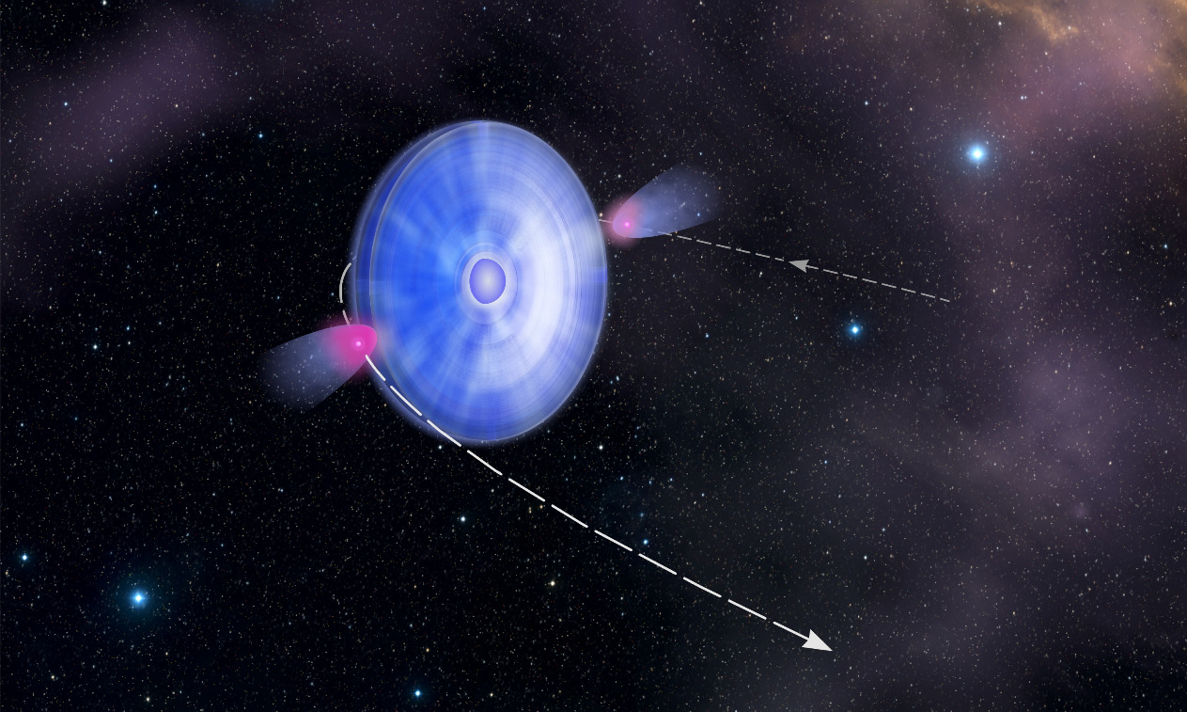
PSR B1259-63/LS 2883
Pulsar + Be star
  Orbital period ~ 3.4 yr
Be star
Pulsar
Decretion disk
NASA

Slide 5
Previous observations
Unpulsed emissions
  Interaction between the pulsar and the stellar disk
Radio (10 GHz)
  Synchrotron
X-ray
  Synchrotron or inverse Compton?
Gamma-ray
  inverse Compton?
No radio observations at 10 GHz
ALMA
SED
Abdo et al. (2011)

Slide 6
Our Cycle 5 ALMA observations
Band 3 (97 GHz)
  71 and 84 days after 2017 periastron
Band 7 (343 GHz)
  69 days after 2017 periastron
Exposure time is ~ 5 min for each observation!
Our observations
  Gamma-ray flares were observed at  72 days
  2nd Band 3 observation was done at a less active period
Gamma-ray light curve
(Johnson et al. 2018)
Flux
Flares
Days

Slide 7
Results
Band 3
  No flux change between the two observations
    Band 3 emissions are irrelevant to the gamma-ray flares
  On an extrapolation of lower frequency observations
    Synchrotron
      Prompted by pulsar-disk interaction
Fujita et al. (2019)

Slide 8
Results
Band 7
  Not on an extrapolation of lower frequency observations
    Disk emission?
      van Soelen, & Meintjes (2011)
  If X-ray and gamma-ray emissions are inverse Compton, the disk could provide seed photons
Fujita et al. (2019)

Slide 9

Results
Our picture
  Band 3
    Pulsar-disk interaction
  Band 7
    Disk
Magnetic fields
  Synchrotron emissions up to ~100 GHz (Band 3) means
Time since electron injection

Slide 10
Short Summary
ALMA observations of PSR B1259-63/LS 2883
  Band 3
    No relation to gamma-ray flares
    Synchrotron (pulsar-disk interaction)
  Band 7
    Stellar disk
  We are planing to confirm the above speculations in Cycle 7

Slide 11
MeV cosmic-rays and 6.4 keV Fe line emissions from supernova remnants (SNRs)
Yutaka Fujita (Osaka)
Ken Makino (Osaka)
Kumiko K. Nobukawa, Arisa Hirayama, Aika Shimaguchi, Shigeo Yamauchi (Nara women’s)
Hironori Matsumoto (Osaka)
Yutaka Ohira (Tokyo)
Masayoshi Nobukawa (Nara edu.)
Makino et al. 2019, PASJ, 71, 78
Nobukawa et al. 2019, PASJ, in press

Slide 12
6.4 keV Fe line in SNRs
Nobukawa et al. (2018)
  Five middle age supernova remnants (SNRs) show 6.4 keV line
W28
W44
6.4 keV
GeV
Suzaku observations (Nobukawa et al. 2018)

Slide 13
6.4 keV Fe line in SNRs
Fe I Kα line (neutral iron)
Interaction between neutral irons and
  X-rays (~10 keV)
  Electrons (~20 keV)
  Protons (~10 MeV)
They can be discriminated by equivalent width (EW)
  X-rays (< 0.7 keV)
  Electrons(< 0.4 keV)
  Proton (> 0.9 keV)
X-ray spectrum of
an SNR
Nobukawa et al. (2018)

Slide 14
Origin of 6.4 keV line
No X-ray sources near the SNRs
EW > 0.4 keV
  Origin must be ~10 MeV protons
    Probe of missing link of cosmic-ray (CR) proton acceleration by SNRs
      SNRs are a main source of Galactic CRs up to ~ 100 TeV
E²f(E)
CR spectrum
?
Acceleration
Thermal
Detectable with γ-rays
E
MeV GeV TeV

Slide 15
Evolution of CR spectrum
A standard scenario of CR escape
  Momentum of escaping CRs p_{esc}
⇔ escaping time t_{esc}
⇔ radius of the SNR R_{sh}
~ R_{esc} (escape radius)
Confined CRs
Ohira, Murase, & Yamazaki (2010)
dN/dp
t
∝ p ^{- s}
Escaped CRs
(total)
Confined CRs
∝ p ^{- s}
∝ p ^{- sesc}
s ~ 2
t
p
MeV
p_{esc} (t_{present})
p_{esc} (t=0)
~ GeV

Slide 16
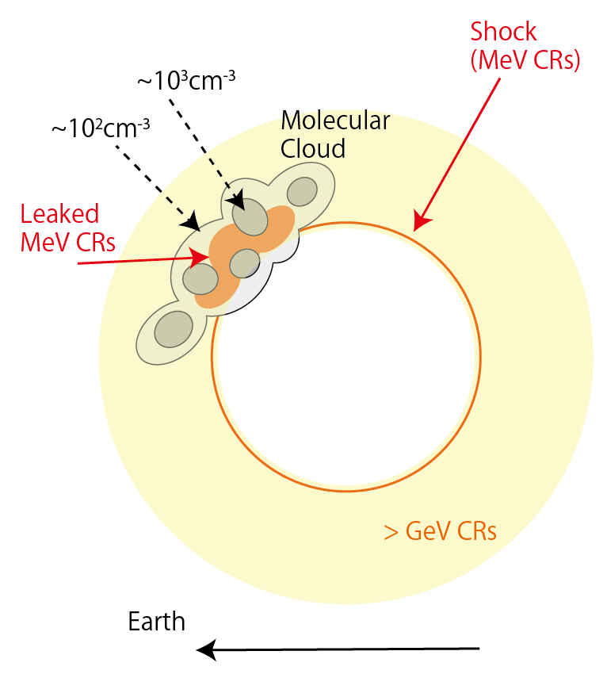
Our model
A SNR bumps into molecular clouds before MeV CRs start to escape
  MeV CRs are still localized around the shock → high density
  MeV CRs seep into clouds
  > GeV CRs have already escaped
We construct a model that can explain both MeV CRs (6.4 keV line) and > GeV CRs (γ-rays)
Fe line
γ-ray
SNR
γ-ray
γ-ray

Slide 17
Equations for escaped CRs
Diffusion equation
CR injection at the surface of the SNR
Solution (distribution function)
Ohira, Murase, & Yamazaki (2011)
p: CR momentum
α ~ 6.5 (for Sedov)

Slide 18
Interaction with molecular clouds
MeV CRs seep into molecular clouds

Slide 19
Our strategy
The spectrum of accelerated CRs can be constrained by gamma-ray spectrum
  Fitting parameters
    Total CR energy (E_{CR,tot})
    Maxim CR energy (p_{max} c)
    Index of CR spectrum (s)
  Other parameters (e.g. molecular clouds) are determined from observations
Using the fitting results, 6.4 keV line intensity is calculated
⇔ observations

Slide 20
Fitting results
Gamma-ray spectra
  3 SNRs (W28, W44, IC443)
IC443

Slide 21
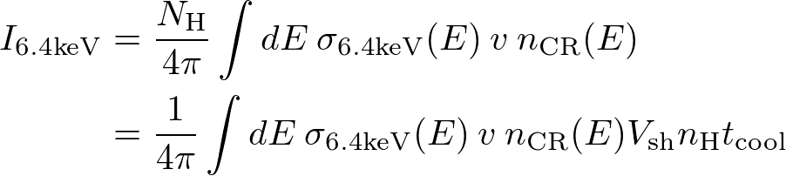
6.4 keV line intensity
σ_{6.4keV}: reaction cross-section
N_{H}: column density (molecular cloud)
v: CR velocity
n_{CR}: CR density
n_{H}: gas density (molecular cloud)
V_{sh}: shock velocity
t_{cool}: CR cooling time
(photons s⁻¹ cm⁻² str⁻¹)
Does not depend on details of the molecular cloud
  t_{cool} ∝ n_{H}⁻¹
  Good indicator of n_{CR}(E ~ 10 MeV)

Slide 22
6.4 keV line intensity
Predictions and observations
  Consistent with observations
SNR | I_{6.4keV} (cm⁻²s⁻¹sr⁻¹) Observations | I_{6.4keV} (cm⁻²s⁻¹sr⁻¹) Our predictions
W28 | 0.1 ± 0.05 | 0.07^{+0.01}_{-0.05}
W44 | 0.15 ± 0.08 | 0.10^{+0.04}_{-0.02}
IC443 | 0.27 ± 0.12 | 0.29^{+0.10}_{-0.11}
Observations: Nobukawa et al. (2018, 2019)

Slide 23
Short Summary
We explain 6.4 keV Fe line emissions from SNRs by interaction between SNRs and molecular clouds
  MeV CRs are still confined in the SNR when the SNR bumps into the molecular clouds
  After the collision, the MeV CRs leak into the clouds and produce the neutral iron line emissions
  GeV–TeV CRs had already escaped from the SNRs and emit gamma-rays through interaction with molecular
Gamma-ray spectrum and 6.4 keV Fe line intensity can be explained by our model
    Consistent with a standard CR escape scenario

Slide 24
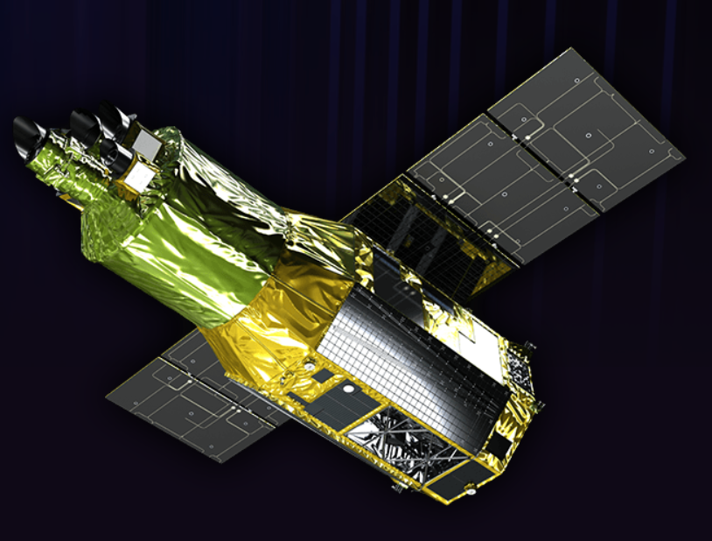
XRISM (X-Ray Imaging and Spectroscopy Mission)
Recovery mission for Hitomi (2016)
  It will be launched by the spring of 2022
Superb spectral resolution
  Detailed gas motions (e.g. sloshing in clusters) associated with the growth of dark halos
  Plasma compositions and states
Website (http://xrism.isas.jaxa.jp)
Turbulent velocity in
the Perseus cluster
164±10 km s⁻¹
XRISM
Hitomi Collaboration (2016)

Slide 25
Performance
Basically same as Hitomi, although the hard X-ray detector has been canceled
(Microcalorimeter)
(CCD)
Tashiro et al. (2018)

Slide 26
Lessons from Hitomi
Overall sensitivity was moderate, but the line sensitivity was high
Hitomi observation of
LMC SNR N132 D
Line redshift (~800 km s⁻¹)
was detected with only
17 photon counts!
Hitomi Collaboration (2018)

