Slide 1
Observational study for
State switching of gamma-ray pulsar PSR J2021+4026 and
High-magnetic field pulsar, PSR J119-6127
Jumpei Takata (Huazhong University of Science and Technology, 華中大学, China)
with
Wang H.H., Zhao J. (HUST)
Ng C.W , Cheng K.S. (HKU)
Tam P.H.T. (SYSU)
Lin. L.C.C., Hui. C.Y., Li. K.L. (UNIST, Korea)
Kong A.K.H. (NTHU, Taiwan)
Cin-Ping Hu. (Kyoto University, Japan)
S. Dai (CSIRO, Australia)
M. Kerr (Space Science Division, Washington)
X. Hou (Yunnan Observatory, China)
Notes:
I am going to talk about variable gamma-ray emissions from PSR J2021+4026, which is related to the glitch. I am jumpei Takata from this University, and the collaborators are Ruby Ng and KS of the University of Hong Kong.

Slide 2
Contents
Unusual temporal evolution of the spin-down rate
State switching of PSR J2021+4026
State switching at 2011 October
New state switching at 2018 February
Radio/X-ray/gamma-ray observations for PSR J1119-6127 after 2016 X-ray outburst
Discussion
Change of the global magnetosphere
Twisted magnetic field
Precession
Notes:
This is contents of my talk. First I very briefly introduce about the glitch, then I talk about the glitch event of radio quiet gamma-ray pulsar PSR J2021+4026. We did extensive Fermi data analysis of this pulsar and propose the model.

Slide 3

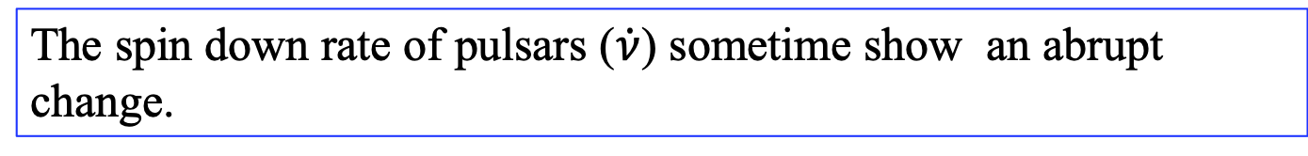
1. Introduction
The spin down rate of pulsars ($\dot{ν}$) sometime show an abrupt change.
Glitch of PSR B1930+22
Glitch
-- Abrupt spin up (/down) of the neutron star
-- >185 glitching pulsar (by radio)
-- Linearly/exponential recovery.
-- Change of the momentum inertia and/or internal structure of NS.
$$ν$$
Unusual evolutions:
-- Permanent change in the spin down rate after the glitch.
-- Repeating state switching
-- Rapid evolution of the spin down rate after the X- ray outburst (magetar/high-B pulsar)
-- Intermittent pulsar , etc...
(Espinoza et al. 2011)
Torque exerted on pulsar

Slide 4

1. Introduction
(a) State switching pulsars
-- Transient (permanent-like) between different two (or three?) spin down rate states.
-- Time scale : day~year
-- Change of the radio pulse profile.
-- ~20 radio pulsars (maybe more….)
Radio pulses
in different spin down states
PSR B1828-11
Pulse period derivative $\dot{P}$
(Stair et al. 2019)
The global magnetosphere probably repeats a transition between two meta-states.
(Lyne et al. 2010)
Notes:
Some pulsars show sudden change in the spin frequency and the spin down rate. The glitch slightly increase of the spin frequency, but some glitch significantly change the spin down rate. According to the pulsar glitch catalog, so far about 165 glitching pulsars have been detected, including radio pulsars, high-B pulsars and radio-quiet gamma-ray pulsars.

Slide 5


1. Introduction
State switching
-- No clear association with the glitch events.
-- The jump of the spin down rate is relatively larger than glitching pulsars.
: glitch position
Switching pulsars
Glitch pulsars
J2021+4026
$$∆\dot{ν}$$
$$\dot{ν}$$
The global magnetosphere transitions among different meta-steady states.

Slide 6
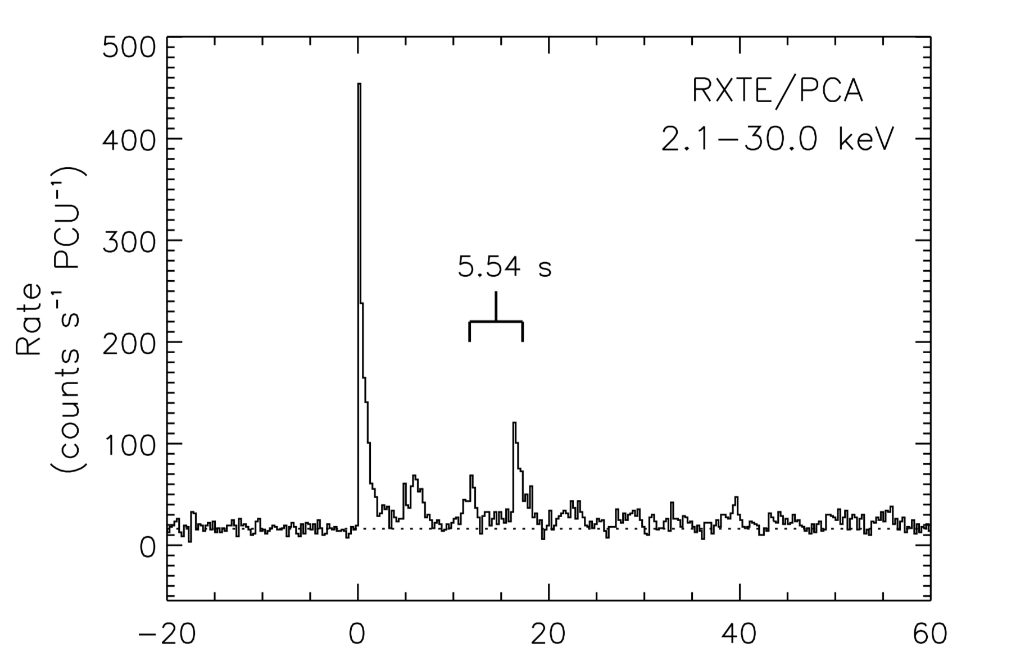
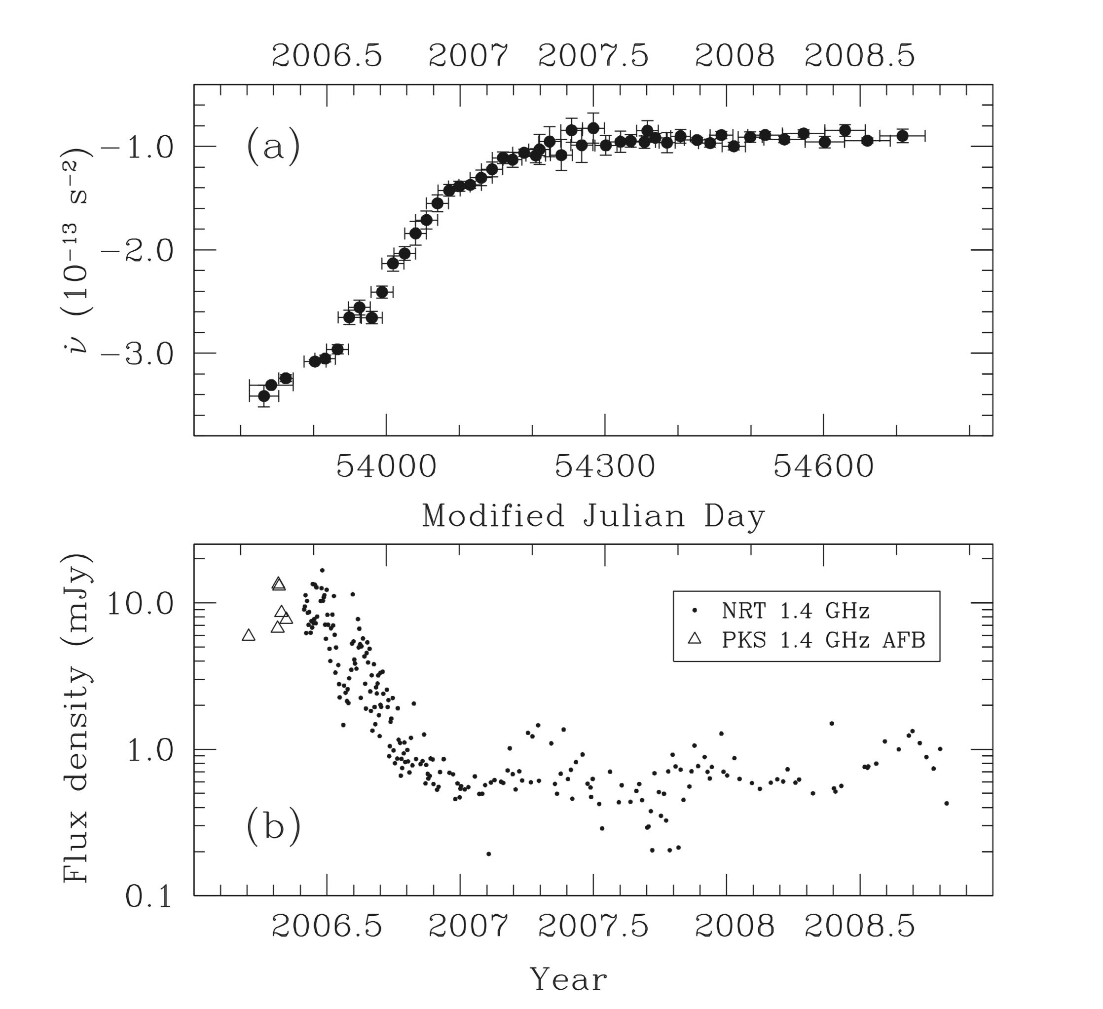
1. Introduction
(b) Large spin-down evolution after the X-ray outburst
X-ray outburst of magnetar XTE J1810-97
2004 outburst
After outburst, the spin down rate was increases for one years and then recovered to the value before the outburst.
Radio emission appeared after the outburst.
→ Reconfiguration of the global magnetosphere /current structures.

Slide 7
1. Introduction
PSR J2021+4026
Repeating state switching pulsar discovered by Fermi
PSR J1119-6127
- High-B pulsar showing magnetar like X-ray outburst in 2016

Slide 8
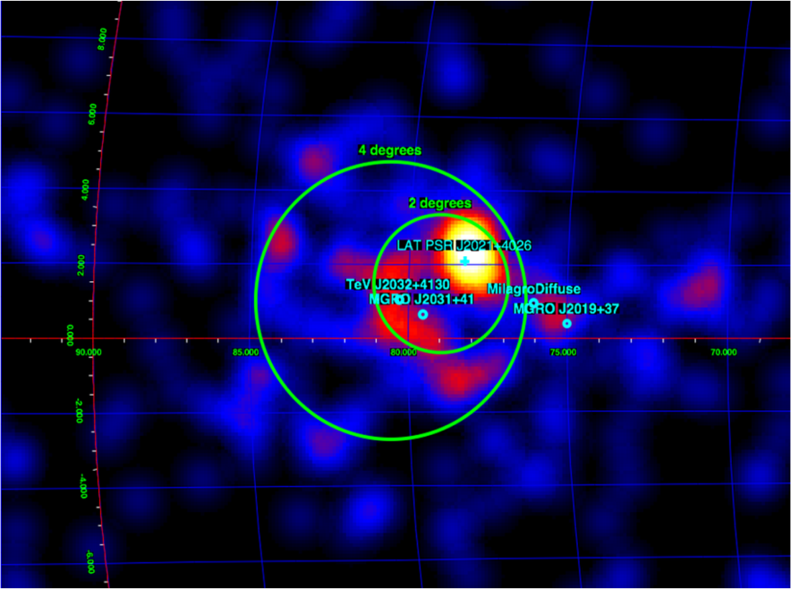
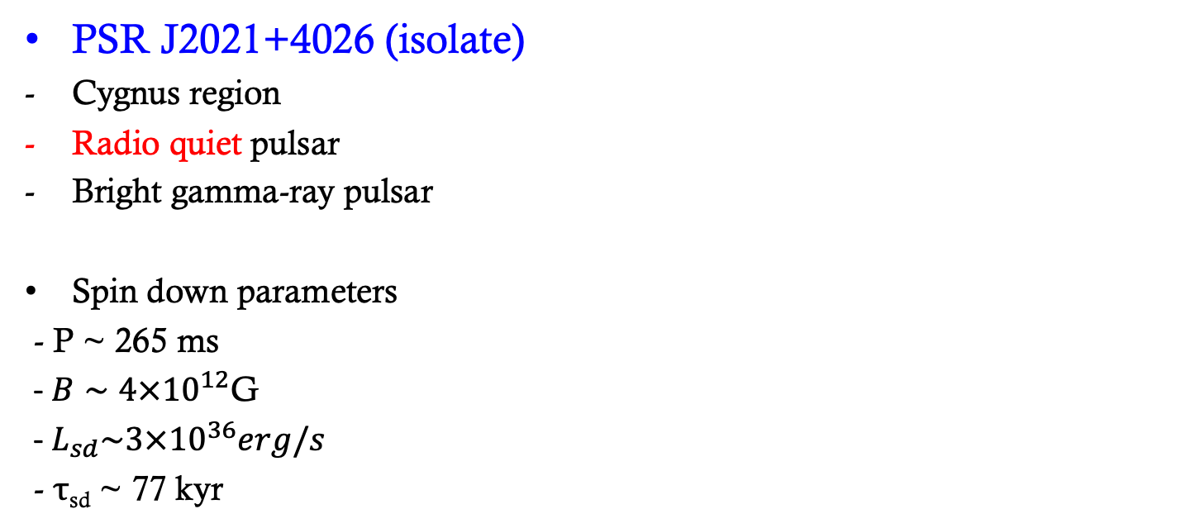
2. State switching of PSR J2021+4026
PSR J2021+4026 (isolate)
Cygnus region
Radio quiet pulsar
Bright gamma-ray pulsar
Spin down parameters
- P ~ 265 ms
- $B∼4×{10}^{12}$G
- $L_{sd}\sim {3×10}^{36}erg/s$
- τ_{sd} ~ 77 kyr
TS map around Cygnus region
Gamma-ray spectrum
>0.1GeV pulse profile
Energy flux
1GeV
10GeV
Energy
Notes:
I think one reason of the difficulty to understand the glitch events is usually the glitch do not accompany radiative events. Before and after the glithc there are not changes in the radiation properties for the glitching radio pulsars. However, it has been found that some glitch events of magnetars and rrat change the flux and pulse profile. For example, anomalous X-ray pulsar 1E1048 frequently shows the glitches, which change X-ray fluxes and pulse profiles. So, we know some glitch events affect the structure of the magnetosphere.

Slide 9
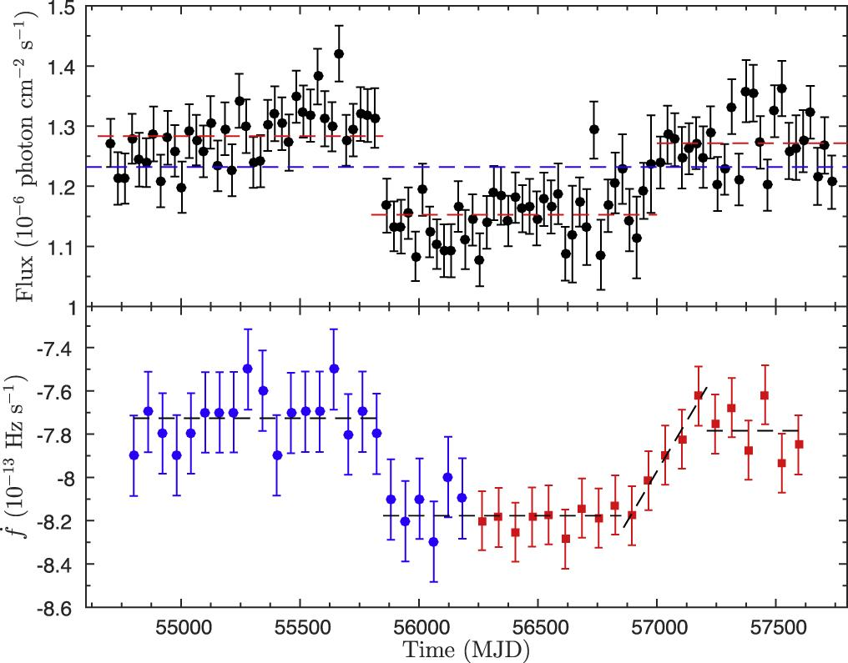
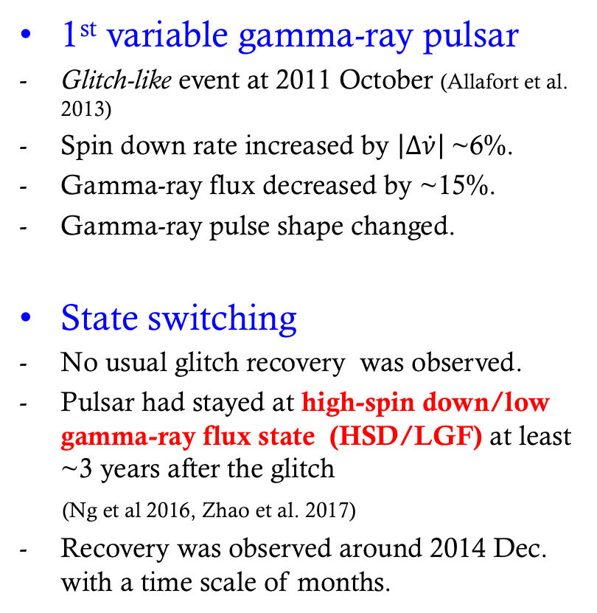
2. State switching of PSR J2021+4026
(Zhao et al. 2017)
2011 Oct.
1st variable gamma-ray pulsar
Glitch-like event at 2011 October (Allafort et al. 2013)
Spin down rate increased by $\left|∆\dot{ν}\right|$~6%.
Gamma-ray flux decreased by ~15%.
Gamma-ray pulse shape changed.
State switching
No usual glitch recovery was observed.
Pulsar had stayed at high-spin down/low gamma-ray flux state (HSD/LGF) at least ~3 years after the glitch
(Ng et al 2016, Zhao et al. 2017)
Recovery was observed around 2014 Dec. with a time scale of months.
>0.1GeV Flux
HSD/LGF
recovery
Spin down rate
Before 2011Oct
After 2011 Oct
>0.1GeV
0.1-0.3GeV
(Allafort et al. 2013)
Notes:
So PSR 2021+4026 is the first variable gamma-ray pulsar, it is the radio-quiet and it is likely isolated pulsar. This pulsar is located in the Cygnus region. The pulsar is typical case of the middle age pulsar.

Slide 10


2. State switching of PSR J2021+4026
Confirmation of new state change:
New abrupt change of spin-down rate/flux was observed at 2018 Feb (Takata et al. 2019).
The pulsar is now HSD/LGF state
Current spin down rate is consistent with previous HSD/LGF state
Abrupt switching was probably occurred with a time scale less than 10days.
~10 years evolution of >0.1GeV flux and spin down rate
Around the event (10 days time bin)
2011 Oct.
2018 Feb.
2011 event
2018 event
$$\dot{ν}({10}^{−13}Hz s^{−1})$$
$$\dot{ν}({10}^{−13}Hz s^{−1})$$
(Takata et al. 2019)
Notes:
So PSR 2021+4026 is the first variable gamma-ray pulsar, it is the radio-quiet and it is likely isolated pulsar. This pulsar is located in the Cygnus region. The pulsar is typical case of the middle age pulsar.

Slide 11
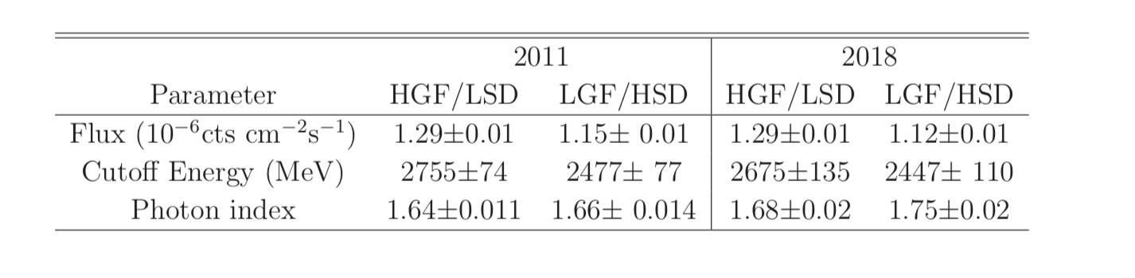
2. State switching of PSR J2021+4026
Gamma-ray Emission properties also repeat transition.
Parameters of spectrum
1GeV
10GeV
>0.1GeV pulse profile
Two gaussian fitting for the pulse profile
width
Intensity ratio

Slide 12
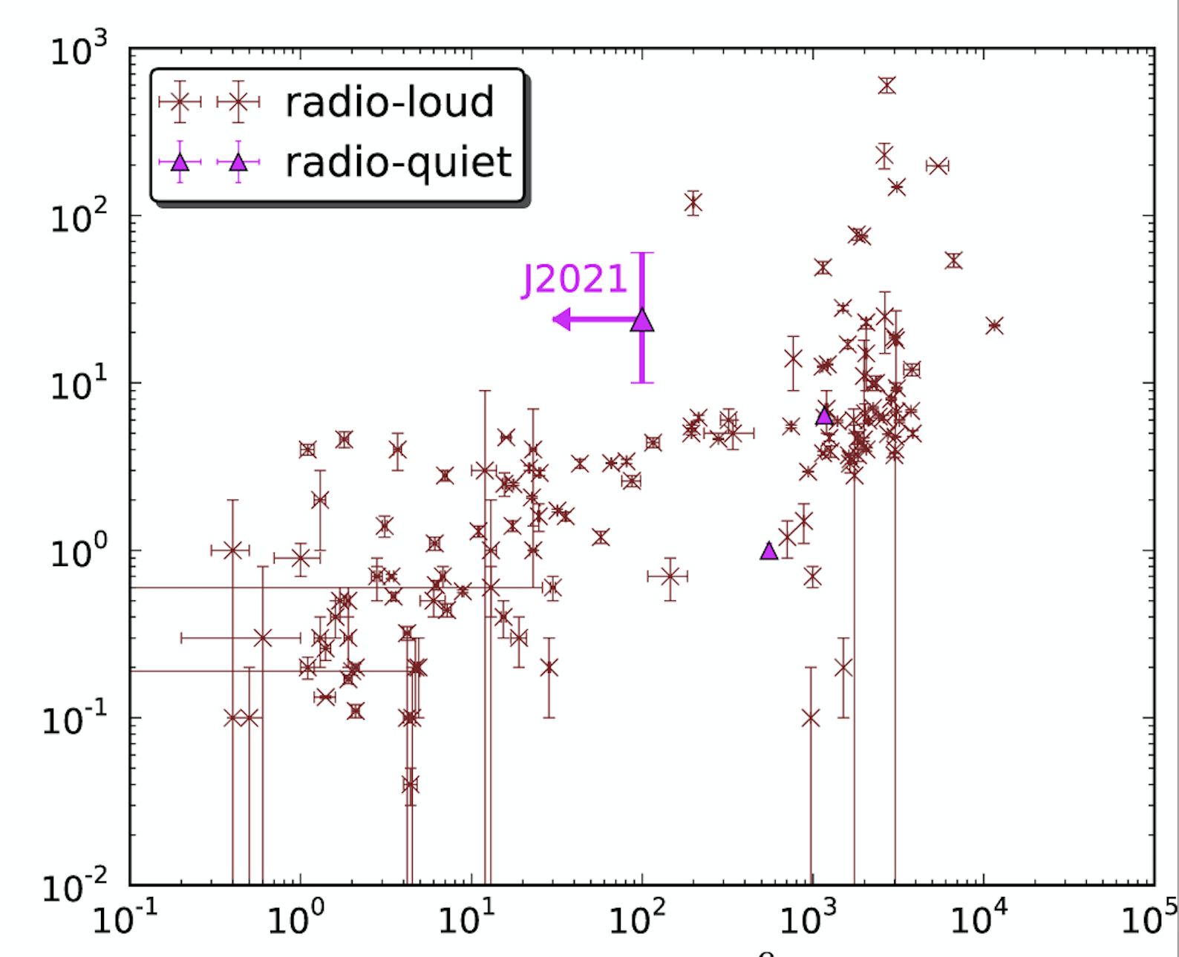





2. State switching of PSR J2021+4026
We cannot confirm the glitch event : $\frac{∆ν}{ν}<{10}^{−7}$
Evolution of the spin frequency
Glitch size of gamma-ray pulsars
$$ν$$
$$Δ\dot{ν}/\dot{ν}({10}^{−3})$$
$$∆ν$$
$$\frac{Δν}{ν}({10}^{−9})$$
Notes:
So PSR 2021+4026 is the first variable gamma-ray pulsar, it is the radio-quiet and it is likely isolated pulsar. This pulsar is located in the Cygnus region. The pulsar is typical case of the middle age pulsar.

Slide 13

2. State switching of PSR J2021+4026
X-ray emission
- Heated polar cap emission.
$kT\sim 0.2keV, R_{eff}\sim 250−270m$
Observations in different states:
- No remarkable difference in two stages.
Gamma-ray and X-ray radio pulse profiles
(Wang et al. 2017)
X
Gamma
Notes:
So PSR 2021+4026 is the first variable gamma-ray pulsar, it is the radio-quiet and it is likely isolated pulsar. This pulsar is located in the Cygnus region. The pulsar is typical case of the middle age pulsar.

Slide 14
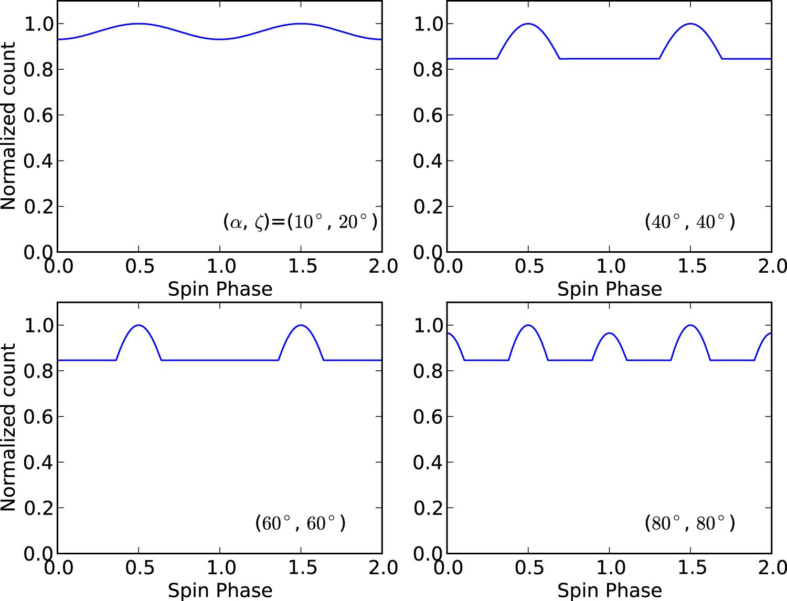
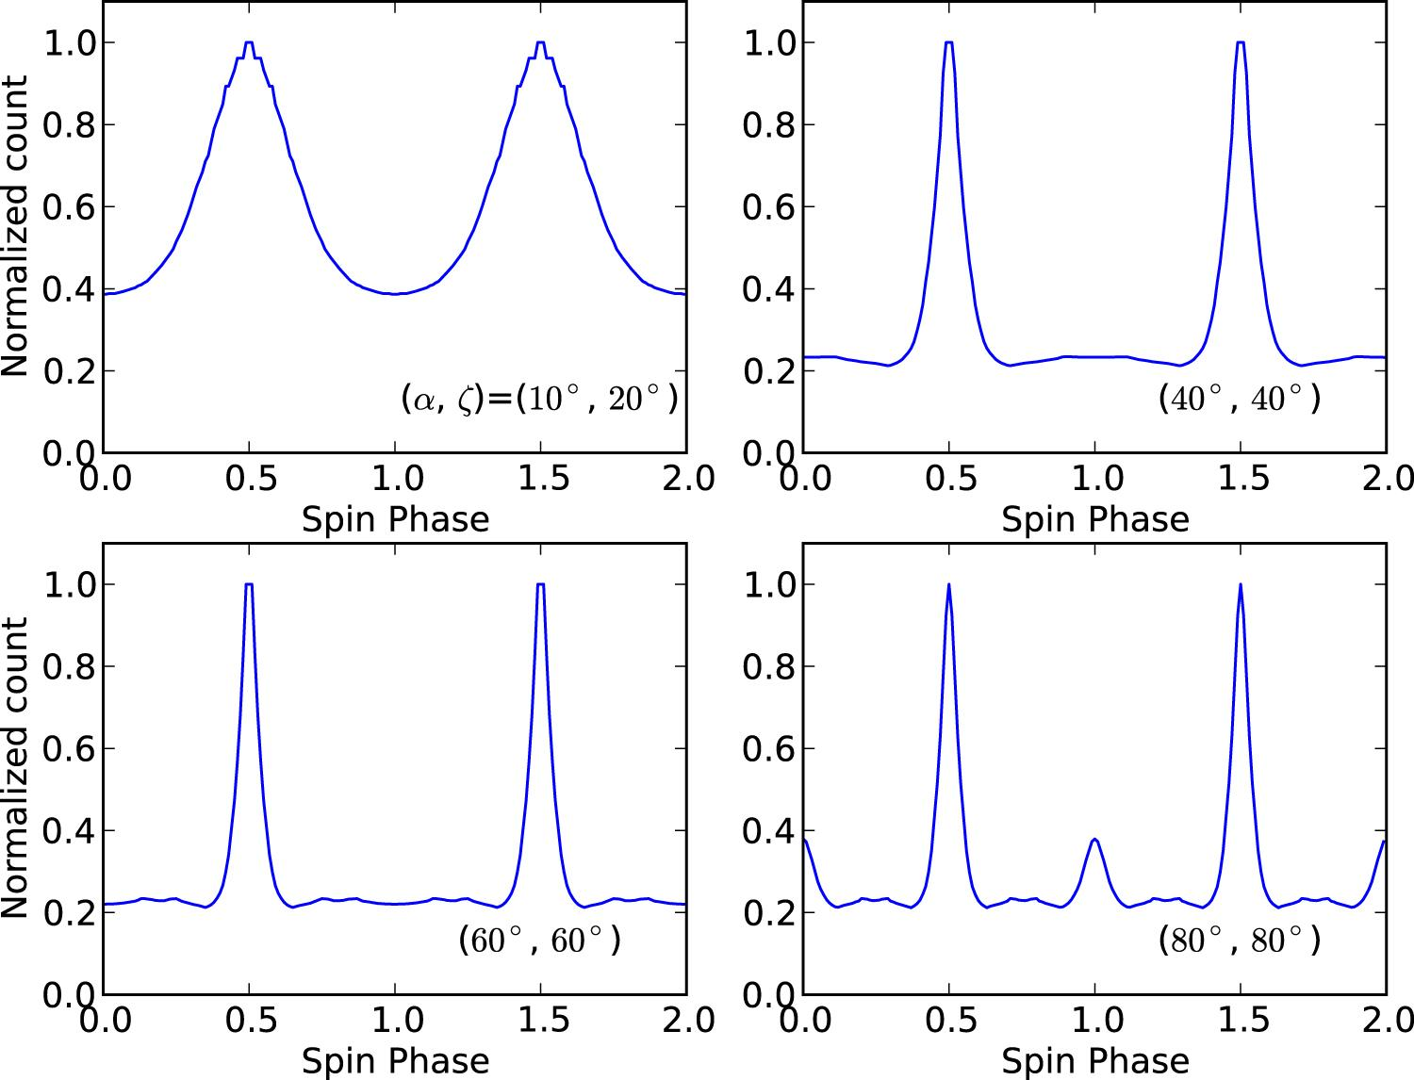
2. State switching of PSR J2021+4026
High pulsed fraction of X-ray emission
→ It seems the light bending effect is not important.
Beaming effect due to the strong magnetic field would not explain the pulse shape.
The temperature of north and south poles could be different ?
Light and large NS?
BKG level
Light bending
Light bending + beaming effect
Contribution from unseen pole

Slide 15

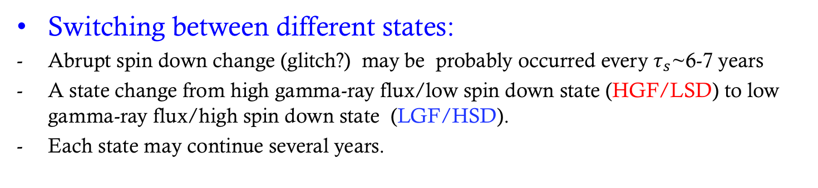
2. State switching of PSR J2021+4026
Switching between different states:
Abrupt spin down change (glitch?) may be probably occurred every $τ_{s}$~6-7 years
A state change from high gamma-ray flux/low spin down state (HGF/LSD) to low gamma-ray flux/high spin down state (LGF/HSD).
Each state may continue several years.
6.5 years
?
~3 years
?
HGF/LSD
LGF/HSD
HGF/LSD
LGF/HSD
$$\dot{ν}({10}^{−13}Hz s^{−1})$$
Notes:
So PSR 2021+4026 is the first variable gamma-ray pulsar, it is the radio-quiet and it is likely isolated pulsar. This pulsar is located in the Cygnus region. The pulsar is typical case of the middle age pulsar.

Slide 16
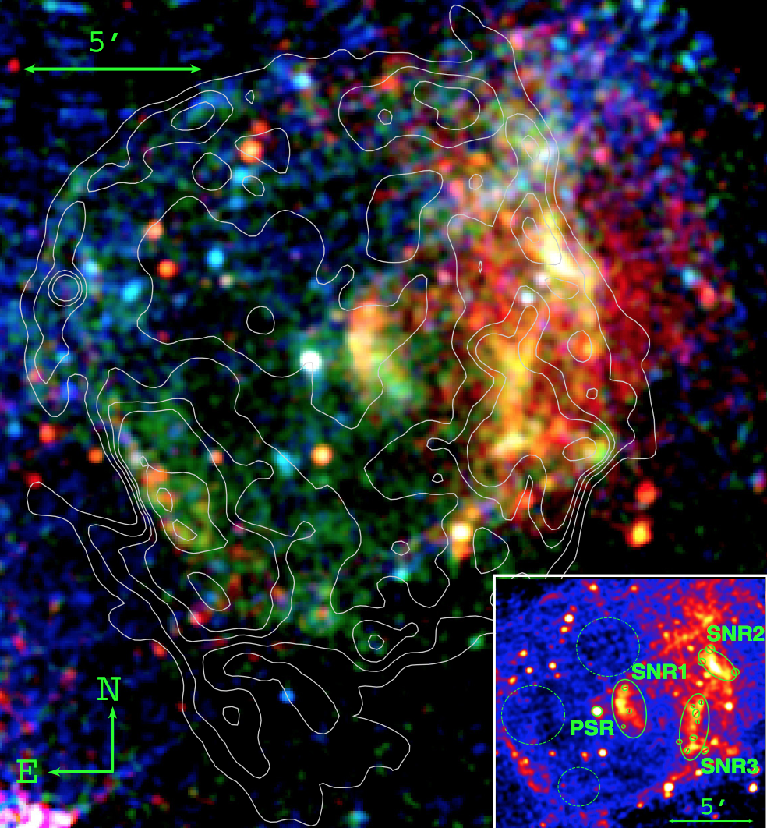
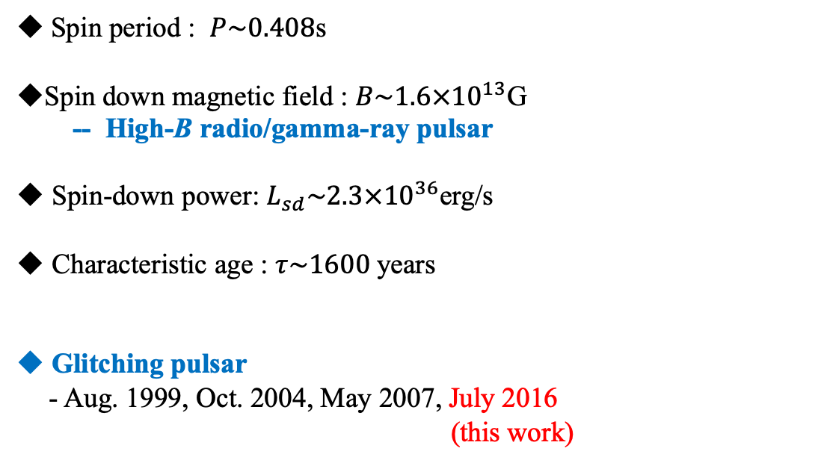
3. Observations for PSR J1119-6127
Spin period : $P\sim 0.408$s
Spin down magnetic field : $B\sim 1.6×{10}^{13}$G
  -- High-B radio/gamma-ray pulsar
Spin-down power: $L_{sd}\sim 2.3×{10}^{36}$erg/s
Characteristic age : $τ\sim 1600$years
Glitching pulsar
- Aug. 1999, Oct. 2004, May 2007, July 2016
(this work)

Slide 17
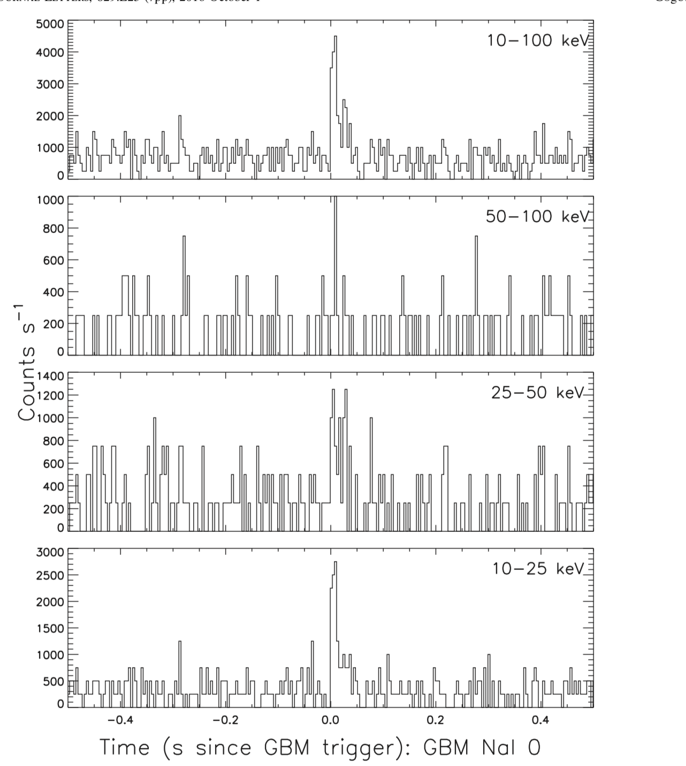
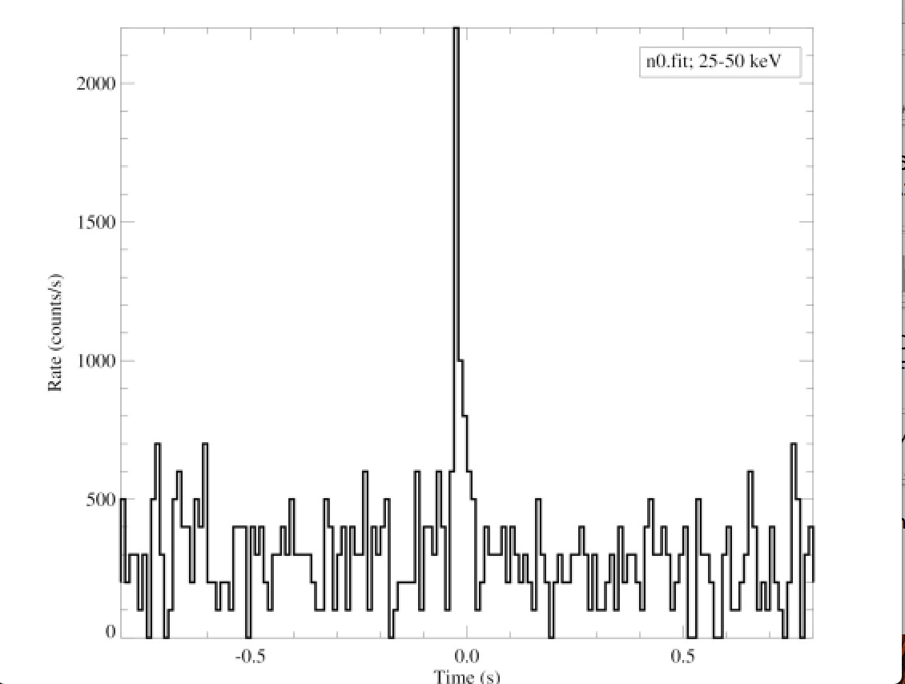
2016 X-ray outburst and glitch
3. Observations for PSR J1119-6127
X-ray Outburst triggered by Fermi/GBM triggered on 2016 July 27
Duration of 0.040s 。
Large glitch (Archibald et al 2016)
(Gogus et al. 2016)

Slide 18
7/27
8/31
December
Rapid evolution in spin down rate, radio flux and X-ray.
X-ray outburst : July 27 (MJD 57596).
Spin down rate/radio flux increased by a factor of 6 in 30 days.
After August 31, the spin down rate/radio flux showed a recovery
X-ray flux decreased by one two order of magnitude in a half month.
Gamma-ray emission might be suppressed in the August.
Reconfiguration of global magnetosphere?
(Dai et al 2018; Wang et al. 2019)

Slide 19

3. Observations for PSR J1119-6127
Rapidly change of radio emission properties
Dai et al. (2018)
Aug. 13
Aug. 19
Aug. 29
Aug. 30
Radio flux vs. spin down rate
Efficiency of the radio emission
Before outburst
2016/8/31
(Wang et al. 2019)
$$\dot{ν}$$

Slide 20
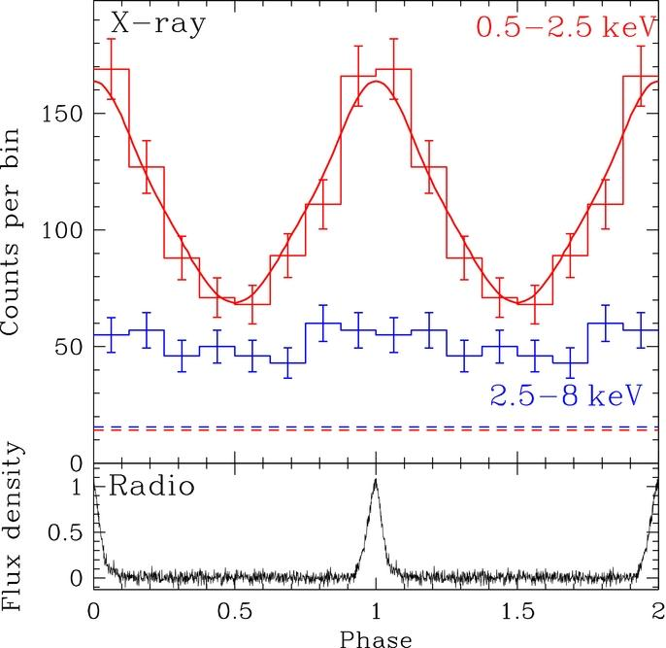
3. Observations for PSR J1119-6127
X-ray emission:
- Luminosity reached ~10% of the spin down power.
- Two BB components in the spectrum, but single peak in pulse profile.
(before outburst one BB + single pulse)
After outburst
Before outburst
8/15
8/6
8/30
12/13
Ng et al. 2012
(Wang et al. 2019)

Slide 21
3. Observations for PSR J1119-6127
The gamma-ray flux would be slightly suppressed after the X-ray outburst.
It is difficult to find a pulsation during several months after the outburst (relaxation stage) because of the rapid evolution of the spin down rate.
The pulse profile and spectrum measured in 2017 are consistent with characteristics before the outburst.
Pre-outburst
Relaxation
Post-relaxation
Multi-wavelength observations suggest that the reconfiguration of the global magnetosphere after the outburst continued ~0.5 year.

Slide 22
3. Discussion
Reconfiguration of the global magnetosphere.
Open magnetic field structure.
Global current structure.
State switching pulsar; PSR J2021+4026
-- Transit between two meta steady sates (why two?)
-- The switching is probably triggered by NS interior or polar cap
Partially filled magnetosphere
FF magnetosphere
Transit ?
(Wada and Shibata 2007+)
(Spitkovsky 2006
Notes:
Fermi-LAT team found the sudden gamma-ray flux change for this pulsar, which is occurred 2011 November. The pulse gamma-ray flux decreases

Slide 23
3. Discussion
After glow of PSR J1119-6127
Crust shearing of whole neutron star due to the magnetic stress
The twist of the closed magnetic field line.
Creates new open magnetic field region.
Create new radio emission region by the plasma flow.
Time scale of untwisting magnetic field :~0.5 year.
(Thompson et al. 2002)
Evolution of X-ray luminosity
Notes:
The glitch causes the change of the pulse profile, For example, in the pre Jumpa there is the bump between the two peaks, it is disappeared in the pulse profile of post Jump. The glitch also affects the gamma-ray spectrum.

Slide 24
Summary
State switching of PSR J2021+4026.
After glow of PSR J1119-6127.
Rapid change of the torque exerted on NS.
Reconfiguration of the global magnetosphere.
-- Change of the structure of the open field line region?
-- Twist magnetosphere?

