Slide 1

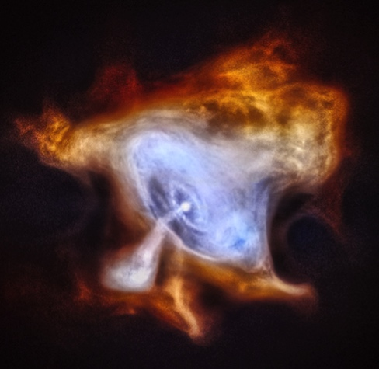
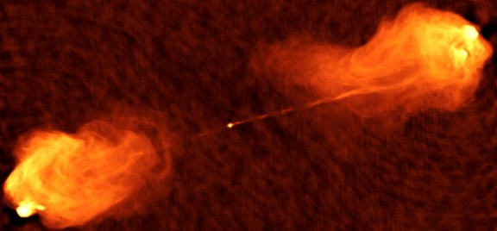

非理想磁気流体効果による相対的流れの加速
Shuta J. Tanaka (Aoyama Gakuin Univ.)
with
Kenji Toma (Tohoku Univ.)
Crab (Chandra)
CYG
Cyg A (VLA)

Slide 2
Introduction

Slide 3
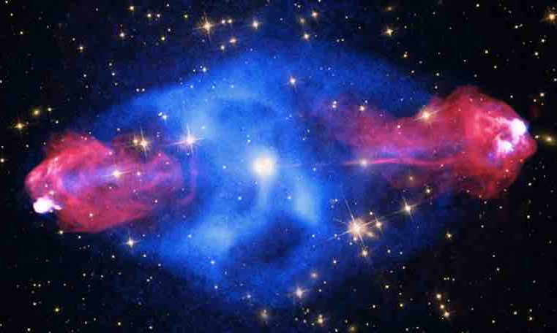
Relativistic Jet
Cyg A (Chandra, HST, SDSS, VLA)
Powered by NS or BH
Relativistic plasma outflow
High-energy (non-thermal) emission
Bipolar jets from engine
CYG
Common astrophysical phenomena in AGN, microquasar & GRB
Jet
Gravitational energy (inflow -> outflow)
Rotation powered?
Role of magnetic field?
How to accelerates to relativistic velocity?
How to collimate jets?
Disc
Disc
Jet

Slide 4
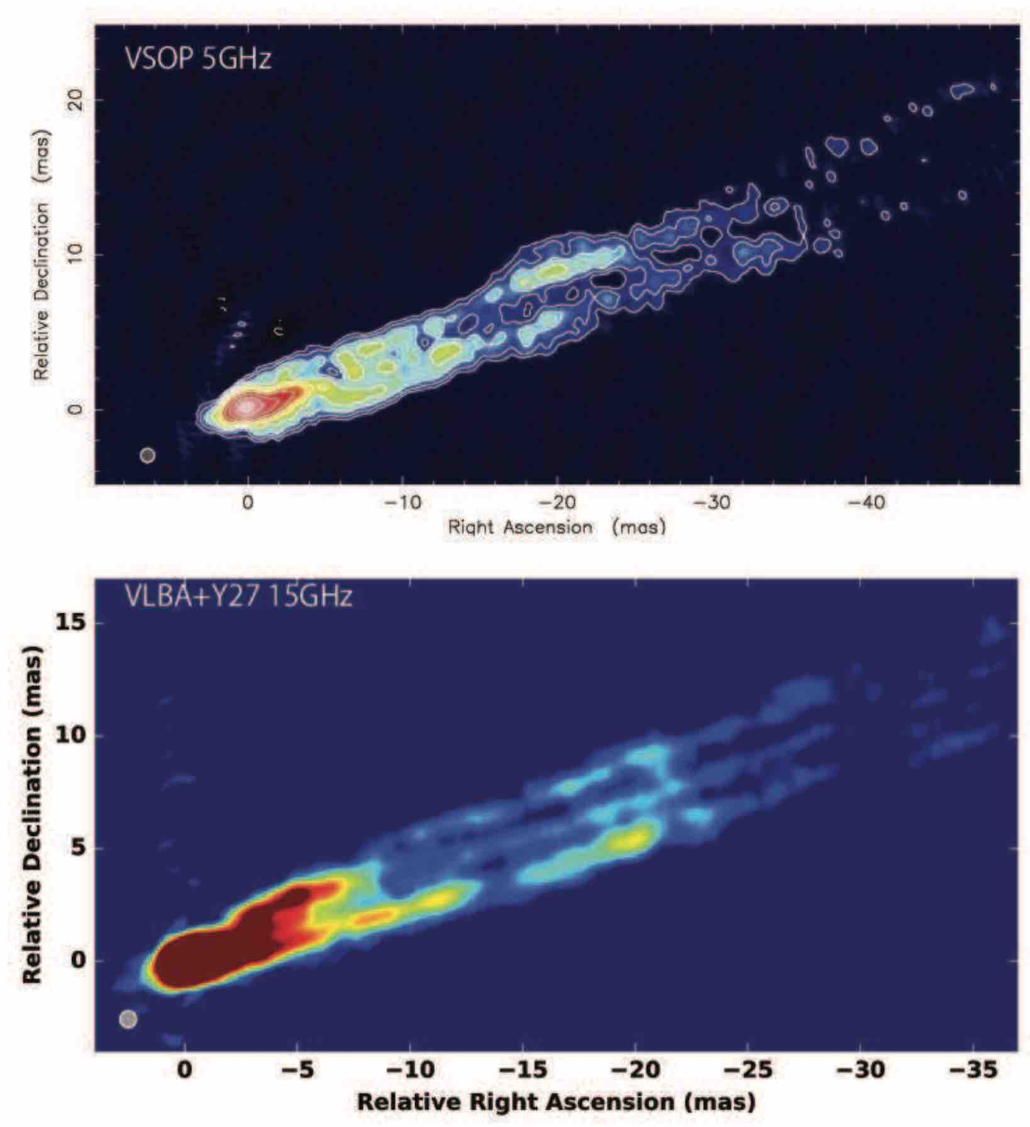
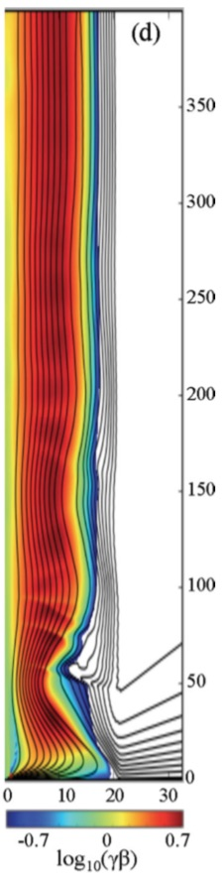
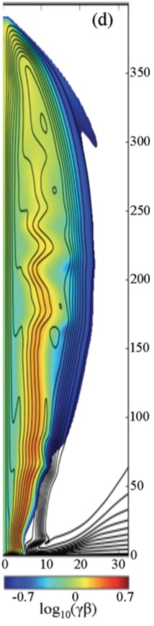
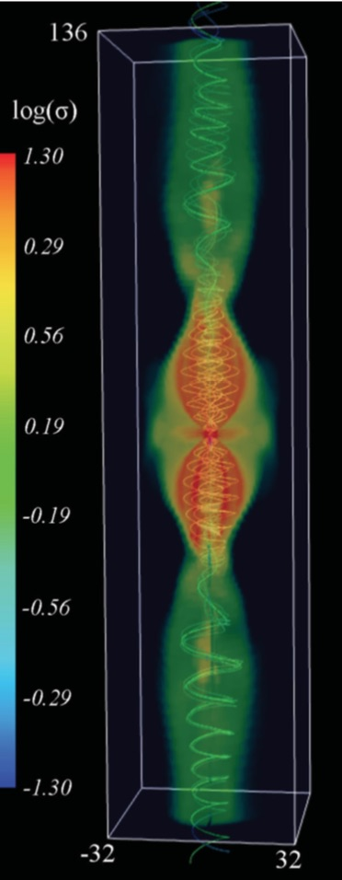

Jet Core ~ Cylindrical
Asada+17
Bromberg&Tchekhovskoy16
M87 (VSOP)
M87* (EHT)
M87 (VLBA)
Cyg A (VLA)

Slide 5
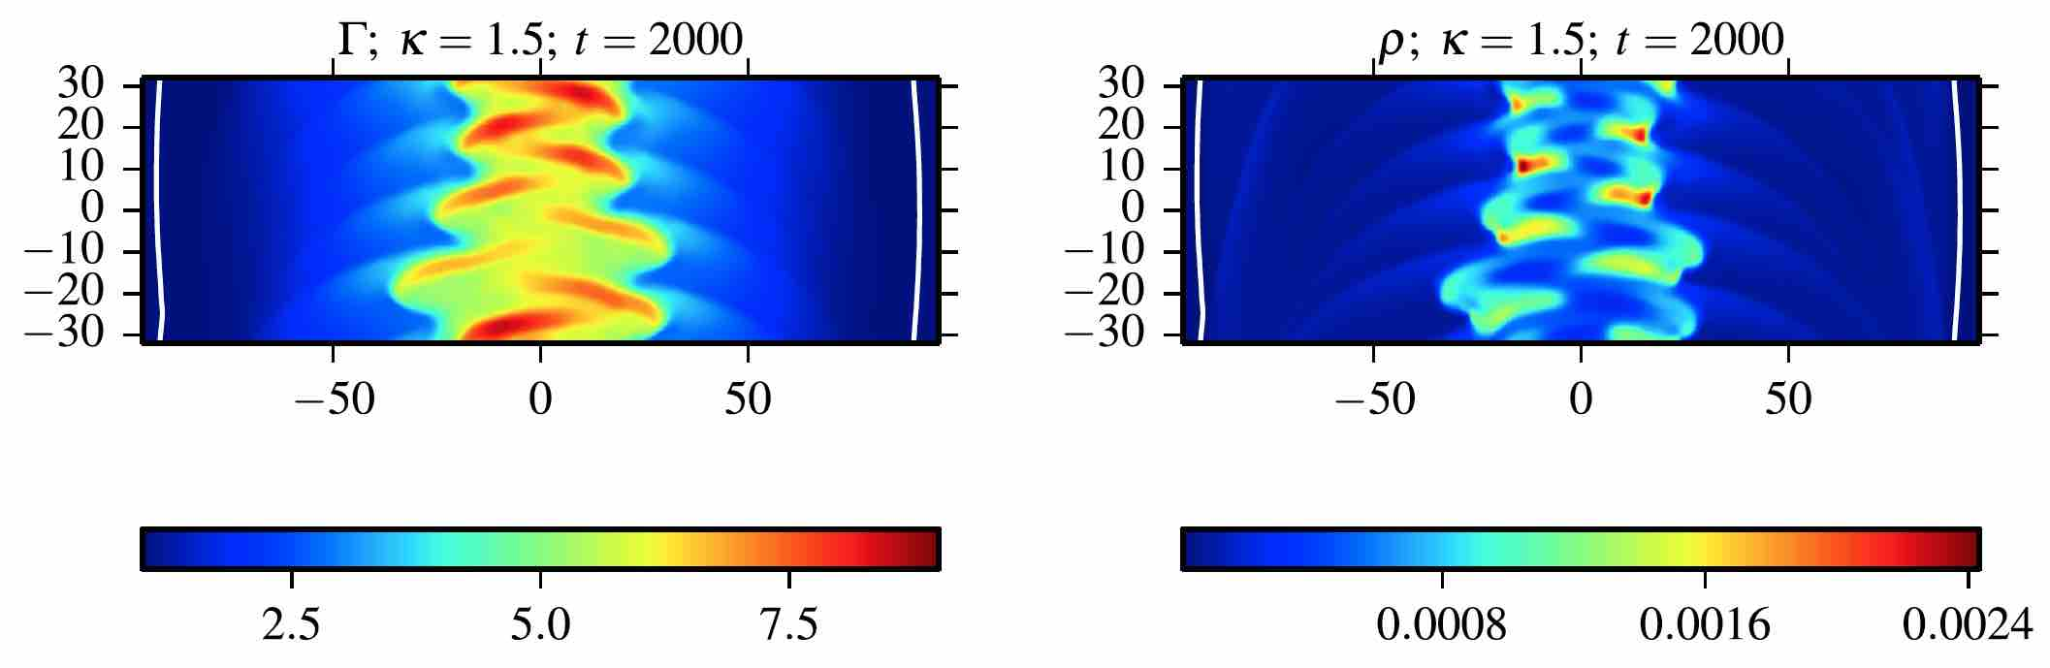
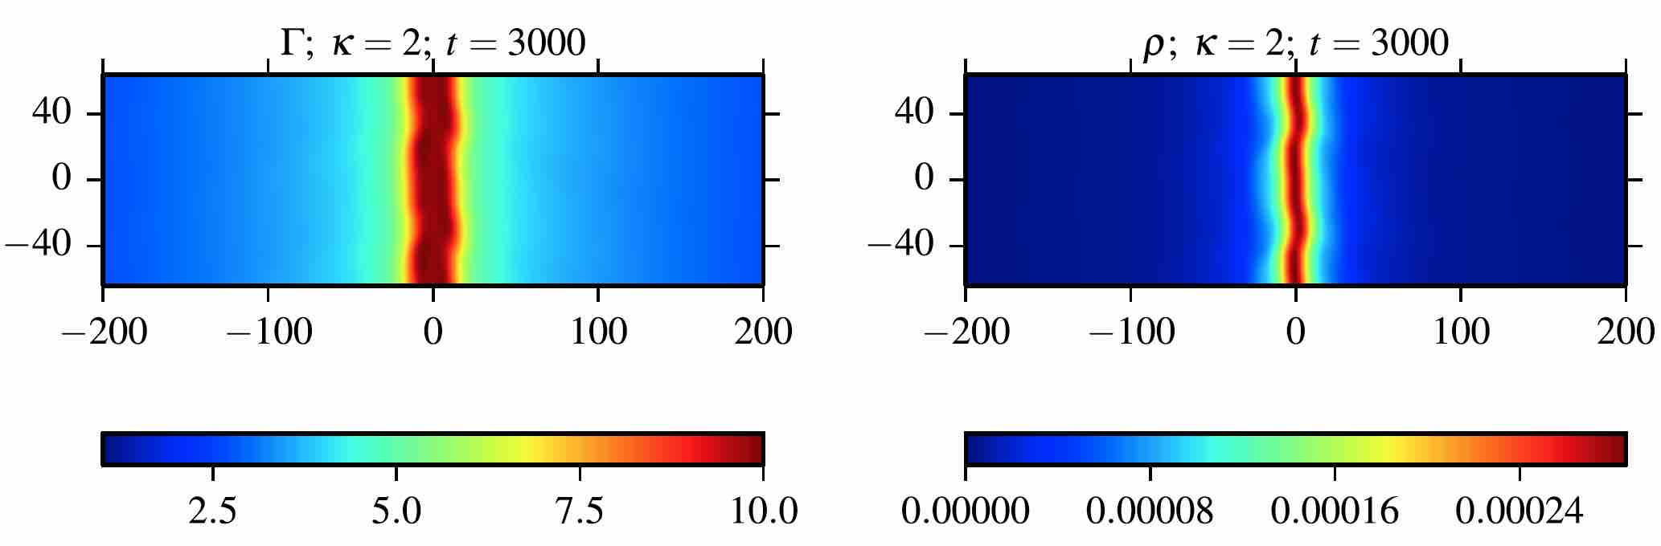
Inst. of Cylinder Jets
Lorentz factor of flow
Density
κ=1.5
t =2000
κ = 2 is critical for ‘external’ kink instability.
κ=2.0
t =3000
Porth&Komissarov15
A lot of other intabilities… Focus on cylinder jet

Slide 6
A Model of Cylindrical Jet

Slide 7
Basic Equations
Relativistic MHD model w/ tangled B-field
radiation loss, turbulent magnetic field, & magnetic dissipation.
ST,Toma&Tominaga 18
Eq. of continuity
Conservation of total energy
Conservation of
fluid internal energy
Induction equation for (mean) toroidal field + turbulent field
Applying to ‘steady cylindrical’ jets

Slide 8
Mechanisms of Acceleration
1D steady flow in ideal MHD limit
no
no
expansion ⬄ acceleration
Inclusion of non-ideal MHD terms adopted by Tanaka+18
Different from the well-known expantion acceleration

Slide 9
Results

Slide 10
Conversion vs. Cooling Accel.
→ ∞
Low-σ flow: σ₀ = 10⁻²
High-σ flow: σ₀ = 10²
four vel.
u
four vel.
u
z_{cool} = 10, 10³, 10⁵
magnetization
σ
magnetization
σ
z_{conv} = 10, 10³, 10⁵
energy flux
l = uγε
energy flux
l = uγε
no cooling
z
z
Tanaka&Toma submitted
u₀ = u_{c}+ε, γ_{max} = 10⁴, δb₀ = 0

Slide 11
Conversion & Cooling Accel.
σ₀ = 10², γ_{max} = 10⁴
For all lines, z_{diss} = z_{cool} = 10
z_{conv} = 10, 10³, 10⁵
Slow conversion ⬄ slow acceleration ⬄ large maximum velocity ⬄ large final luminosity
Acceleration stops at σ ~ 1
four vel.
u
magnetization
σ
energy flux
l = uγε
Tanaka&Toma submitted
z
Efficient accel. with small loss

Slide 12
Summary
Acceleration of cylindrical flow beyond critical points
Non-ideal MHD effects (cooling, conversion, dissipation)
Flow accelerates with cooling the flow by radiation or CR accel.
Flow accelerates with converting toroidal B-field to turbulent one.
Coupling of cooing & conversion effects efficiently accel. the flow
  terminal vel. ~ maximum vel. / 2 for the most efficient case.
  total energy flux ~ initial energy flux /2 for the most efficient case
Further studies
Modeling other processes to understand their roles (mass loading etc.).
Understanding complicated behaviors of 3D simulations.
c.f., ST+18MNRAS

