Slide 1
How special are brightest group and cluster galaxies?
Anja von der Linden et al., 2007, MNRAS, 379, 867
On the prevalence of radio-loud active galactic nuclei in brightest cluster galaxies: implications for AGN heating of cooling flows
P. N. Best et al., 2007, MNRAS, 379, 894

Slide 2
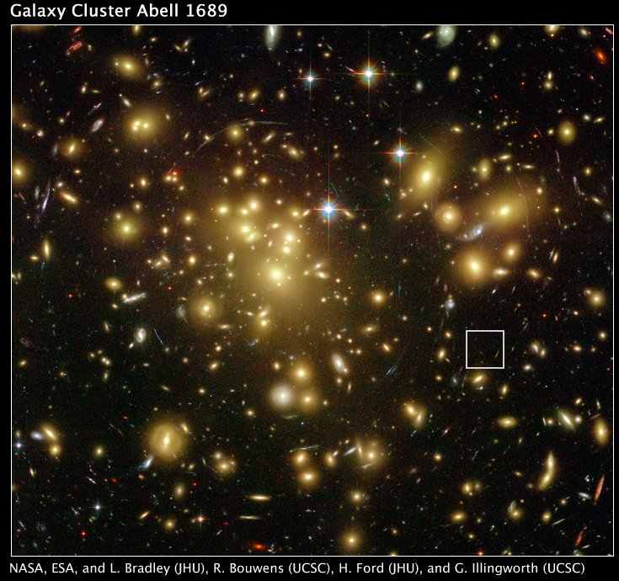
1. Introduction to BCGs
の分散σ_{v,cl}
BCGs are massive end galaxies.
BCGs locate at/near the cluster center.

Slide 3
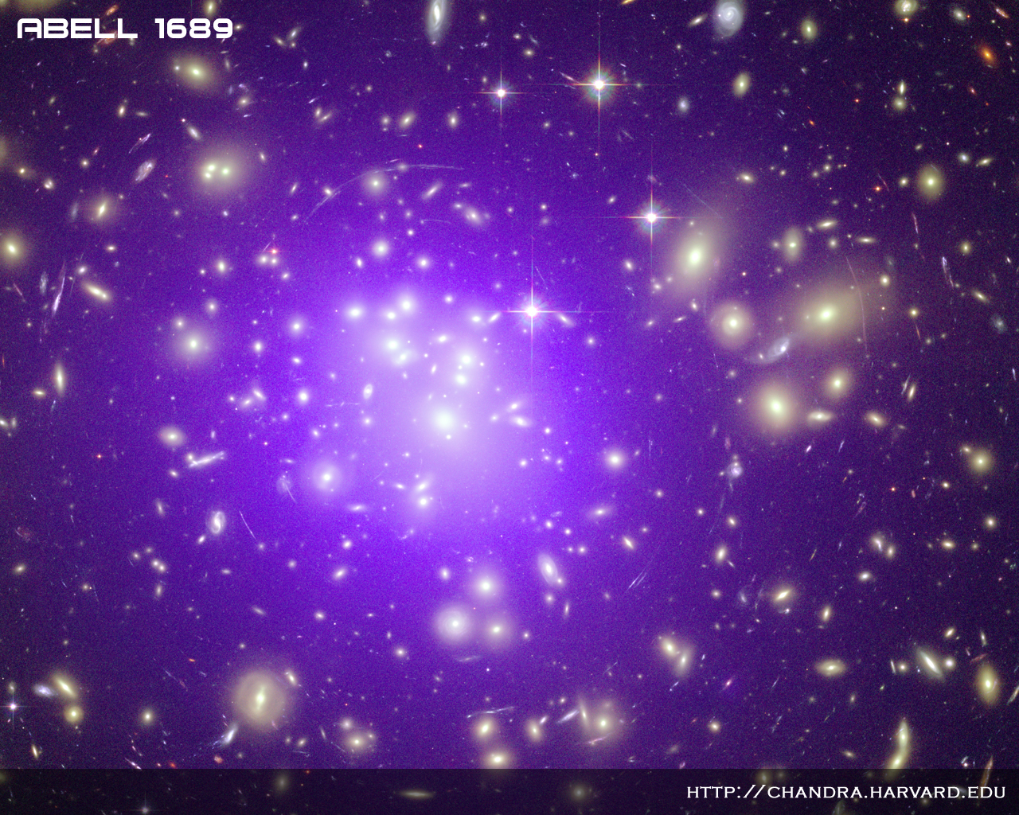
1. Introduction to BCGs
the density of hot gas is highest!
Galaxies with X-ray emitting hot gas halo

Slide 4
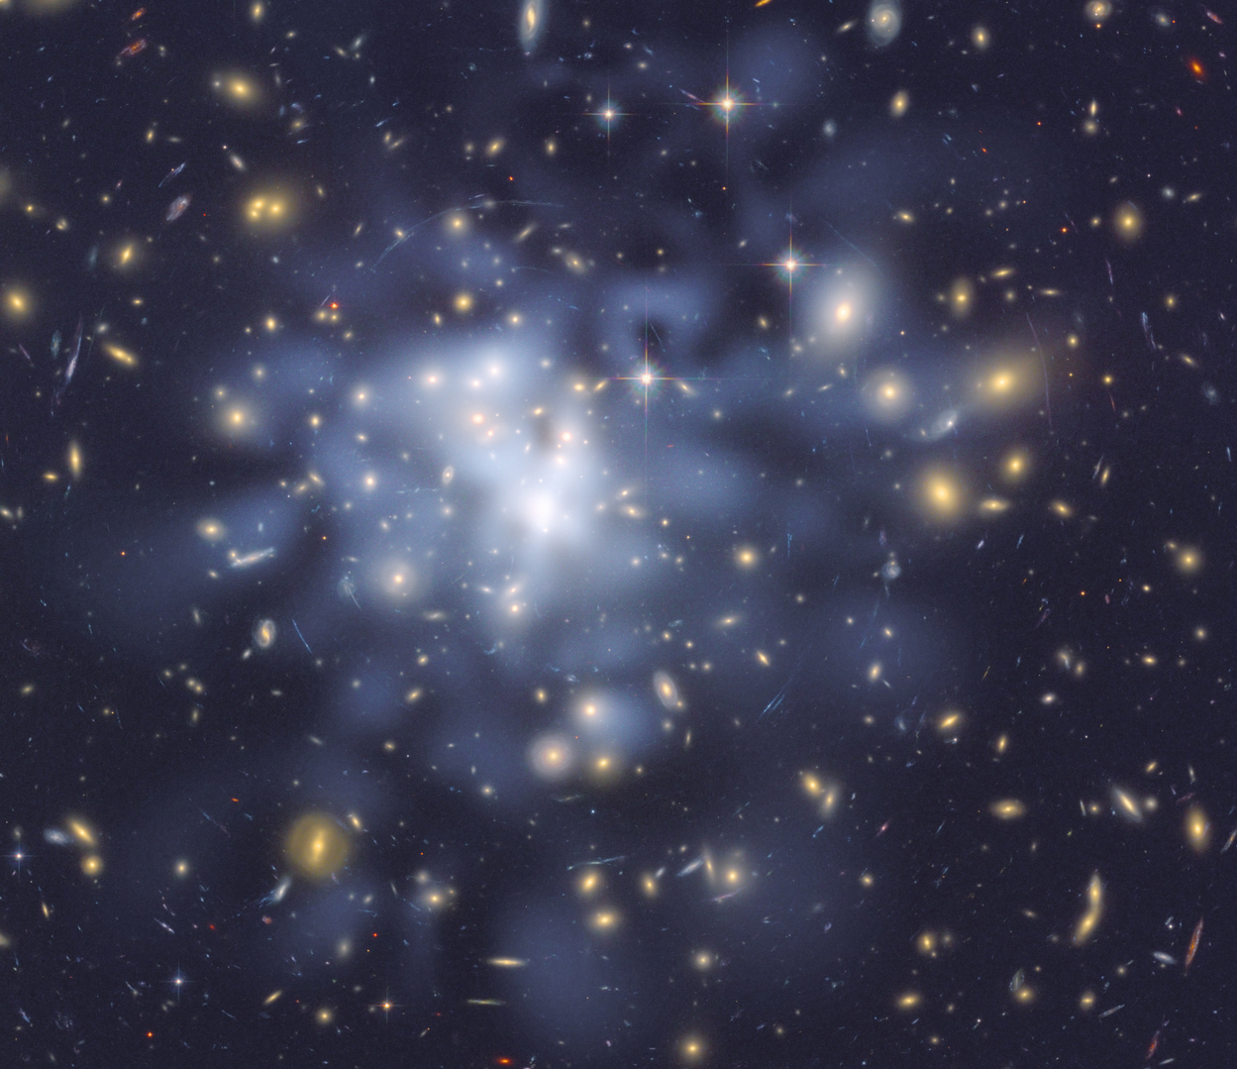
1. Introduction to BCGs
Galaxies with dark matter halo
the density of dark matter is highest!
http://www.nasa.gov/mission_pages/hubble/science/dark-matter-map.html
By D. Coe, N. Benitez, T. Broadhurst, and H. Ford.

Slide 5
1. Topics related to BCGs
ETG: Early-Type Galaxy,
DMH: Dark Matter Halo,
SFH: Star Formation History,
IGM/ICM: Intra Galactic/Cluster Medium,
RL-AGN: Radio-Loud Active Galactic Nuclei.
BCGs are high-M* end galaxies! (~ETG)
-ETG scaling relation → dynamical property.
N-body simulation, contribution from DMH.
BCGs are at cluster center!
-ETG scaling relation → dynamical property.
-SF from cooling flow(SFH, stellar population).
High RL-AGN fraction!
-Radio mode feedback to IGM/ICM.
-RL-AGN fraction + radio-LF + ‘‘L(radio) → L(mechanical)
relation’’ = radio-mode feedback energy.

Slide 6
2. Data
SDSS DR4 spec-galaxy:
14.5<m_{r}<17.7, μ<24.5 mag arcsec⁻², N>5×10⁵ spectra.
MPA-JHU spectral measurements.
Photometry within r < r_{iso23} [μ>23+2.5log(1+z)⁴]
Blanton’s k-correction.
Best’s FIRST-NVSS-SDSS match.
SDSS: Sloan Digital Sky Survey, MPA: Max-Plank-Institute for Astrophysics,
JHU: Johns Hopkins University, FIRST: Faint Images of the Radio Sky at Twenty cm,
NVSS: NRAO VLA Sky Survey, NRAO: National Radio Astronomy Observatory,
VLA: Very Large Array, SDSS: Sloan Digital Sky Survey,

Slide 7
2. C4 catalog
0.02<z<0.16, 14.5<m_{r}<17.7, μ<24.5 mag arcsec⁻² , from DR3 spec(+photo) galaxy → 1106 clusters.
z_{cl}, σ_{v,cl}(within 0.5, 1, 1.5, 2, 2.5h⁻¹ Mpc), mean galaxy/ BCG properties.
- mean galaxy: the galaxy at density peak.
-BCG: the galaxy within 500h⁻¹ kpc from the mean galaxy AND
v_{offset}<4σ_{v,cl} AND without strong Hα emission.
~30% of the BCG were missed by fiber collision and this is corrected by photometric objects(but low-reliability).

Slide 8
2. BCG Selection
Non-zero,
min(σ_{v,cl}(< 0.5, 1, 1.5, 2, 2.5h⁻¹ Mpc))
z<0.1, M_{r}<-20 galaxies, from the C4 catalog → 833 clusters.
Within max(R₂₀₀, 0.5 Mpc) from the mean galaxy, two brightest BCG candidates are selected which meet the following:
-c=R_{i90}/R_{i50}>2.5, fracDeV_r>0.5.
-Δ(u-g)<0.6, Δ(g-r)<0.5, Δ(r-i)<0.4.
-TARGET_GALAXY flag ○, SATURATED flag ×.
-Δz<0.01.
→Brighter one is first BCG candidate.
→If the first is brighter 1 mag than the other, the other becomes
second BCG candidate.
→ ETG-like
→ similar color between C4 and this work
→ to remove star
For the first and second BGC candidates.
→ it is possible that the first is foreground ETG

Slide 9
2. BCG Selection
CAS: Catalog Archive Server,
w/: with, w/o: without.
-c>2.3, w/o Δ(u-g), w/o TARGET_GALAXY criteria.
-The other criteria are the same.
→If selected one is brighter than the first and second
candidate(s), this becomes third BCG candidate.
If the first=second=third candidate, then it is BCG. (242 obj)
Other cases, the candidates are inspected visually on 2.5’’×2.5’’ color images from DR4 CAS. (472)
Other cases, inspected visually on color images(only <2Mpc, Δz<0.01 obj, w/ other criterion). (54)
Otherwise, inspected visually on Finding Chart in CAS(only <2Mpc, Δz<0.01 obj, w/o other criterion). (65) [242+472+54+65=833]
if BCG is not closest to the mean, they regarded these system as a substructures in other clusters. So rejected. (-101)
For the third BGC candidate.

Slide 10
2. New σ_{v,cl}, z_{cl}, R₂₀₀
ave(σ_{v,cl}(< 0.5, 1, 1.5, 2, 2.5h⁻¹ Mpc
in C4 catalog)
They developed the iterative procedure:
If galaxy_i is R<2R_{start} from the new BCG and z_{i}-z_{cl}^{C4}<0.025, they(i=1,…,N) are regarded as ‘cluster’ in first iteration.
σ_{v,cl} in first-cluster is σ_{v,cl} = (Σ_{i=1}^{N}|z_{i}-z_{cl}^{C4}|/N) c. (limited to σ_{v,cl}<500 km/s)
From galaxy_ j that meets |v_{j} /c| = |(z_{j}-z_{cl}^{C4})/(1+z_{cl}^{C4})| < 3σ_{v,cl} and R<R₂₀₀ from the BCG, z_{cl} and σ_{v,cl} in first-cluster re-determined by using the biweight estimator(Beers+’90).
z_{cl} & σ_{v,cl} → |v_{j} /c| & R₂₀₀ → z_{cl} & σ_{v,cl} → to δz_{cl} & δσ_{v,cl} < 0.001.
’
R_{start}

Slide 11
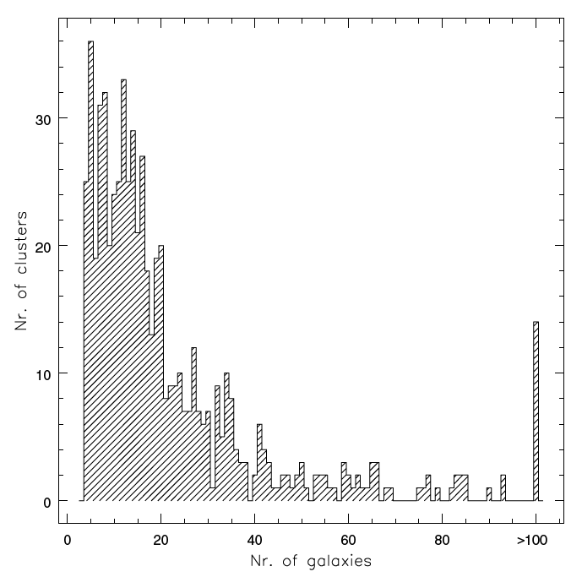
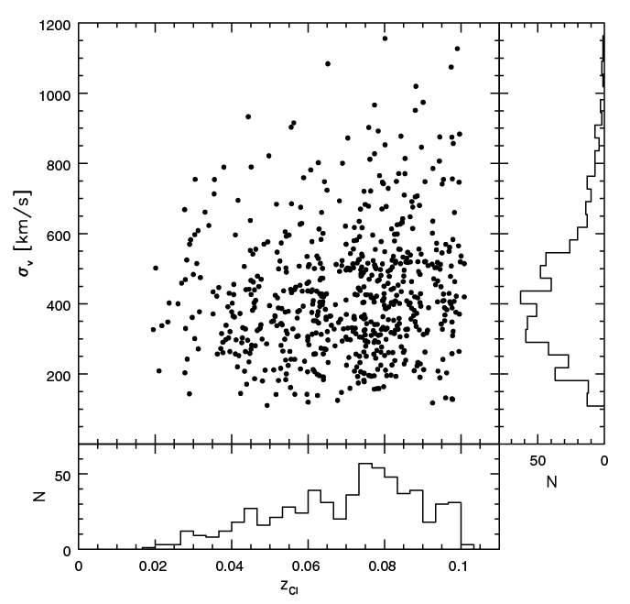
2. Selection results
If one ‘cluster’ has only two or three galaxies, they discarded it.
As a result, the number of BCGs(clusters) is 625.
σ_{v,cl} [km/s]
Number of clusters
z_{cl}
Number of galaxies

Slide 12
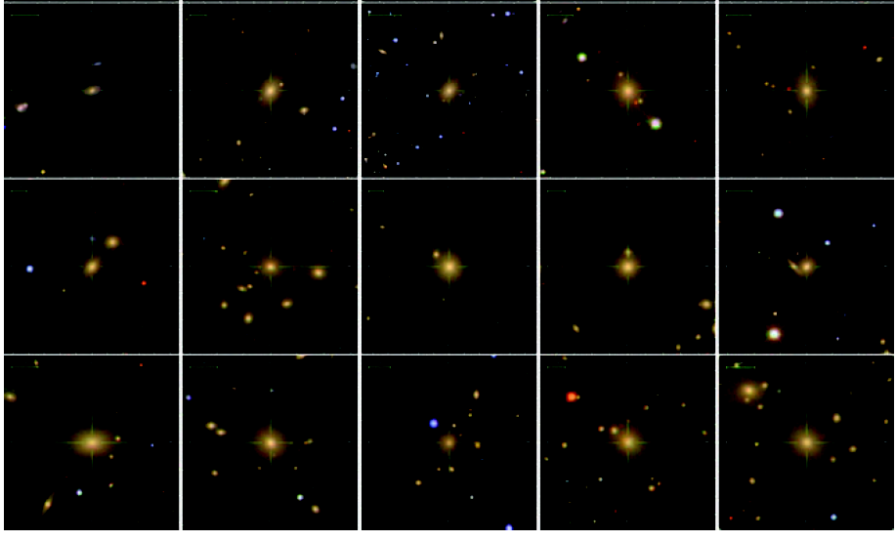
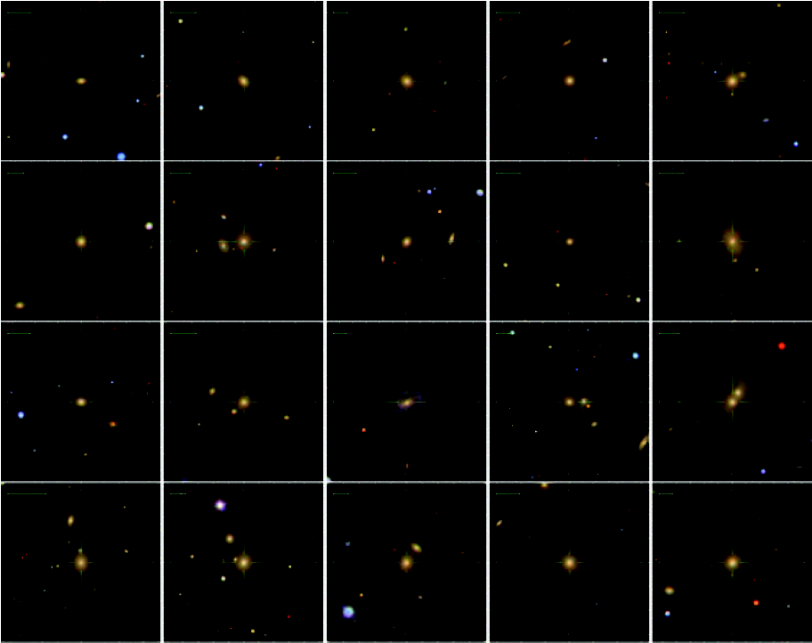
3. BCG image

Slide 13
4. BCG vs. non-BCG control sample
Closest neighbor in 3 parameter space:
log(M*/M☉), z, g-r
Upper BCG-M* limit: log(M*/M☉)<11.3.
-BCGs are from DR3, comparison non-BCGs are from DR4
→ possible DR4-BCGs in comparison non-BCGs.
-small number of non-BCGs in high-M* end.
Comparison Sample 3-phot(CS3p)
Comparison Sample 3-spec(SC3s)
-w/o color and fracDeV, w/ upper M* limit.
CS1p
CS1s
-w/ M_{g}-M_{r}>0.75 and fracDeV_r>0.8, w/o upper M* limit.
For comparison
in physical properties.
For comparison
in ETG scaling relations.
→ to select ETGs

Slide 14
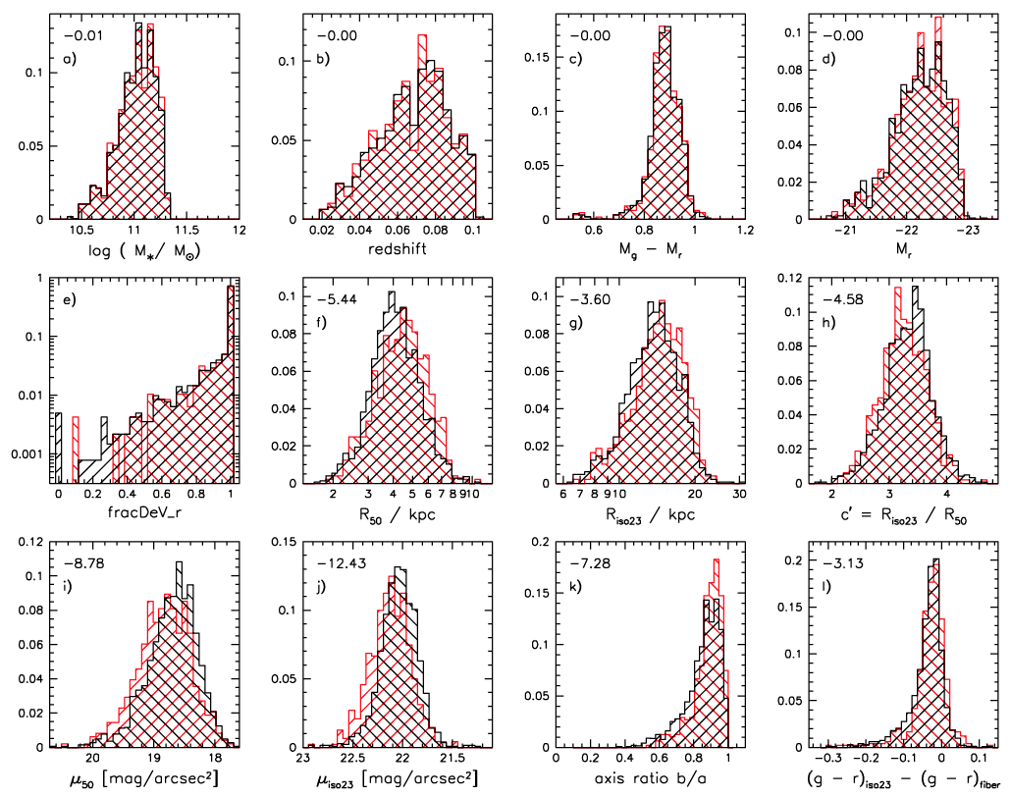
5-1. BCG vs. non-BCG (SC3p)
log(1-CL), CL in KS-test.
The same distribution by sample construction.
More extended
in BCGs
Larger in BCGs
More strong color grad in non-BCGs
More diffuse in BCGs

Slide 15
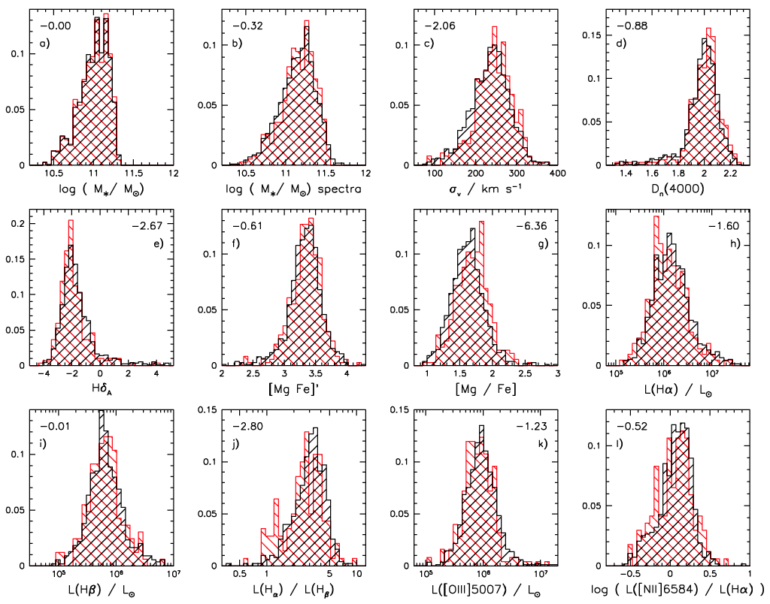
5-2. BCG vs. non-BCG (CS3s)
Same!
Same?
Larger σ*
In BCGs.
Same.
Slightly smaller
in BCGs.
Larger
in BCGs.

Slide 16
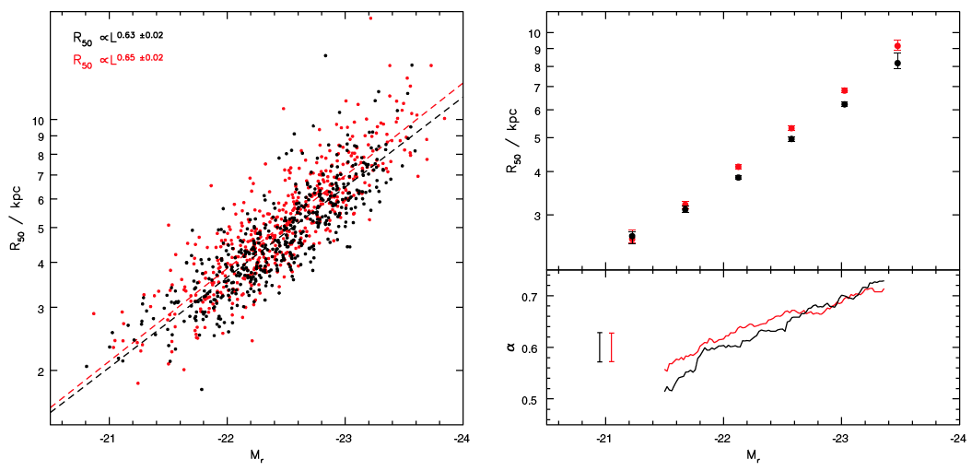
6-1. Size-luminosity relation (SC1p)
Non-BCG
BCG
R₅₀∝L^{α}:
Larger R₅₀ in BCGs.
α increases with M_{r},
slightly larger α in BCGs.

Slide 17
6-2. Dynamical to stellar mass ratio
Aperture correction:
A
Dynamical mass from observation(& Virial theorem):
If NFW(’97) DM profile and Hernquist(’90) LM profile are assumed, dynamical mass becomes
A
M’_{dyn,50}/M_{*,50} is . . .

Slide 18
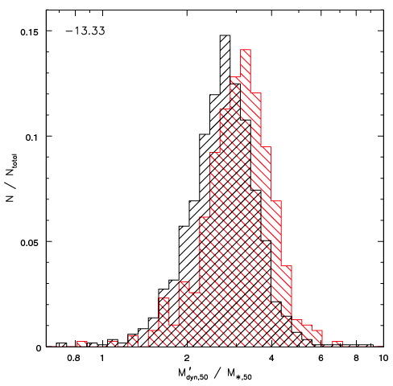
6-2. Dynamical to stellar mass ratio
Non-BCG
BCG
log(1-CL)
N_{bin}/N_{total}
M’_{dyn,50}/M_{*,50}
Larger ratio in BCGs → larger contribution from MDH?

Slide 19
6-3. Fundamental Plane (CS1s)
Generic FP relation is
where a~1.2-1.6, b~0.8.
Theoretical(from Virial theorem) FP is
So, a=2, b=1.
(a has large scatter, b has small scatter)
(they assumed b_{BCGs} is the same as b_{CS1s} )

Slide 20
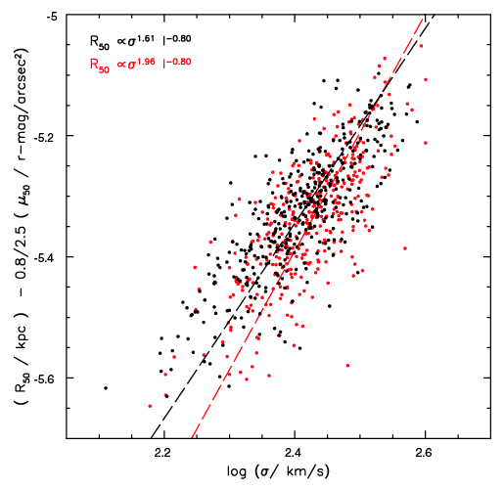
6-4. Fundamental Plane (CS1s)
Non-BCG
BCG
a_{BCGs}=1.96
a_{CS1s}=1.61
BCGs with small R₅₀/high μ/high σ* deviate from generic FP.

Slide 21
6-4. Fundamental Plane
μ_{e}-R_{e}: Kormendy relation.
L(R_{e},I_{e})-σ_{v}: Faber-Jackson relation.
Generic FP relation is
where a~1.2-1.6, b~0.8.
Theoretical(from virial theorem) FP is
So, a=2, b=1. (If c₁, c₂, M*, M_{dyn,50} are const)
This pre-factor varies for different ETGs?
(the ‘tilt’ of the FP)

Slide 22
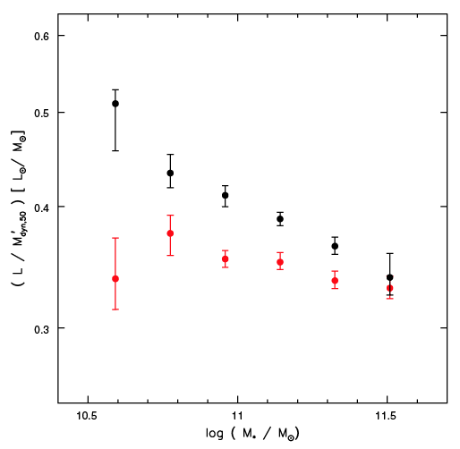
Non-BCG
BCG
Generic FP
Theoretical FP expects const.
BCG FP
注) パワポフィット
Large difference at low-M*:
→ BCG FP is different from generic FP especially at low-M*.
Smaller pre-factor variation in BCG FP:
→ BCG FP is more close to theoretical FP.

Slide 23
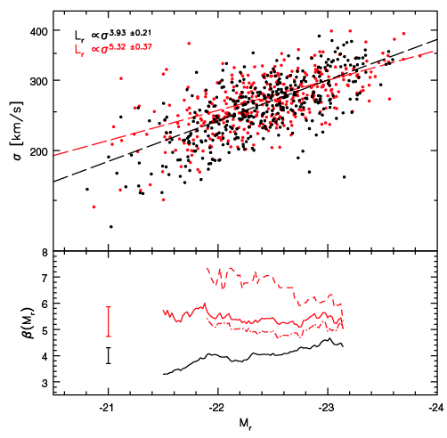
6-5. Faber-Jackson relation
Generic/theoretical FJ relation(L∝σ_{v}^{β}) is β~4/=4.
For this sample,
β=3.93(non-BCGs),
β=5.32(BCGs).
In dissipationless merger
(Boylan-Kolchin+2006),
β increases with eccentricity
of the merger orbit.
Non-BCG
BCG
members
BCG

Slide 24
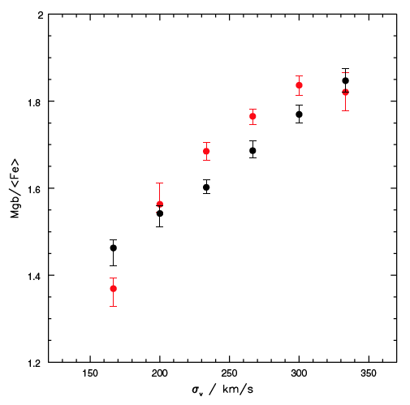
7-1. Star formation history (CS1s)
Non-BCG
BCG
Strong correlation between Mg/Fe and σ*.
Higher Mg/Fe ratio in BCGs.
→ shorter time-scale SF.
Mgb/<Fe>
σ_{v} [km/s]

Slide 25
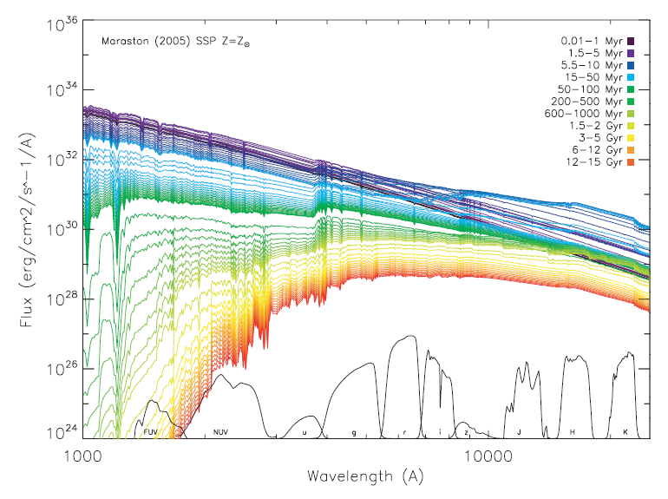
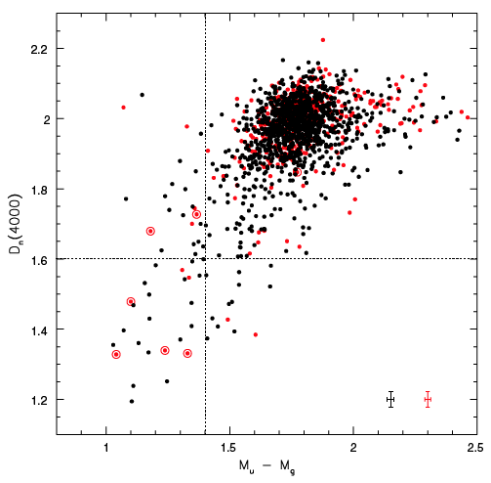
7-2. Star formation in BCGs (CS3s)
Non-BCG
BCG
Dn(4000)(SP~K, M star~few Gyr)
They don’t find enhanced SF in BCGs.
M_{u}-M_{g}(~Balmer break)
(SP~A, F star~100 Myr)

Slide 26
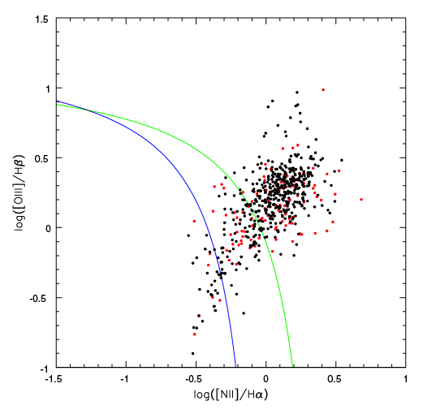
8. Emission-line ratio (CS3s)
TOTAL
(30%)119/391 in BCGs
(40%)472/1173 in non-BCGs
Diagnostics to the ionization source
AGN
SF
(6%)7/119 in BCGs
(6%)29/472 in non-BCGs
SF
TRO
(24%)29/119 in BCGs
(16%)79/472 in non-BCGs
TRO
Non-BCG
BCG
AGN
(70%)83/119 in BCGs
(77%)364/472 in non-BCGs
Lower optical-activity fraction in BCGs.
EL-ratio distribution is the same.

Slide 27
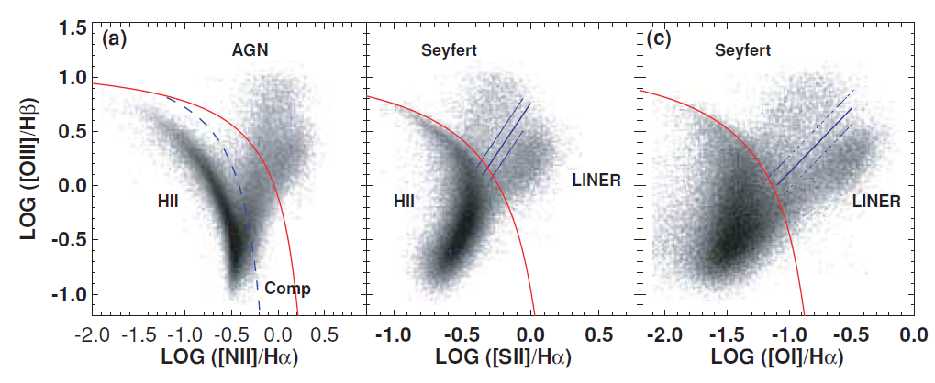
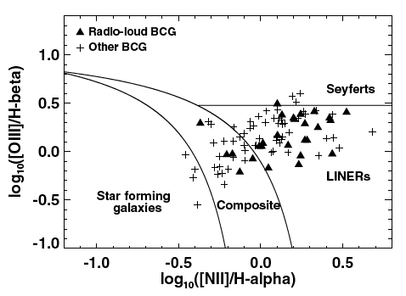
Kewley+06, MNRAS, 372, 961
DR4 full sample
DR3 BCGs
(Best+07)
DR3 RL-BCGs
Almost the same?

Slide 28
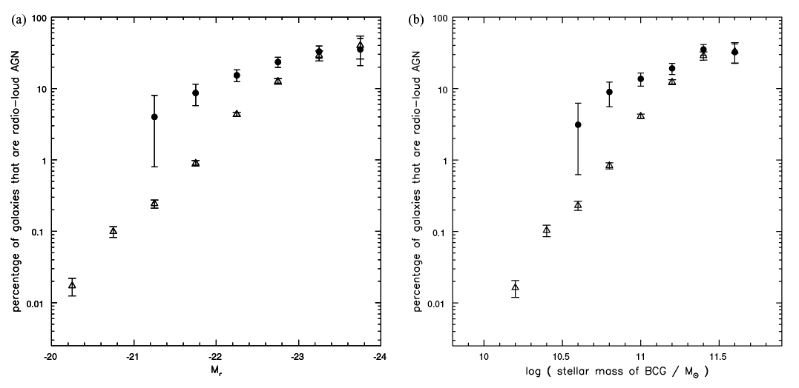
9-1. RL-AGN fraction in BCGs
△: All galaxies,
●: BCGs.
△: All galaxies,
●: BCGs.
M_{r}
Log(M*/M☉)
BCG is higher RL-fraction!
→ Hδ_{A}-Dn(4000) plane, L(1.4GHz)>10²³ W/Hz
→ possible radio emission from AGN(jet+lobe)!

Slide 29
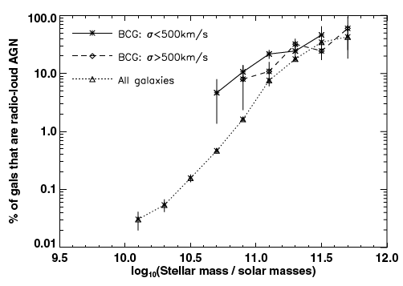
9-2. RL-AGN % in BCGs.
Best et al., 2007, MNRAS, 379, 894
RL-BCG fraction in high/low-σ_{v,cl} cluster
Almost same between σ_{v,cl} bin!

Slide 30
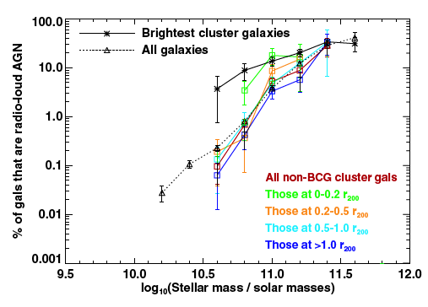
9-3. RL-AGN % in BCGs.
RL-% in different cluster centric radius
Higher RL-% in r=0-0.2r₂₀₀.

Slide 31
Summary (BCG vs. non-BCG)
BCG vs. non-BCG: M*, z, g-r, controlled sample.
More diffuse, extended surface brightness.
Larger σ* & M’_{dyn,50}/M_{*,50} & a(in FP) & β(in FJ).
BCG FP is different from that of non-BCG in low-M*.
BCG FP is more close to theoretical FP.
Larger Mgb/<Fe>.
Slightly negative larger Hδ_{A}.
Lower optical-activity fraction.
EL-ratio typical of high-M* galaxies.
Higher RL-AGN fraction.

