Slide 1

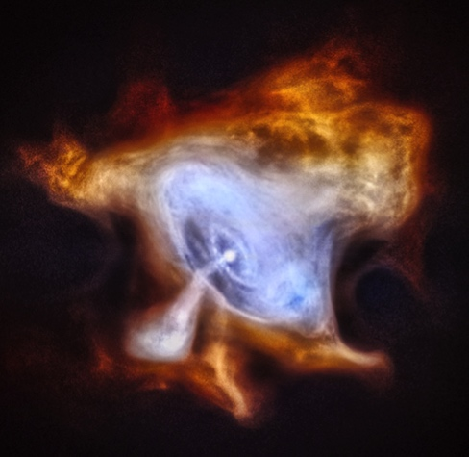
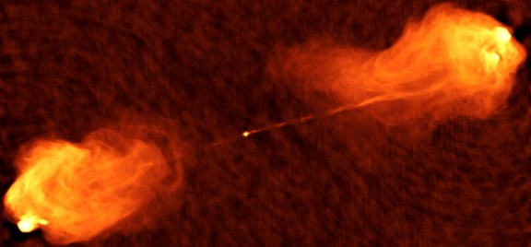

Acceleration of
Relativistic Jets with Tangled Magnetic Field
Shuta J. Tanaka (Aoyama Gakuin Univ.)
with
Kenji Toma (Tohoku Univ.)
Crab (Chandra)
CYG
Cyg A (VLA)

Slide 2
Introduction

Slide 3
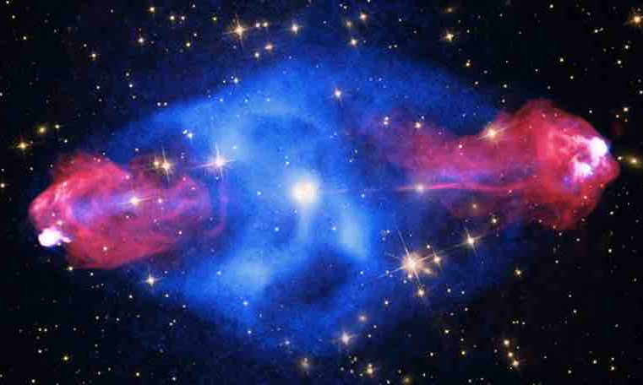
Relativistic Jet
Cyg A (Chandra, HST, SDSS, VLA)
Powered by NS or BH
Relativistic plasma outflow
High-energy (non-thermal) emission
Bipolar jets from engine
CYG
Common astrophysical phenomena in AGN, microquasar & GRB
Jet
Gravitational energy (inflow -> outflow)
Rotation powered?
Role of magnetic field?
How to accelerates to relativistic velocity?
How to collimate jets?
Disc
Disc
Jet

Slide 4
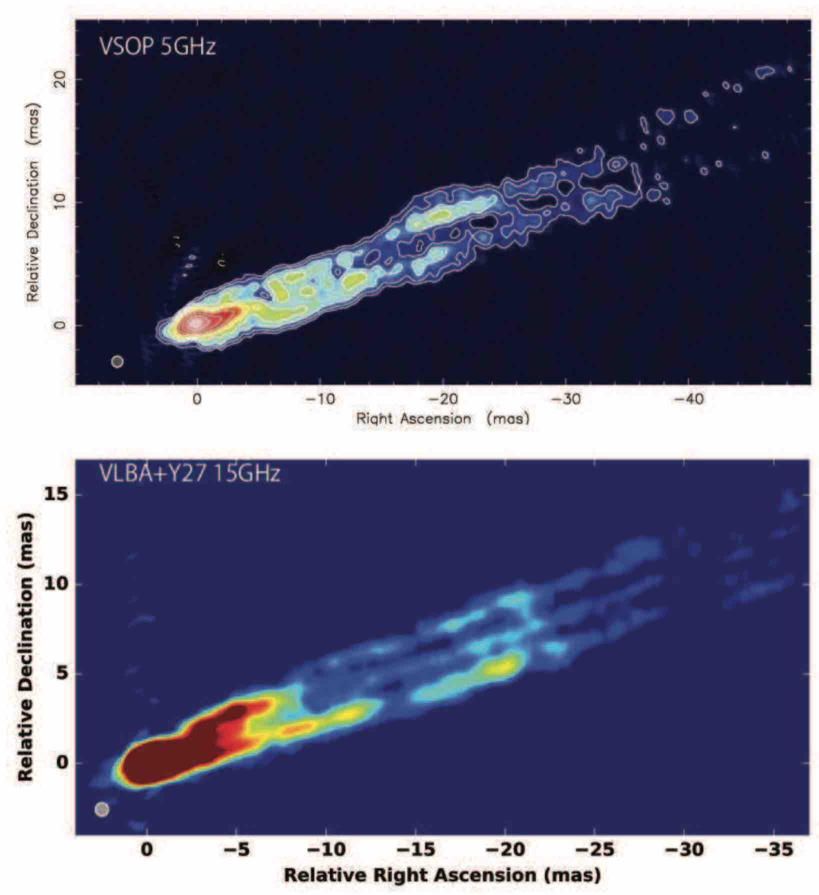
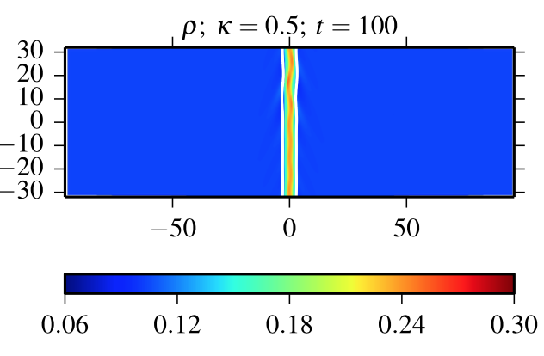

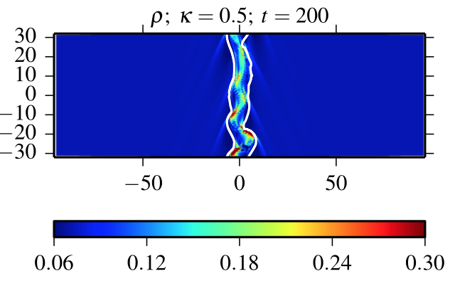
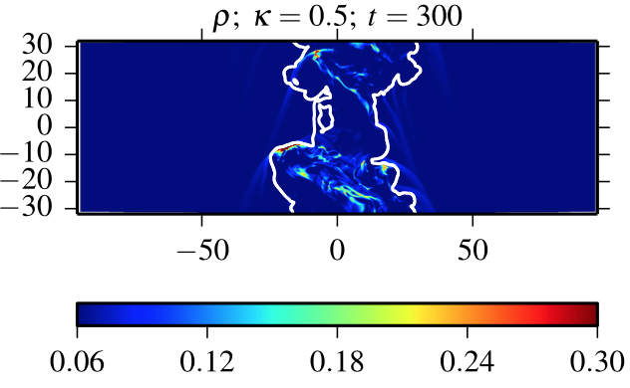
Turbulence & Radiation in Jets
Asada+17
Development of turbulence
M87 (VSOP)
M87* (EHT)
Hydra A (radio, opt & X-ray)
M87 (VLBA)
Cyg A (VLA)
Porth&Komissarov15
Study the effects on jet dynamics

Slide 5
Cylindrical Jet Model

Slide 6
Basic Equations
Relativistic MHD model w/ tangled B-field
radiation loss, turbulent magnetic field, & magnetic dissipation.
ST,Toma&Tominaga 18
Eq. of continuity
Conservation of total energy
Conservation of
fluid internal energy
Induction equation for (mean) toroidal field + turbulent field
Applying to ‘steady cylindrical’ jets

Slide 7
Mechanisms of Acceleration
1D steady flow in ideal MHD limit
no
no
expansion ⬄ acceleration
Inclusion of non-ideal MHD terms adopted by Tanaka+18
Different from the well-known expantion acceleration

Slide 8
Results

Slide 9
Conversion vs. Cooling Accel.
→ ∞
Low-σ flow: σ₀ = 10⁻²
High-σ flow: σ₀ = 10²
four vel.
u
four vel.
u
z_{cool} = 10, 10³, 10⁵
magnetization
σ
magnetization
σ
z_{conv} = 10, 10³, 10⁵
energy flux
l = uγε
energy flux
l = uγε
no cooling
z
z
Tanaka&Toma submitted
u₀ = u_{c}+ε, γ_{max} = 10⁴, δb₀ = 0

Slide 10
Conversion & Cooling Accel.
σ₀ = 10², γ_{max} = 10⁴
For all lines, z_{diss} = z_{cool} = 10
z_{conv} = 10, 10³, 10⁵
Slow conversion ⬄ slow acceleration ⬄ large maximum velocity ⬄ large final luminosity
Acceleration stops at σ ~ 1
four vel.
u
magnetization
σ
energy flux
l = uγε
Tanaka&Toma submitted
z
Efficient accel. with small loss

Slide 11
Cooling acceleration
Steady cylindrical geometry, no magnetic field
Cooling acceleration also appears in non-relativistic flow.
Super- (sub-)sonic flows are accelerating (decelerating).
No trans-sonic point (because of no gravity?)

Slide 12
Dissipation acceleration
Steady cylindrical jets with magnetic dissipation
The same as Drenkhan02 which studied spherical flow.
The index (acceleration efficiency) is also the same as Drenkhan02.

Slide 13
Conversion acceleration
Steady cylindrical jets with development of the magnetic turbulence
The Different acceleration efficiency from dissipation acceleration.

Slide 14
Summary
Acceleration of cylindrical flow beyond critical points
Non-ideal MHD effects (cooling, conversion, dissipation)
Different acceleration mechanism from differential collimation.
Flow accelerates with cooling the flow by radiation or CR accel.
Flow accelerates with converting toroidal B-field to turbulent one.
Coupling of cooing & conversion effects efficiently accelating the flow
  terminal vel. ~ maximum vel. / 2 for the most efficient case.
  total energy flux ~ initial energy flux /2 for the most efficient case
Further studies
Modeling other processes to understand their roles (mass loading etc.).
Understanding complicated behaviors of 3D simulations.
c.f., ST+18MNRAS

